Slide 1
Can a computational model with regular exposure to a second language do a better job at word splicing compared to a computational model that did not get this exposure?
Izabelle Auriaux

Slide 2
The research
Bilingual LLM
Word Splicing
Automatic Speach Model: Wav2Vec2
Common Voice data
TIMIT

Slide 3
Data (distribution)
German, Dutch, English
Same length (roughly 800 hours)
100%, 75/25%, 50/50%, 25/75%, 100%
Symmetry

Slide 4
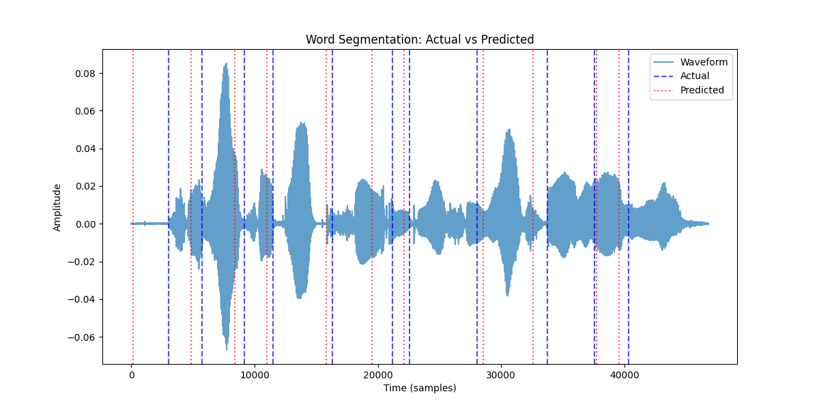
Results
100% Nederlands model
She had your dark suit in greasy wash water all year.
zie hed je dak zi in grisie as worden al jeer
Mean absolute error: 0,210 seconds

Slide 5
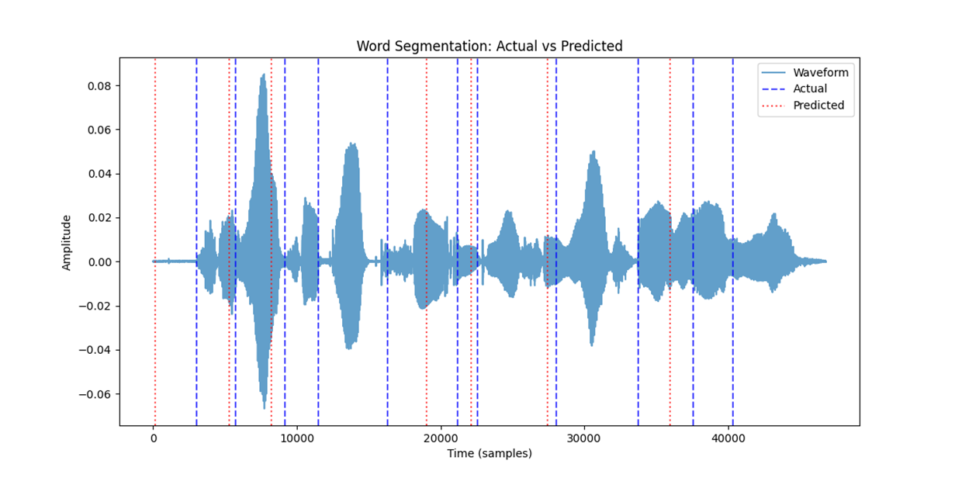
Results
25/75 Model
She had your dark suit in greasy wash water all year.
cie hert jedacsu in grisi wacwor aljeer
Mean absolute error: 0.329 seconds

Slide 6

Results
50/50 Model
She had your dark suit in greasy wash water all year.
Zihed je dakte ingrissie was voorden aljeer
Mean absolute error: 0.365 seconds

Slide 7

Results
75/25 Model
She had your dark suit in greasy wash water all year.
shie ha jadocu in gresy wacwal roer
Mean absolute error: 0.335 seconds

Slide 8
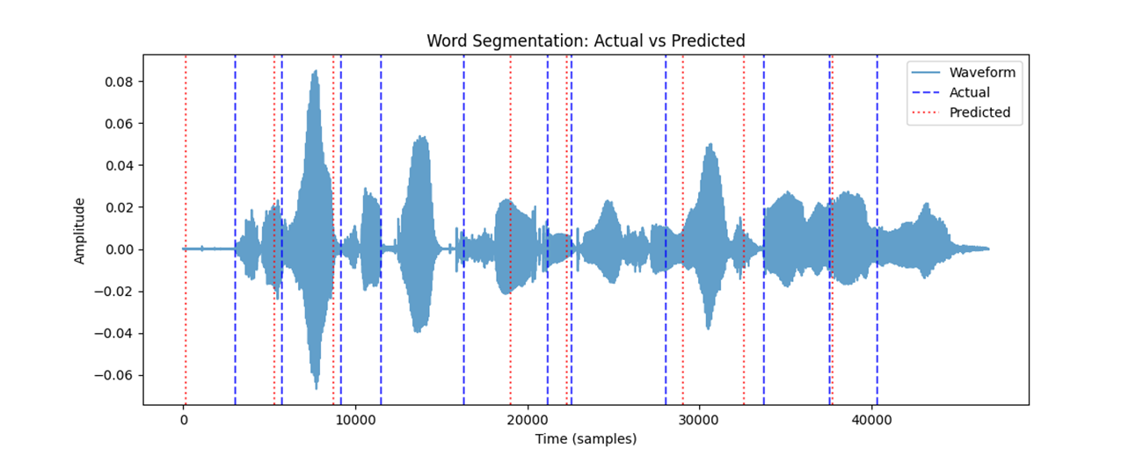
Results
75/25 Model
She had your dark suit in greasy wash water all year.
chie het jedox se in grecey whwade oiere
Mean absolute error: 0.351 seconds

Slide 9
Final Results
Dutch performed best
50/50 performed worst
All the others performed somewhat close

