Slide 1
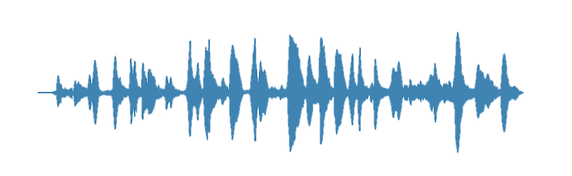
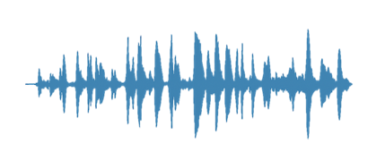
Data preprocessing
1. Select all the available training & testing data from Common Voice.
2. Remove unnecessary columns for both test & training split.
3. Remove special characters & capitalization for both test & training splits labels.
Training data
"Sorry! My Prada's at the cleaners! Along with my hoodie and my 'fuck you' flip-flops, you pretentious douchebag!“ Saverin said.
Audio | Path | Accent | … | Age | Gender
Test data
Audio | Path | Label
sorry my pradas at the cleaners along with my hoodie and fuck you flipflops you pretentious douchebag saverin said
5. Downsample the audio’s sampling rate from 48kHz (Common Voice) to 16kHz, which is the expected sampling rate for Wav2Vec 2.0. Also add padding to any audio fragment shorter, than the longest fragment.
4. Replace “ “ with “|” for more clarity for the
model, and change strings into a list of characters in
both split labels.
48kHz
i love to pet dogs
16kHz
i | | | l | o | v | e | | | t | o | | | p | e | t | | | d | o | g | s
Longest audio sample

Slide 2
3. Remove special characters & capitalization for both test & training splits labels.
4. Replace “ “ with “|” for more clarity for the
model, and change strings into a list of characters in
both split labels.
"Sorry! My Prada's at the cleaners! Along with my hoodie and my 'fuck you' flip-flops, you pretentious douchebag!“ Saverin said.
i love to pet dogs
sorry my pradas at the cleaners along with my hoodie and fuck you flipflops you pretentious douchebag saverin said
i | | | l | o | v | e | | | t | o | | | p | e | t | | | d | o | g | s

Slide 3
5. Downsample the audio’s sampling rate from 48kHz (Common Voice) to 16kHz, which is the expected sampling rate for Wav2Vec 2.0. Also add padding to any audio fragment shorter, than the longest fragment.
6. Using the Wav2Vec2FeatureExtractor to transforms continuous audio signals into numerical representations that the Wav2Vec 2.0 model can process.
48kHz
3
0
.
6
5
0
0
.
0
0
0
2
.
4
7
2
7
.
3
5
0
0
.
0
0
0
0
.
0
0
0
0
.
0
0
9
1
.
6
4
1
1
.
8
3
0
0
.
0
0
9
2
.
4
6
0
0
.
0
0
16kHz
…
Longest audio sample

Slide 4
Time (frames)
Prediction given by model
h
h
e
e
∅
l
l
∅
o
o
After collapse
h
e
∅
l
l
∅
o
Remove blanks (∅)
h
e
l
l
o
Final transcript
hello

Slide 5
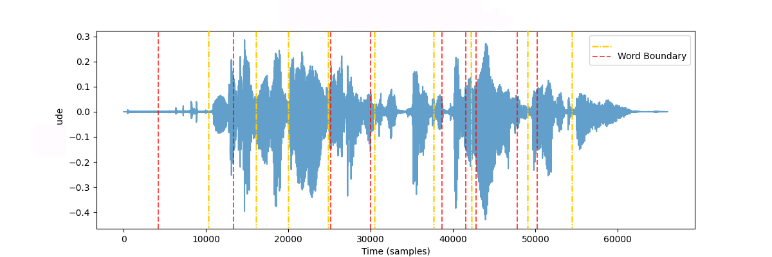






True Word Boundary

