Slide 1



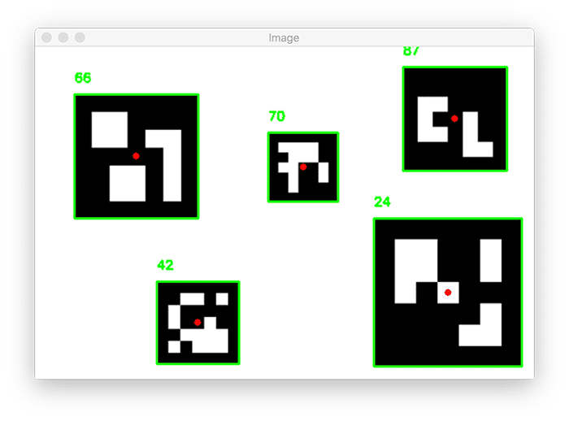
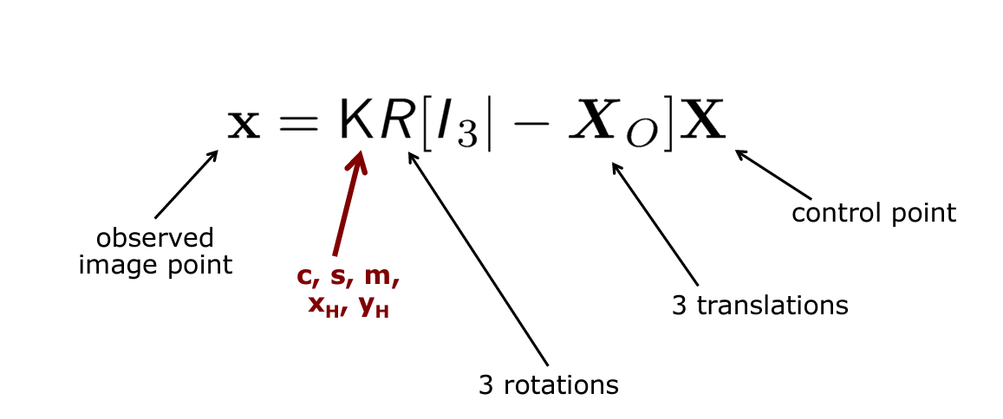
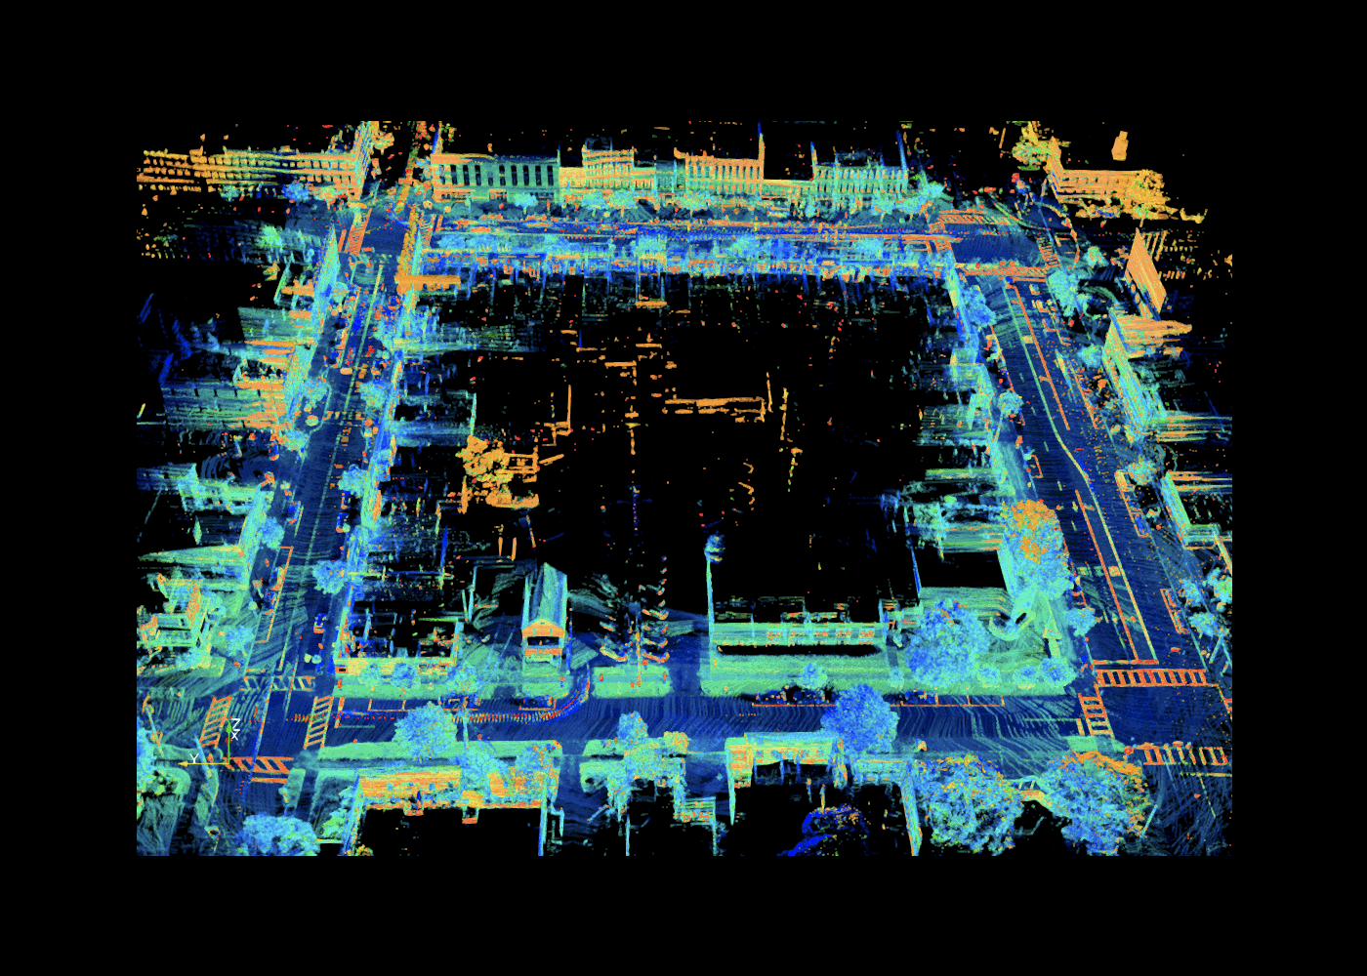
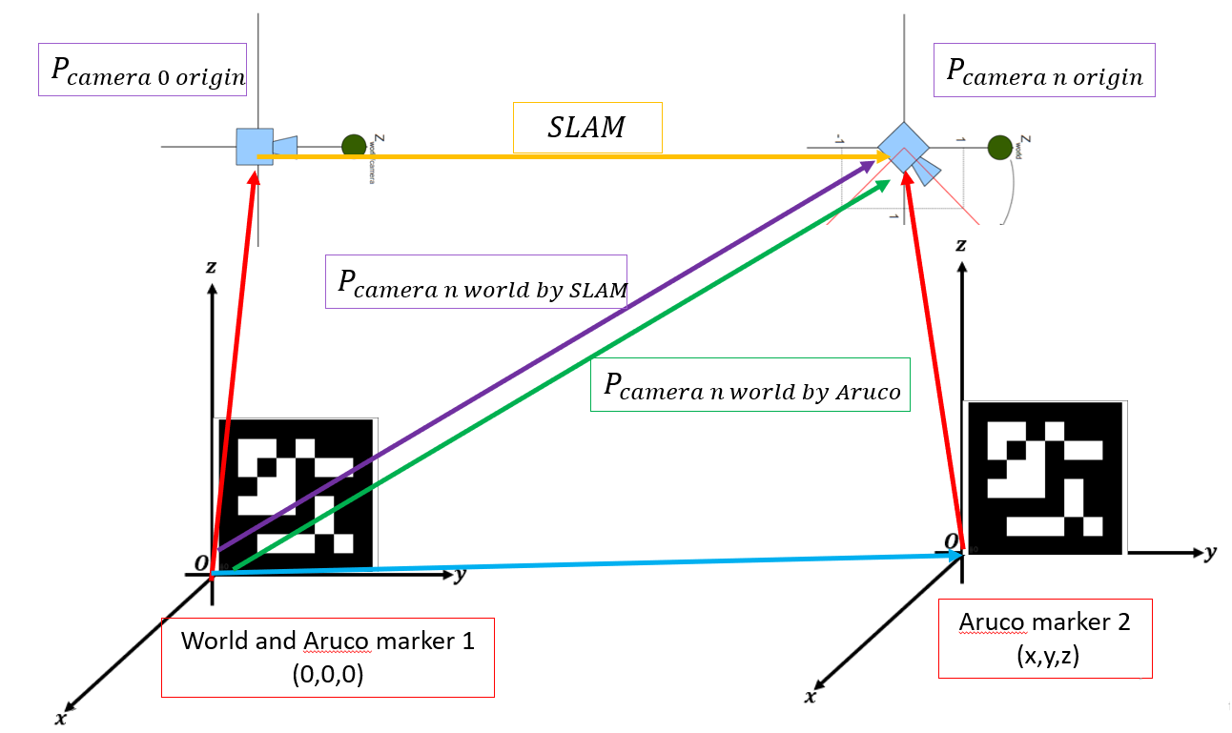
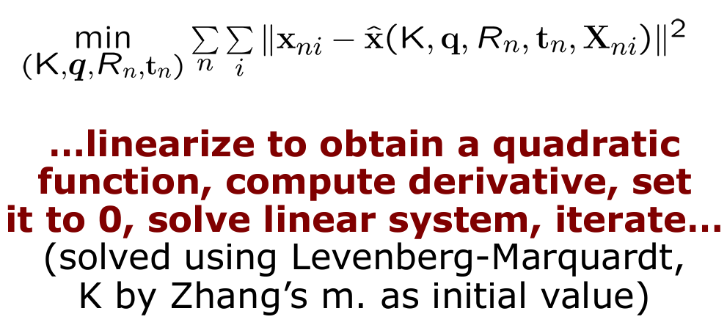
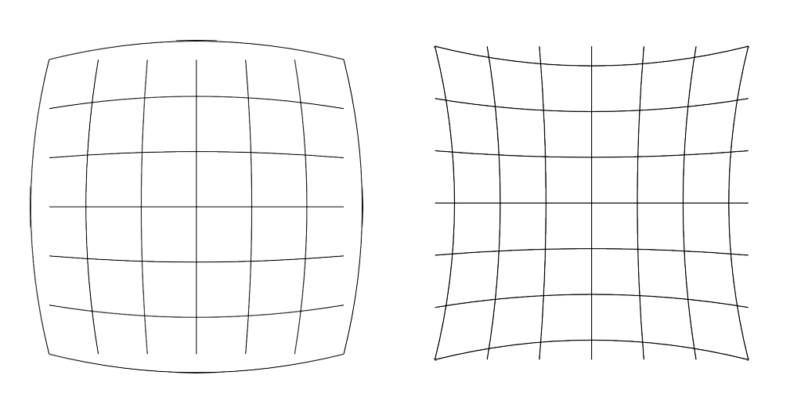
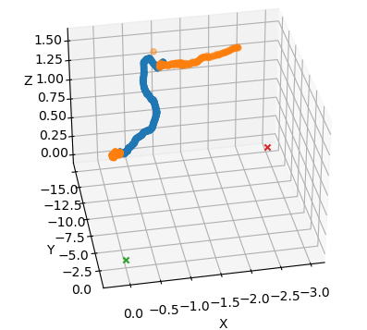
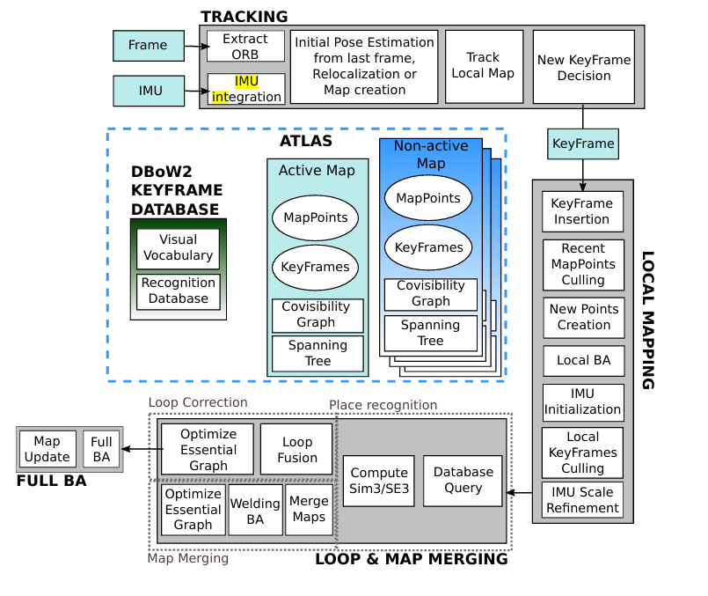
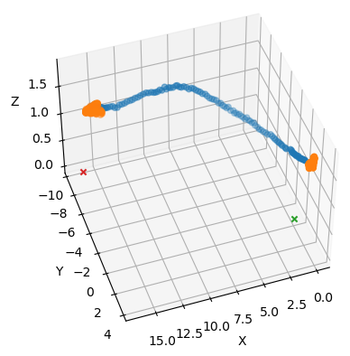
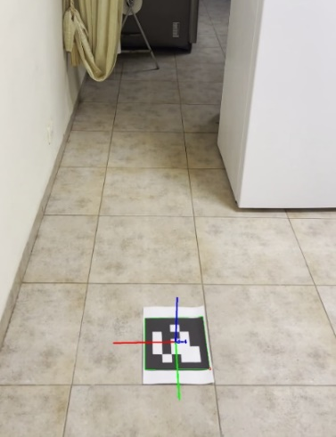
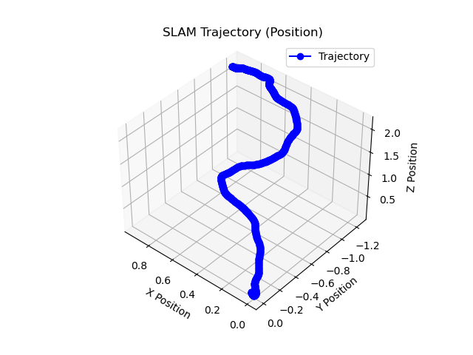
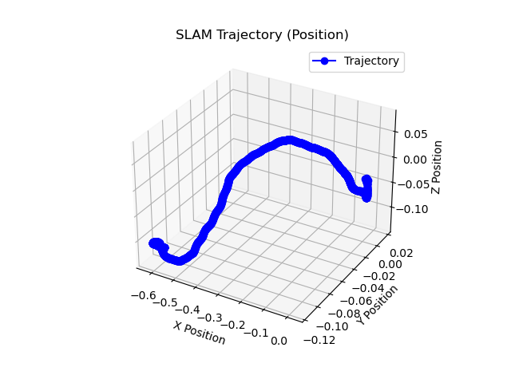

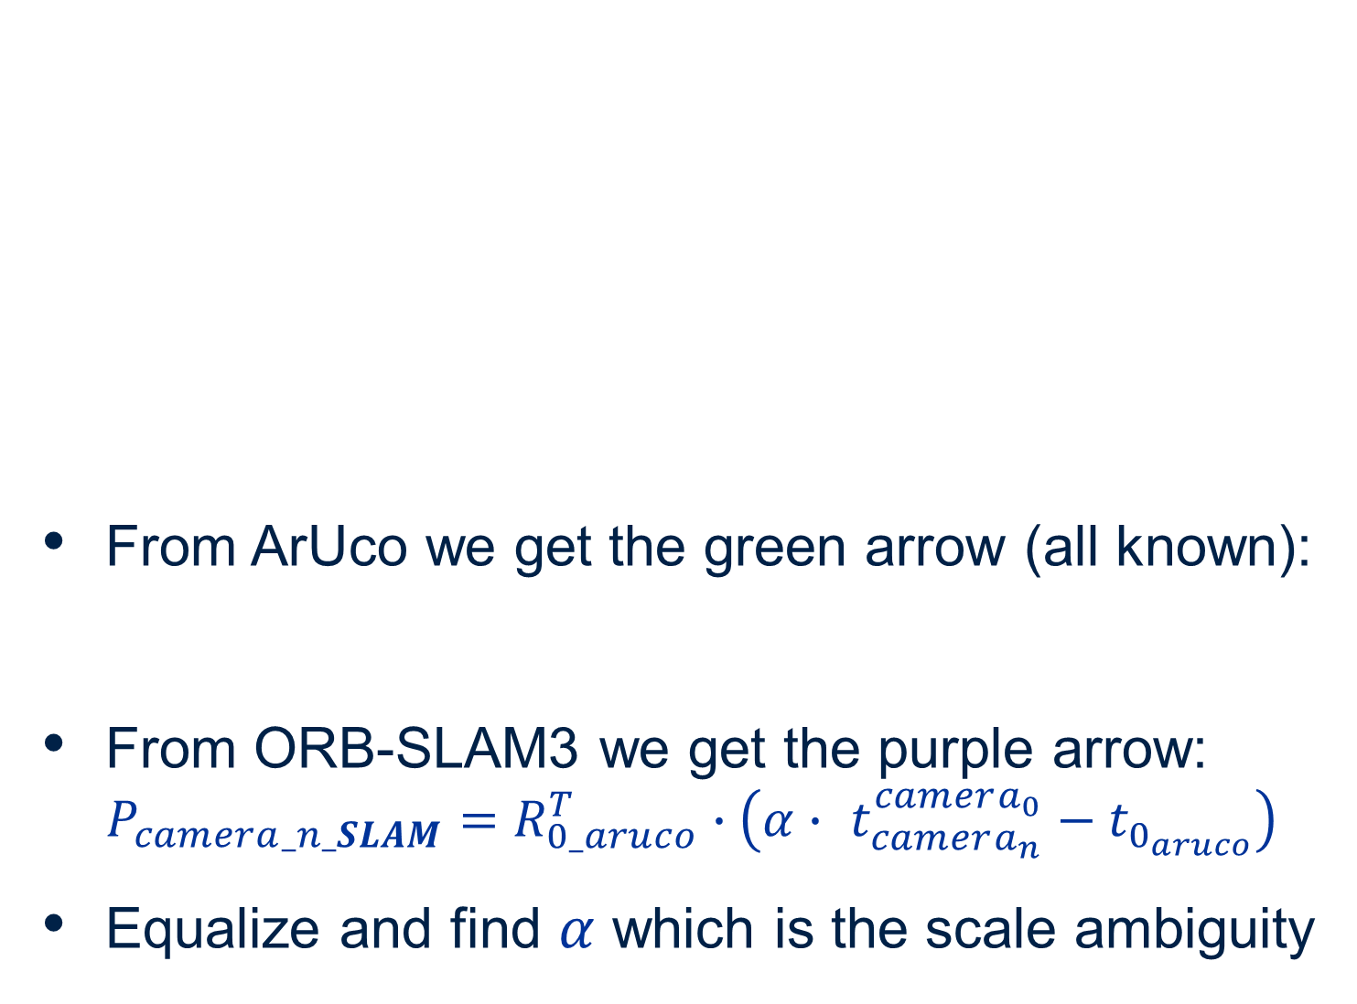

Indoor Navigation with Camera
Izar Hasson and Raz Shemesh, Supervised by Chen Katz
Introduction
Calibration
Pose Estimation by ArUco
Simultaneous Localization and Mapping (SLAM) is a computational process that enables a system to map its environment while simultaneously determining its own location within that map.
Monocular SLAM systems, such as ORB-SLAM3, are limited by their inability to determine absolute scale and true location on the map.
Purpose: Camera calibration estimates the intrinsic and extrinsic parameters of a specific camera to correct image distortions and accurately map 3D world points to 2D image points.
Find K:
Assumption: we know the shape and size a chess board
We will identify the corners of the chessboard by a simple corner detection algorithm
Set corner of the board to be world center
Distance of each corner from the other is known, that's how we get the real points
With enough pairs, solve using SVD
will not be able to correct non-linear phenomena such as radial distortion
That's why we will also use numerical methods of minimizing the reprojection error
Detect and determine marker ID
Assumption: we know the shape and size of the marker, like in Calibration find matrix M using PnP algorithm
M
M
Finding Scale Coefficient
SLAM used on city roads
From ArUco we get the green arrow (all known):
From ORB-SLAM3 we get the purple arrow: $P_{camera_n_SLAM}=R_{0_aruco}^{T}∙\left(α∙ t_{camera_{n}}^{camera_{0}}−t_{0_{aruco}}\right)$
Equalize and find $α$ which is the scale ambiguity
Goals
Estimate and 3D map the true location of the camera based on a video
Monocular visual camera provides input
Robust treatment for varying conditions
Computationally efficient algorithm
$$P_{camera_n_ArUco}=−{R_{world}^{aruco_{n}}}^{T}t_{world}^{aruco_{n}}+P_{marker 2}$$
Challenges
ORB-SLAM3
Results
Monocular ORB-SLAM3 inability to determine absolute scale
Monocular ORB-SLAM3 inability to determine true location on the map
Camera movement
Environment with low amount of unique features
ORB features for efficient keypoint detection and description, ensuring robust tracking under varying conditions
Constructs a sparse map using selected keyframes, balancing computational efficiency and accuracy
Two experiments:
First: high number of unique features:
ArUco: orange color ORBSLAM3:blue color
Second: low number of unique features:
Markers marked with X
3D Mapping the trajectory
Calibration- camera parameters
Pose estimation using ArUco
Pose estimation
$$(x,y)$$
ORB-SLAM3
Trajectory of movement
Calculating scale coefficient
Input Frame
$$(x,y)$$
SLAM’s scale coefficient
Conclusions
3D Mapping
Calculating true Trajectory of movement
By combining ArUco markers with the ORB-SLAM3 algorithm the system addresses the limitations of monocular SLAM
achieving high accuracy in various scenarios
This hybrid solution demonstrates the potential of integrating technologies for precise mapping and tracking in dynamic environments
3D Map of trajectory
3D real world locations
The inputs are:
camera parameters from calibration
The exact locations of the ArUco markers, one at start and one at end of track
Video of moving in an environment
Trajectory for two different settings
January 2025

