Slide 1

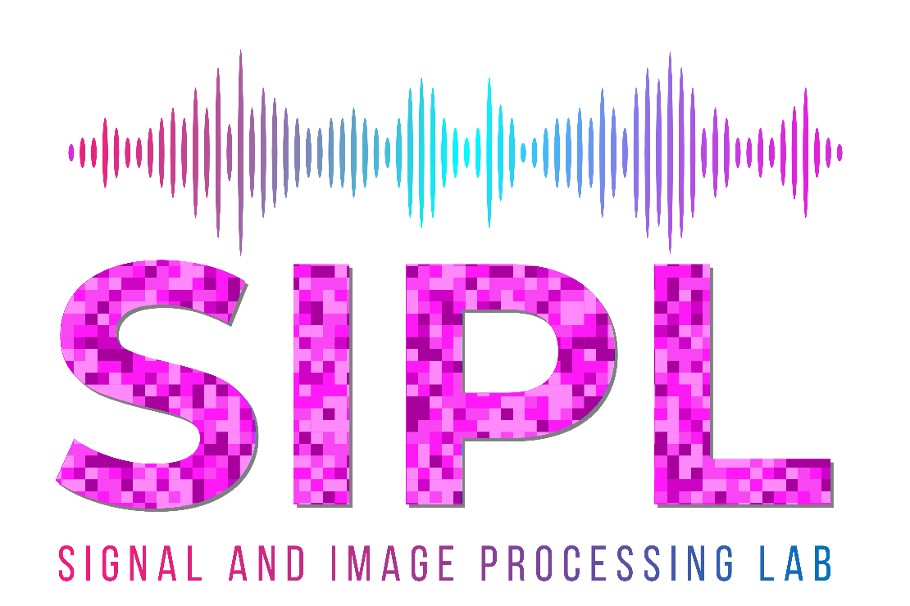

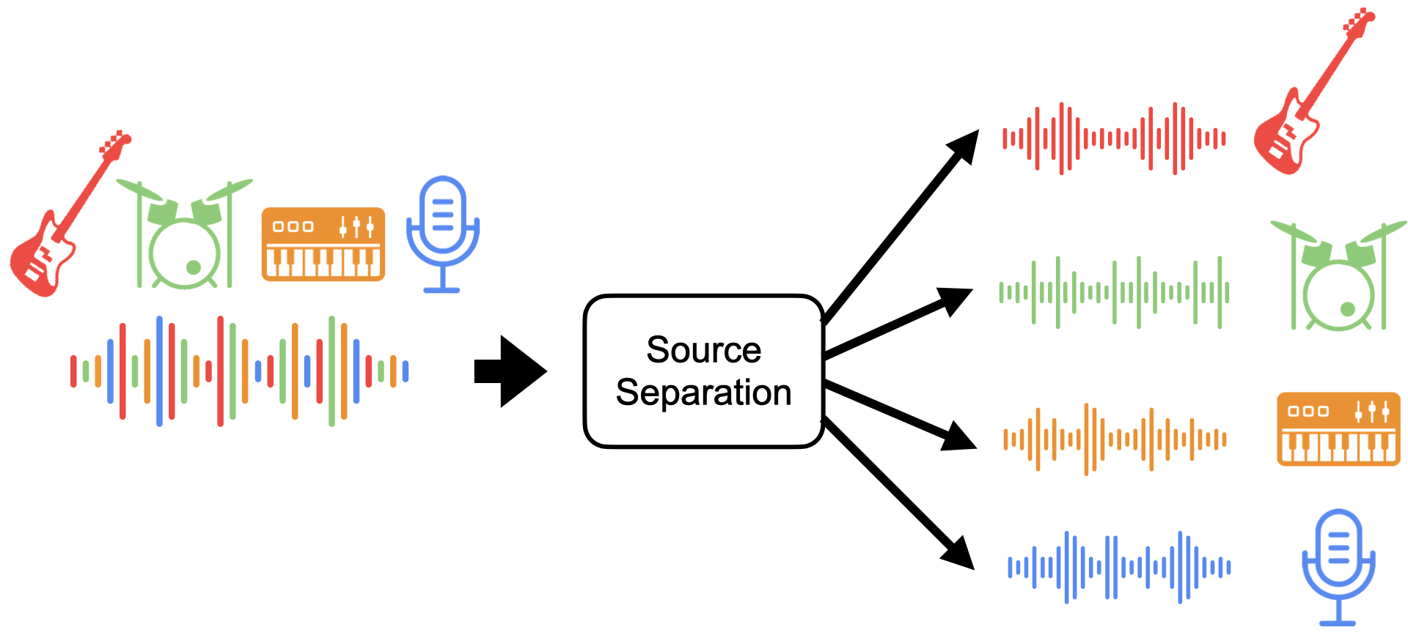
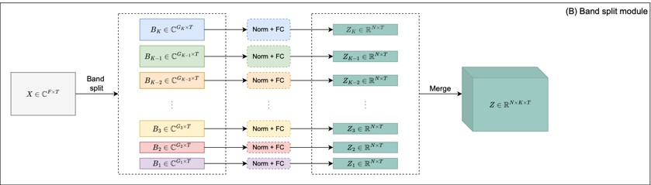
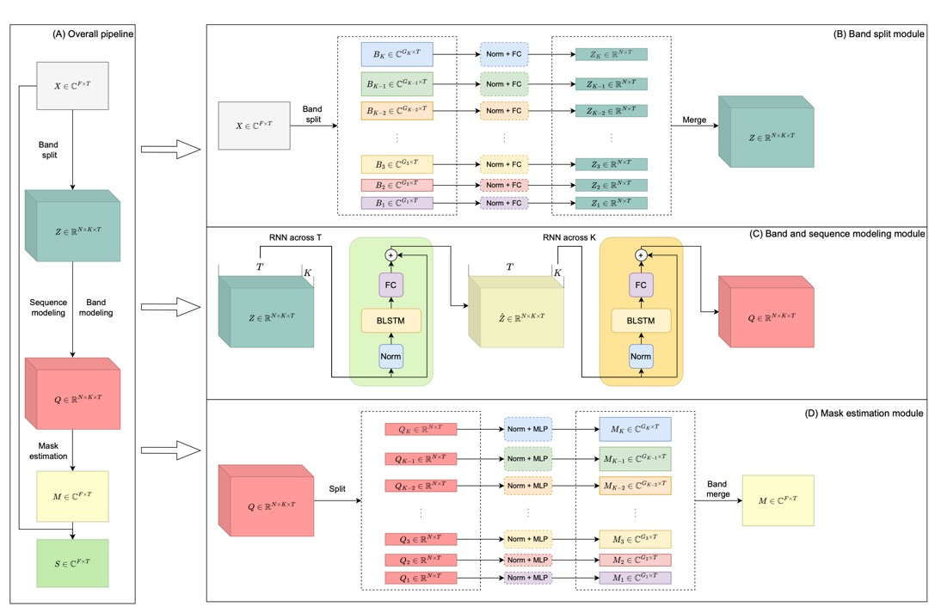
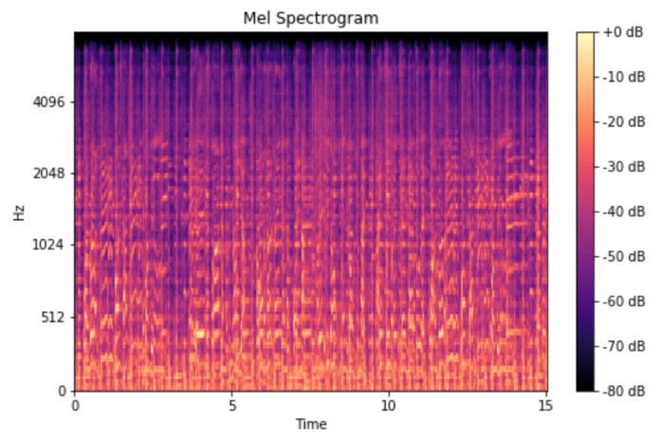
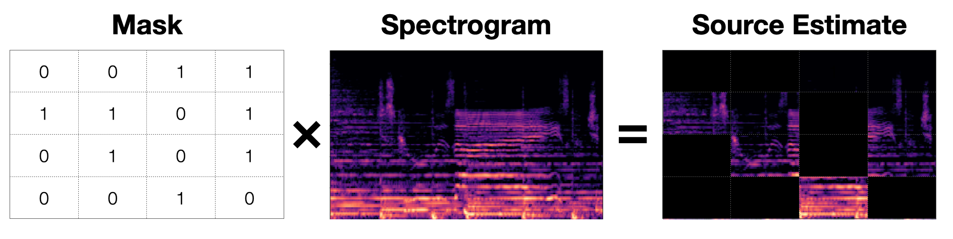

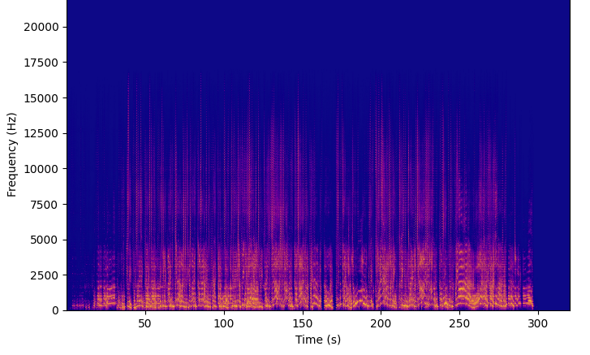
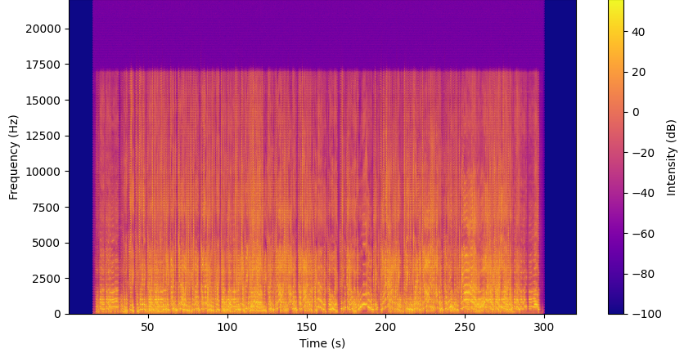
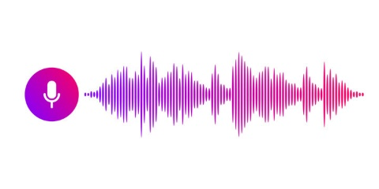

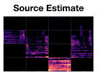
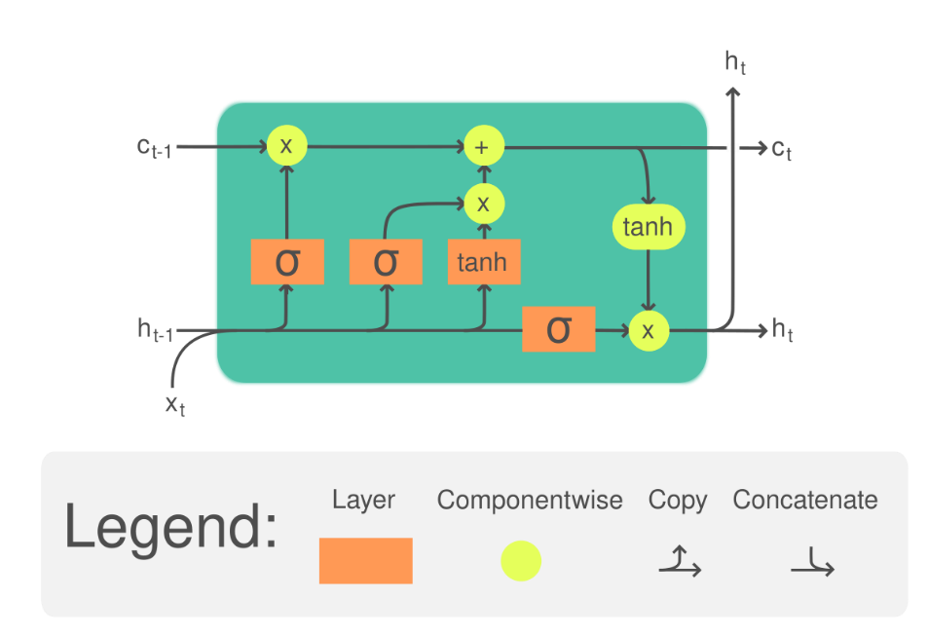
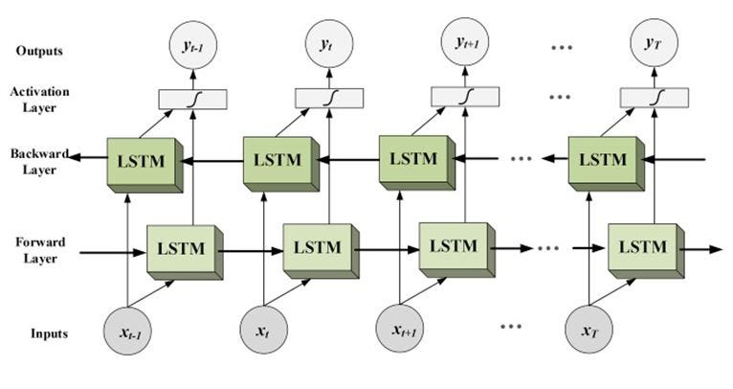

Karaoke Maker Using Deep Learning
Izar Hasson, Supervised by Hadas Ofir
Introduction
Frequency Band Splitting
Mask Estimation
Audio source separation involves isolating individual components (e.g., vocals, drums, bass) from a mixed audio signal.
This technology has applications in music production, audio restoration, and more.
Deep learning-based approaches, have proven effective, but challenges remain in improving accuracy and handling diverse audio conditions.
Allows specialized processing for different frequency ranges
The chosen frequency bands are designed to align with the distribution of musical components
Band splitting improves separation accuracy
Generating a spectral mask that highlights the target source while suppressing unwanted components.
The refined feature maps provide a better representation of the audio for our task.
The mask estimation module then applies a learned transformation to predict the optimal mask
F , T - the frequency and time dimensions K- number of bands N- the chosen size of the dimension of the latent space
The module reconnects every band to the final mask
Application of the Mask
Source Separation
Element-wise multiplication of the predicted spectral masks with the original spectrogram.
The masked spectrogram is then used to produce a clean extraction of individual instruments or vocals from the mixture.
Goals
Develop a deep learning model for audio source separation.
Leverage spectral information and advanced neural network architectures.
Achieve high separation accuracy across varied audio tracks.
Example for Band Splitting, lower frequencies get finer resolution because that where the vocals and instruments usually at
Band and Sequence Modeling Module
Challenges
Overlapping Frequencies: Sources share similar spectral components.
Background Noise: Environmental noise complicates separation.
Variability: Diverse genres, recording conditions, instruments, and sound quality.
Model Complexity: Balancing accuracy and computational efficiency.
Results
F , T - the frequency and time dimensions K- number of bands N- the chosen size of the dimension of the latent space
Songs were processed through our module
For comparison to ground truth, we used 50 songs from the test set in out dataset. Meaning we know the ground truth vocals, drums etc.
Results show a Mean Squared Error of 0.875. For comparison, the mean squared error of the original open Unmix module is 0.913.
Band and Sequence Modeling Module is an efficient feature extraction Module
Suggested in [Yi Luo et al., 2022]
Processes the frequency bands sequentially to capture temporal dependencies and relationships across sub-bands.
The model applies bidirectional LSTM layers (BiLSTMs) in two dimensions: across time and across frequency sub-bands.
This dual-path processing enhances the model's ability to track temporal structures while maintaining spectral consistency, leading to improved audio source separation.
Vocal Separation
Estimated Vocals
Ground Truth Vocals
Input Audio
STFT
Spectrogram
Deep Network Model Using BiLSTMs
Each Band
Estimated Vocals vs. Ground Truth Vocals
main differences are in the high frequencies, which the human ear can’t notice
The results are mostly pleasing to the human ear
$$(x,y)$$
Frequency Band Splitting
Mask Estimation
LSTM:
BiLSTM:
Conclusions
Mask Application
Successfully separated audio sources with pleasing accuracy using deep learning techniques
Effective band-splitting and sequential modeling frequency representation
BiLSTM-based sequence modeling
Feasible for practical applications in music processing and source separation tasks
The input is an audio mix
After band splitting, each band is processed through our deep network
The Mask get multiplied with the input spectrogram to get the estimated spectrogram
The estimated spectrogram goes through ISTFT to get the audio back
BiLSTMs (Bidirectional Long Short-Term Memory networks) are a type of recurrent neural network (RNN) that process data in both forward and backward directions.
This allows the model to capture both past and future context, making them highly effective for sequential tasks like audio processing.
February 2025

