Slide 1
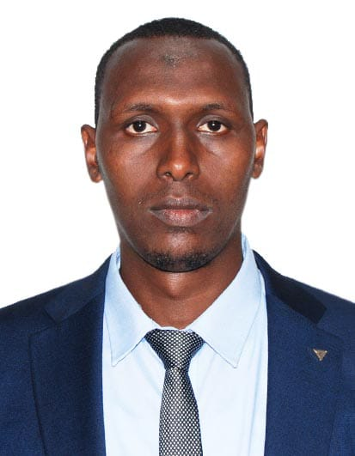

Isaac Abdow
Junior software Developer,
Python Django and PHP
Laravel Framework
intro
My Reasons
Intro
Tenets
Cloud/Security Enthusiast
AWS re/Start Training and Certification - Applicant Cohort 8 AWS Cloud Practitioner

Slide 2



AWS re/Start Key Tenets
In-Demand Skills
Hands-on Learning
AWS Tenets
intro
Dashboard
Reports
My Reasons
Industry-Leading Certification
Supportive Community

Slide 3

Reasons for Applications
Jobs Placement Report
PWDs Registration
University Applications Report
Job Opportunity
Tenets
End
Reason
intro
User Management
Youth Groups Registered

Slide 4
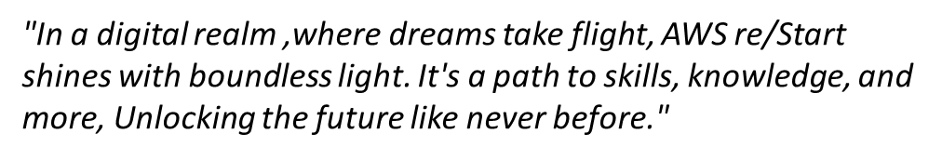

I will be an honor, to be aboard plane Aws re/Start Cohort 8 cloud practitioner,
ready to leverage on the skills and knowledge and bring about
positive change to my community and the world at large.
Tenets
Reason
Thank You
Intro

