Slide 1
Null Void
Third Person Platformer Game

Slide 2






Meet Our Team
Mahfuja Khatun Trisha
MD Shakil Anower Samrat
MD. Misbah Uddin
Roll: 306 | Reg. No:2849
Roll: 307 | Reg. No:2850
Roll: 325 | Reg. No:2867
Md.Sujon Ahamed
Md.Tanvir Hasan Sayem
Progga Laboni Lamia
Roll: 328 | Reg. No:2870
Roll: 313 | Reg. No:2856
Roll: 357 | Reg. No:2899
Manager

Slide 3
Supervisor
Md Nagrul Islam
Lecturer
Department of Computer Science & Engineering
Mymensingh Engineering College

Slide 4
Introduction
Null Void is a 3rd person platformer game that will test your skills and dexterity. It is made using the Unreal Engine 5 game engine, Blueprint scripting system, and C++ programming language. It is a project undertaken by a team of dedicated students in Mymensingh Engineering College as part of the Application Development Lab course.

Slide 5
Contents
1
2
3
4
5
6
7
8
Introduction
Platforms & Requirements
Results & Discussion
Future Scope of the Project
Purpose of the Project
Methodology & Design
Limitations of the game
Conclusion

Slide 6
Purpose of the project
To help the team members develop their skills in game development and create a challenging and engaging game.
To provide the team members with an opportunity to apply their knowledge of programming, game development, and project management in a real-world setting
To demonstrate the team members' ability to work together effectively and efficiently to create a high-quality game
To create a game that can be enjoyed by players of all skill levels
You can simply impress your audience and add a unique zing and appeal to your Presentations.

Slide 7
Platform & Requirement
Platform Used:
Unreal Engine 5
Visual Stdio 2019
Metahuman Creator
Epic Games
Windows 11 Pro 64 bit
Requirement to use Game:
Windows 10 64 bit and above
Dual-core Processor with clock speed at least 2 Ghz
Dedicated GPU memory 1 GB
4 GB RAM
Availability of Device’s Storage (1 GB) or more

Slide 8
Methodology & Design
Shakil Anower Samrat

Slide 9
Design
The design of "Null Void" creates an immersive and thrilling experience for players.
The character in the game is a custom-designed 3D third-person character, adding a unique element to the game.
Add Text
Add Text
The game's world features a unique winter atmosphere and visually stunning environment.
The game's user interface is simple, easy to navigate, and visually appealing.
Add Text
Add Text
Add Text
Add Text
The inclusion of a pipe that moves round and round tests player's skill and dexterity and adds danger to the game.
The game's UI design is minimalistic and user-friendly, making it easy for players to understand the controls and navigate the game.

Slide 10
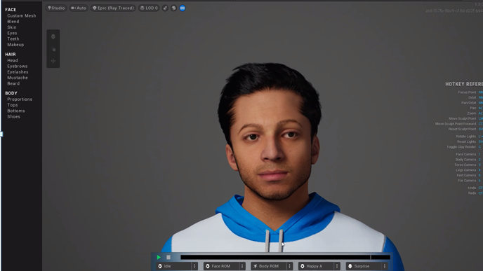
Fig: Third person character

Slide 11
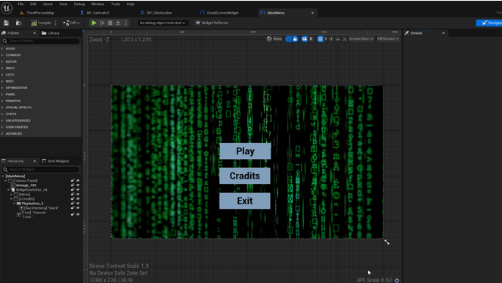
Fig: Main menu

Slide 12
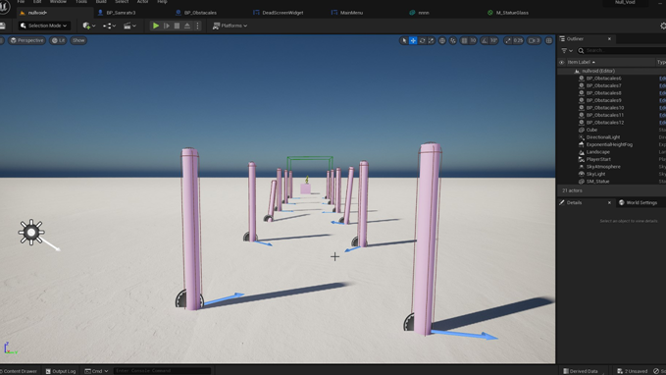
Fig: Level

Slide 13
Methodology
The team conceptualized the game by discussing ideas for the storyline, gameplay mechanics, and visual design.
The team used Unreal Engine 5, Blueprint, and C++ for development, creating the game's world, mechanics, and visual design.
The team continuously tested the game to ensure it functioned properly and was compatible with Windows operating systems.
The game was deployed and made available for download on various platforms, with marketing efforts to reach potential players.

Slide 14
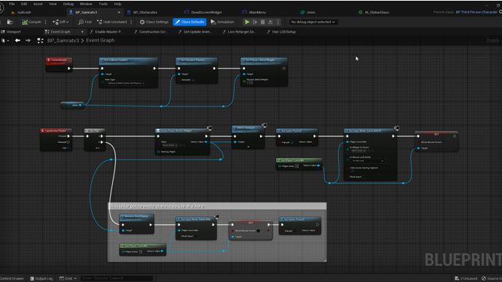
Fig: Third person character pause and death event

Slide 15
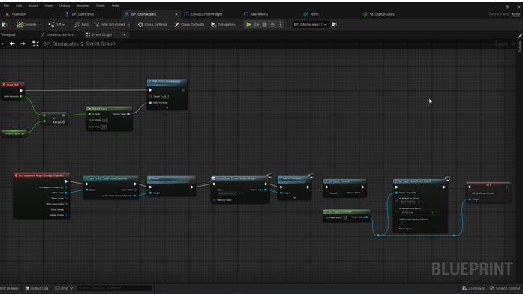
Fig: Obstacales of blueprint

Slide 16
Results
We did it! The result of this project is a game that is nothing short of mind-blowing. "Null Void" is a third-person platformer game that immerses players in a thrilling adventure through a mysterious and dangerous void. The game features challenging gameplay, stunning graphics, and a compelling storyline.

Slide 17
Discussion
Developing "Null Void" was an incredible journey, but we couldn't have done it without the dedication and hard work of our team. The primary objective of this project was to create a game that would be both challenging and enjoyable for players. And let me tell you, we've succeeded. The game features high-quality graphics that are visually stunning, challenging gameplay that will test your skills, and an engaging storyline that will draw you into the game's world and keep you coming back for more.

Slide 18
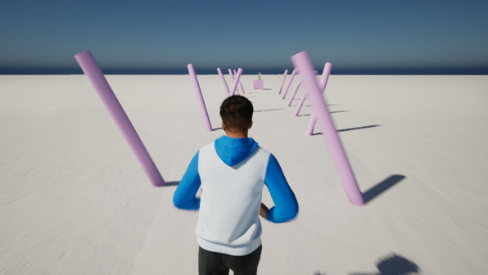
Fig: Playing game

Slide 19
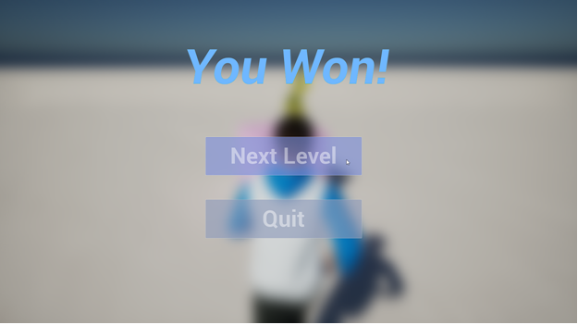
Fig: Win Screen

Slide 20
Limitations of the Project
Graphic optimization:
Due to the limited resources and time, the game's graphics may not be fully optimized for performance on all devices.
Option B
Multiplayer:
The game currently does not have a multiplayer mode and may not provide the experience for players who prefer to play with friends or compete with other players.
Option A
In-game purchas
The game currently does not have an option for in-game purchases, which may limit the players' ability to customize their gameplay experience.
Option B
Leaderboard:
The game currently does not have a leaderboard feature, which may limit the players' ability to compete with other players.
Option A

Slide 21
Future Scope of the Project
Additional Levels:
The game could be expanded to include additional levels and challenges, providing players with even more gameplay options.
Mobile Platforms:
The game could be adapted to be played on mobile platforms, making it accessible to a wider audience.
Improved Graphics:
The graphics of the game could be improved with the latest technology to enhance the gaming experience.
Cloud saving:
The game could have an option for cloud saving, to allow players to access their progress and settings from any device.

Slide 22
Conclusion
This project was a valuable learning experience for the team members and has resulted in a game that is challenging, engaging, and visually stunning. The team members are proud of the work they have accomplished and look forward to the future development of "Null Void" and other similar projects. Thanks for joining us on this journey, we can't wait for you all to play the game!

Slide 23
THANK YOU

