Slide 1
WELCOME
To our presentation

Slide 2
This Presentation
Presented By Presented To
Md Shakil Anower Samrat Md Nagrul Islam
Progga Laboni Lamia Lecturer
Mahfuja Khatun Trisha Department of
Md.Sujon Ahamed Computer Science & Engineering
Supayan Chakma
Md.Tanvir Hasan Sayem
MD. Misbah Uddin

Slide 3
Contents
Introduction
Purpose of the Project
Platforms & Requirements
Methodology & Design
Results & Discussion
Limitations of the game
Future Scope of the Project
Conclusion

Slide 4
Introduction
A third-person character is a playable character that is visible on the screen,allowing the player to see and control the actions of the character from a perspective outside ofcharacter's body.In this presentation, we will delve into the design process, from concept art to 3D modeling, animation, and rigging. We will also discuss the implementation of the character into the game engine, including its movement, interactions with the game world and physics, and AI behavior.
Our goal is to showcase the process of bringing a believable, dynamic and engaging third person character to life, and how it enhances the player's experience.

Slide 5
Perpous of the project
The main purpose of this project is to develop the skills of the team members in game development and create a challenging and engaging game for players. The project is also intended to provide an The opportunity for the team members to apply their knowledge of programming, game development, and project management in a real-world setting. Additionally, the project aims to demonstrate the team members' ability to work together effectively and efficiently to create a high-quality game using industry-standard tools and technology. Furthermore, the project aims to create a game that can be enjoyed by players of all skill levels and provide them with an immersive and thrilling experience.

Slide 6
Platform & Requirement
Platform Used:
Unreal Engine 5
Visual Stdio 2019
Metahuman Creator
Epic Games
Windows 11 Pro 64 bit
Requirement to use Game:
Windows 10 64 bit and above
Dual-core Processor with clock speed at least 2 Ghz
Dedicated GPU memory 1 GB
4 GB RAM
Availability of Device’s Storage (1 GB) or more

Slide 7
Methodology & Design
The design of the game "Null Void" was carefully crafted to create an immersive and thrilling experience for players. The game's world was created with a winter atmosphere, providing players with a unique and visually stunning environment to explore. The character in the game is a custom-designed 3D third-person character, developed by the team member Shakil Anower Samrat, which adds a unique element to the game's world.
One of the key elements of the game's design is the inclusion of a pipe that moves round and round, and if it hits the character, the character will die, providing an added challenge for players. This feature is designed to test the player's skill and dexterity, as well as add an element of danger to the game.
The game's user interface was designed to be simple and easy to navigate, with clear and concise instructions. The win screen, death screen, pause screen, and main menu were all designed to be visually appealing and easy to understand, allowing players to quickly navigate through the game.

Slide 8
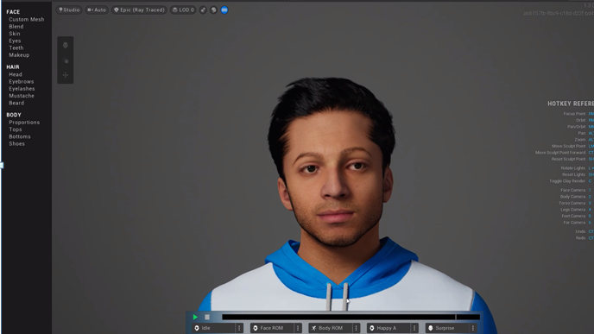
Fig: Third person character

Slide 9
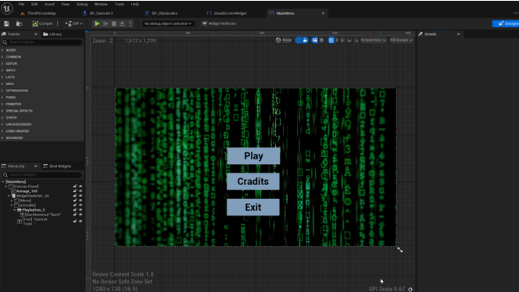
Fig: Main menu

Slide 10
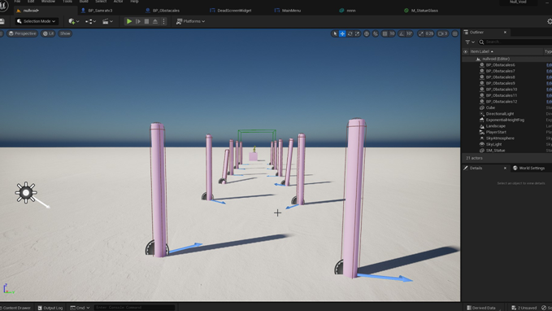
Fig: Level

Slide 11
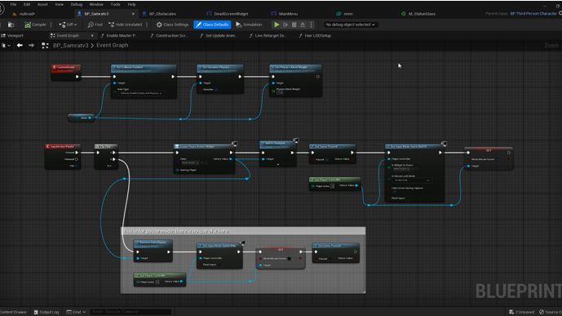
Fig: Third person character pause and death event

Slide 12
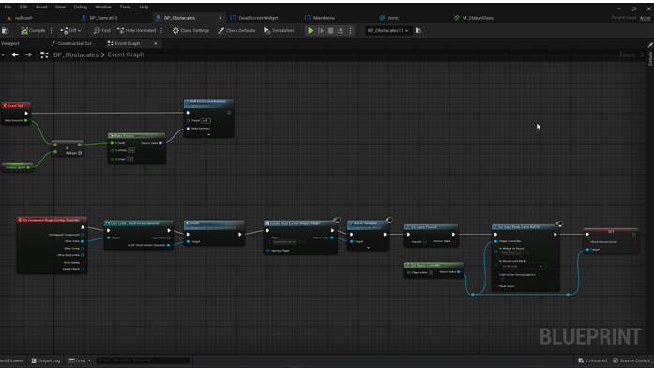
Fig: Obstacales of blueprint

Slide 13
Result
We did it! The result of this project is a game that is nothing short of mind-blowing. "Null Void" is a third-person platformer game that immerses players in a thrilling adventure through a mysterious and dangerous void. The game features challenging gameplay, stunning graphics, and a compelling storyline.

Slide 14
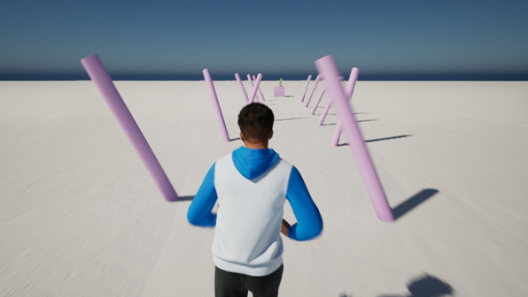
Fig: Playing game

Slide 15
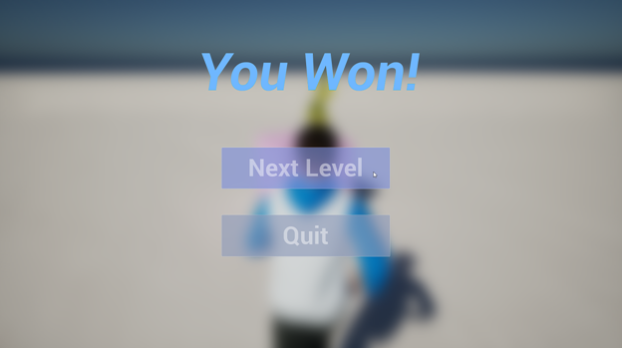
Fig: Win Screen

Slide 16
Discussion
Developing "Null Void" was an incredible journey, but we couldn't have done it without the dedication and hard work of our team. The primary objective of this project was to create a game that would be both challenging and enjoyable for players. And let me tell you, we've succeeded. The game features high-quality graphics that are visually stunning, challenging gameplay that will test your skills, and an engaging storyline that will draw you into the game's world and keep you coming back for more.

Slide 17
Limitations of the game
Compatibility: The game is currently only compatible with Windows operating systems and may not be accessible to players using other operating systems.
Graphic optimization: Due to the limited resources and time, the game's graphics may not be fully optimized for performance on all devices.
Multiplayer: The game currently does not have a multiplayer mode and may not provide the experience for players who prefer to play with friends or compete with other players.
Mobile Platforms: The game is not yet adapted for mobile platforms, which may limit the accessibility for players who prefer to play on mobile devices.
In-game purchases: The game currently does not have an option for in-game purchases, which may limit the players' ability to customize their gameplay experience.
Leaderboard: The game currently does not have a leaderboard feature, which may limit the players' ability to compete with other players.

Slide 18
Future Scope of the game
Additional Levels: The game could be expanded to include additional levels and challenges, providing players with even more gameplay options.
Virtual Reality: The game could be adapted to be played in virtual reality, providing players with an even more immersive experience.
Mobile Platforms: The game could be adapted to be played on mobile platforms, making it accessible to a wider audience.
More enemies and Power-ups: The game could include a variety of new enemies and power-ups, keeping the gameplay fresh and engaging.
Improved Graphics: The graphics of the game could be improved with the latest technology to enhance the gaming experience
In-Game Purchases: The game could have an option for in-game purchases, such as new characters, power-ups, or levels.

Slide 19
Conclusion
This project was a valuable learning experience for the team members and has resulted in a game that is challenging, engaging, and visually stunning. The team members are proud of the work they have accomplished and look forward to the future development of "Null Void" and other similar projects. Thanks for joining us on this journey, we can't wait for you all to play the game!

Slide 20


