Slide 1

Sonicboom Onboarding
TCP/IP

Slide 2
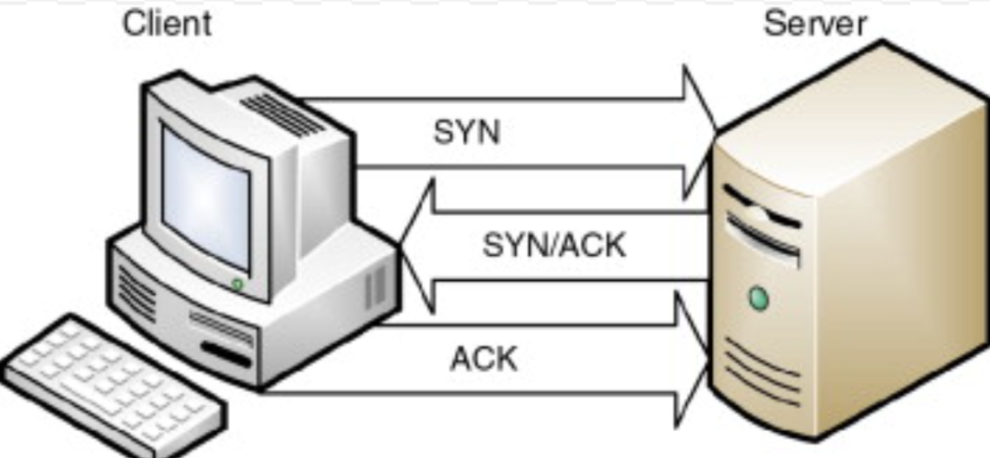
TCp (Transmission control protocol)
Reliable connection between client and server
Establishes connection via 3-way handshake (SYN, SYN-ACK, ACK)
Splits data into multiple packets, which can be sent across different routes but be assembled in the correct order at the destination.

Slide 3
TCp client and server
Client
Initiates the connection to server
‘Subscribes’ to only one server
Server
Waits passively for incoming messages.
Is able to handle multiple client requests asynchronously.
Processes client messages and sends out response

Slide 4
TCP vs UDP(user datagram protocol)
TCP
Reliability of connection (ensures ACK)
Corrupted data triggers retransmission
Unsuitable for small networks
Packets are reassembled into the correct order before delivery to application
e.g. banking, emails
UDP
‘Fire and forget’
Corrupted data is not retransmitted
Higher speed and lighter network load
Packets may arrive out of order. Up to application to handle ordering.
e.g. video, gaming

Slide 5
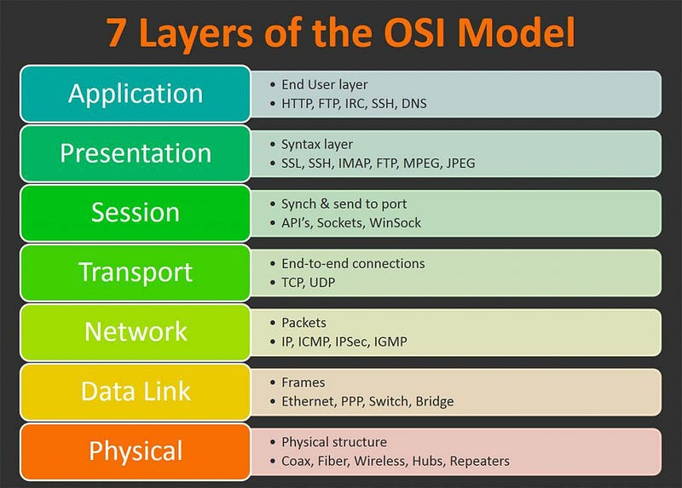
Open systems interconnection model HTTP, HTTPS, SMPT…
Protocol | Description | Default Port
HTTP | Web traffic (unsecured) | 80
HTTPS | Secure web traffic (SSL/TLS) | 443
FTP | File Transfer Protocol | 21 (control), 20 (data)
FTPS | FTP over SSL/TLS | 990 (implicit), 21 (explicit)
SFTP | SSH File Transfer Protocol | 22
SMTP | Simple Mail Transfer Protocol (sending email) | 25, 587 (TLS), 465 (SSL)
IMAP | Internet Message Access Protocol (read email) | 143, 993 (SSL)
POP3 | Post Office Protocol (download email) | 110, 995 (SSL)
DNS | Domain Name System | 53 (TCP/UDP)
DHCP | Dynamic Host Configuration Protocol | 67 (server), 68 (client)
MQTT | Lightweight IoT messaging protocol | 1883 (TCP), 8883 (SSL)
SSH | Secure Shell (remote login) | 22
Telnet | Remote login (insecure) | 23
SNMP | Simple Network Management Protocol | 161 (UDP)
LDAP | Directory access (e.g., Active Directory) | 389 (plain), 636 (SSL)
NTP | Network Time Protocol | 123 (UDP)
RDP | Remote Desktop Protocol | 3389
Kerberos | Network authentication protocol | 88
Syslog | Logging protocol | 514 (UDP)

