Slide 1

Final Project Presentation
A web application for events.

Slide 2
Problem Statement
Large amounts of location data already exists with today’s technology, and it continues to grow.
However, this data often focuses on the larger picture.
Mapping routes
Finding locations
The data is often static

Slide 3
…continued…
There exists numerous social media / messaging apps.
But most of these apps don’t show events happening on maps

Slide 4
The goal
A web application which creates dynamic location data.
The user is able to create real-time events for other people to find.
The real-time events show what is happening around your area.

Slide 5

A future goal
Be able to use this data for optimization. For example:
A user may create an event which tells others how crowded an area is.
Stores would be able to create an event if something special is happening.
Users would be able to create an event for obstructions such as an accident,

Slide 6
User Description
Targeted for all to use.
Developers are able to get geojson data for the events.
Made for people who wish to find things around them and help socialize.

Slide 7
Data Sources
Using a location API to get a user’s current location:
Use’s geolocation to get the user’s current position.
Uses MapBox ‘s API to create the map.
Uses MapBox’s API to get directions to an event.

Slide 8
Architecture
Front-end development
HTML5/CSS/JavaScript/jQuery
Back-end development
Python in conjunction with Django
Database management with Heroku in conjunction with pgAdmin4

Slide 9

Architecture
Location is identified
Backend (Server Database) : Django
Web/Application Server (Front-end)
User enters information about an event.
User places event on the map
Event is created
Updated Map
Geojson response created
Event time runs out.

Slide 10
API design
Main Database structure:
User information (account, comments, additions to application).
A database for the events which contains all relevant information.
A database for the geojson responses.
A database to store private sessions.
Can get a geojson response of all currently active events happening.

Slide 11
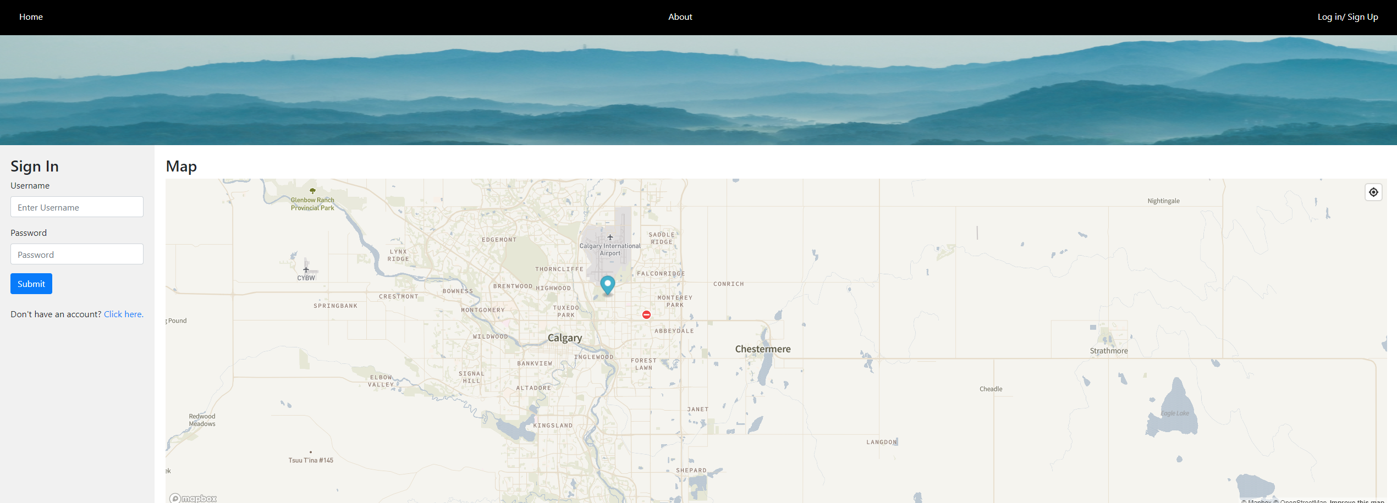
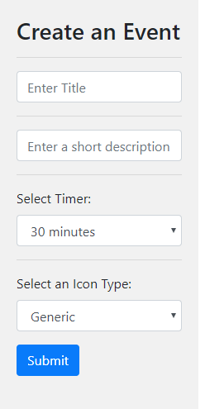
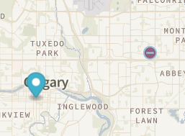
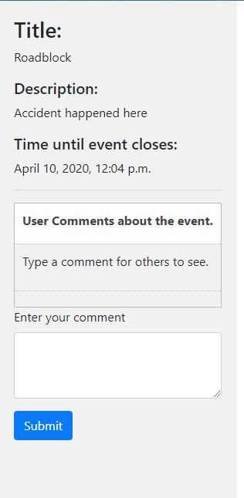
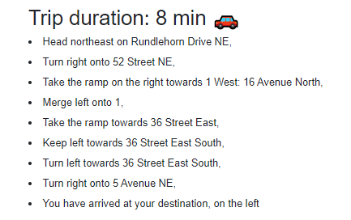
UI/UX Design

Slide 12

Web 2.0 Principles adopted
Users will be able to upload their own additions to the maps contributing to a better mapping experience.
User location will be used to identify which areas are the busiest which can be used by people for optimization.
Using APIs from different companies to contribute to a better experience
User generated content.
Website creates own geojson responses of the events for its own API

Slide 13
Risk
Success is directly tied the number of users.
The greater the amount of users, the more user generated content there is.
There are competitors such as OpenStreetMap, but this application will be focused on more dynamic features and the number of people affected by it rather than mapping everything.
The location of a user is needed which may cause privacy issues.
Reveals the location of an event which may also cause security issues.

Slide 14
Conclusion
Ultimately, the goal is to allow users to use the Map to find real-time events happening around them.
Real-World Applications:
A user can create a private session which they can share to friends to help them plan a trip or something else.
A user can check the feedback of an event by looking at the comments of the event.
The events disappear with time, so new-events are always happening.

