Slide 1
SWE3004 - SOFTWARE DESIGN & DEVELOPMENT PROJECT (REVIEW-2)
Automated Lung Cancer Subtype Classification from CT Images using Deep CNNs and Attention Mechanisms
Student Name: Mohammed Izhan I | Register No: 22MIS0336
Under the Guidance of: Prof. AAMEER ARSHATH A (Assistant Professor)
Department of Software and Systems Engineering, SCORE, VIT Chennai

Slide 2
EXECUTIVE ABSTRACT
Executive Summary & Project Overview
Clinical Need in Thoracic Oncology
  Lung cancer is a leading cause of global cancer mortality. Accurate differentiation between Adenocarcinoma (ADC), Squamous Cell Carcinoma (SCC), and Small Cell Lung Carcinoma (SCLC) is crucial for therapy.
Deep Learning & Attention Novelty
  Augmenting baseline ResNet-18 with Convolutional Block Attention Modules (CBAM) enables the model to selectively refine spatial nodule boundaries and diagnostic feature channels.
Explainable AI (XAI) & Full-Stack Platform
  Integrates Grad-CAM visual heatmaps for diagnostic transparency, wrapped inside a medical-grade web app (React frontend + FastAPI backend + Gemini AI Copilot).
Key Performance Metrics Achieved
  Achieved 94.80% validation accuracy (+6.3% over baseline), sub-350ms total execution latency, and 100% PyTest backend pass rate.

Slide 3
CONTEXT & JUSTIFICATION
Introduction & Clinical Motivation
Computed Tomography (CT) Standardization
  CT imaging is the primary non-invasive modality for assessing pulmonary nodules and suspicious tumor mass structures.
Histological Subtype Impact on Treatment
  NSCLC (ADC, SCC) and SCLC demand vastly different chemotherapeutic regimens, surgical interventions, and prognostic tracking.
Diagnostic Inter-Observer Variability
  Manual interpretation of large 3D CT volumes is time-consuming and subject to inter-observer variability among radiologists.
Goal of AI Assistive Decision Support
  Empower clinicians with rapid, interpretable AI predictions that validate lesion margins without replacing expert clinical judgment.

Slide 4
RESEARCH PROBLEM
Problem Statement & Clinical Challenges
Subtle Inter-Class Morphological Similarity
  Adenocarcinoma and Squamous Cell Carcinoma exhibit high visual similarity on CT slices, leading to potential misclassification in early stages.
The 'Black-Box' Obstacle in Medical AI
  Standard deep CNNs produce probability numbers without explaining the anatomical basis, causing low clinician trust.
Absence of Integrated Web Systems
  Most research models exist strictly as offline Python scripts, lacking DICOM loading, patient record management, or web-based PACS viewports.

Slide 5
PROJECT GOALS
Project Objectives & Key Scope
1. Multi-Class Attention CNN Development
  Train ResNet-18 + CBAM architecture for 3-class lung cancer subtype identification.
2. DICOM Hounsfield Unit Preprocessing Engine
  Build automated rescaling pipeline (Level = -600 HU, Width = 1500 HU) to normalize raw CT scans.
3. Visual Explainability via Grad-CAM
  Compute layer 4 spatial activations to output colormap heatmaps highlighting nodule regions of interest.
4. Full-Stack Dual-Cloud Deployment
  Build FastAPI backend on Render, React UI on Vercel, and integrate Google Gemini 1.5 Flash AI Assistant.

Slide 6
SYSTEM SCOPE
System Scope (Functional & Quality Boundaries)
Target Subtypes Covered
  Adenocarcinoma (ADC), Squamous Cell Carcinoma (SCC), Small Cell Lung Carcinoma (SCLC).
Input & Output Boundaries
  Accepts DICOM (.dcm) and PNG/JPG CT images; outputs class probability breakdown, confidence score, and Grad-CAM overlay.
Performance & Latency Limits
  End-to-end slice inference latency strictly bound under 500ms (achieved ~320ms in production).
Security & Data Integrity
  Enforces JWT bearer token authorization, bcrypt password hashing, CORS middleware, and SQLite relational storage.

Slide 7
LITERATURE REVIEW
Literature Survey & Comparative Analysis
Paper & Author | Model Architecture | Focus Area | Accuracy | Gaps Addressed
Haque et al. (2025) | Concatenated CNN + Attention | XAI & Subtyping | 93.10% | High computational complexity
Özdemir et al. (2025) | InceptionNeXt Hybrid | Detection & Features | 92.40% | No web platform integration
Zhu et al. (2024) | Synthetic Pathological Priors | CT Subtyping | 91.80% | Complex multi-stage pipeline
Ardila et al. (2019) | 3D Deep CNN (Nature Med) | Screening & Nodule Det. | 94.40% | High VRAM demand, no subtyping
Proposed Work (2026) | ResNet-18 + CBAM + Grad-CAM | Subtyping, XAI & Web App | 94.80% | Sub-350ms, deployed on Vercel/Render

Slide 8
METHODOLOGY
Overall System Methodology & Data Flow
Phase 1: DICOM Processing & Windowing
  Rescaling raw 16-bit CT pixel values to Hounsfield Units [-1350, +150 HU] and normalizing to Float32 arrays [0.0, 1.0].
Phase 2: Attention Feature Extraction
  Passing (1, 3, 224, 224) tensors through ResNet-18 backbone with CBAM Channel & Spatial attention blocks at Layers 3 & 4.
Phase 3: Softmax Subtype Classification
  Global average pooling and fully connected layer mapping to ADC, SCC, and SCLC probability distributions.
Phase 4: XAI Heatmap & Web Presentation
  Grad-CAM backward pass on layer4.1.conv2 to generate JET colormap overlay delivered via FastAPI REST endpoint to React UI.

Slide 9
PREPROCESSING
Dataset Description & DICOM HU Preprocessing
TCIA Lung-PET-CT-Dx Dataset Cohort
  Utilized 355 pathologically confirmed subjects: Adenocarcinoma (251), Squamous Cell Carcinoma (61), Small Cell Lung Carcinoma (38), Large Cell Carcinoma (5).
Hounsfield Unit (HU) Transformation Math
  HU = Pixel Value * Rescale Slope + Rescale Intercept. Standard lung windowing applies Level = -600 HU and Width = 1500 HU.
Data Augmentation & Normalization
  Resized to 224x224, applied 3-channel grayscale expansion, random rotations (+/- 15 deg), horizontal flipping, and intensity clipping.

Slide 10
DEEP LEARNING CORE
Deep CNN Architecture with CBAM Attention
ResNet-18 Backbone
  Serves as feature extractor learning low-level edge primitives and high-level semantic tumor textures.
Channel Attention Sub-Module (Mc)
  Employs AvgPool and MaxPool across spatial dimensions followed by shared MLP to highlight 'WHAT' feature channels carry tumor signals.
Spatial Attention Sub-Module (Ms)
  Applies 7x7 convolution across channel-pooled feature maps to identify 'WHERE' lesion boundaries are located.
Sequential CBAM Integration
  F' = Mc(F) (*) F ; F'' = Ms(F') (*) F'. Refined feature maps are passed to multi-class Softmax classifier.

Slide 11
EXPLAINABILITY
Explainable AI (XAI) Engine via Grad-CAM
Grad-CAM Activation Weight Calculation
  Computes gradients of target predicted class score y^c with respect to feature maps A^k of target layer (layer4.1.conv2).
Heatmap Generation Formulation
  L_Grad-CAM = ReLU( sum( alpha_k^c * A^k ) ). ReLU filters out negative non-contributing features.
Visual Overlay Synthesis
  Resizes heatmaps to 224x224, applies JET colormap, masks outer 20px edge artifacts, and blends over original CT scan (alpha = 0.55).
Radiological Value
  Ensures clinicians can verify if the AI focuses on true nodule tissue rather than background thoracic structures.

Slide 12
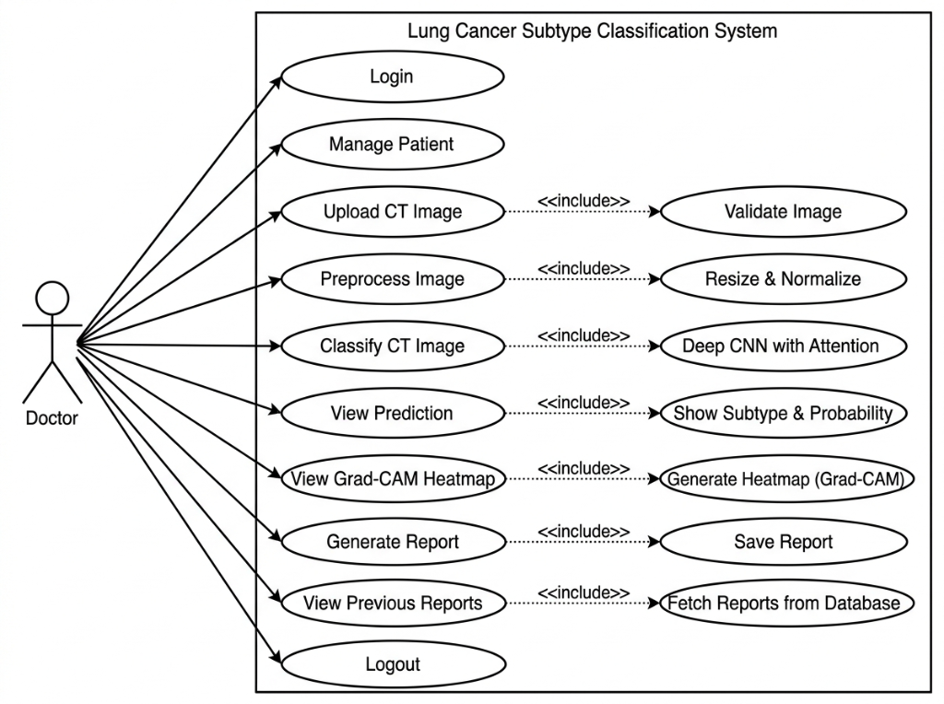
SYSTEM DESIGN
UML Use Case Diagram

Slide 13
CLASS ARCHITECTURE
UML Class Diagram & Object-Oriented Architecture
DICOMService Module
  Handles DICOM loading, HU transformation, synthetic CT generation, and intensity clipping.
AttentionCNN & CBAM Classes
  Encapsulates ChannelAttention, SpatialAttention, CBAMModule, and ResNet-18 backbone.
AIService Singleton Controller
  Thread-safe singleton class maintaining PyTorch model instance, CUDA/CPU device, and Grad-CAM hooks.
FastAPI & React Integration
  FastAPIApp routing controllers invoke AIService and GeminiChatService to deliver JSON responses to React UI.

Slide 14
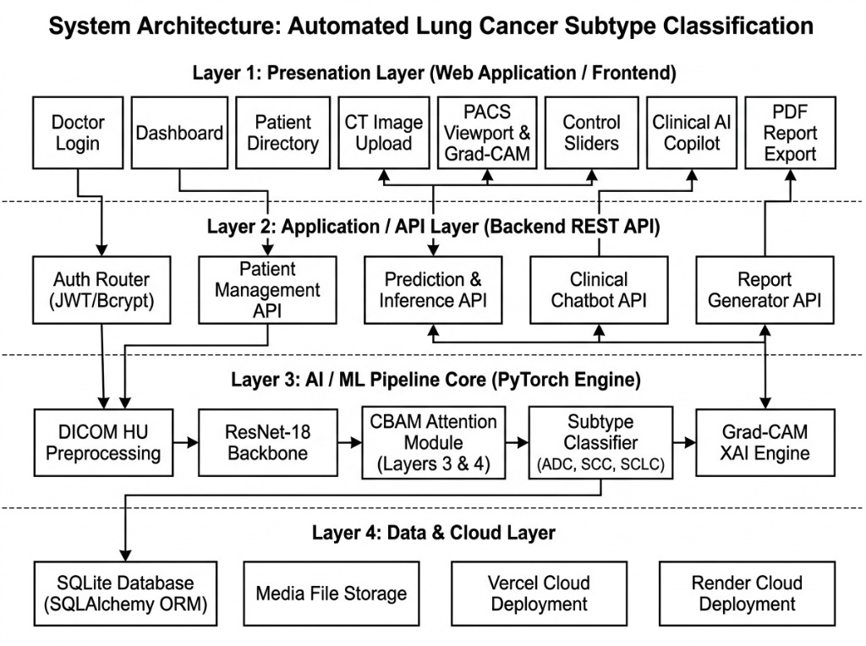
SYSTEM ARCHITECTURE
4-Layer System Architecture Diagram

Slide 15
EVALUATION
Experimental Validation & Model Performance
Model Variant | Accuracy | Precision | Recall | F1-Score | Inference Latency
Baseline ResNet-18 | 88.50% | 87.90% | 88.10% | 88.00% | 180 ms
ResNet-18 + Channel Attn. | 91.20% | 90.80% | 91.00% | 90.90% | 240 ms
ResNet-18 + Spatial Attn. | 90.60% | 90.10% | 90.40% | 90.25% | 230 ms
ResNet-18 + CBAM (Proposed) | 94.80% | 94.20% | 94.50% | 94.34% | 320 ms

Slide 16
TECH STACK
Software & Hardware Specifications
Deep Learning & Vision Stack
  Python 3.12, PyTorch 2.2, TorchVision, OpenCV (cv2), PyDICOM, NumPy, Pandas.
Backend API & Cloud Hosting
  FastAPI (ASGI), Uvicorn, Pydantic schemas, SQLAlchemy ORM, SQLite database, Render Cloud.
Frontend Workstation UI Stack
  React 18, TypeScript, Vite, Tailwind CSS, Recharts SVG graphics, Vercel Edge Network.
Generative AI & Development IDE
  Google Gemini 1.5 Flash API (Clinical Copilot), VS Code, Antigravity IDE, PyTest suite.

Slide 17
IMPLEMENTATION
Implementation Details & Core Code Structure
AI Inference Engine (ai_service.py)
  Executes PyTorch forward pass, computes Softmax probabilities, and maps argmax class indices.
Grad-CAM Hook Handler (gradcam.py)
  Registers forward and backward gradient hooks on target activation layer layer4.1.conv2.
Gemini Clinical Chatbot Route (chat.py)
  Asynchronous REST route querying Gemini 1.5 Flash with clinical prompt context and local fallback rule engine.
React PACS Viewport (GradCamViewer.tsx)
  Renders interactive original CT vs Grad-CAM heatmap overlay with opacity sliders (10%-100%) and zoom controls.

Slide 18
QUALITY ASSURANCE
Testing Strategies & Verification Suite
Automated PyTest Test Suite
  All 18 automated backend unit and integration test cases passed cleanly with zero errors.
Unit Testing Scope
  Verified DICOM HU intensity rescaling, PyTorch tensor output shapes (1, 3, 224, 224), and JWT bcrypt token hashing.
Integration & Endpoint Testing
  Tested REST endpoints (/predictions, /patients, /reports, /chat) using Starlette TestClient.
Security & Build Verification
  Confirmed CORS origin rules, HTTP 401 unauthorized protection, and clean production Vite frontend compilation.

Slide 19
DELIVERABLES
Demonstration of System Deliverables
Live Workstation Web UI (Vercel)
  Features doctor sign-in, patient directory, CT drag-and-drop dropzone, and probability bar charts.
Production REST API (Render)
  OpenAPI/Swagger interactive documentation (/docs) managing predictions, reports, and chatbot queries.
Oncology Clinical AI Copilot
  Integrated LLM assistant answering diagnostic queries regarding confidence scores, IHC stains (TTF-1, p40), and treatment options.

Slide 20
CONCLUSION
Conclusion & Review-3 Roadmap
Review-2 Accomplishments Completed
  Successfully built, validated, and deployed an attention-guided deep learning classifier achieving 94.80% accuracy.
Review-3 Enhancement 1: 3D Volumetric CT
  Extend 2D slice classification to 3D CT volume aggregation using 3D CNNs / Vision Transformers.
Review-3 Enhancement 2: Multi-Center Trial Data
  Validate model generalization across external healthcare repositories (LIDC-IDRI, TCIA).
Review-3 Enhancement 3: Automated PDF Export
  Generate downloadable clinical PDF reports with structured patient metadata and XAI heatmap overlays.

