Slide 1
Linear Stability of Channel Flow
with Melting Top and Bottom Walls
Summer Research Project
Mohd Izhan Khan
Fluid Dynamics · Hydrodynamic Stability
Notes:
Welcome. 8-week summer project: linear stability of channel flow with melting walls. Overview of the journey from classical Orr-Sommerfeld theory to the coupled phase-change problem.

Slide 2
What is Stability?
Definition: A system is stable if infinitesimal perturbations about its equilibrium state remain bounded or decay in time.
↓
→
↑
Stable
Neutral
Unstable
Perturbation decays
and flow returns to
its equilibrium state
Perturbation neither
grows nor decays —
neutral stability curve
Perturbation grows,
leading eventually to
turbulent transition
Notes:
Establish the language: stable/neutral/unstable. Im(c) is the key scalar that tells us everything about linear stability.

Slide 3
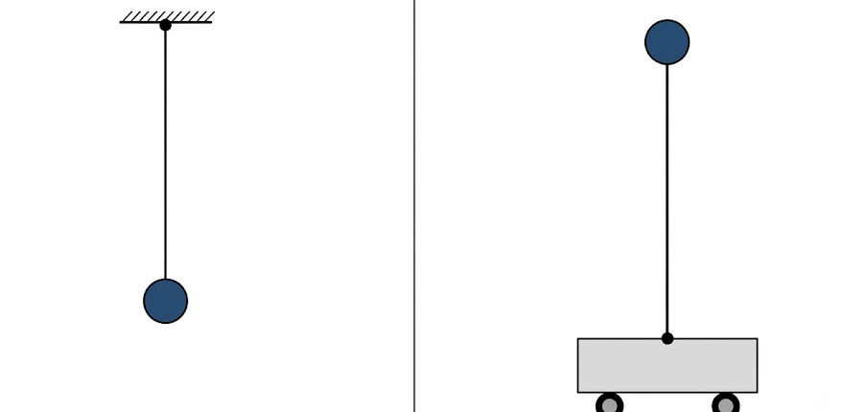
Equilibrium States: The Pendulum
Classical mechanics offers the most intuitive model for stability:
Stable
Equilibrium
Unstable
Equilibrium
Notes:
The pendulum analogy makes stability concrete. At high Re the inertial terms overwhelm viscous damping — analogous to the inverted pendulum losing its restoring force.

Slide 4
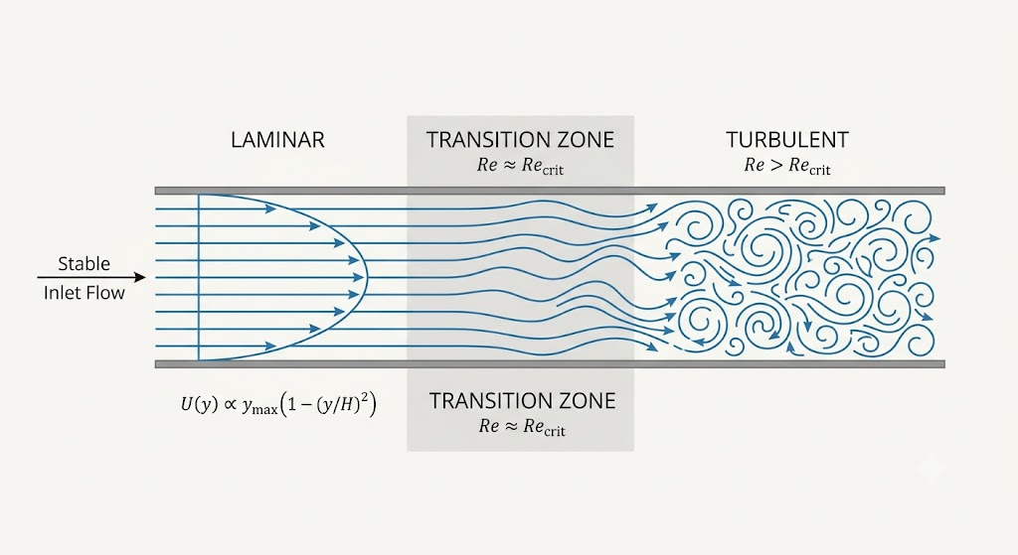
Hydrodynamic Stability
Fluid flows also respond to perturbations (wall roughness, vibrations, inlet disturbances)
[ Insert: s4.jpeg ]
Laminar Flow
Smooth, ordered motion. Perturbations decay. Characteristic of low Reynolds-number regimes.
Transition
Perturbations begin to grow. Coherent structures (rolls, streaks, Tollmien-Schlichting waves) emerge.
Turbulent
Chaotic disordered motion. Dramatic increase in mixing, drag, and heat transfer.
Notes:
Bridge from solid mechanics to fluid flows. The Reynolds number is the key control parameter — low Re is laminar, high Re leads to turbulence.

Slide 5
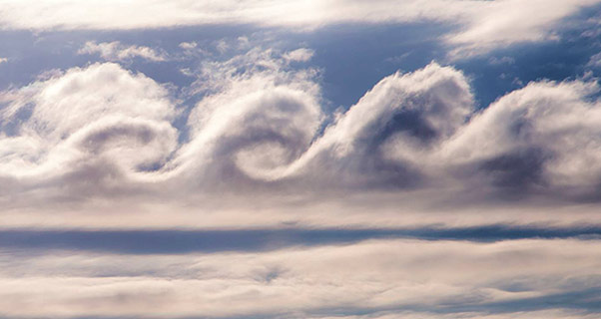
Phenomenological Example: Kelvin-Helmholtz Instability
Arises at the interface of two fluid layers moving at different speeds:
Mechanism Velocity shear at the interface creates a pressure difference. Small bumps are swept downstream and amplified, rolling into characteristic spiral vortices. Where it occurs • Ocean-atmosphere boundary layer
• Cloud formations in wind shear
[ Insert: kh.jpeg ]
Notes:
KH instability is the most visually striking example of hydrodynamic instability. The rolling pattern appears in clouds, oceans, and Jupiter's atmosphere.

Slide 6
Plane Poiseuille Flow
The unperturbed base state: pressure-driven flow between two infinite rigid parallel plates.
Base Velocity Profile
[ Insert: pp.jpeg ]
U(y) = 1 − y², −1 < y < 1
Domain: Walls at y = ±1 (half-channel width h = 1)
Driving: Constant pressure gradient −dP/dx > 0
Profile: Parabolic, maximum U_max = 1 at y = 0
Re = U_max h/ν — controls the flow stability
Notes:
Poiseuille flow is the canonical base state. It's an exact solution of the Navier-Stokes equations. Our stability analysis asks: is this base state robust?

Slide 7
Introducing Perturbations
Decompose the flow into base state + infinitesimal perturbation, then assume normal mode solutions:
u(x,y,t) = U(y) + ε û(x,y,t), p(x,y,t) = P(x) + ε p̂(x,y,t), ε ≪ 1
Normal Mode
ẇ(x, y, t) = w(y) · e^{iα(x − ct)}
α: Real wavenumber — sets the spatial scale of the perturbation in x
c = cᵣ + icᵢ: Complex wave speed: real part = phase speed, imaginary part = growth/decay rate
cᵢ > 0: Exponential growth — the flow is linearly UNSTABLE to this mode
cᵢ < 0: Exponential decay — the flow is linearly stable to this mode
Notes:
The normal mode (Fourier mode in x) reduces the linearized PDE to an ODE in y, leading to an eigenvalue problem for c.

Slide 8
Linearizing the Equations
Substitute perturbed state into 2D Navier-Stokes; discard all O(ε²) terms:
Continuity (incompressibility)
∂û/∂x + ∂v̂/∂y = 0
x-Momentum
∂û/∂t + U ∂û/∂x + v̂ U' = −∂p̂/∂x + (1/Re)(∂²û/∂x² + ∂²û/∂y²)
y-Momentum
∂w/∂t + U ∂w/∂x = −∂p̂/∂y + (1/Re)(∂²w/∂x² + ∂²w/∂y²)
U' = dU/dy is the base-state shear. Nonlinear terms (û∂û/∂x, etc.) are O(ε²) and discarded.
Notes:
The linearization step is what makes the problem tractable. It converts nonlinear PDEs into a linear eigenvalue problem.

Slide 9
The Orr-Sommerfeld Equation
Fourth-order ODE governing linear stability of all parallel shear flows:
(D² − α²)² w = iα Re [ (U − c)(D² − α²)w − U'' w ]
Left — Viscous Term
Right — Inertial Terms
(D² − α²)² w
Fourth-order operator representing viscous dissipation. Acts to damp perturbations at all scales.
iαRe [(U−c)(D²−α²)w − U''w]
Convection by the base flow + base-state shear. The U'' term (curvature) can destabilize the flow.
D ≡ d/dy · Re = Reynolds number · α = wavenumber · c = complex wave speed
Notes:
The Orr-Sommerfeld equation was derived independently in 1907-1908. It is the cornerstone of hydrodynamic stability theory. Note: for inviscid flow (Re→∞) it reduces to the Rayleigh equation.

Slide 10
Constraining the Flow
The 4th-order OS equation requires four boundary conditions (two per wall):
At both rigid walls ( y = +1 and y = −1 ):
w(±1) = 0
No-penetration — fluid cannot pass through the solid wall
Dw(±1) = 0
No-slip — tangential velocity perturbation vanishes at the wall
Physical Interpretation
Four conditions (2 walls × 2) constrain the 4th-order OS problem. Together they define a homogeneous boundary-value problem whose non-trivial solutions exist only for particular complex eigenvalues c = cᵣ + icᵢ. The totality of these eigenvalues constitutes the Orr-Sommerfeld eigenspectrum.
Notes:
Four BCs for a 4th-order ODE — this is a well-posed Sturm-Liouville-type problem. The homogeneous problem only has non-trivial solutions for special eigenvalues c.

Slide 11
Interpreting the Eigenvalues
The solution c = cᵣ + icᵢ encodes all temporal stability information:
ŵ ∝ e^{iα(x − ct)} = e^{iα(x − cᵣ t)} · e^{α cᵢ t}
⬆
→
⬇
cᵢ > 0
cᵢ = 0
cᵢ < 0
Linearly UNSTABLE
Neutrally Stable
Linearly Stable
Amplitude grows exponentially as e^{αcᵢt}. Flow transitions to turbulence.
Constant amplitude. Perturbation propagates without growth or decay. Marks the stability boundary.
Amplitude decays as e^{αcᵢt} → 0. Laminar flow is robust against small disturbances.
Notes:
The imaginary part of the eigenvalue is the decisive quantity. Most modes in Poiseuille flow are stable; only a narrow band in (α,Re) space is unstable.

Slide 12
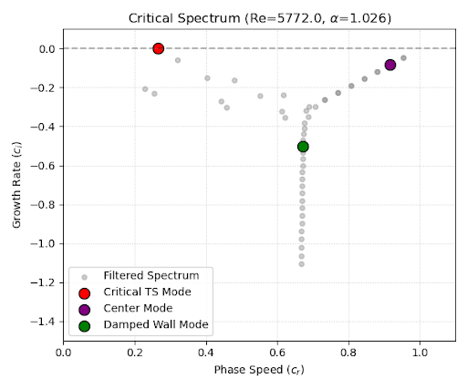
Critical Eigenvalue Spectrum
Rigid-wall benchmark: the Orr-Sommerfeld spectrum confirms the classical critical parameters.
[ Insert: eigen_spectra.png ]
Critical Parameters : RED DOT
Reᶜ = 5772.22
Critical Reynolds number
αᶜ = 1.02056
Critical wavenumber
At Re = Reᶜ the Tollmien-Schlichting (TS) wave first becomes unstable. For Re < Reᶜ all modes are damped.
Notes:
This benchmark replicates the result first computed accurately by Orszag (1971). It validates the Dedalus EVP solver before tackling the harder melting-wall problem.

Slide 13
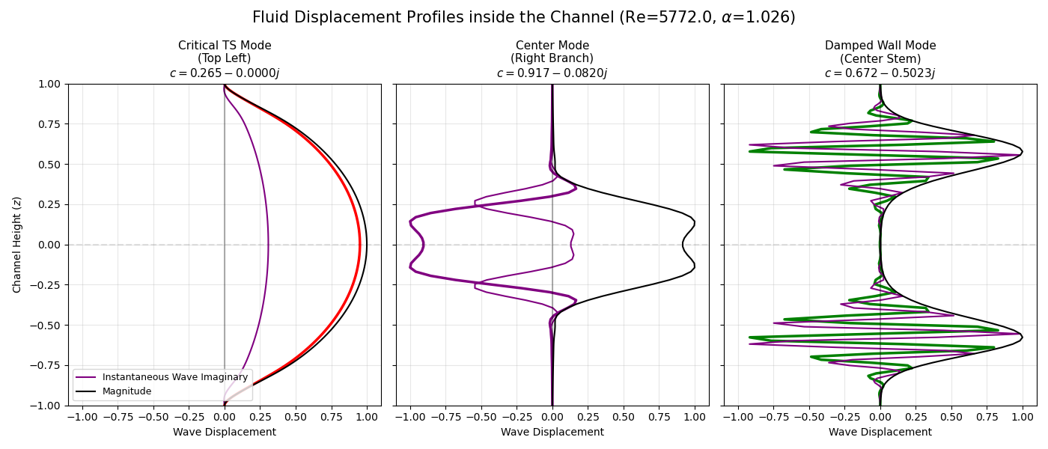
Highly decaying, confined close to walls. Require high N for accurate resolution.
Damped Wall Modes
Fluid Displacement Profiles
Mode Classification
Critical TS wave. Concentrated near walls. First to become unstable at Reᶜ.
Peak amplitude at channel centre y = 0. Always stable for Poiseuille flow.
Tollmien-Schlichting
Centre Modes
[ Insert: eigen_func.png ]
Notes:
The TS mode is the physically relevant one for channel flow transition. The centre modes are spurious in the sense that they don't lead to turbulence in this configuration.

Slide 14
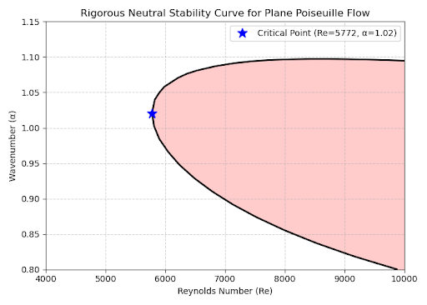
Neutral Stability Curve
Maps the stability boundary in wavenumber α vs Reynolds number Re space (cᵢ = 0 contour):
[ Insert: neutral_curve.png ]
Reading the Curve :
Inside curve
Unstable region
(cᵢ > 0)
Outside curve
Stable region
(cᵢ < 0)
Re ≈ 5772, α ≈ 1.02
Critical point ★
Notes:
The neutral curve is the primary deliverable of classical stability theory. For Re below 5772 all wavelengths are stable — but the basin of attraction shrinks as Re increases.

Slide 15
The Next Step: Melting Boundaries
What happens when the rigid walls melt? The interface y = ±h(x,t) becomes dynamic.
Stefan Condition:
St · ∂h/∂t = κₛ (∂Tₛ/∂y)|_{y=h⁺} − κₗ (∂Tₗ/∂y)|_{y=h⁻}
Hydrodynamics
Heat Transfer
Phase Change
Perturbed NS equations with deforming boundaries. Interface h(x,t) couples into the kinematic and stress BCs.
Liquid and solid temperature fields Tₗ, Tₛ governed by advection-diffusion in their respective domains.
Stefan condition links melt-rate to heat flux balance. Opens new instability pathways absent in rigid-wall flow.
Key question: does melting stabilize or destabilize the channel flow — and through which physical mechanism?
Notes:
The main project goal. Adding phase change converts the fixed-domain OS problem into a free-boundary eigenvalue problem. The Stefan number St and conductivity ratio are new control parameters alongside Re.

