Slide 1
Image-Compression Using lapped transform
Syed mir izhar ali shah (65581)
Azmat sultan Awan (65821)

Slide 2
Introduction
Compression of the images using lapped transform.
To compare the efficiency of the Lapped Transform technique with the Discrete Cosine Transform (DCT) in image compression.
Lapped transform divides the images into segments.
Reduces artifacts and increase efficiency
Used in high-quality compression

Slide 3
Methodology
Lapped transform using neural network model
CIFAR-100 dataset
Convolutional layer for transform
Deconvolution for reconstruction
Filter size of 16x16
Train the model for 5 epochs
Repository from GitHub for images dataset
Applying the transform to get image compression

Slide 4
Observation
Compression ratio obtained is 32.0 percent
Compression can be increased or decreased
Parameters of the convolution layer can be modified
i.e Stride, padding , no. of channels
Filter acts as weights which can be trained
Overall better efficiency can be achieved

Slide 5
Discrete Cosine Transform
Cloning base code repository
Running the code to get DCT compression
Gives compression ratio of the images
Evaluation
Using compression ratio
Perceptual similarity (LPIPS)

Slide 6
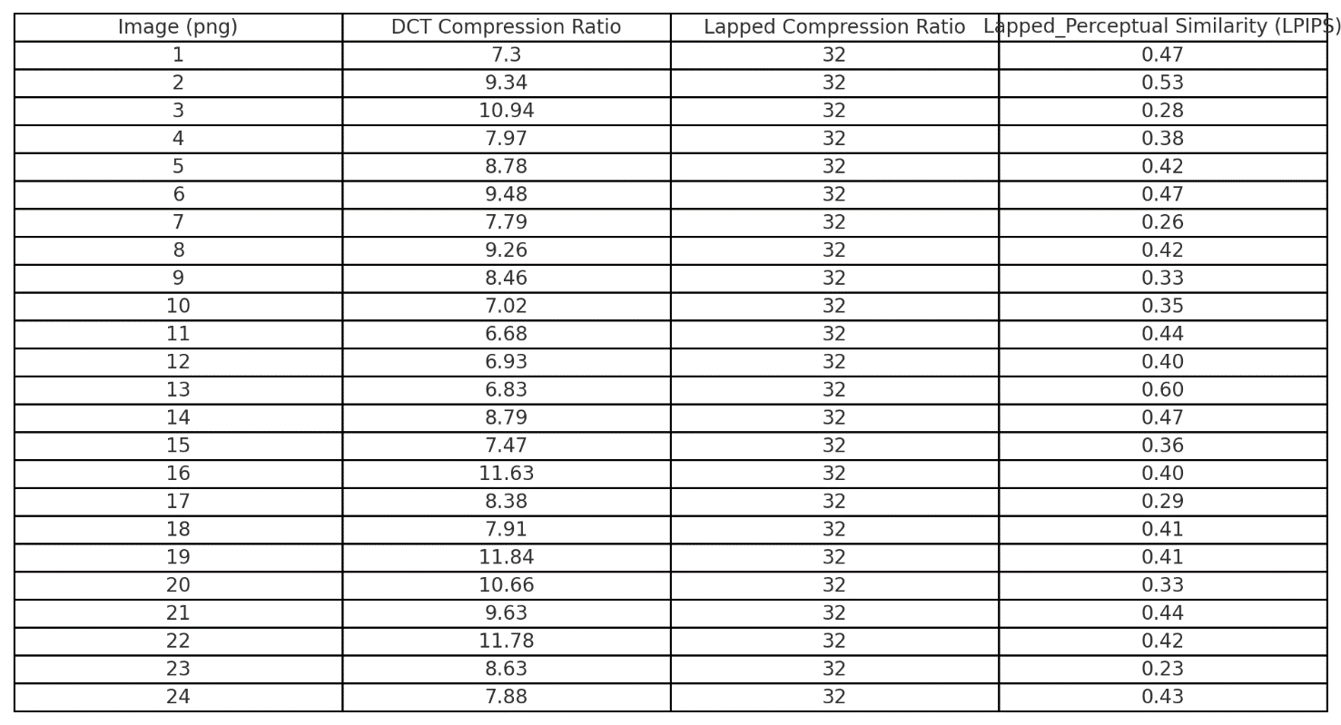
Results

Slide 7
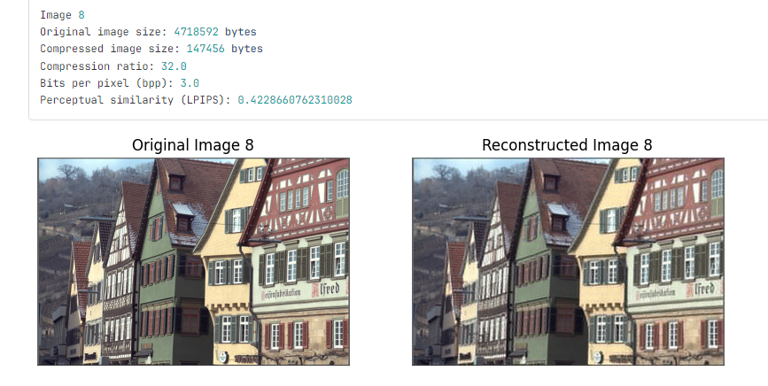
Compressed Evaluation

Slide 8
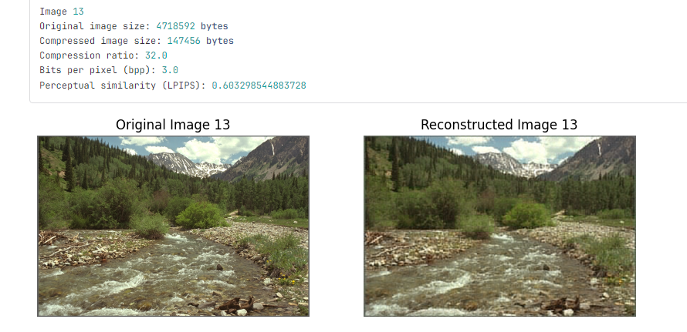
Compressed Evaluation

Slide 9
Results and Conclusion
Comparison Metrics
DCT vs. Lapped Transform: Compression ratios
Perceptual similarity (LPIPS)
Key Findings
Lapped Transform achieves higher compression ratios with minimal feature loss
Flexibility in adjusting compression ratio by tuning model parameters
Conclusion: Lapped Transform as an effective alternative to traditional DCT for image compression.

