Slide 1
Day6 notes

Slide 2
THEORY
APPLICATION

Slide 3
Investigating seed sequence of miRNAs

Slide 4
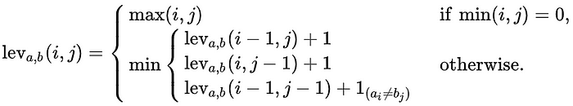
Mining miRBase
We have a list of unique seed sequences
Now we want to investigate the similarity among them
To do this, we will use a measure called the Levenshtein distance

Slide 5
Seed region analysis
class Sequence: def __init__(self, h, s): self._header = h self._sequence = s self._gcPercent = 0.0 self._ntCount = 0 self._gcCount = 0
def calcGC(self): self._gcCount = 0.0;
A Seed Region is a property of a miRNA, but not of all sequences.
However, GC Percent is still a property of a miRNA
So, a miRNA is a specific kind of sequence So we create a new class for miRNA that inherits the properties of the Sequence class
This tells us that the MiRNA class inherits from the Sequence class
The GC Percent is a property of a sequence, so we put it in a Sequence class
from sequence import Sequence
class MiRNA(Sequence): def __init__(self, h, s): Sequence.__init__(self, h, s)
This tells us where to find the Sequence class definition
This tells the MiRNA class constructor to also run the constructon of the Sequence class

Slide 6
Seed region analysis
For the GC analysis, we want to do the following:
Start with an empty python file and add a main() function
Load a fasta file of miRNA sequences and filter using the species code
Get a list of unique seed sequences
Write out the list of unique seed sequences
Generate a LogoPlot
import sys
def main(argv=None):
if argv is None:
argv = sys.argv
if __name__ == '__main__':
sys.exit(main())
We need to create suitable test data
Mature.fa has too many sequences. So just select a smaller number

Slide 7
Seed region analysis
1. load fasta file and filter by species code
If we have the first header line, we don’t add it until we get the matching sequence
headerLine = "”
sequence = ""
headerLines = []
sequenceLines = []
s = 0
for fastaLine in fastaLines:
if fastaLine[0] == '>’:
if s > 0 and headerLine.startswith(speciesCode):
headerLines.append(headerLine)
sequenceLines.append(sequence)
sequence = ""
headerLine = fastaLine[1:].strip()
sequence = ""
else:
sequence = sequence + fastaLine.strip()
s += 1
if headerLine.startswith(speciesCode):
headerLines.append(headerLine)
sequenceLines.append(sequence)
return len(headerLines)
If the header line starts with the species code then we keep the sequence (headerLine + Sequence)
If we reach the end of fastaLines, we still have one more sequence we may need to keep (if it has the right species code)

Slide 8
Seed region analysis
2. Get a list of unique seed sequences
Store the unique seed sequences in this list
uniqSeedSeqs = []
seqNo = 0
for seqLine in sequenceLines:
miRSeq = miRNA.MiRNA(headerLines[seqNo], seqLine)
thisSeedSeq = miRSeq.getSeedSequence(seedBegin, seedEnd)
if thisSeedSeq not in uniqSeedSeqs:
uniqSeedSeqs.append(thisSeedSeq)
print("found <" + str(len(uniqSeedSeqs))+ "> unique seed sequences")
return uniqSeedSeqs
Loop through each species sequence
Create an instance of a miRNA class for this sequence and get the seed
If this seed sequence isn’t in the list, then add it

Slide 9
Seed region analysis
Need this to create the filename for the output file
3. Write out the list of unique seed sequences
Get the folder name from the fasta file
def writeUniqSeqs(uSeqs):
import os
from pathlib import Path
foldername = os.path.dirname(fastaFile)
basename = Path(fastaFile).stem
outputfafile = os.path.join(foldername, basename + "__uniqseeds" + ".fa")
print("output fasta file is <" + outputfafile + ">")
file = open(outputfafile,'w')
s = 1
for uSeq in uSeqs:
file.writelines(">uniqseed_" + str(s) + os.linesep)
file.writelines(uSeq + os.linesep)
s+=1
file.close()
Get the fasta filename without the extension
e.g. file1.fa → file1
Build the output filepath using os.path.join

Slide 10

Seed region analysis
4. Generate a Sequence Logo plot
We need a way of visualizing the results, so we are going generate a Sequence Logo Plot using LogoMaker
At position 1, all 4 nucleotides are likely to occur
At position 6, only G is found

Slide 11
Seed region analysis
4. Generate a LogoPlot
Need this to create the filename for the output file
def writeUniqSeqs(uSeqs):
import os
from pathlib import Path
foldername = os.path.dirname(fastaFile)
basename = Path(fastaFile).stem
outputfafile = os.path.join(foldername, basename + "__uniqseeds" + ".fa")
print("output fasta file is <" + outputfafile + ">")
file = open(outputfafile,'w')
s = 1
for uSeq in uSeqs:
file.writelines(">uniqseed_" + str(s) + os.linesep)
file.writelines(uSeq + os.linesep)
s+=1
file.close()
Get the folder name from the fasta file
Get the fasta filename without the extension
e.g. file1.fa → file1
Build the output filepath using os.path.join

Slide 12
Seed region analysis
Store nt frequencies in a list
4. Generate a Sequence Logo plot
To make a logo plot we have to get the nucleotide frequencies at each position
lntFrequencies = []
n = 0
while n < seedEnd - seedBegin:
aCount, cCount, gCount, tCount = 0
for uniqSeedSeq in uniqSeedSeqs:
nt = uniqSeedSeq[n]
if nt == 'a' or nt == 'A':
aCount += 1
elif nt == 'c' or nt == 'C':
cCount += 1
elif nt == 'g' or nt == 'G':
gCount += 1
elif nt == 't' or nt == 'T' or nt == 'u' or nt == 'U':
tCount += 1
n+=1
ntCount = aCount + cCount + gCount + tCount
lntFrequencies.append({'A': aCount/ntCount, 'C': cCount/ntCount, 'G': gCount/ntCount, 'T': tCount/ntCount})
# convert list to dataframe
dfNTFrequencies = pd.DataFrame(lntFrequencies)
return dfNTFrequencies
Increment over each position in the seed string (we know every sequence will be the same length)
Append the frequencies to the list as a dictionary
Convert to a Panda DataFrame for LogoMaker

Slide 13
Seed region analysis
Need both logomaker and matplotlib
4. Generate a LogoPlot
For a basic logo, just give logomaker a DataFrame of the frequencies
def generateLogoPlot(dfNTFrequencies):
import logomaker as lm
import matplotlib.pyplot as plt
logo = lm.Logo(dfNTFrequencies, font_name = 'Arial Rounded MT Bold')
foldername = os.path.dirname(fastaFile)
basename = Path(fastaFile).stem
outputpngfile = os.path.join(foldername, basename + "__uniqseeds_logoplt" + ".png")
plt.savefig(outputpngfile)
Generate an output filepath for the plot as we did for the unique seed sequences
Save the plot as a png file

Slide 14
Mining miRBase
def parseArgs(argv): '''parse out Command line options.’’’
# Setup argument parser parser = ArgumentParser(description=program_license, formatter_class=RawDescriptionHelpFormatter) parser.add_argument("-f", "--fasta_file", dest="fastafile", action="store", help="fasta file for which you want to calc GC% [default: %(default)s]") # Process arguments args = parser.parse_args() global fastaFile fastaFile = args.fastafile
def main(argv=None): # IGNORE:C0111 parseArgs(argv)
n = readFastaFile(fastaFile)

Slide 15
Mining miRBase
def calcAverageGCPercent(): ''' calculate GC percent for each sequence and return the average value :return: ''' totalGCPercent = 0 sCount = 0 for seqLine in sequenceLines: seq = sequence.Sequence(headerLines[sCount], seqLine) seq.calcGC() print("for sequence <" + seq.getHeaderLine() + "> GC% is <" + str(100.0*seq.getGCPercent()) + ">") totalGCPercent = totalGCPercent + seq.getGCPercent() return totalGCPercent/len(sequenceLines)
class Sequence: def __init__(self, h, s): ''' Constructor ''' self._header = h self._sequence = s self._gcPercent = 0.0 self._ntCount = 0 self._gcCount = 0

Slide 16
Seed region analysis
class Sequence: def __init__(self, h, s): self._header = h self._sequence = s self._gcPercent = 0.0 self._ntCount = 0 self._gcCount = 0
def calcGC(self): self._gcCount = 0.0;
A Seed Region is a property of a miRNA, but not of all sequences.
However, GC Percent is still a property of a miRNA
So, a miRNA is a specific kind of sequence So we create a new class for miRNA that inherits the properties of the Sequence class
This tells us that the MiRNA class inherits from the Sequence class
The GC Percent is a property of a sequence, so we put it in a Sequence class
from sequence import Sequence
class MiRNA(Sequence): def __init__(self, h, s): Sequence.__init__(self, h, s)
This tells us where to find the Sequence class definition
This tells the MiRNA class constructor to also run the constructon of the Sequence class

Slide 17
def main(argv=None):
if argv is None:
argv = sys.argv
global fastaFile
fastaFile = "/Users/simonray/data/mirna_test.fa"
global speciesCode
speciesCode = "hsa"
global seedBegin
global seedEnd
seedBegin = 2
seedEnd = 8
readFastaFile(fastaFile)
if __name__ == '__main__':
sys.exit(main())
We set the run parameters in the main() method
So, if we want to run a different analysis (for example look at a different seed region, a different species and a different input file, we will have to change the main method in four different places
This isn’t very convenient and it also means you end up with multiple versions of the same program, when all you are changing is the run parameters
This is why we use the argparse package

Slide 18
YAML files

Slide 19
As we get more and more run parameters, it can get complicated trying to keep track of all the parameters.
Instead we can put them in a single file and load that
A common format is YAML
It’s like XML, but more concise
---
fasta_file: 'mirna_test.fa'
species_code: 'hsa'
seed_begin: 2
seed_end: 8

Slide 20
Unit Testing

Slide 21
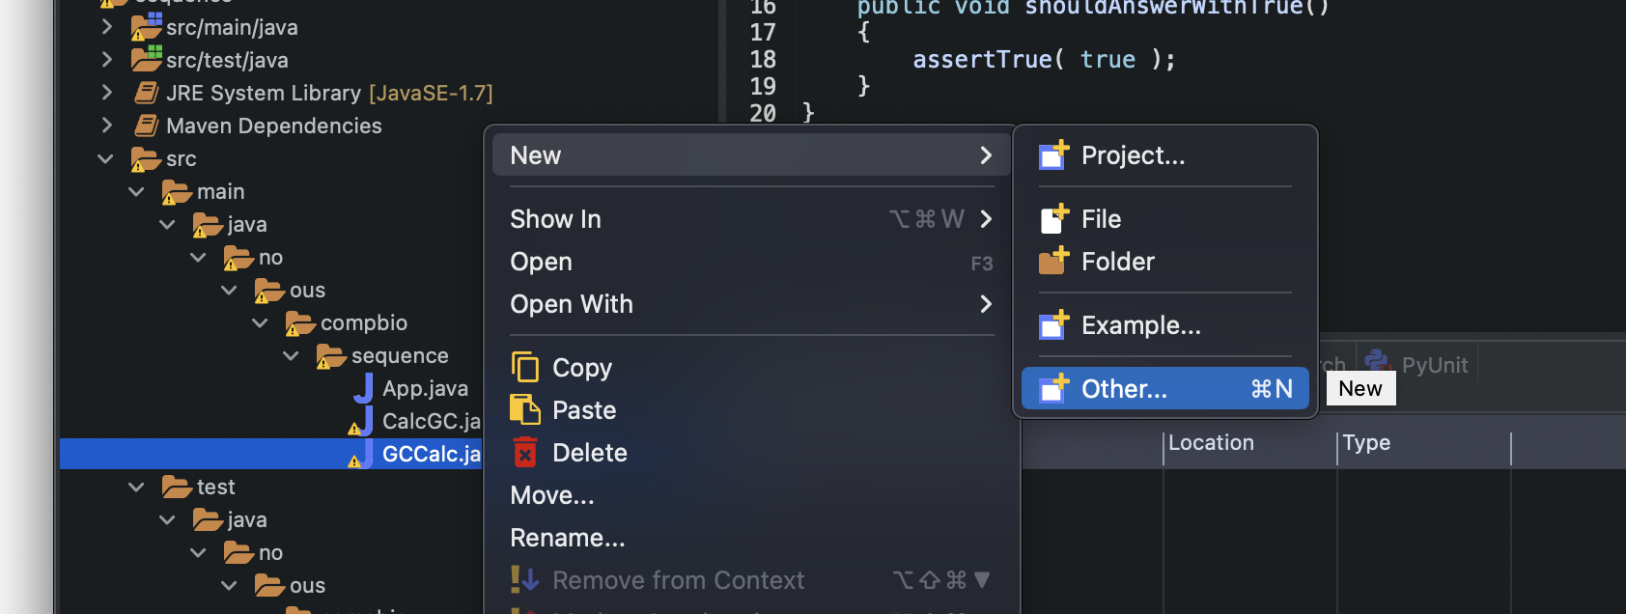
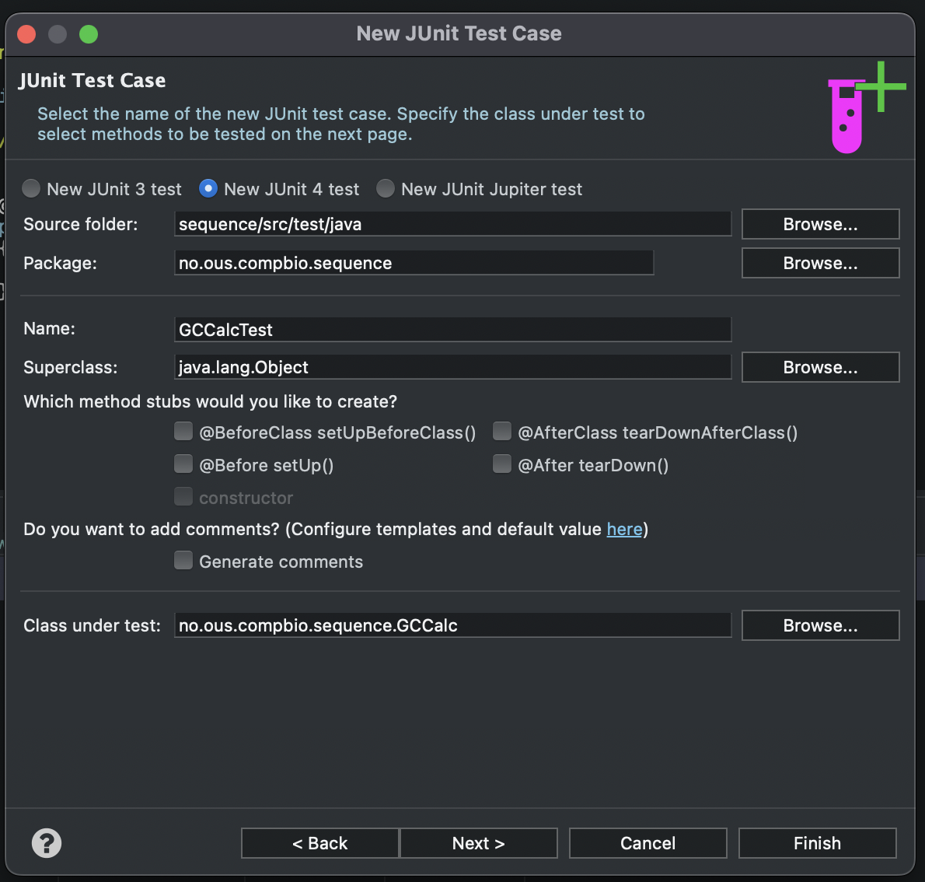
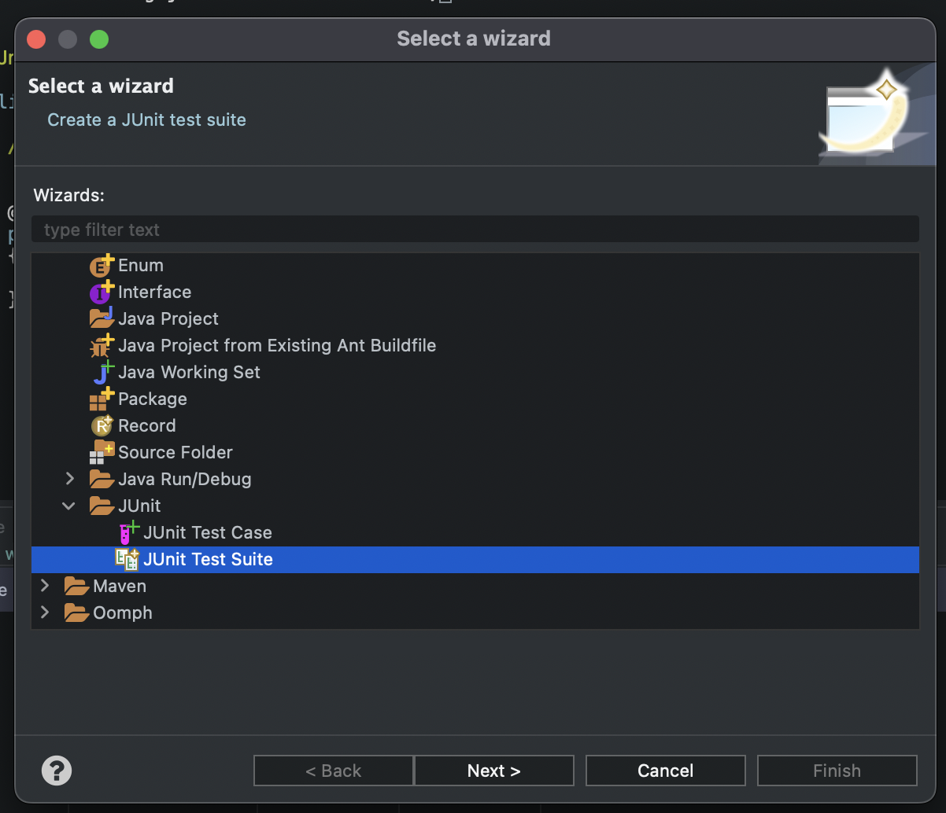
1
3
2

Slide 22
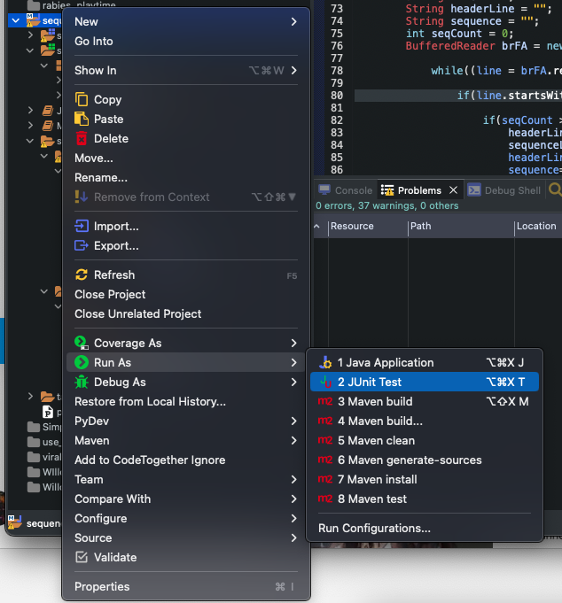
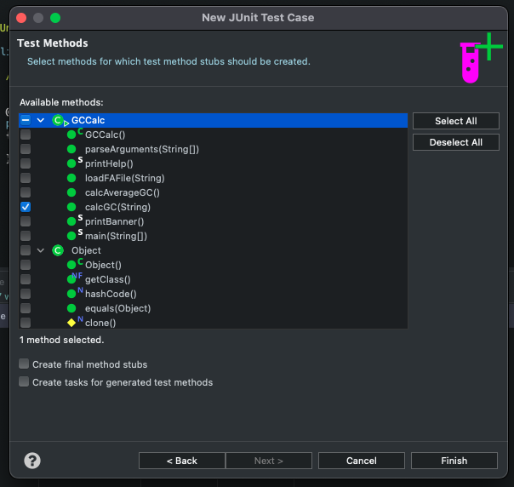
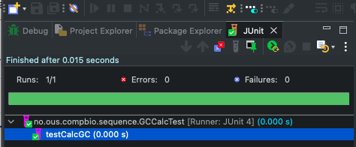
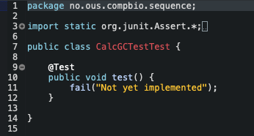
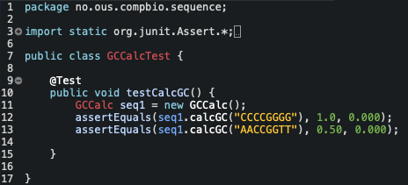
4
7
8
5
6

Slide 23
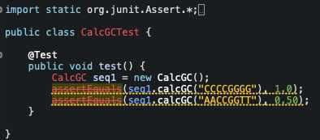
2 test examples. Find the problem before you start using the class
Deprecation
The method assertEquals(double, double) from the type Assert is deprecated
Rounding errors

