Slide 1
Course Outline
Simon Rayner
simon.rayner@medisin.uio.no
https://github.com/IzmirKCU/IKCU_1

Slide 2
Focus on
Install Ubuntu for Windows
Introduction to Python programming
how to write clean and reusable Python code
How to debug code and report errors
How to maintain and collaborate on code
How to document code
How to keep an electronic lab book

Slide 3
Course files
You can download from github at

Slide 4
If you are familiar with github, you can pull it from
https://github.com/orgs/CBGOUS/repositories
Need java 11. Use SDKMAN to handle java versions (https://sdkman.io/ )
curl -s "https://get.sdkman.io" | bash
Note: you need to restart terminal after installation (or just logout and in again)
or run
source "$HOME/.sdkman/bin/sdkman-init.sh”
To install Corretto 17:
sdk install java 17.0.6-amzn
To install Corretto 8:
sdk install java 8.0.442-amzn

Slide 5
hairpin.fa
From mirbase.org, a list of all hairpin sequences, for all species

Slide 7
Question 1
How many sequences in the file?
Question 2
How many species in the file?
Question 3
How many human sequences in the file?

Slide 8
Install Ubuntu on Windows

Slide 9
Install Ubuntu on Windows
Install Python

Slide 10
Install Ubuntu on Windows
Install Java (sdkman)

Slide 11
Install Java (sdkman)
Need java 11. Use SDKMAN to handle java versions (https://sdkman.io/ )
curl -s "https://get.sdkman.io" | bash
Note: you need to restart terminal after installation (or just logout and in again)
or run
source "$HOME/.sdkman/bin/sdkman-init.sh”
To install Corretto 17:
sdk install java 17.0.6-amzn
To install Corretto 8:
sdk install java 8.0.442-amzn

Slide 12
Some basic Linux commands

Slide 13
pwd
ls
cd
wc –l
grep
sed
awk
find
xargs
piping commands using the ‘|’ character

Slide 14
Some basic Linux commands
Install Java (sdkman)

Slide 15
GC Calculation
Find the GC content of the fasta file hairpin.fa

Slide 16
cat hairpin.fa|more
>cel-let-7 MI0000001 Caenorhabditis elegans let-7 stem-loop
UACACUGUGGAUCCGGUGAGGUAGUAGGUUGUAUAGUUUGGAAUAUUACCACCGGUGAAC
UAUGCAAUUUUCUACCUUACCGGAGACAGAACUCUUCGA
>cel-lin-4 MI0000002 Caenorhabditis elegans lin-4 stem-loop
AUGCUUCCGGCCUGUUCCCUGAGACCUCAAGUGUGAGUGUACUAUUGAUGCUUCACACCU
GGGCUCUCCGGGUACCAGGACGGUUUGAGCAGAU
>cel-mir-1 MI0000003 Caenorhabditis elegans miR-1 stem-loop
AAAGUGACCGUACCGAGCUGCAUACUUCCUUACAUGCCCAUACUAUAUCAUAAAUGGAUA
UGGAAUGUAAAGAAGUAUGUAGAACGGGGUGGUAGU
>cel-mir-2 MI0000004 Caenorhabditis elegans miR-2 stem-loop
UAAACAGUAUACAGAAAGCCAUCAAAGCGGUGGUUGAUGUGUUGCAAAUUAUGACUUUCA
UAUCACAGCCAGCUUUGAUGUGCUGCCUGUUGCACUGU
Let’s modify the file so that we have one sequence/line
awk '/^>/ {printf("\n%s\n",$0);next; } { printf("%s",$0);} END {printf("\n");}’ \
< hairpin.fa > hairpin_flat.fa

Slide 17
cat hairpin_flat.fa|more
>cel-let-7 MI0000001 Caenorhabditis elegans let-7 stem-loop
UACACUGUGGAUCCGGUGAGGUAGUAGGUUGUAUAGUUUGGAAUAUUACCACCGGUGAACUAUGCAAUUUUCUACCUUACCGGAGACAGAACUCUUCGA
>cel-lin-4 MI0000002 Caenorhabditis elegans lin-4 stem-loop
AUGCUUCCGGCCUGUUCCCUGAGACCUCAAGUGUGAGUGUACUAUUGAUGCUUCACACCUGGGCUCUCCGGGUACCAGGACGGUUUGAGCAGAU
>cel-mir-1 MI0000003 Caenorhabditis elegans miR-1 stem-loop
AAAGUGACCGUACCGAGCUGCAUACUUCCUUACAUGCCCAUACUAUAUCAUAAAUGGAUAUGGAAUGUAAAGAAGUAUGUAGAACGGGGUGGUAGU
>cel-mir-2 MI0000004 Caenorhabditis elegans miR-2 stem-loop
UAAACAGUAUACAGAAAGCCAUCAAAGCGGUGGUUGAUGUGUUGCAAAUUAUGACUUUCAUAUCACAGCCAGCUUUGAUGUGCUGCCUGUUGCACUGU
Let’s modify the file so that we have one sequence/line
awk '/^>/ {printf("\n%s\n",$0);next; } { printf("%s",$0);} END {printf("\n");}’ < hairpin.fa

Slide 18
We are going to work with the code and data in the folder
../BINF_M612/day1/GCCalculation/software
This folder contains two java files CalcGC.jar and GCCalc.jar
They both calculate average GC content for an input file of fasta sequences
We can find out how to run the program by typing
$ java -jar day1/GCCalculation/software/GCcalc.jar -h
GCCalc
initializing
parse arguments
=======================================================================\
| GCCalc : \
| Java code to calculate GC percentage in a FastA file \
=======================================================================\
usage: command line options
-f,--sequence file <arg> sequence file in FASTA format
-h,--help view help
So, we just need to specify a fasta file. Let’s start with the file data/GCtest.fa
(This corresponds to an alignment of sequences for the 3’UTR of the Lysine Methyltransferase 5B gene)
DEBUGGING: GC CALCULATION

Slide 19
We’ve tried with a small test dataset. Let’s repeat with a real one.
$ java -jar day1/GCCalculation/software/GCCalc.jar
-f day1/GCCalculation/data/GCtest.fa
GCCalc
initializing
parse arguments
fasta input file is <day1/GCCalculation/data/ENSG00000110066___ENST00000441488___2___KMT5B__uniq_aln.fa>
read <16> sequences from file
average GC value of all sequences is <43.35%>
And repeat using CalcGC.jar
$ java -jar day1/GCCalculation/software/CalcGC.jar
-f day1/GCCalculation/data/GCtest.fa
CalcGC
initializing
parse arguments
fasta input file is <day1/GCCalculation/data/ENSG00000110066___ENST00000441488___2___KMT5B__uniq_aln.fa>
read <16> sequences from file
average GC value of all sequences is <43.35%>
So, two programs give the same results, which is encouraging
DEBUGGING: GC CALCULATION

Slide 20
We’ve checked the programs using a simple test dataset.
Now let’s try running the programs against the hairpin.fa file
What do you find?
How can you figure out what is going on?
DEBUGGING: GC CALCULATION

Slide 21
Data set is very large – so let’s use a simpler test set

Slide 22
Programming in Python

Slide 23
We started with calculating the average GC content of all the sequences in the hairpin.fa file using two different Java programs
We installed Java using SDKMAN
This allows us to run different versions of Java, which is quite handy if you are running programs you have downloaded from other sites

Slide 24
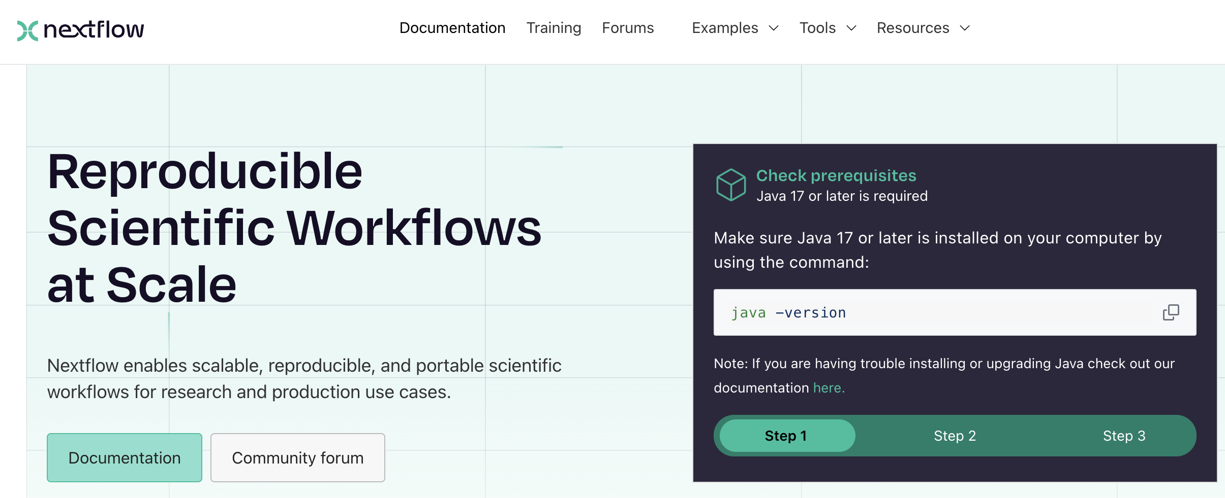
For example, Nextflow requires Java 17

Slide 25
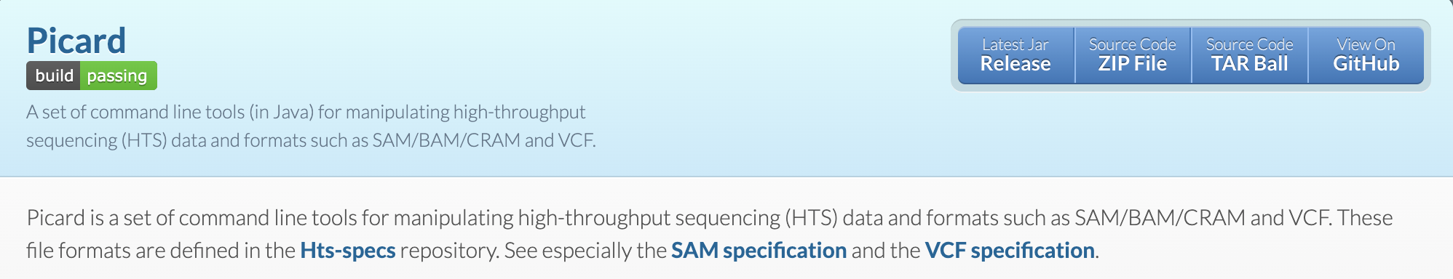
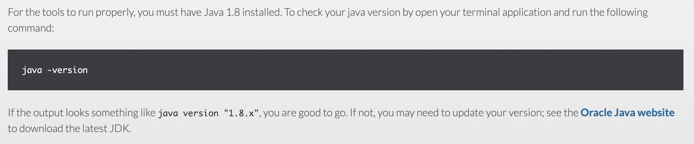
But Picard, another popular tool only requires Java 8

Slide 26
We found that running the two different Java programs sometimes returned different values for GC %
We didn’t have the source code, but we found the error by creating a simple test dataset to put into the programs
i.e., rather than calculating the GC% for 38000 sequences, we created a test file containing the sequence
>test1
AACCGGTT

Slide 27
Now we are going to do the same thing by writing some Python code
We will do this by starting with a simple Python program and run in two different ways
First of all, we will run it from inside a terminal window
Then we will run it inside Jupyter

Slide 28
Programming in Python
Writing code inside Jupyter Notebook

Slide 29
Open a command window
(in Windows you can do this by typing <CTRL>+<SHIFT>+P)
When a window opens, type
jupyter notebook

Slide 30
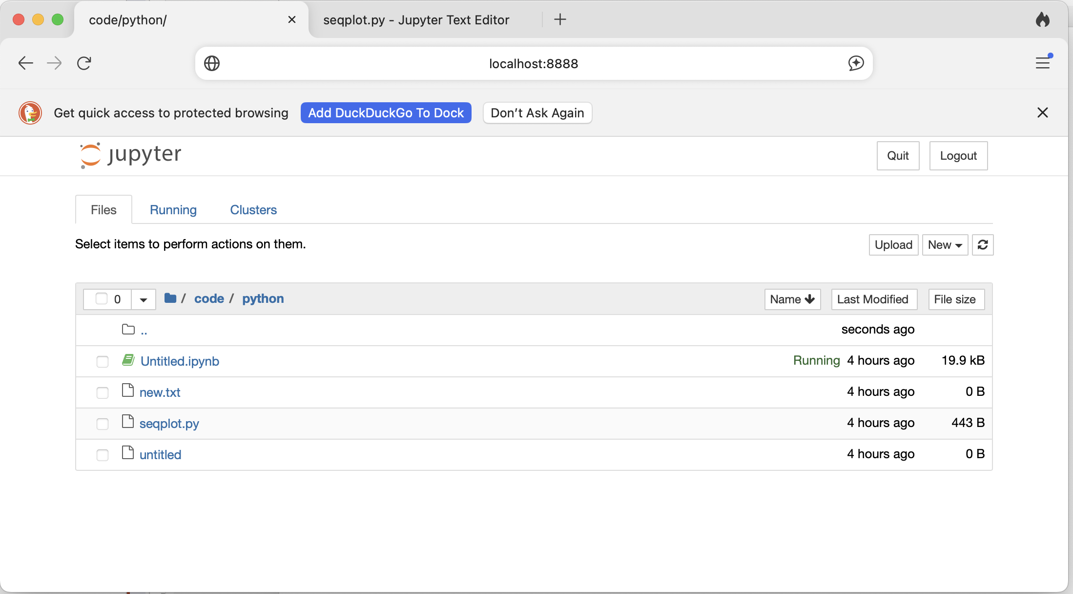
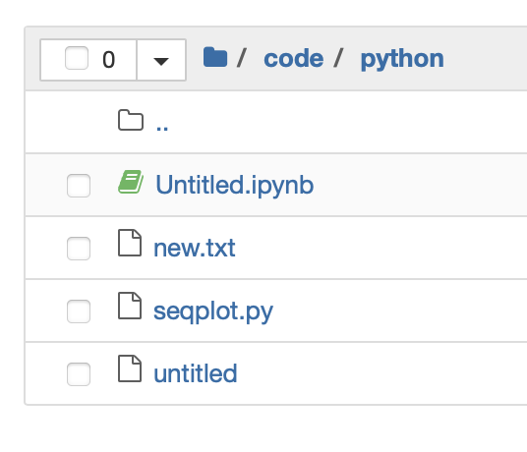
After a while (depending on your computer’s speed), a webpage will open that looks something like this
It won’t look exactly the same, because you need to move to the folder where you downloaded the code

Slide 31
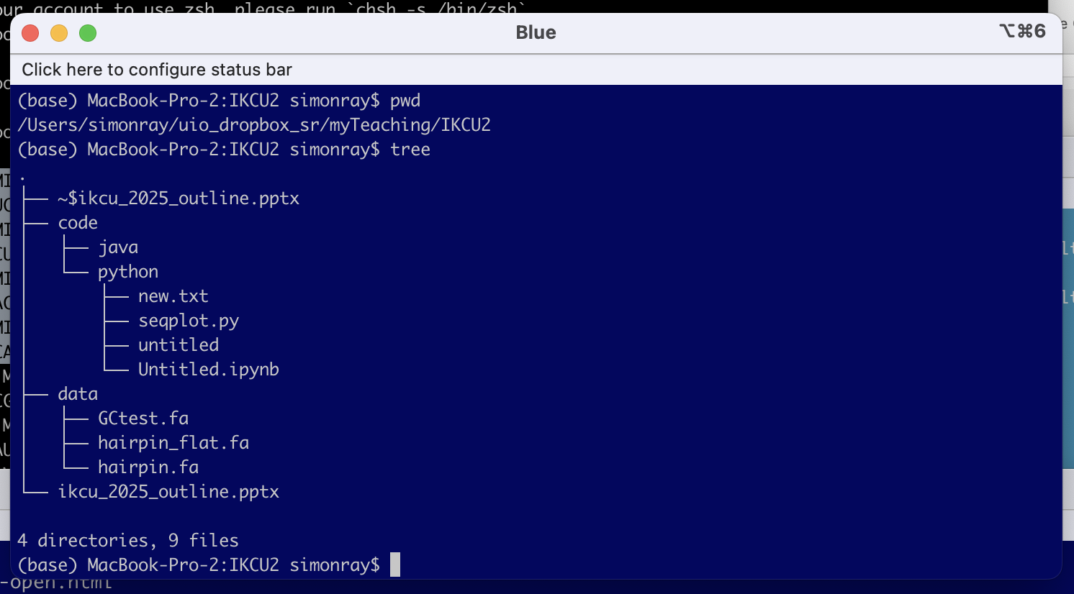
For example, before i started jupyter, i changed the directory to the folder where i downloaded the code

Slide 32
Programming in Python
Running code inside a virtual environment

Slide 33
How would you describe a bicycle?
Two wheels
Handlebar
Saddle
frame

Slide 34

Here is a bike

Slide 35
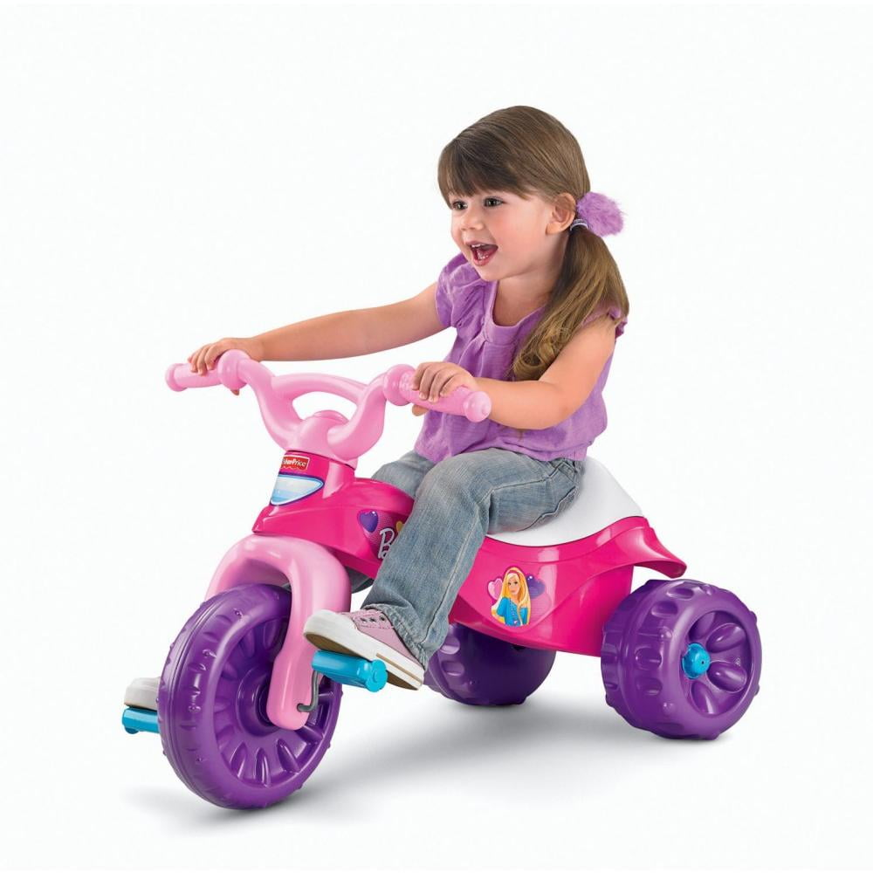
Here is another bike

Slide 36
The parts are incompatible (e.g., you can’t change the wheels

Slide 37
This is a bit like the problem you face with Python
import sklearn import tensorflow as tf
They both use Pandas, but may require different versions of the Pandas package

Slide 38

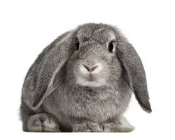





What about Anaconda or MiniConda?
Anaconda gives you whatever version happens to be in the package. So it tries to make sure the are no dependency issues, but it may break other programs you already have installed
Also, Anaconda gives you many other packages you may never use

Slide 39
Virtual Environments
Virtual Enviroments give you a way to create a custom environment to run your code
VE1
VE 2

Slide 41
Reproducible Research

Slide 42
miRBASE ANNOTATION : HIGH CONFIDENCE SETS
TO ADDRESS SOME OF THESE ANNOTATION PROBLEMS miRBASE RELEASED A HIGH CONFIDENCE ANNOTATION SET
ALL SPECIES
HUMAN
MOUSE
V20 → V21 → V22
3298 DISTINCT HAIRPIN PRECURSORS ACROSS THE THREE RELEASES,
ONLY 925 (231 HUMAN HAIRPINS) ARE PRESENT ACROSS ALL THREE RELEASES
We saw that the high confidence miRBase set changed between each version
How does the variation among different miRBase releases affect an analysis?

Slide 43
Variation in miRBase Annotation

Slide 44
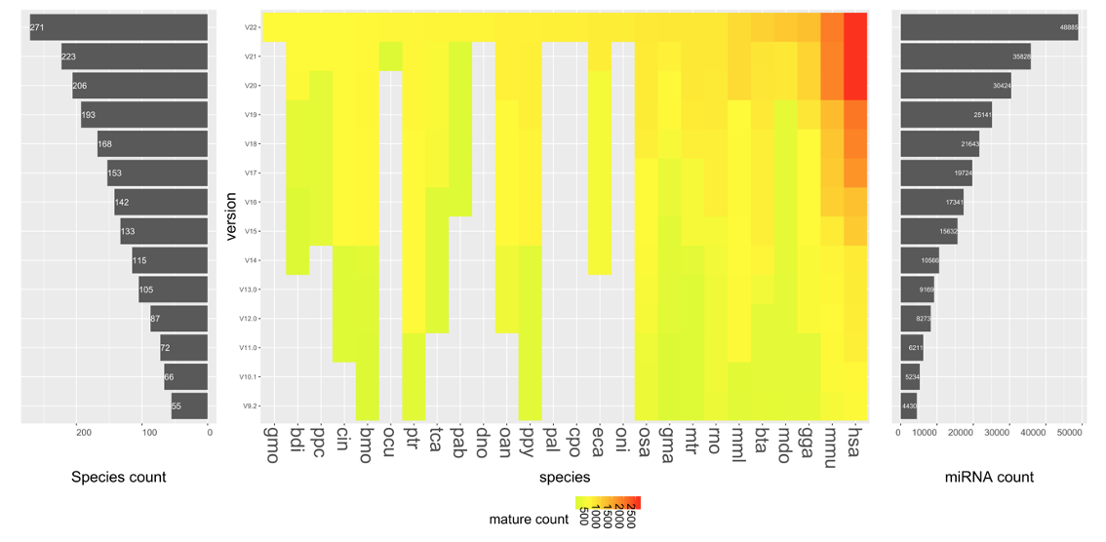

miRBase: Growth

Slide 45
We are going to look at the impact of using different annotation and parameter values on the analysis results
To do this, we are going to run the mapping part of a NGS analysis using smallRNA seq data using the bowtie mapping tool
To do the analysis, we need some reads, and a reference genome
It will take too long to work with a whole NGS dataset + Reference Genome, so we are going to use a test dataset, smallRNA_reads.fa
And a shorter reference genome containing only chr 10 and chr X.

Slide 46
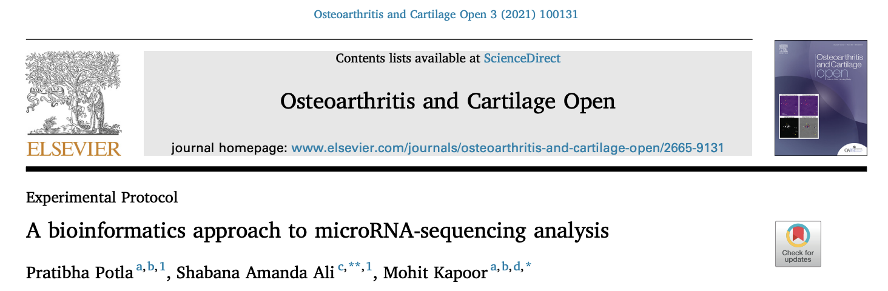
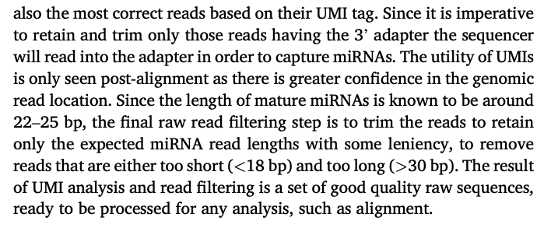

Slide 47
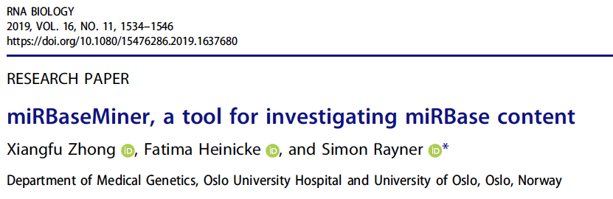
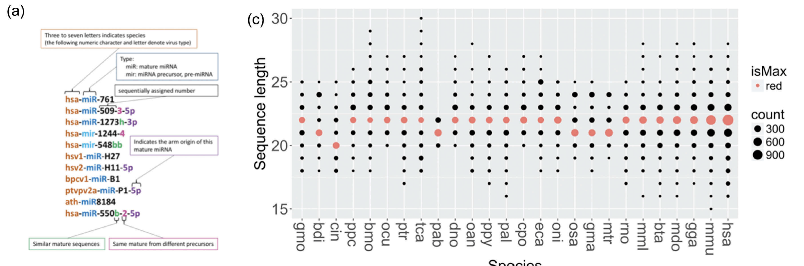

Slide 48
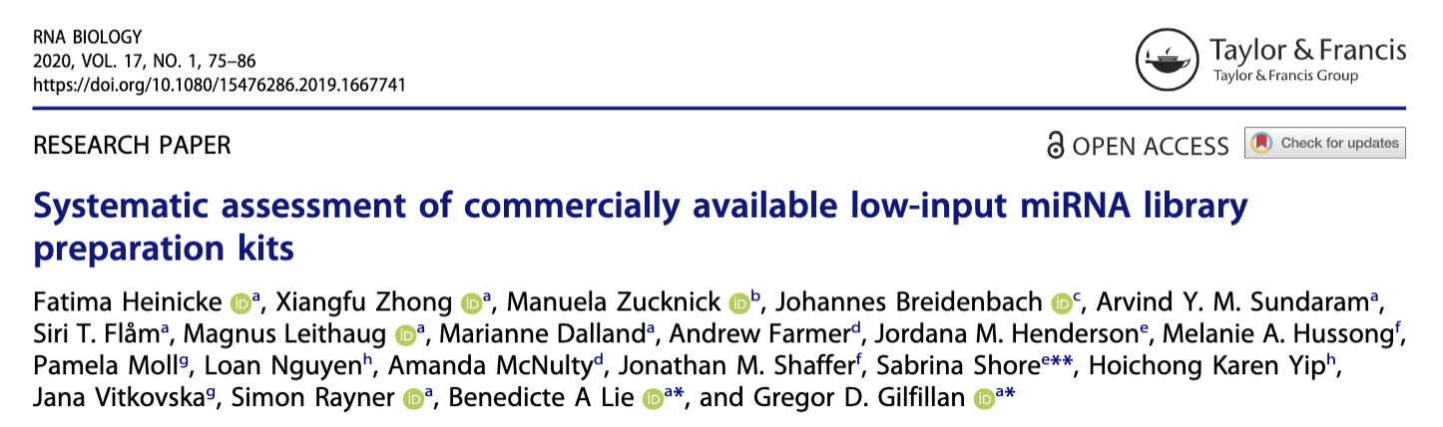
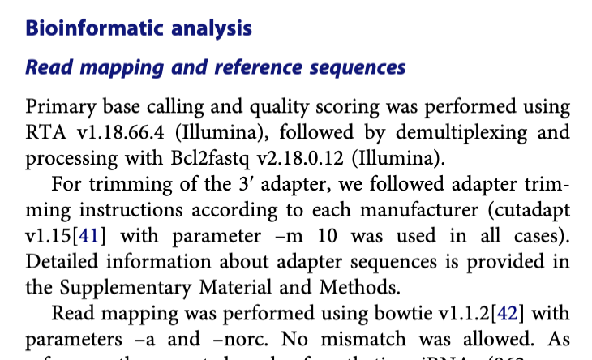
bowtie -x bowtie/hsa_chr10 -f ngsdata/smallRNA_reads.fa –n 0

Slide 49
We are going to look at the impact of using different annotation and parameter values on the analysis results
To do this, we are going to run the mapping part of a NGS analysis using smallRNA seq data using the bowtie mapping tool
To do the analysis, we need some reads, and a reference genome
It will take too long to work with a whole NGS dataset + Reference Genome, so we are going to use a test dataset, smallRNA_reads.fa
And a shorter reference genome containing only chr 10 and chr X.
Let’s see how this affects read mapping ….

Slide 50
What is the length distribution of human miRNAs?

Slide 51
We need the following software
bowtie https://sourceforge.net/projects/bowtie-bio/files/bowtie/1.3.1/
samtools
bedtools
bgzip
Installed using apt-get install
c:\User\simonrat\Downloads —> /mnt/c/Users/simonrat/Downloads
1. Map the reads to the reference genome
bowtie -x bowtie/hsa_chr10 -f ngsdata/smallRNA_reads.fa
bowtie -x bowtie/hsa_chr10 -f ngsdata/smallRNA_reads.fa -S 10.sam
samtools view -bo 10.bam 10.sam
bedtools intersect -a mirbase/21/hsa_s.gff3 -b 10.bam
2. Map the reads to the reference genome and write to 10.sam
3. Convert the alignment results to binary format (less space and faster to process)
4. Find which reads overlap the features in the gff file

Slide 52
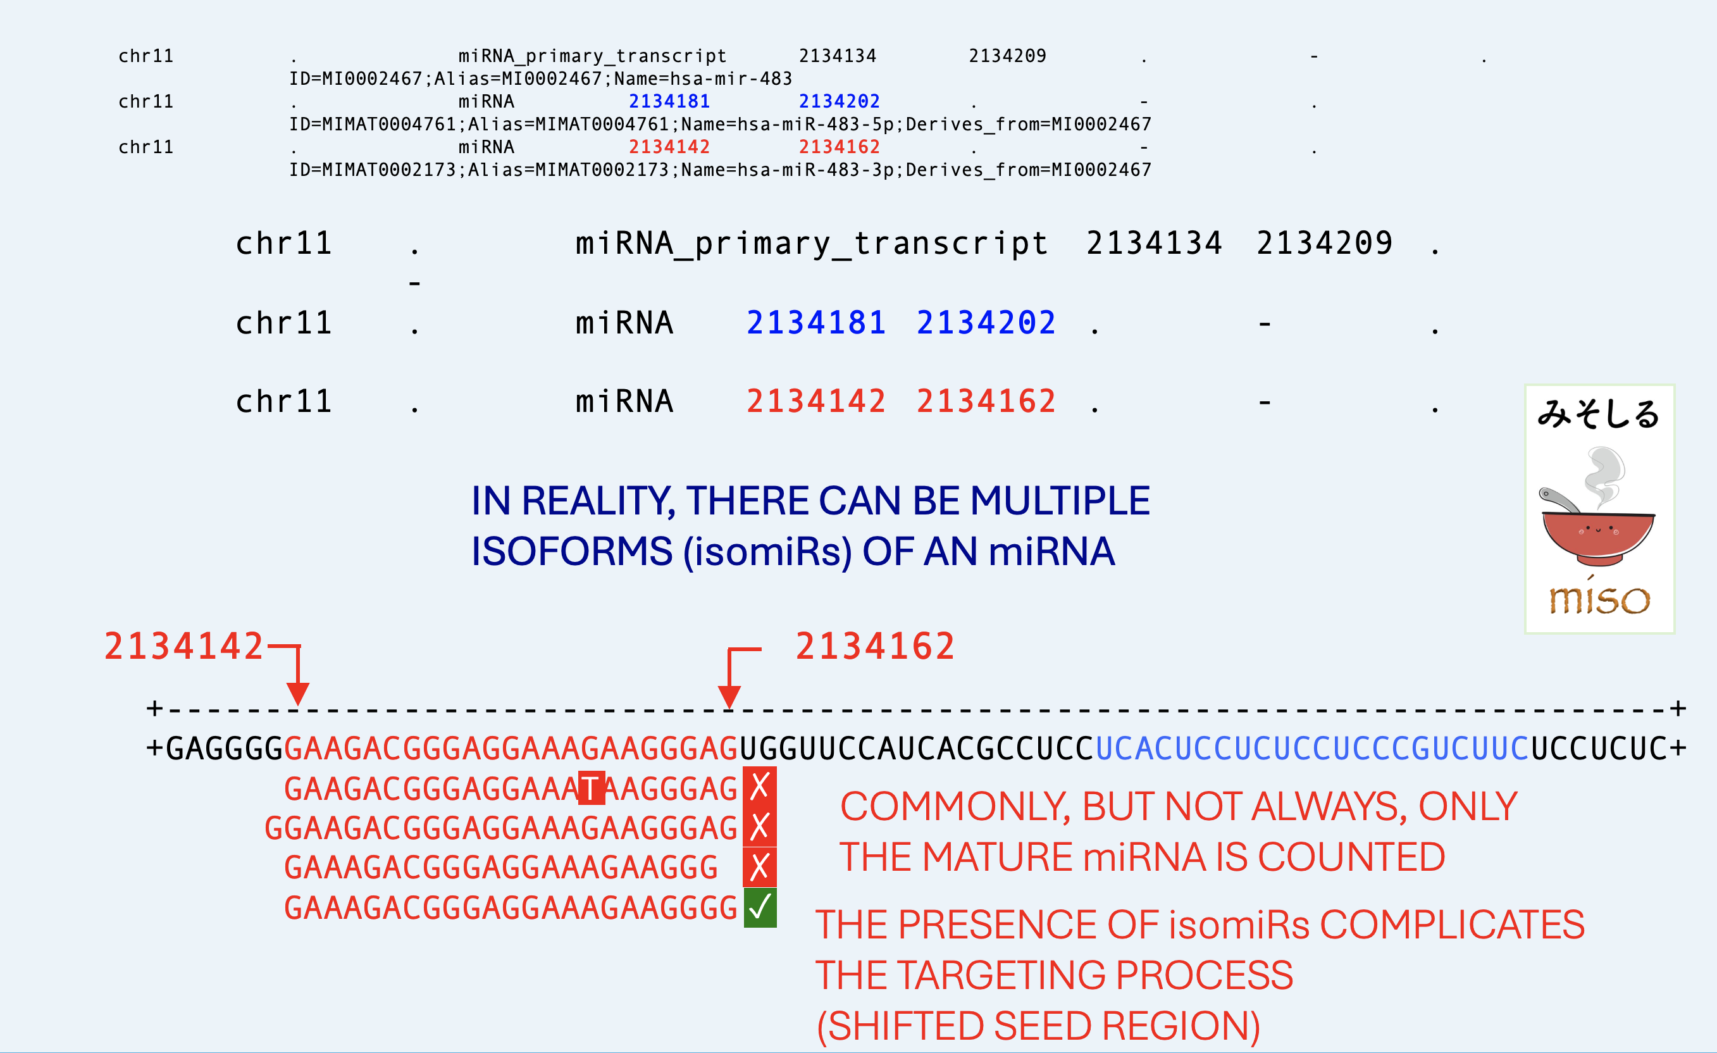

Slide 53
So far, we have been working with the hairpin.fa file.
Actually, what we are really interested in are the miRNAs that are generated from the hairpin sequence

Slide 54



seed region
miRNA GENE OR INTRON
RNA POL II/III
TRANSCRIPTION
5’
mRNA
3’
pri-miRNA
miRNA
3’
5’
DROSHA
CLEAVAGE
DGCR8
pre-miRNA
GTP
EXPORTIN-5
RAN
NUCLEAR EXPORT
THIS IS THE SEQUENCE IN hairpin.fa
DICER
CLEAVAGE
TRBP
miRNA duplex
passenger strand
DEGRADATION
Ago2
RISC FORMATION
THIS IS THE SEQUENCE WE WANT TO LOOK AT
(IN mature.fa)
mature miRNA
mRNA TARGET CLEAVAGE
mRNA DEADENYLATION
TRANSLATIONAL REPRESSION
Notes:
This is the standard Biogenesis pathway. Some miRNAs use alternative pathways not described here

Slide 55
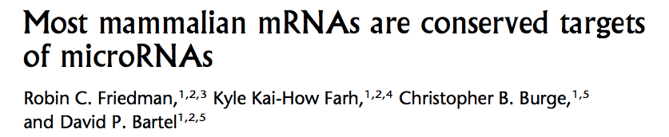
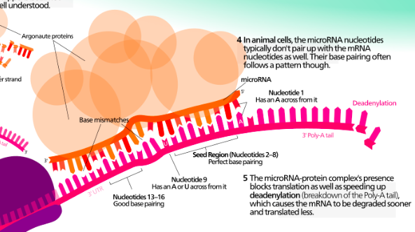
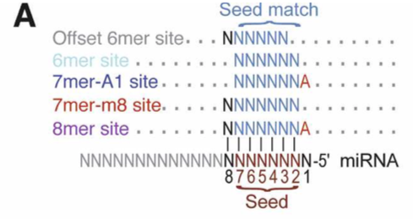
Targeting model
TARGET SITE IDENTIFICATION
2009: 10.1101/gr.082701.108

Slide 56
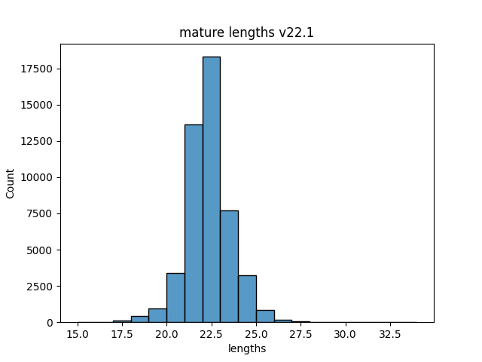
So, let’s begin by looking at the mature sequences in miRBase
These are stored in
reproducible_research/data/mirbase
├── 21
│ ├── hsa_s.gff3
│ ├── hsa.gff3
│ └── mature.21.fa
└── 22.1
├── hairpin.fa
├── hsa.gff3
└── mature.fa
from Bio import SeqIO
import pandas as pd
records = list(SeqIO.parse("22.1/mature.fa", "fasta"))
seqLens = []
i=0
while i < len(records):
seqLens.append(len(records[i].seq))
i = i + 1
dfseqLens = pd.DataFrame(seqLens, columns=['lengths'])
from matplotlib import pyplot as plt
import seaborn as sns
histplot=sns.histplot(data=dfseqLens, x="lengths", binwidth=1)
fig=histplot.get_figure()
fig.savefig("22.1/out.png")

Slide 57
This is the plot for all mature sequences.
Next,
generate plots for
human and mouse, and for 21 and 22
Human and mouse, for seed regions, for 21 and 22
Give your files sensible names so you know which file is which
You need to get the mature hsa sequences only. You can do this using grep
I haven’t put in the full file path to save space
grep -A 1 hsa mature.fa | grep -v "^--" > hsa_mature_v21.fa
grep -A 1 hsa mature.fa | grep -v "^--" > hsa_mature_v22.fa

