Slide 1
Going Dutch

Slide 2
Going Dutch team :
Guide – Dr. Murugeswari (Mam)
Izna – 20BCE11021
Chandrika Sharma – 20BCE11032
Vishvas Patel – 20BCE10993
Sambhav Mehta – 20BCE11033
Radheshyam B Soni - 20BCE10994

Slide 3
You might pay the bills, but I am not
ready to pay the price so,
Let's split!

Slide 4


INTRODUCTION
Let’s Go Dutch !
Going on a road trip ? Worried about all the math you gotta do to find out "who owes whom and how much" after the trip? Well, worry not! Add all your expenses to our app and let it do the calculations for you.
“Let’s go Dutch”, is a phrase that has become extremely common in terms of usage and popularity among the masses lately.
The term indicates that each person in the group while dining out or working pays for their own share. The practice of splitting bills is more popular among the youth, as the masses are becoming more financially independent and have become used to paying their own bills.

Slide 5
“Going Dutch”, a phrase that arguably owes its origin to a door a traditional Dutch farmhouses door consisted of two equal parts - is common practice today.
But most likely, the roots of "splitting the bill may be related to Dutch etiquette. In the Netherlands, it's not unusual to pay separately when working or going out as a group. But the big question - after you have decided that you are going Dutch - is how? Technically, going Dutch means separate tabs, each person pays for himself or herself.

Slide 6
OBJECTIVE
Mobile application have become a part of day-to-day life. Many application are available in the market to manage personal and group expenses. Not many application are reliable or are able fulfil the user requirements.
In this project we will design a mobile application that managers a person’s all expenses, their personal contribution toward group expenses, maintain monthly income, recurring and ad hoc payment. It provides information of "who owes who and by how much".

Slide 7
The proposed application would eliminate sticky note, spreadsheet and ledger that cause confusions, data inconsistency problems while recording and splitting of expenses.
With our application user can manage these expenses more effectively. This application will not only helps users to manage their expenses but also help marketing executives by providing them the platform they need.

Slide 8
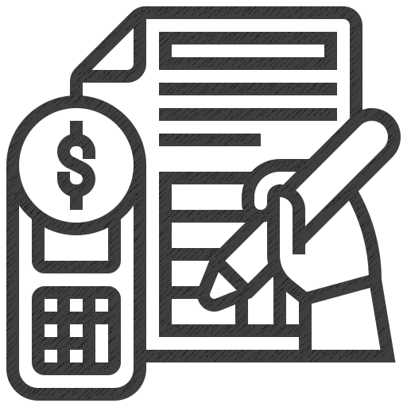
PROPOSED WORK & METHODOLOGY
It is a mobile application intended to run on android devices. It is design to fulfil the needs of the user by reducing their efforts for the settlement of the bill.
The application encourages corresponding users help in who owes who, and for what.
Aim to provide user the best approach to help user and their companion to share expenses easily.

Slide 9
This application will let bunch users together and their companions to have detailed view inside this application around the individual costs and to settle them.
This application allows its user to add remark to an expense, click on the expense name in any expense list. Bill posting will have space for comments. It will also have the notification option to notify each time somebody adds a remark to an expense user is on, or user can withdraw to posted bill.
It has our algorithm that calculates to last digit precisely who must take or give how much to whom. It makes it easier to calculate and settle payments for a big event or even a small restaurant bill

Slide 10
Features concepts (final may vary)
No user login and registration required
Uses a O(n) algorithm to settle debts
Built in Java for Android Platform
Recycler views
Fragments & View Pager
Activities & intents
Room Persistence, Live Data, View-Model
Different types of layouts

Slide 11
HARDWARE AND SOFTWARE REQUIREMENTS
SECURE
FAST AND RELIABLE
For User​
Our site can be accessed anywhere through any device with a browser.​
Just ensure a proper network connection in any device and Yes! You are good to go.​
ACCESSIBLE

Slide 12
TIMELINE OF OUR PROJECT
Review 1
Review 2
Problem Identification​
January 22
Generation of Ideas & Solutions​
January 21
Presentation of Ideas​
February 16

Slide 13
CONCLUSION
We will develop this application to help user to track his/her contribution towards group expenses.
We aim to make our application intelligent enough to show “who owes who and by how much”.
This application will reduce human efforts for the settlement of the shares.
It will also minimize the human interfere in the splitting process which will lead to the most accurate results.
The results obtained will be accurate for the performed operations on the application.
This application will not only help user to maintain expenses but will also settle the expenses on the spot which could be the hectic process.

Slide 14
REFERENCES
Presentation template by Slidesgo
https://medium.com/@POSist/splitting-bills-going-the-dutch-way-e3163f319e21
Developer.android.com
https://www.splitwise.com/terms
https://www.xpenditure.com/en?
Fundamentals of Database systems – book by Elmasri and Navathe
Data Mining and Analysis: Foundations and Algorithms, Mohammed J. Zaki and Wagner Meira,
Jr, Cambridge University Press, 2013

Slide 15
THANK YOU !

