Slide 1
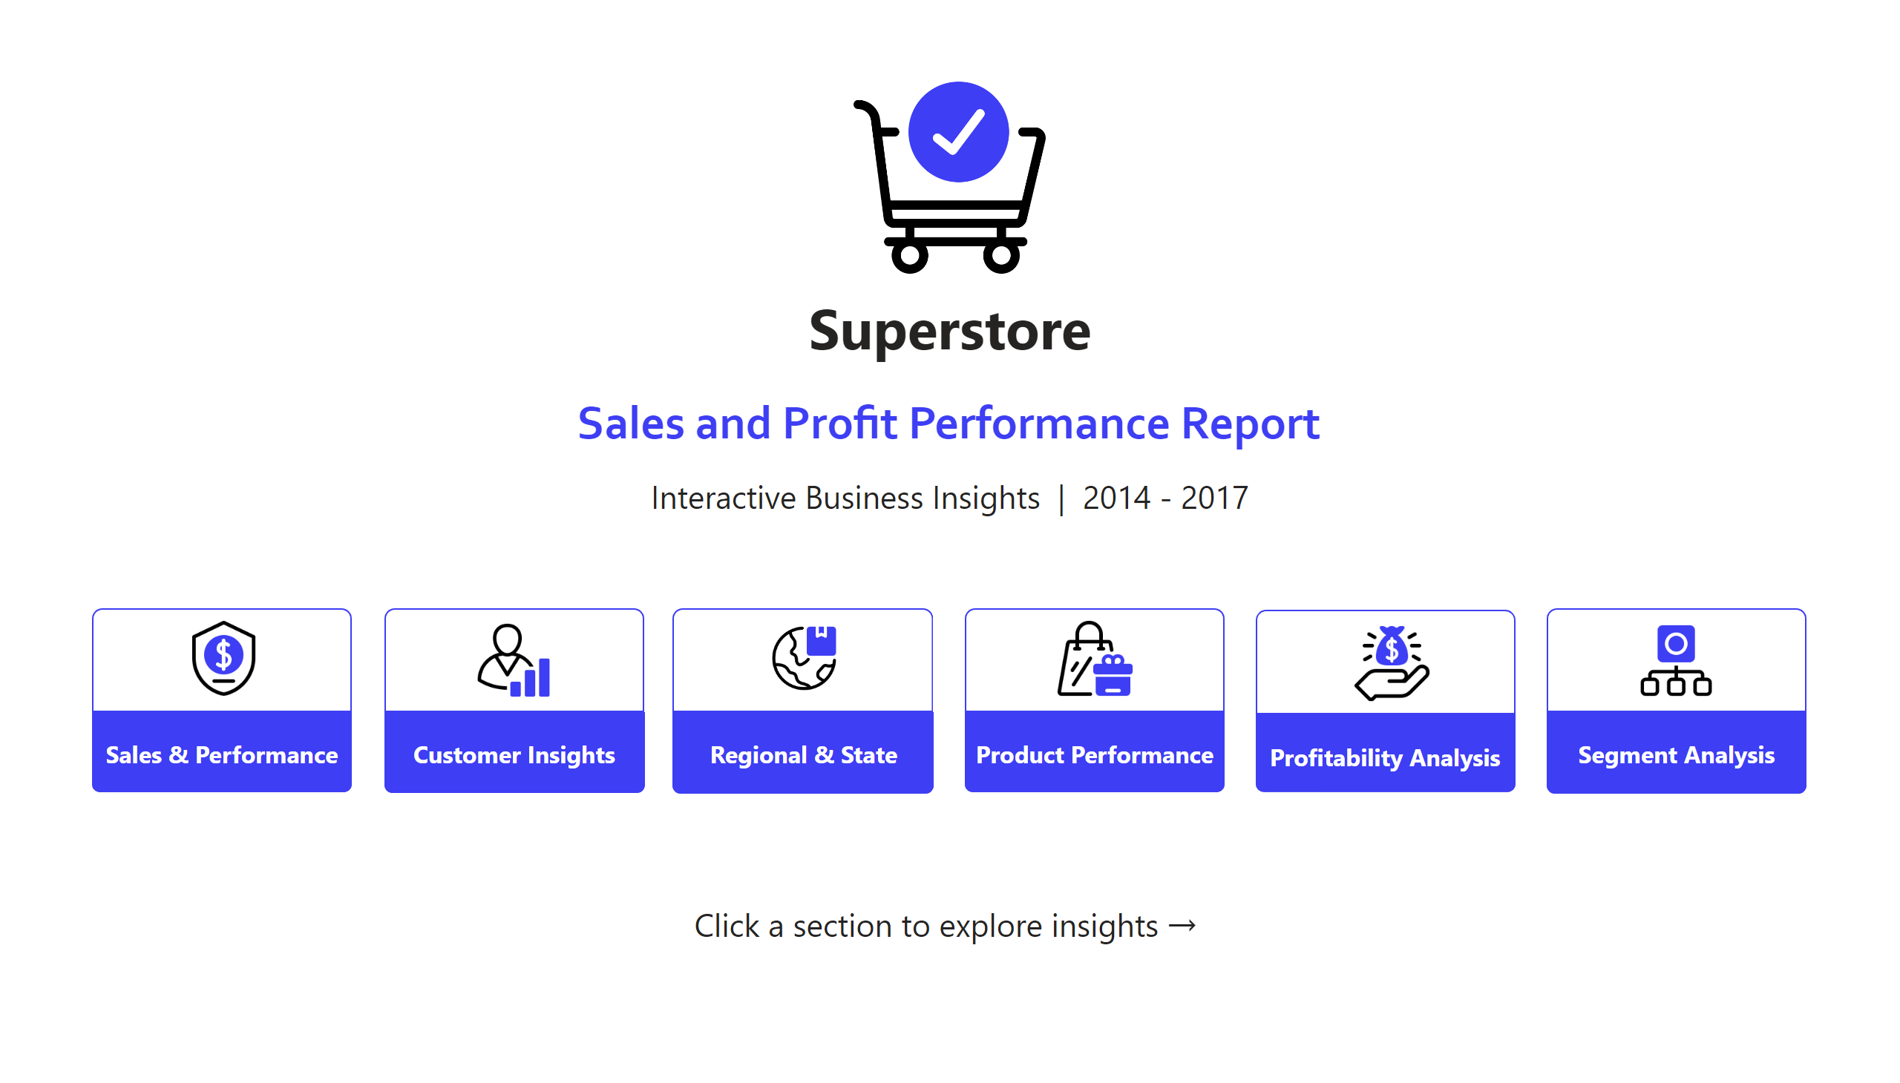
Home
Notes:
image
No alt text provided
textbox
No alt text provided
textbox
No alt text provided
textbox
No alt text provided
textbox
No alt text provided
image
No alt text provided
shape
No alt text provided
shape
No alt text provided
shape
No alt text provided
shape
No alt text provided
image
No alt text provided
textbox
No alt text provided
shape
No alt text provided
shape
No alt text provided
image
No alt text provided
textbox
No alt text provided
textbox
No alt text provided
image
No alt text provided
shape
No alt text provided
shape
No alt text provided
shape
No alt text provided
shape
No alt text provided
image
No alt text provided
textbox
No alt text provided
textbox
No alt text provided
textbox
No alt text provided
shape
No alt text provided
image
No alt text provided
shape
No alt text provided

Slide 2
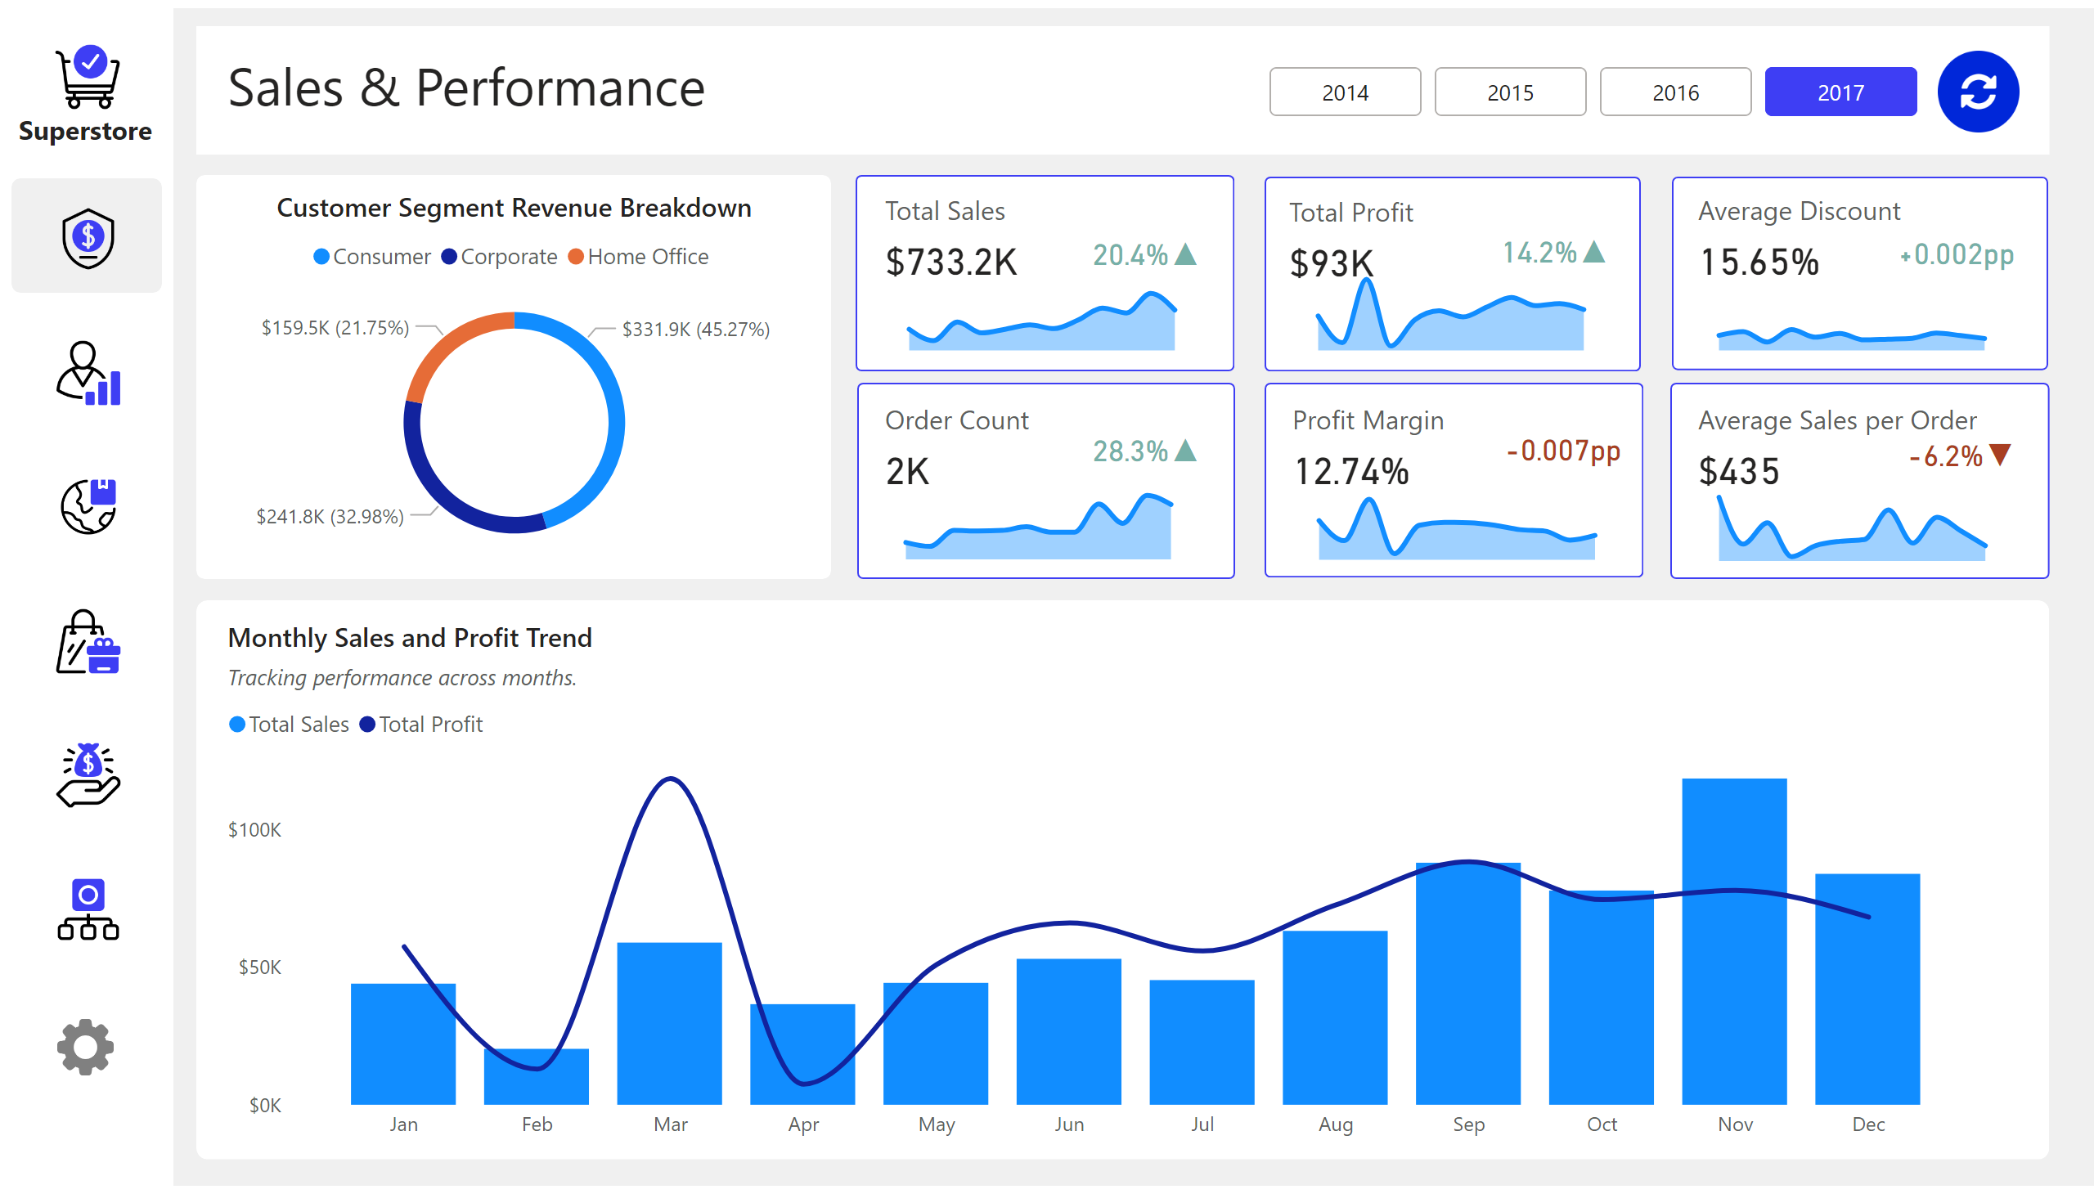
Sales & Performance
Notes:
cardVisual
No alt text provided
Monthly Sales and Profit Trend
No alt text provided
Customer Segment Revenue Breakdown
No alt text provided
shape
No alt text provided
textbox
No alt text provided
advancedSlicerVisual
No alt text provided
shape
No alt text provided
image
No alt text provided
image
No alt text provided
image
No alt text provided
image
No alt text provided
image
No alt text provided
image
No alt text provided
shape
No alt text provided
image
No alt text provided
textbox
No alt text provided
image
No alt text provided
shape
No alt text provided
shape
No alt text provided
cardVisual
No alt text provided
cardVisual
No alt text provided
shape
No alt text provided
shape
No alt text provided
cardVisual
No alt text provided
shape
No alt text provided
cardVisual
No alt text provided
shape
No alt text provided
cardVisual
No alt text provided
card
No alt text provided
areaChart
No alt text provided
areaChart
No alt text provided
card
No alt text provided
areaChart
No alt text provided
card
No alt text provided
areaChart
No alt text provided
card
No alt text provided
areaChart
No alt text provided
areaChart
No alt text provided
card
No alt text provided
card
No alt text provided
shape
No alt text provided
shape
No alt text provided
image
No alt text provided

Slide 3
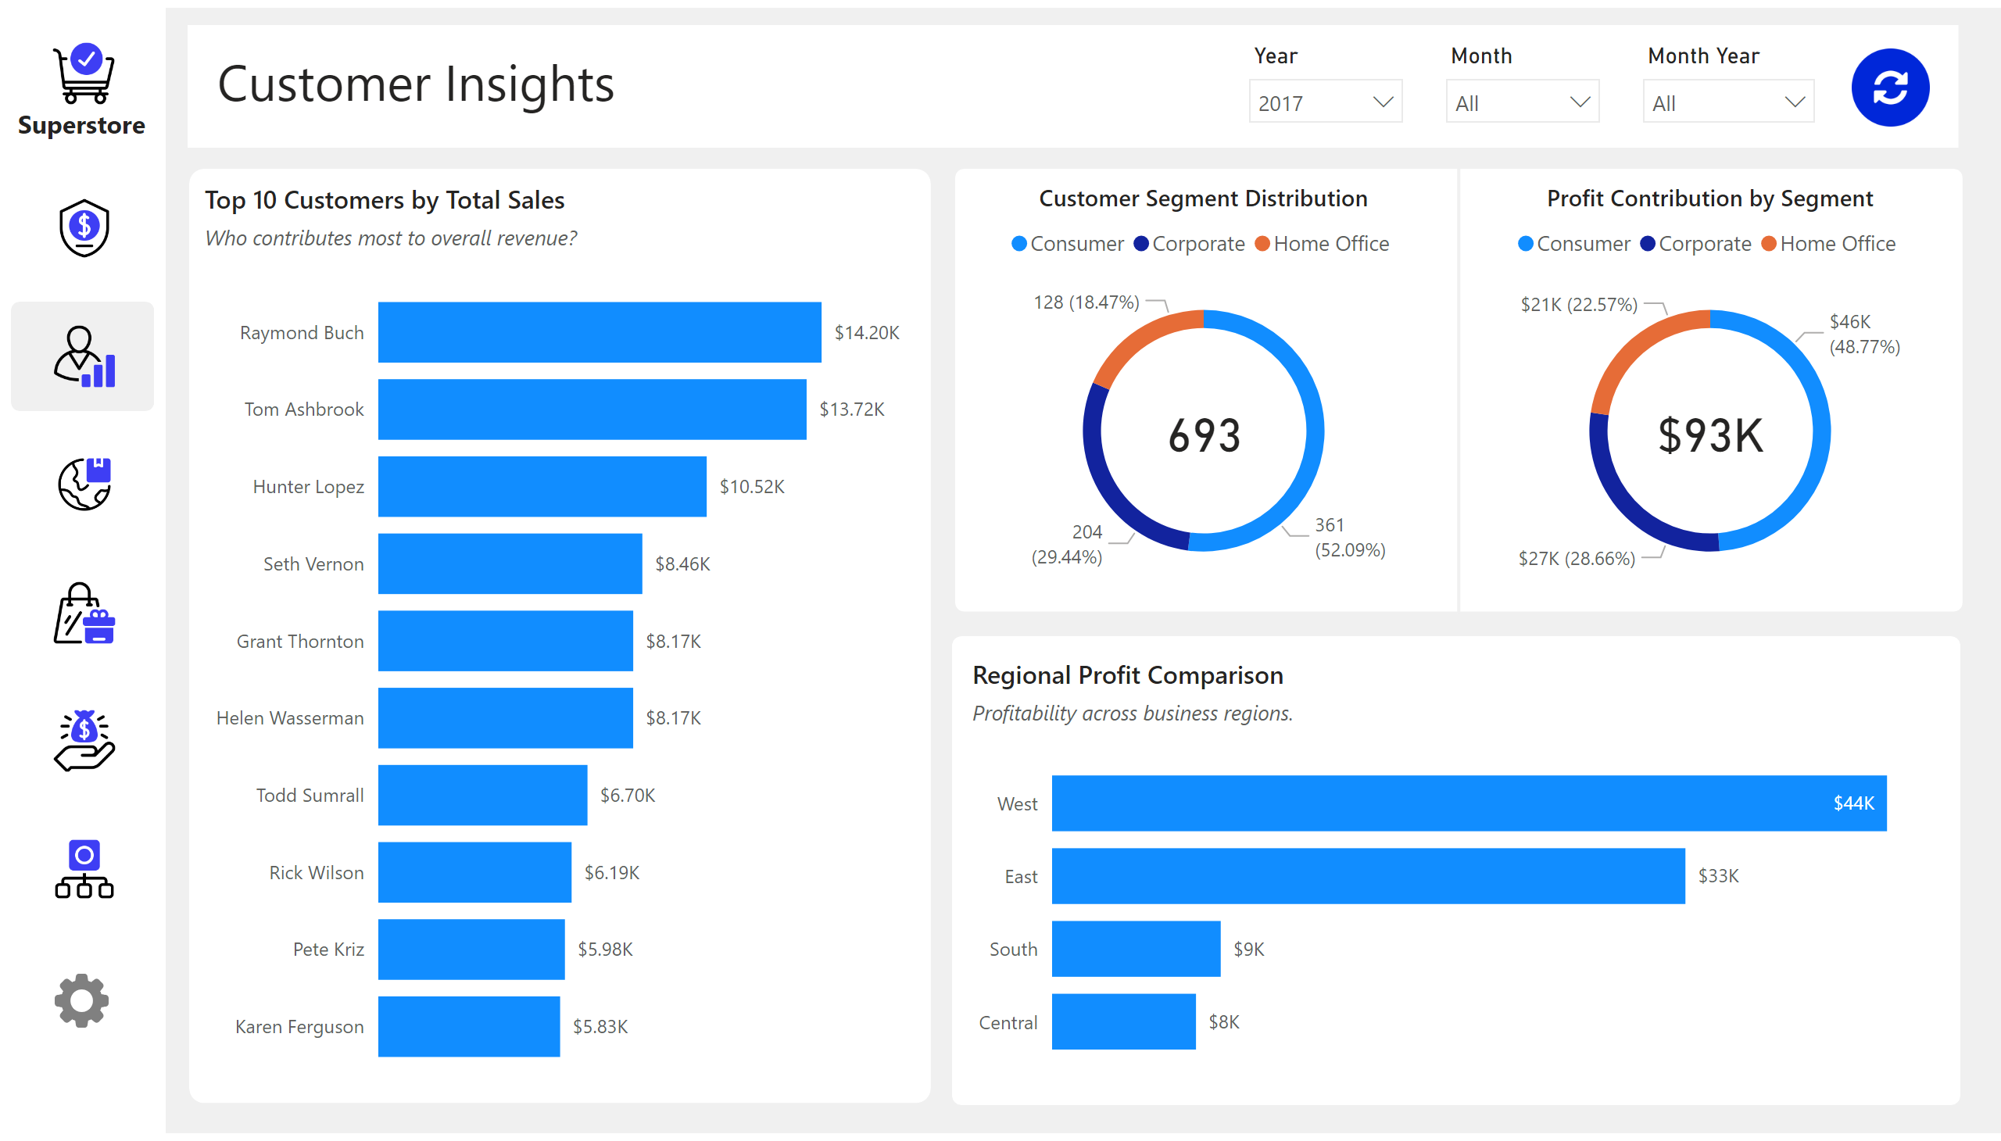
Customer Insights
Notes:
textbox
No alt text provided
shape
No alt text provided
Top 10 Customers by Total Sales
No alt text provided
Customer Segment Distribution
No alt text provided
Profit Contribution by Segment
No alt text provided
Regional Profit Comparison
No alt text provided
image
No alt text provided
image
No alt text provided
image
No alt text provided
image
No alt text provided
image
No alt text provided
image
No alt text provided
shape
No alt text provided
shape
No alt text provided
textbox
No alt text provided
image
No alt text provided
image
No alt text provided
shape
No alt text provided
shape
No alt text provided
shape
No alt text provided
shape
No alt text provided
card
No alt text provided
card
No alt text provided
slicer
No alt text provided
slicer
No alt text provided
slicer
No alt text provided
image
No alt text provided

Slide 4
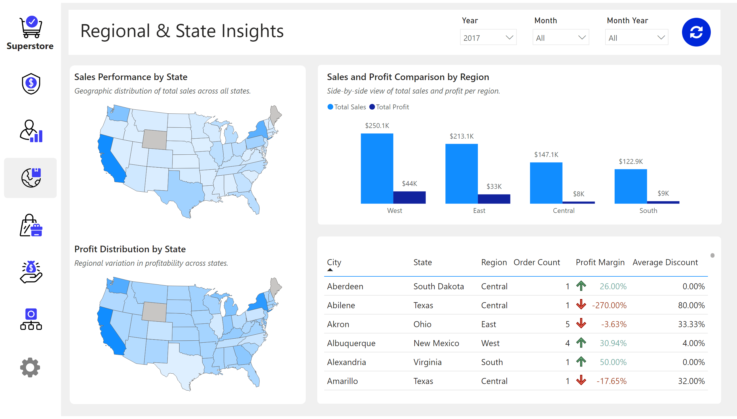
Regional & State Insights
Notes:
textbox
No alt text provided
shape
No alt text provided
Sales Performance by State
No alt text provided
Profit Distribution by State
No alt text provided
Sales and Profit Comparison by Region
No alt text provided
tableEx
No alt text provided
image
No alt text provided
image
No alt text provided
image
No alt text provided
image
No alt text provided
image
No alt text provided
image
No alt text provided
shape
No alt text provided
shape
No alt text provided
textbox
No alt text provided
image
No alt text provided
slicer
No alt text provided
slicer
No alt text provided
slicer
No alt text provided
image
No alt text provided
shape
No alt text provided
shape
No alt text provided
shape
No alt text provided
image
No alt text provided

Slide 5
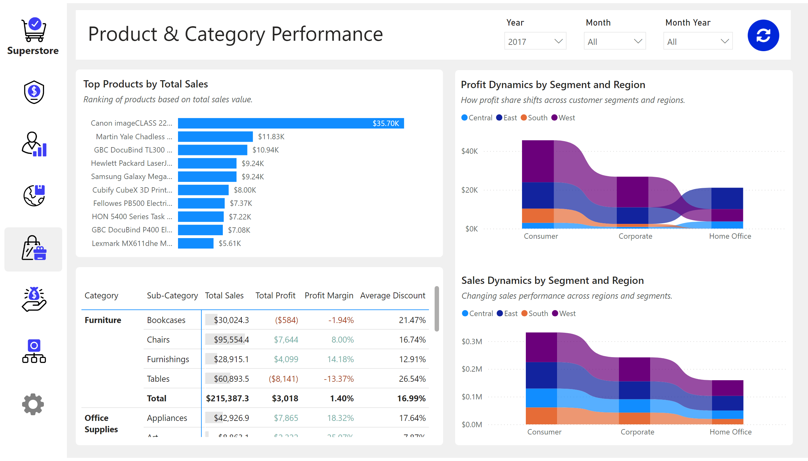
Product & Category Performance
Notes:
textbox
No alt text provided
shape
No alt text provided
Top Products by Total Sales
No alt text provided
pivotTable
No alt text provided
Sales Dynamics by Segment and Region
No alt text provided
Profit Dynamics by Segment and Region
No alt text provided
image
No alt text provided
image
No alt text provided
image
No alt text provided
image
No alt text provided
image
No alt text provided
image
No alt text provided
shape
No alt text provided
shape
No alt text provided
textbox
No alt text provided
image
No alt text provided
slicer
No alt text provided
slicer
No alt text provided
slicer
No alt text provided
image
No alt text provided
shape
No alt text provided
shape
No alt text provided
shape
No alt text provided
image
No alt text provided

Slide 6
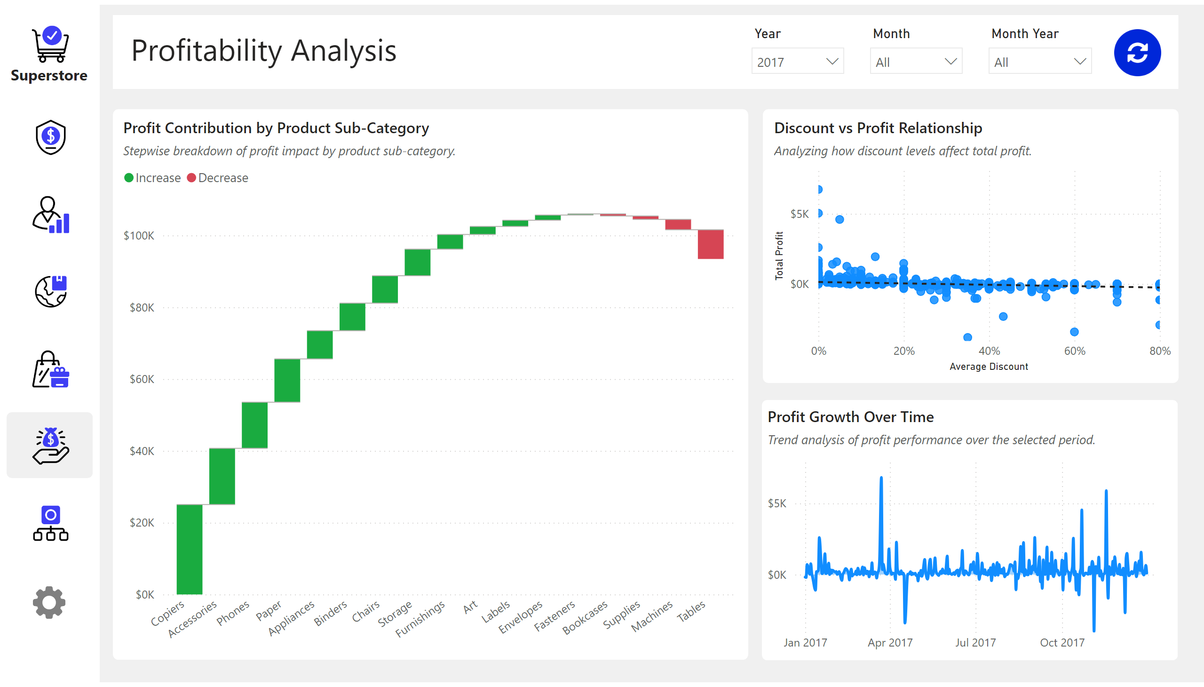
Profitability Analysis
Notes:
textbox
No alt text provided
shape
No alt text provided
Profit Contribution by Product Sub-Category
No alt text provided
Discount vs Profit Relationship
No alt text provided
Profit Growth Over Time
No alt text provided
image
No alt text provided
image
No alt text provided
image
No alt text provided
image
No alt text provided
image
No alt text provided
image
No alt text provided
shape
No alt text provided
shape
No alt text provided
textbox
No alt text provided
image
No alt text provided
slicer
No alt text provided
slicer
No alt text provided
slicer
No alt text provided
image
No alt text provided
shape
No alt text provided
shape
No alt text provided
shape
No alt text provided
image
No alt text provided

Slide 7
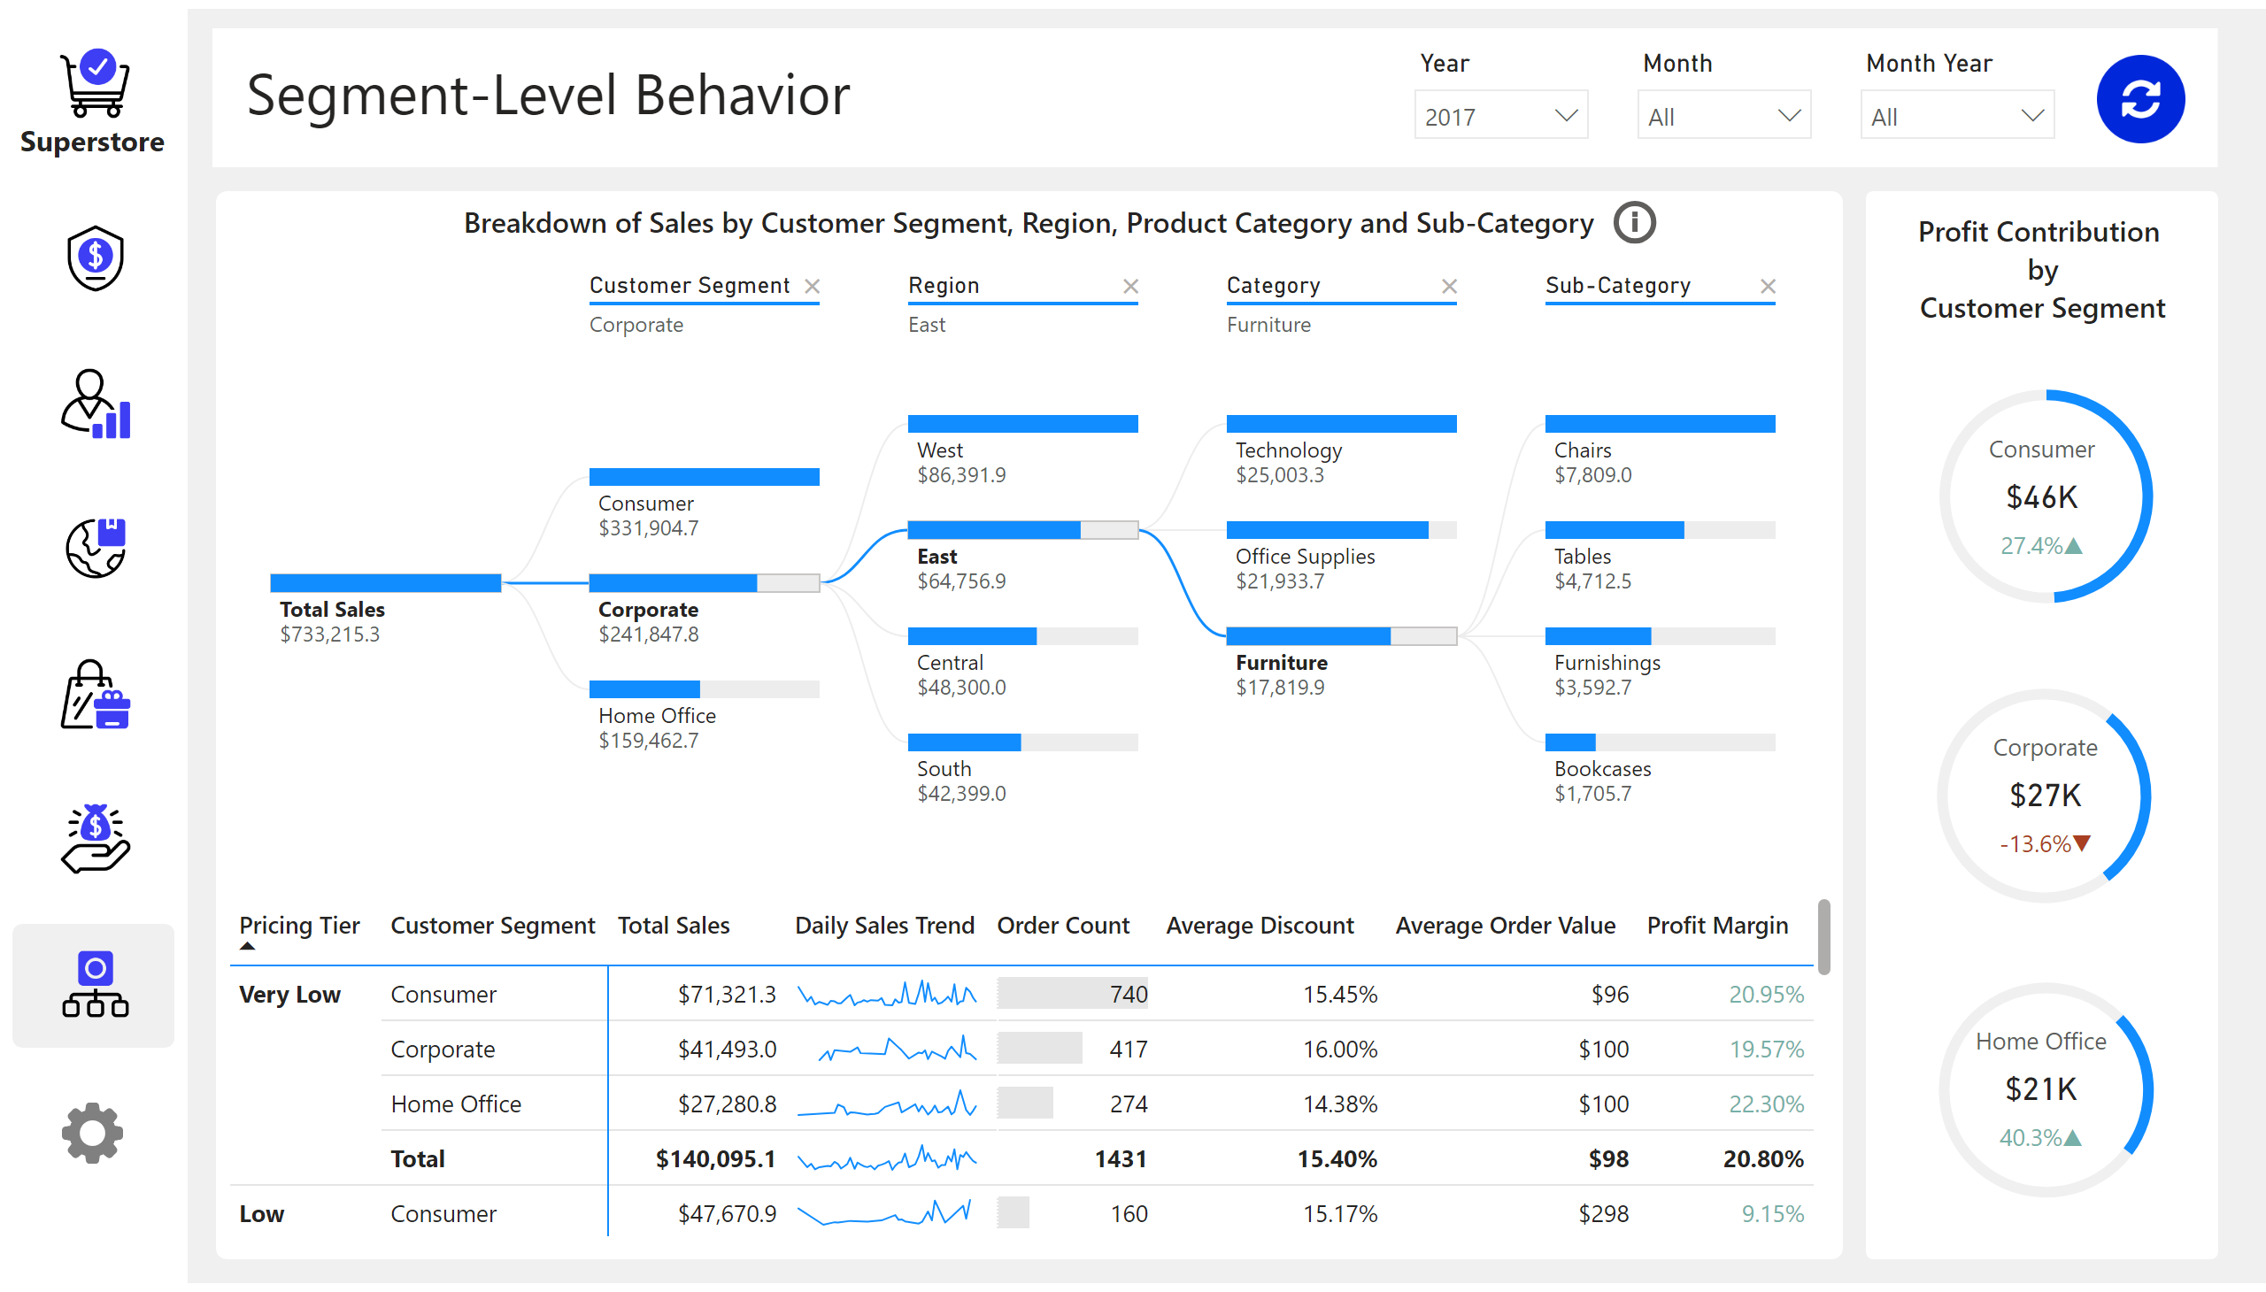
Segment-Level Behavior
Notes:
textbox
No alt text provided
shape
No alt text provided
donutChart
No alt text provided
donutChart
No alt text provided
donutChart
No alt text provided
textbox
No alt text provided
Breakdown of Sales by Customer Segment, Region, Product Category and Sub-Category
No alt text provided
pivotTable
No alt text provided
image
No alt text provided
image
No alt text provided
image
No alt text provided
image
No alt text provided
image
No alt text provided
image
No alt text provided
shape
No alt text provided
shape
No alt text provided
textbox
No alt text provided
image
No alt text provided
slicer
No alt text provided
slicer
No alt text provided
slicer
No alt text provided
image
No alt text provided
cardVisual
No alt text provided
cardVisual
No alt text provided
cardVisual
No alt text provided
shape
No alt text provided
shape
No alt text provided
image
No alt text provided
actionButton
No alt text provided

Slide 8
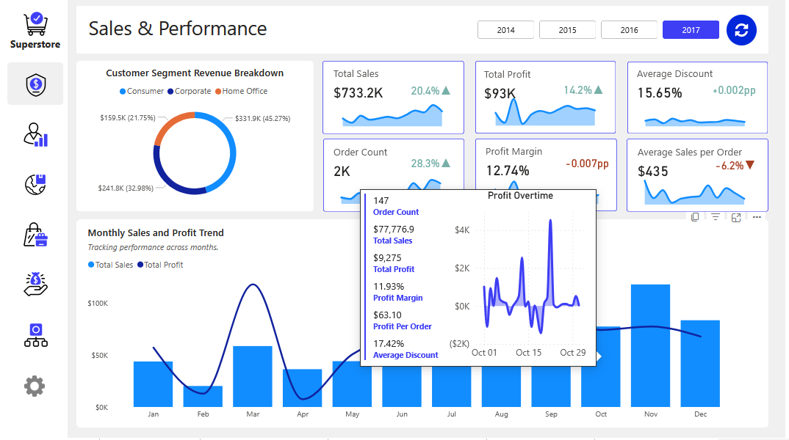
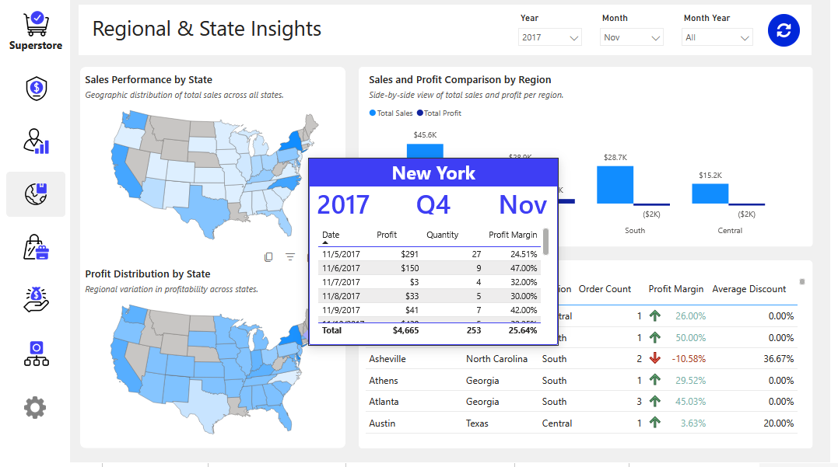
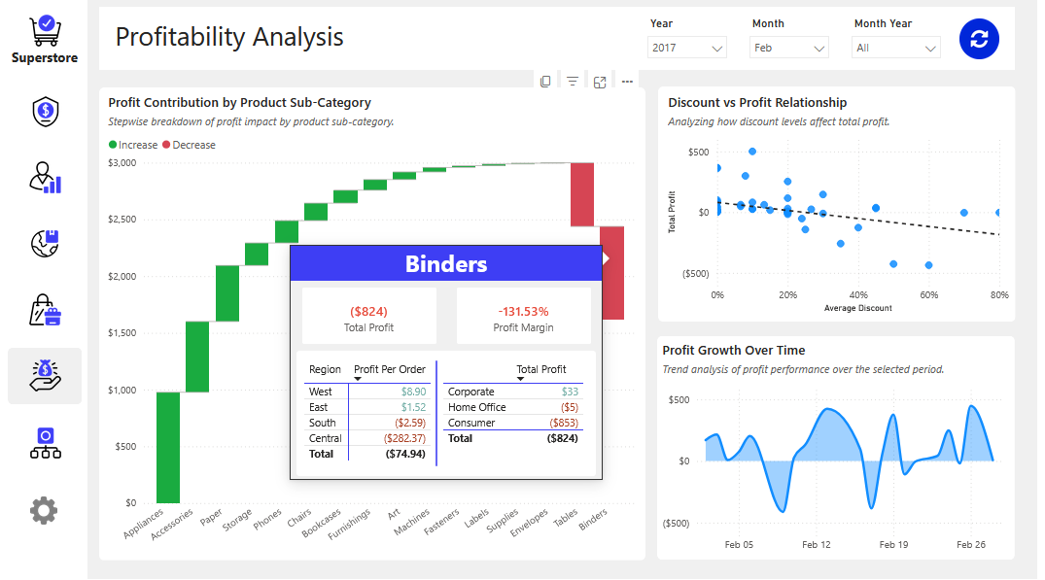
Report Tooltips

Slide 9
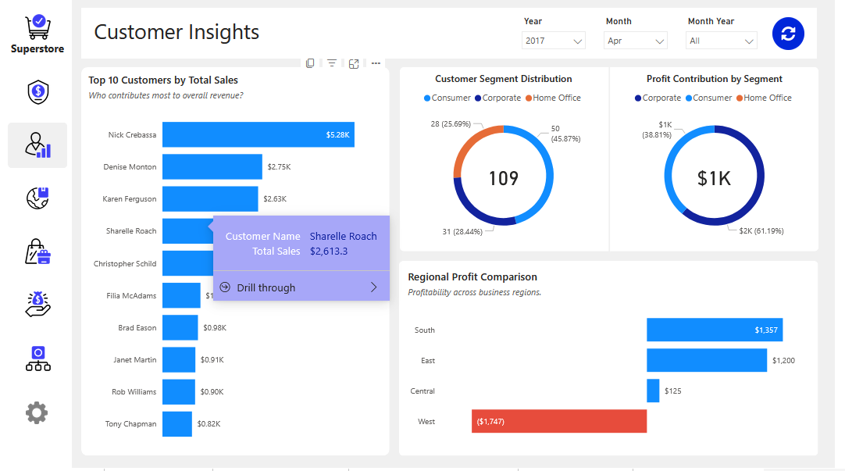
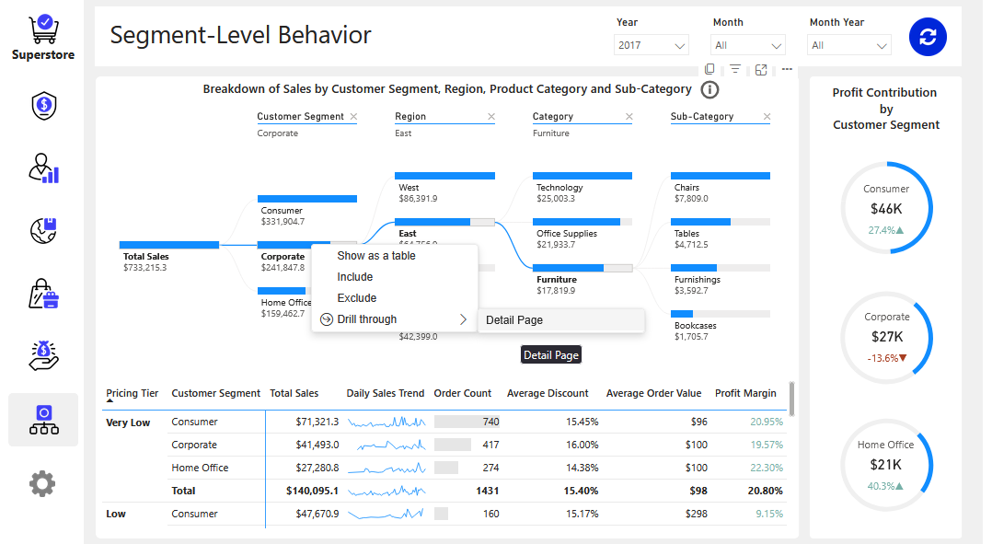
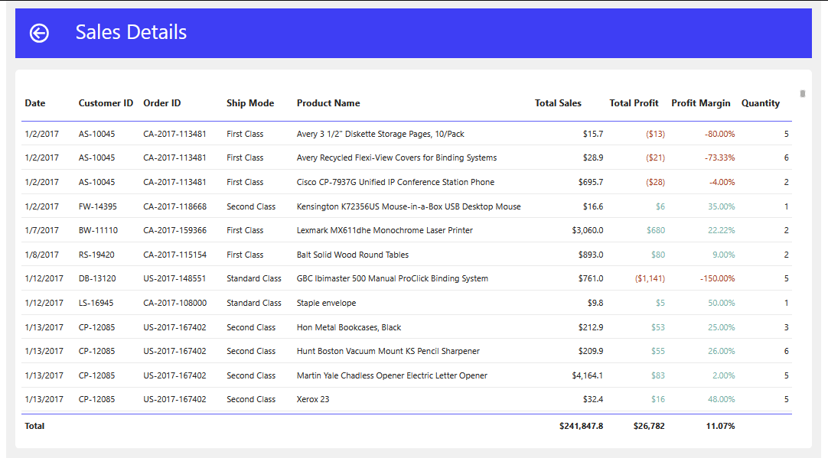
Report Drill Through

