Slide 1
Nutrition Application For Athletes
CSE7101- Capstone Project
Review-1 Batch Number: CIT-28
Roll Number Student Name
2021CIT0034 SYED ABDULLAH HUSSAINI 20221CIT0069 HARSHAVARDHAN 20221CIT0127 SHRISHA JAMAKHANDIKAR
Under the Supervision of,
MR. SAKTHIVEL E
Assistant Professor
School of Computer Science and Engineering
Presidency University
Name of the Program: B.TECH
Name of the HOD: DR. S P ANANDARAJ
Name of the Program Project Coordinator: DR. SHARMASTH VALI
Name of the School Project Coordinators: DR. SAMPATH A K , DR. GEETHA A

Slide 2
Content
Problem Statement
Objectives
Background and Related work for title Selection
Analysis of Problem Statement
Innovation or Novel Contributions
Git-hub Link
Timeline of the Project
References

Slide 3
Problem Statement Number: PSCS_543
Organization: Department of Computer Science and Engineering,
Presidency University Bangalore
Category: Software
Problem Description: Upcoming athletes lack access to affordable and personalized nutrition guidance, as professional services are costly and generic advice fails to meet sport-specific needs. This results in poor performance, higher injury risks, and slower recovery. Existing fitness apps focus on general wellness rather than athlete-oriented nutrition. A user-friendly digital platform is needed to provide tailored diet plans, supporting athlete health and SDG 2 – Zero Hunger.

Slide 4
Objectives
Develop Freemium Application
Create a user-friendly app offering free basic nutrition plans and premium advanced features for athletes.
Provide Personalized Nutrition Plans
Generate diet charts tailored to age, body type, sport category, and training intensity.
Integrate AI-Powered Recommendations
Use AI/ML to align nutrition with training load, recovery needs, and performance goals.
Enhance Nutrition Awareness
Educate athletes about the importance of diet in performance, recovery, and overall health.
Support SDG 2 – Zero Hunger
Promote sustainable nutrition practices and contribute toward global hunger awareness initiatives.

Slide 5
Background and Related work for title Selection
Background
Athletes require personalized diet plans to support training, recovery, and performance.
Traditional consultations are costly and lack scalability.
Existing nutrition apps mainly focus on calorie counting, not athlete-specific needs.
AI/ML now enables predictive nutrition models for tailored diet planning.
Related Work
MyFitnessPal – Popular calorie-tracking app, but lacks athlete-specific personalization.
HealthifyMe – Provides AI-based diet suggestions, but limited focus on sports nutrition.
Gap Identified
No dedicated freemium platform offering AI-driven, athlete-focused nutrition planning with awareness features.

Slide 6
Analysis of Problem Statement
Nutritional imbalance and deficiencies remain a persistent issue despite global advances in
food production. The problem exists because individuals often lack awareness of their dietary
needs, and food choices are increasingly influenced by urban lifestyles, processed foods, and
convenience-driven habits. Moreover, cultural food practices, misinformation, and inadequate
access to reliable nutritional data contribute to poor dietary planning. This leads to rising cases
of obesity, diabetes, and micronutrient deficiencies across diverse populations. Without timely
intervention, these issues can escalate into long-term public health challenges and economic
burdens.

Slide 7
Analysis of Problem Statement (contd...)
Scope
Covers all age groups, with focus on children, adolescents, pregnant women, and elderly.
Addresses nutritional deficiencies (vitamin/mineral gaps), overnutrition (obesity, lifestyle diseases), and malnutrition.
Involves dietary planning, nutrient tracking, and personalized recommendations based on health data.
Extends to both urban populations (processed food habits) and rural communities (access to balanced diets).
Can integrate with digital health tools (apps, wearable devices, AI-based recommendation systems).

Slide 8
Analysis of Problem Statement (contd...)
Implications
Health-related: Poor nutrition leads to obesity, diabetes, cardiovascular diseases, weakened immunity, and developmental issues.
Psychological: Nutritional imbalance affects mood, cognitive performance, stress, and fatigue.
Economic: Increases healthcare costs, reduces workforce productivity, and impacts national health expenditure.
Social: Worsens inequality where vulnerable groups face higher risks due to lack of access to proper diet.
Global: Impacts sustainability goals (SDG 2 – Zero Hunger, SDG 3 – Good Health and Well-Being).

Slide 9
Innovation or Novel Contributions
Freemium Model
Offers free basic dietary recommendations while providing advanced analytics and personalized features under a premium plan.
AI-Powered Diet Generator
Creates personalized meal plans based on training load, sport type, and individual physique.
Training-Nutrition Synchronization
Aligns diet recommendations with workout cycles to maximize performance and recovery.
SDG Integration (SDG 2 & 3)
Supports Zero Hunger by raising awareness about food security and promotes Good Health & Well-being through improved nutrition planning.

Slide 10
Github Link
GITHUB REPOSITORY LINK:
https://github.com/Izumiiiii17/CIT-28-Capstone-Project

Slide 11
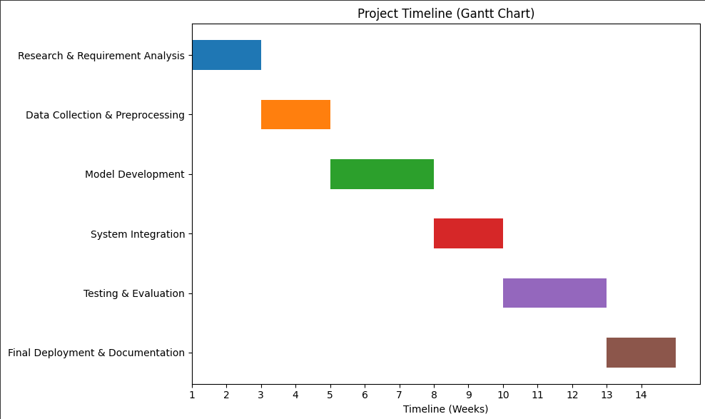


Timeline of the Project (Gantt Chart)

Slide 12
References (IEEE Paper format)
International Journal of Sport Nutrition and Exercise Metabolism, Human Kinetics Journals. [Online]. Available: https://journals.humankinetics.com/view/journals/ijsnem/ijsnem-overview.xml
World Health Organization, Nutrition and Health Guidelines for Athletes. Geneva: WHO, 2006. [Online]. Available: https://www.who.int/publications
United Nations Development Programme (UNDP), Sustainable Development Goal 2: Zero Hunger. [Online]. Available: https://www.undp.org/sustainable-development-goals/zero-hunger
United Nations, Transforming our World: The 2030 Agenda for Sustainable Development. New York: UN, 2015. [Online]. Available: https://sdgs.un.org/2030agenda
United Nations, Sustainable Development Goals (SDGs). [Online]. Available
https://sdgs.un.org/goals

Slide 13


