Slide 1
Nutrition Application For Athletes
CSE7101- Capstone Project
Review-2 Batch Number: CIT-28
Roll Number Student Name
2021CIT0034 SYED ABDULLAH HUSSAINI 20221CIT0069 HARSHAVARDHAN 20221CIT0127 SHRISHA JAMAKHANDIKAR
Under the Supervision of,
MR. SAKTHIVEL E
Assistant Professor
School of Computer Science and Engineering
Presidency University
Name of the Program: B.TECH
Name of the HOD: DR. S P ANANDARAJ
Name of the Program Project Coordinator: DR. SHARMASTH VALI
Name of the School Project Coordinators: DR. SAMPATH A K , DR. GEETHA A

Slide 2
Content
Abstract
Literature Survey
Objectives
Existing Method & Drawbacks
Proposed Method & Feasibility Study
Architecture Diagram
Modules
Software Details
Timeline (Gantt Chart)
References

Slide 3
Abstract
Upcoming athletes face challenges in accessing affordable and personalized nutrition guidance, as professional diet services are costly and general fitness apps fail to address sport-specific needs. This project proposes the development of a freemium mobile application that generates AI-powered, personalized diet plans based on age, sport, body type, and training intensity. The solution synchronizes nutrition with training cycles, promotes nutrition awareness, and supports Sustainable Development Goals (SDG 2: Zero Hunger, SDG 3: Good Health & Well-being). The application will be developed using modern mobile and AI technologies, with a scalable architecture and user-friendly design, ensuring accessibility and feasibility for a wide range of athletes.

Slide 4
Literature Survey – Part 1
Note : These reviews and methodology papers show ML and mobile apps are effective for general nutrition monitoring, but they commonly lack athlete-focused personalization and integration with training cycles.
Paper (short ref) | Key contribution | Limitation
Machine Learning in Nutrition Research — Kirk et al., 2022. PubMed Central | Overview of ML applications in nutrition research and practical guidance for implementing ML in dietary studies. | High-level; focuses on research methods rather than production mobile apps for athletes.
Quality, Usability, and Effectiveness of mHealth Apps — Deniz-Garcia et al., 2023. PubMed Central | Systematic review showing app-based interventions can influence nutrition behaviours and outcomes. | Heterogeneous studies; many apps lack personalization for athlete-specific needs.
A Focused Review of Smartphone Diet-Tracking Apps — Ferrara et al., 2019 (JMIR). JMIR mHealth and uHealth | Assesses popular diet-tracking apps — good usability and calorie coding accuracy. | Most apps are calorie-focused and not designed for sport-specific performance needs.
Mobile Apps for Dietary and Food Timing Assessment — Gioia et al., 2023. PubMed Central | Evaluates apps usable for research and clinical assessment of food timing and diet patterns. | Useful for researchers, but lacks athlete-specific diet prescription and training synchronization.

Slide 5
Literature Survey – Part 2
Note Foundational sports nutrition literature provides authoritative guidelines, but these are static. Integrating them into an adaptive AI system that takes real-time training and individual data into account is still an open opportunity.
Paper (short ref) | Key contribution | Limitation
Current Knowledge about Sports Nutrition — Pramuková et al., 2011. PubMed Central | Reviews sports nutrition basics: energy systems, timing, supplements, athlete-specific strategies. | Foundational but not adaptive or AI-driven.
Nutrition Guidelines for Strength Sports — Slater & Phillips, 2011. Taylor & Francis Online | Detailed recommendations for strength-power athletes (macros, timing). | Discipline-specific; static guidelines — need personalization for individual training cycles.
IOC / Olympic sports nutrition resources — Olympic/IOC material (encyclopaedia). Olympics | Authoritative practice guidance for athlete nutrition strategies and planning. | Practical guidance, not algorithmic or mobile-based personalization.

Slide 6
Literature Survey – Part 3
Note : Recent reviews show AI can create personalized dietary interventions and mobile apps can integrate wearables — but implementation for athlete performance (timing with training loads) is underexplored.
Paper (short ref) | Key contribution | Limitation
Athletes' Nutritional Demands: A Narrative Review — Amawi et al., 2024. PubMed Central | Summarizes macronutrient/micronutrient needs, timing and recovery nutrition specific to athletes. | Clinical/physiological focus — does not propose AI or app-based personalized systems.
Artificial Intelligence Applications to Personalized Dietary Interventions — Wang et al., 2025 (systematic review). PubMed Central | Reviews AI-generated dietary interventions and evidence of clinical impact. | Emerging evidence — many AI interventions are still early-stage and require larger trials.
Mobile Applications & AI for Nutrition (review) — Nogueira-Rio et al., 2024 (MDPI). MDPI | Discusses apps + wearables + AI integration and future directions for personalized nutrition. | Identifies gaps in sports-specific adaptations and real-time training synchronization.

Slide 7
Objectives
Develop Freemium Application
Create a user-friendly app offering free basic nutrition plans and premium advanced features for athletes.
Provide Personalized Nutrition Plans
Generate diet charts tailored to age, body type, sport category, and training intensity.
Integrate AI-Powered Recommendations
Use AI/ML to align nutrition with training load, recovery needs, and performance goals.
Enhance Nutrition Awareness
Educate athletes about the importance of diet in performance, recovery, and overall health.
Support SDG 2 – Zero Hunger
Promote sustainable nutrition practices and contribute toward global hunger awareness initiatives.

Slide 8
Existing Methods And Drawbacks
ML-based Diet Recommendation (Kirk et al., 2022)
  Contribution: Showed feasibility of ML in nutrition research.
  Drawback: Research-focused; not implemented in athlete-specific apps.
mHealth App Reviews (Deniz-Garcia et al., 2023; Ferrara et al., 2019)
  Contribution: Mobile apps effective for tracking diet & behaviour change.
  Drawback: Apps mostly calorie-focused; lack sport-specific personalization.
Athlete Nutrition Guidelines (Amawi et al., 2024; WHO/IOC)
  Contribution: Provide evidence-based nutrition needs for athletes.
  Drawback: Static guidelines; do not adapt to individual or training cycles.
AI-based Personalized Diet Systems (Wang et al., 2025; Nogueira-Rio et al., 2024)
  Contribution: AI interventions show promise in tailoring diets.
  Drawback: Still emerging; limited real-world implementation for sports.

Slide 9
Proposed Innovative Solution
Freemium Model
Offers free basic dietary recommendations while providing advanced analytics and personalized features under a premium plan.
AI-Powered Diet Generator
Creates personalized meal plans based on training load, sport type, and individual physique.
Training-Nutrition Synchronization
Aligns diet recommendations with workout cycles to maximize performance and recovery.
SDG Integration (SDG 2 & 3)
Supports Zero Hunger by raising awareness about food security and promotes Good Health & Well-being through improved nutrition planning.

Slide 10
Justification & Uniqueness
1. Gap from Literature:
  Apps = calorie trackers, no athlete focus.
  Guidelines = static, not personalized.
  AI systems = early stage, no training sync.
2. Our Solution vs Existing Methods:
  Combines AI + Sports Guidelines + Training Data → holistic approach.
  Accessible (freemium model) → benefits both amateur and professional athletes.
  Scalable → can integrate wearables (smartwatches, fitness trackers) in future.
Key Justification:
Athletes need dynamic nutrition, not one-size-fits-all.
Affordable → upcoming athletes can access plans without costly dieticians.
Educational → improves awareness, not just diet charts.

Slide 11
Feasibility Analysis
Technology Feasibility
Frontend: React.js → dynamic, component-based web application.
Styling/UI: Tailwind CSS → responsive & mobile-friendly design.
Backend: Node.js with Express.js → scalable REST APIs.
AI/ML Engine: Python with TensorFlow, Scikit-learn, Pandas, NumPy.
Database: MongoDB Atlas → cloud-hosted, flexible for user profiles & diet plans.
APIs & Data Sources: Nutrition APIs (Edamam / Open Food Database) + WHO / IOC athlete nutrition guidelines.
Resource Feasibility
Team Skills Required:
  Frontend development (React.js & Tailwind)
  Backend integration (Node.js + Express)
  AI/ML modeling & API integration (Python + FastAPI)
Tools: GitHub (version control), Figma (UI design), Jupyter / VS Code (AI development)
Timeline Fit: Full development + testing achievable within a semester project schedule.

Slide 12
Modules
1. User Profile Module
Collects athlete details: age, gender, body type, sport category, training intensity.
Stores dietary preferences: veg/non-veg, allergies, cultural constraints.
Provides base data for personalization.
2. Nutrition Recommendation Module
Core AI/ML engine generates diet charts.
Uses sports guidelines + athlete data.
Adjusts calorie, macro, and micronutrient needs dynamically.
3. Training–Nutrition Synchronization Module
Links training load (frequency, duration, recovery days) with diet.
Provides meal timing guidance (pre-training, intra-training, post-training).
Reduces injury and boosts recovery.

Slide 13
Modules
4. Awareness & Education Module
Provides tips, resources, and SDG awareness.
Helps athletes understand the role of nutrition in long-term performance.
Includes gamified learning (quizzes, infographics).
5. Freemium/Premium Module
Freemium: free basic nutrition plans + awareness.
Premium: advanced analytics, progress tracking, wearable integration.
Ensures affordability while sustaining the app.
GITHUB REPOSITORY LINK:
https://github.com/Izumiiiii17/CIT-28-Capstone-Project

Slide 14
Software And Technology Details
1. Frontend (Web Application)
Framework: React.js
Styling: Tailwind CSS (responsive & mobile-friendly)
UI/UX Design: Figma (wireframing & prototyping)
2. Backend & Database
Backend: Node.js with Express.js (REST APIs)
Database: MongoDB (cloud-hosted on MongoDB Atlas)
Authentication: JWT (token-based authentication)
3. AI/ML Engine
Libraries/Frameworks: TensorFlow, Scikit-learn, Pandas, NumPy
API Integration: FastAPI (serves ML models to backend)

Slide 15
Software And Technology Details
4. APIs & Data Sources
Nutrition Data: Edamam API / Open Food Database
Reference Guidelines: WHO & IOC athlete nutrition datasets
5. Version Control & Deployment
Version Control: GitHub
Frontend Hosting: Vercel
Backend + ML API Hosting: AWS
Database Hosting: MongoDB Atlas

Slide 16
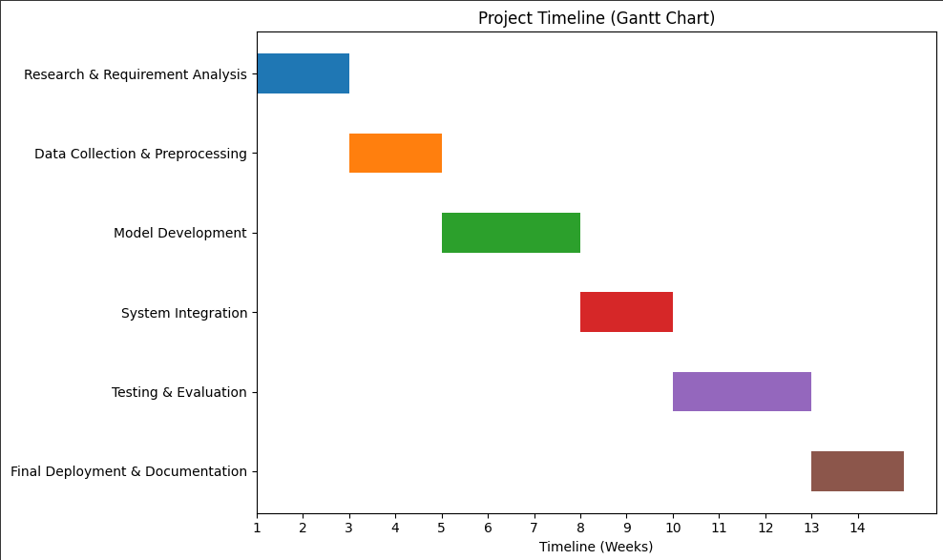


Timeline of the Project (Gantt Chart)

Slide 17
References (IEEE Paper format)
D. Kirk et al., Machine Learning in Nutrition Research, Nutrition Reviews / PMC (2022). PubMed Central
A. Deniz-Garcia et al., Quality, Usability, and Effectiveness of mHealth Apps and … (Systematic review), PMC (2023). PubMed Central
G. Ferrara et al., A Focused Review of Smartphone Diet-Tracking Apps, JMIR (2019). JMIR mHealth and uHealth
S. Gioia et al., Mobile Apps for Dietary and Food Timing Assessment, PMC (2023). PubMed Central
A. Amawi et al., Athletes’ Nutritional Demands: a narrative review (2024). PubMed Central
X. Wang et al., Artificial Intelligence Applications to Personalized Dietary … (2025). PubMed Central
N. Nogueira-Rio et al., Mobile Applications and Artificial Intelligence for Nutrition (MDPI 2024). MDPI
B. Pramuková et al., Current knowledge about sports nutrition (2011). PubMed Central
G. Slater & Phillips, Nutrition guidelines for strength sports (2011). Taylor & Francis Online
IOC / Olympic sports nutrition encyclopaedia / guidance. Olympics

Slide 18


