Slide 1
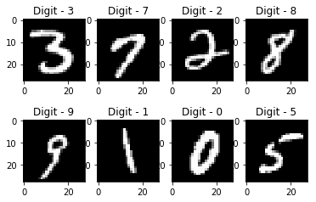
Neural Computing System for Handwritten Digit Recognition
Course: Artificial Neural Network | BSAI F23 Red
Presented by: Izza Iqbal, Noor Bahu, Muhammad Omer Saeed
Submitted to: Dr. Abid

Slide 2


Project Overview & Objectives
What is This Project?
Four Neural Models Implemented:
Goal: Build a complete system to recognize handwritten digits from 0 to 9
Perceptron (1958) - Simple binary classifier
Adaline (1960) - Gradient descent learner
Kohonen SOM (1982) - Unsupervised clustering
MLP with Backpropagation (1986) - Deep learning
Dataset Used: MNIST
70,000 images of handwritten digits
Each image 28 × 28 pixels
60,000 for training, 10,000 for testing
Key Point: All models built from scratch using ONLY NumPy

Slide 3


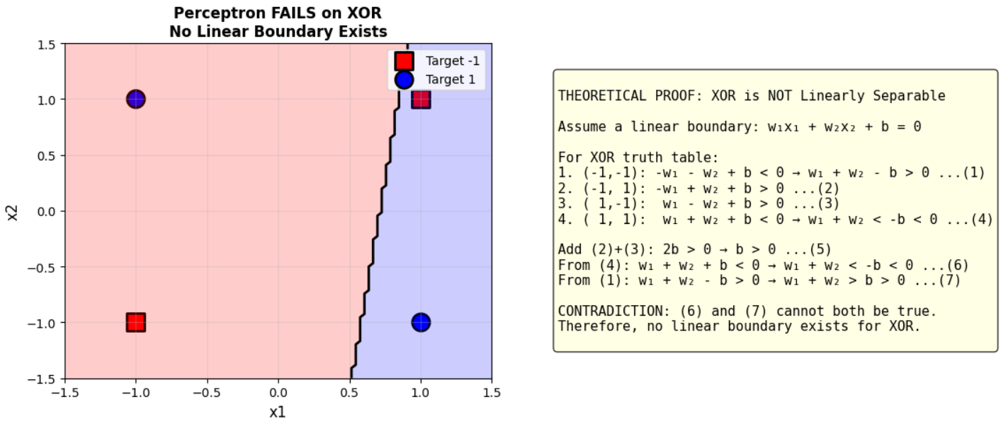

Part A - Perceptron Model
What is Perceptron?
Inspired by Biological Neuron
The Mathematics
Net input = sum of (weight × input) + bias. Output = +1 if net input ≥ 0, Output = -1 if net input < 0
Inputs receive signals like dendrites, weights act like synapses, summation happens in soma, output fires through axon
Learning Rule
New weight = old weight + learning rate × (target - prediction) × input
What We Trained: Digits 0 versus 1 | Result: 100% accuracy achieved in only 6 epochs

Slide 4
Perceptron Limitation - XOR Problem
Why Perceptron Cannot Do Everything
XOR Truth Table
The Problem
Input 1
Input 2
Output
No single straight line can separate these four points. Try drawing any line - you will always misclassify at least one point.
-1
-1
-1
-1
+1
+1
+1
-1
+1
+1
+1
-1
Mathematical Proof
Result
Lesson
Assume a linear boundary exists, write equations for all four points, you get a contradiction - therefore no solution exists
Perceptron got only 50% accuracy on XOR - that is random guessing!
Single-layer networks cannot solve non-linear problems

Slide 5




Part B - Adaline and Delta Rule
What is Adaline?
Adaline = Adaptive Linear Neuron
Linear Activation
Continuous Updates
Gradient Descent
Uses linear activation during training instead of step function
Updates weights on EVERY sample, not just misclassified ones
Minimizes Mean Squared Error using gradient descent
The Delta Rule Derivation (Simple Words)
01
02
Define error = half of sum of squared differences
Take derivative using chain rule
03
04
Result is negative of (target - prediction) times input
Apply gradient descent to update weights
Final Formula: Change in weight = learning rate × (target - prediction) × input. This is called the Widrow-Hoff learning rule

Slide 6
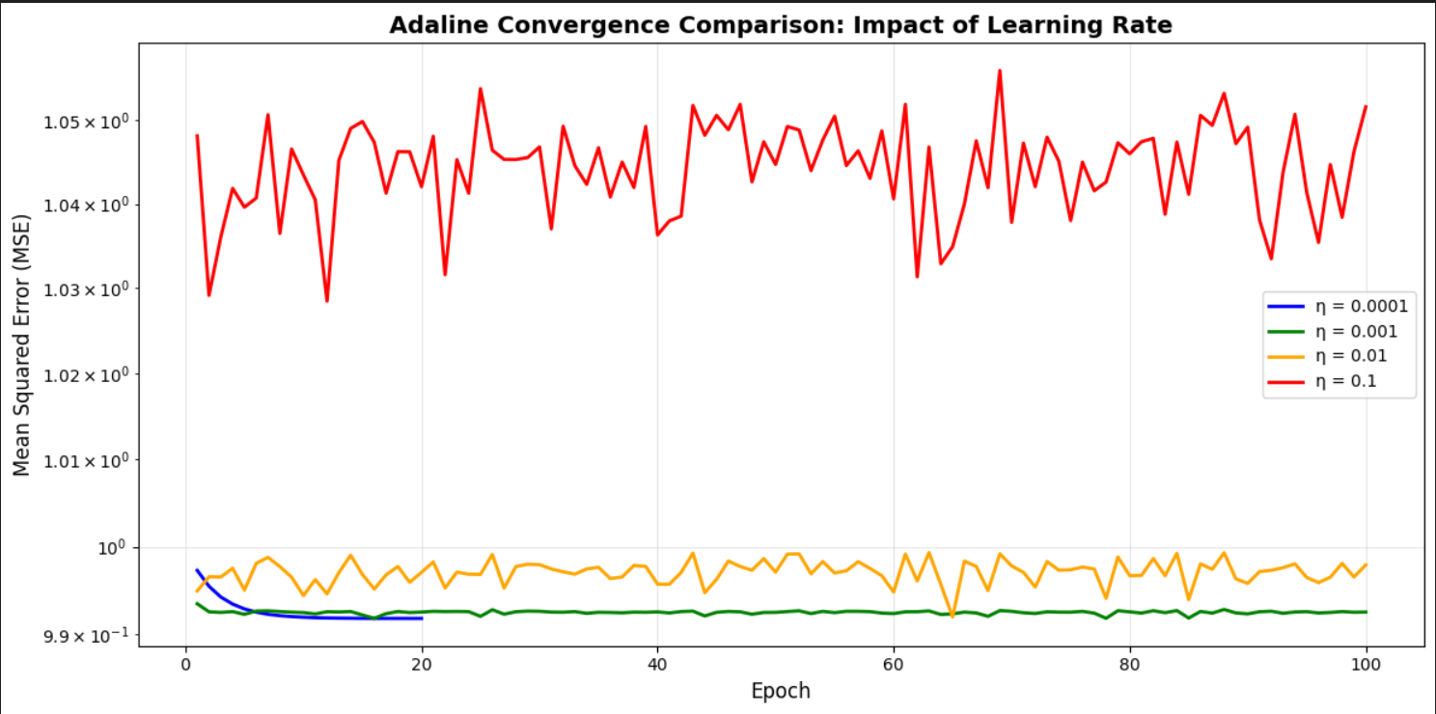
Adaline - Learning Rate Analysis
What Happens with Different Learning Rates?
Learning rate controls how fast the model learns
0.0001 - Very Slow
Takes many epochs to converge
Very stable but inefficient
0.001 - Optimal
Best balance of speed and stability
Smooth convergence to minimum
THIS IS WHAT WE RECOMMEND
0.01 - Fast but Risky
Converges quickly
Shows small oscillations
May overshoot the minimum
0.1 - Too Fast
Very unstable
May diverge completely
NOT RECOMMENDED
Visualization: The 3D plot shows loss surface as a convex bowl. Red path shows gradient descent moving downhill. We start at random weights and reach the minimum.

Slide 7
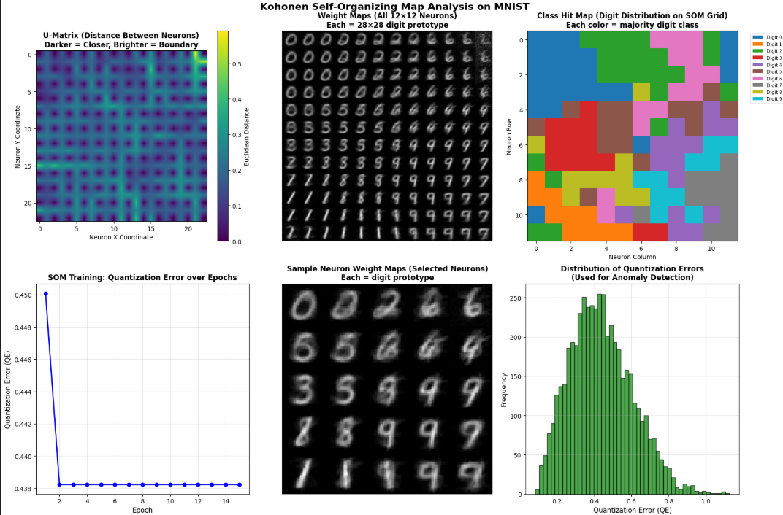
Part C - Kohonen Self-Organizing Map
What is SOM?
Unsupervised Learning - No labels needed
Architecture
Training Process
Input layer: 784 neurons (one for each pixel)
Grid: 12 × 12 = 144 neurons arranged in 2D
Each neuron has its own weight vector
Find the Best Matching Unit (BMU)
Update the BMU and its neighbors
BMU learns the most, nearby neurons learn a little
1
Step 1: Find BMU
BMU = neuron whose weights are most similar to input
2
Step 2: Update Neighbors
BMU learns the most, nearby neurons learn a little, far neurons do not learn
3
Decaying Parameters
Learning rate and neighborhood radius decrease over time

Slide 8
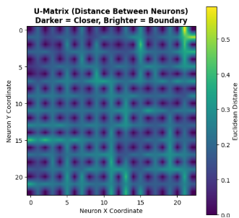
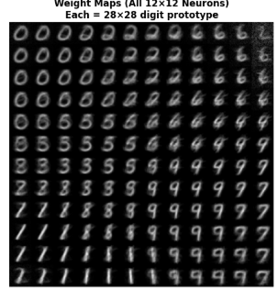
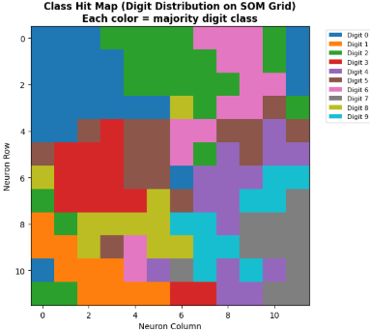


SOM Visualizations and Results
What the SOM Shows Us
U-Matrix Visualization
Weight Maps
Class Hit Maps
Dark areas = clusters of similar digits, bright lines = boundaries between different digits
Each neuron's weights reshaped to 28×28 image, shows what digit pattern that neuron represents
Color coded grid, each color represents a different digit, shows which digit activates which neuron
Quality Metrics We Computed
0.25
4.12%
Quantization Error
Topographic Error
Measures how well inputs map to neurons. Lower is better.
Measures if nearby inputs map to nearby neurons. Lower is better.
Anomaly Detection
We set threshold at 95th percentile of error. Normal digits have low error, corrupted digits have high error.
87%
85%
Precision
Recall

Slide 9



Part D - Backpropagation MLP
What is Multi-Layer Perceptron?
Our Architecture: 784 → 128 → 64 → 10
Forward Pass
Input: 784 pixels from the image
Hidden Layer 1: 128 neurons
Hidden Layer 2: 64 neurons
Output: 10 neurons (one for each digit 0 to 9)
Input moves through hidden layers, each layer multiplies by weights and adds bias, ReLU activation function applied
Backward Pass (How learning happens)
Update Weights
Propagate Backward
Update all weights in the network
Calculate Error
Propagate error backward using chain rule
Calculate error at output layer
Activation Function Comparison
Sigmoid
Tanh
ReLU
Derivative is very small - vanishes for large inputs
Better than sigmoid but still saturates
No vanishing gradient - simply zero for negatives, identity for positives
We chose ReLU because it works best

Slide 10

Results, Comparison & Conclusion
Final Results of All Four Models
Perceptron
Adaline
Binary classification: 100% accuracy
Successfully learned using gradient descent
XOR problem: Only 50% (failed)
Optimal learning rate found: 0.001
Kohonen SOM
MLP
Quantization Error: 0.25
Final test accuracy: 98.48%
Topographic Error: 4.12%
Exceeded our target of 95%
Anomaly detection F1-score: 86%
Critical Comparison
Model
Strengths
Weaknesses
Perceptron
Simple, fast
Only linear problems
Adaline
Gradient descent, smooth
Still single layer
SOM
Unsupervised, topology
No explicit loss
MLP
Universal approximation
Needs more data and time

