Slide 1
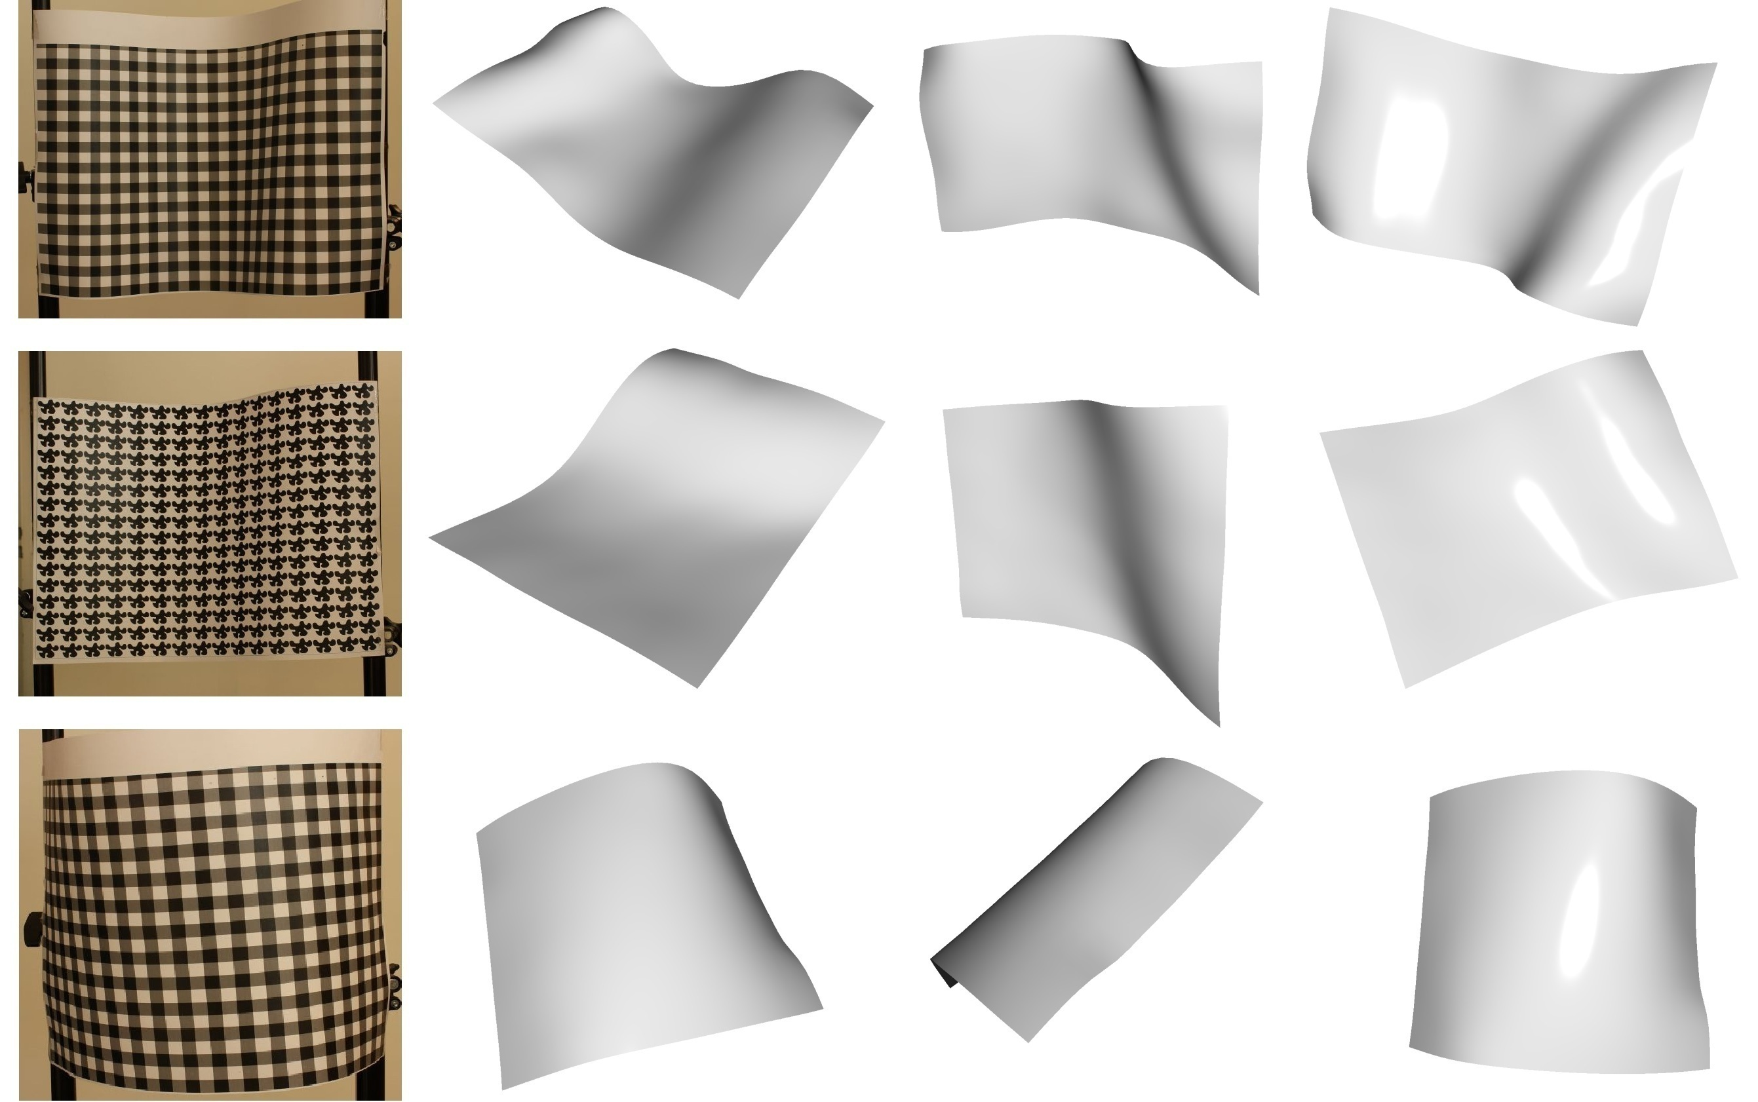
Shape from Texture
Notes:
Project deals with estimating 3 dimensional surface from 2 dimensional texture images. It’s a very important problem in computer vision as it is a part of a much bigger task of object recognition and object modeling for graphics.

Slide 2
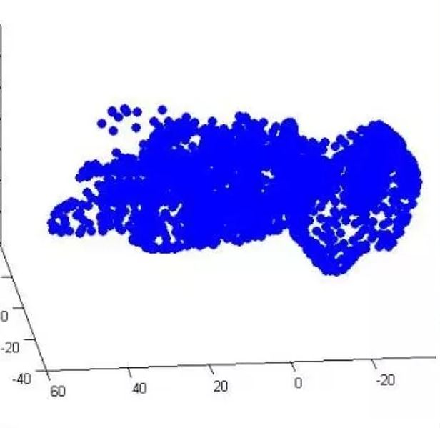
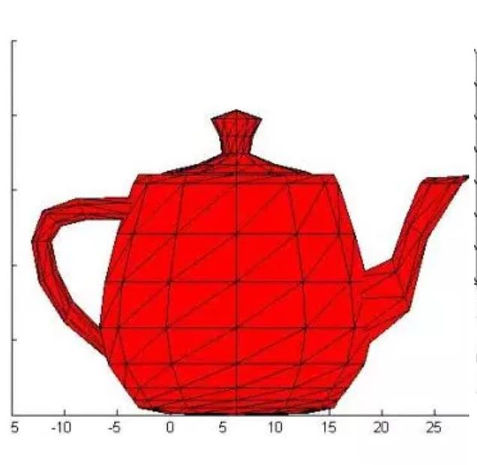
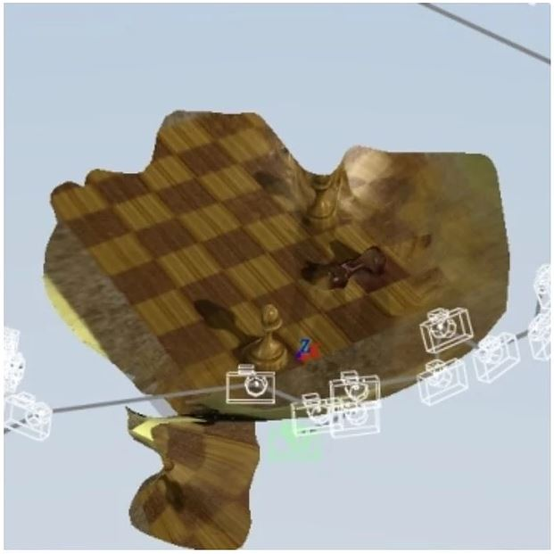
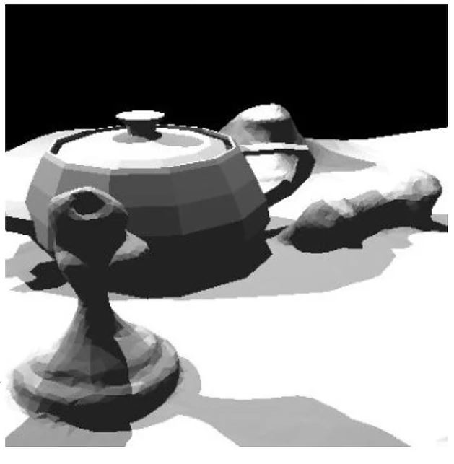
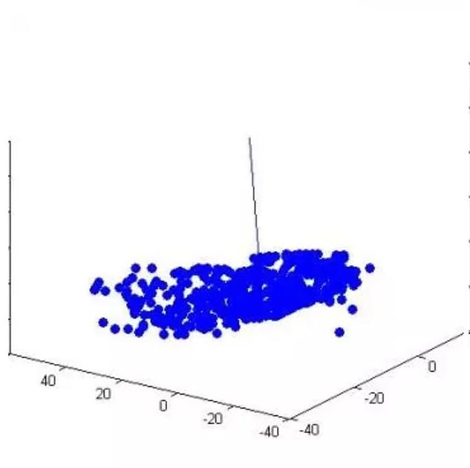
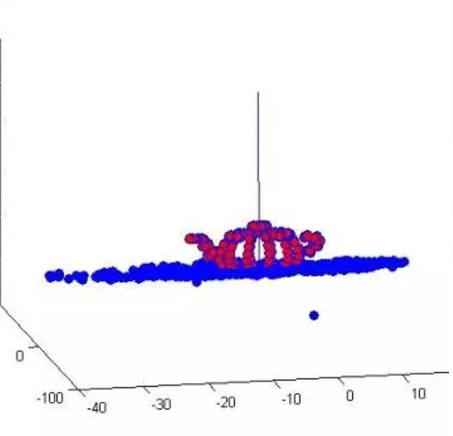
3D Scene Understanding – Undergrad project

Slide 3
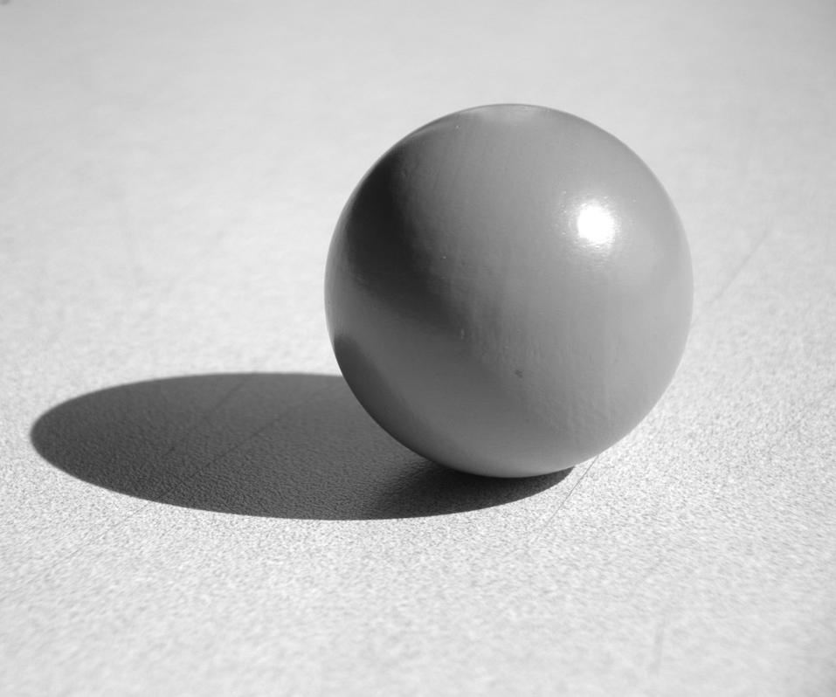
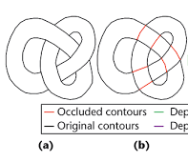
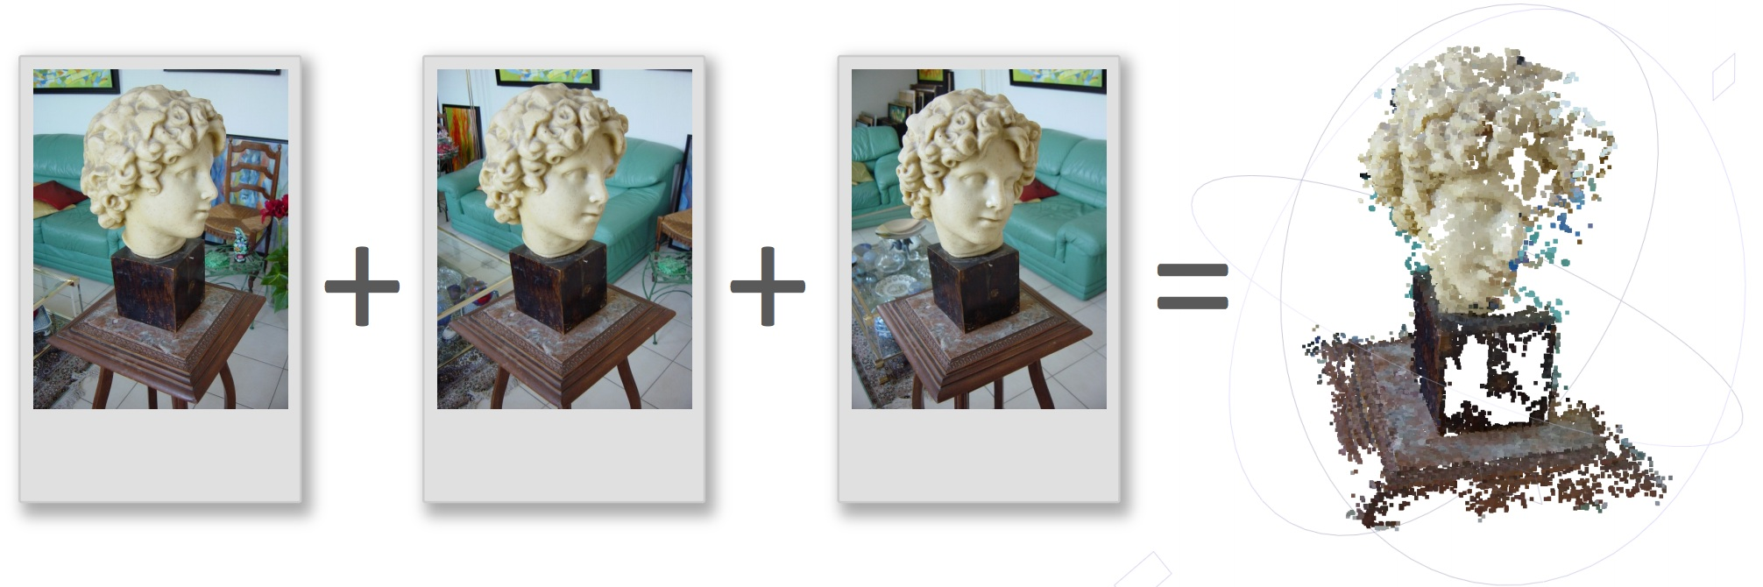
Visual Cues that provide 3D shape information
Shading
Occluding contours
Photogrammetry

Slide 4
Problem
Given a digital image of a textured surface, this program will automatically do the following:
Calculate the orientation parameters p and q
Calculate surface normal
Generate 3D Mesh surface
Input = digital image composed of texels
Output = orientation parameters / 3D mesh

Slide 5
Assumptions and Constraints
Discrete geometric texture elements (texels)
Texture homogeneity
Texture stationarity
Equal sized texels
No border
Orthographic view
Slight blur and illumination allowed
Notes:
Equal density: the amount of surface texture per unit area is
about the same in all surface regions (i.e., surface
texture is homogeneous),

Slide 6
Definitions of Terms
Frontal texel
Slant and tilt angles
Fourier transform
Gaussian window

Slide 7
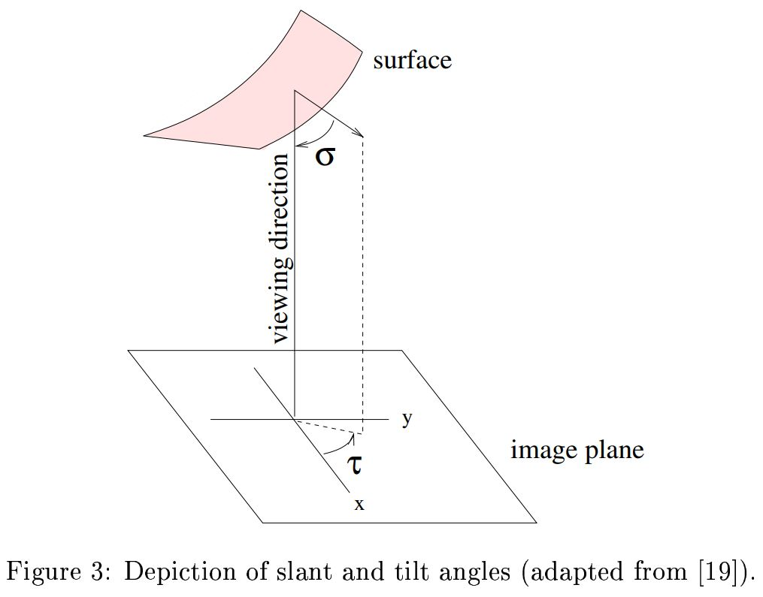
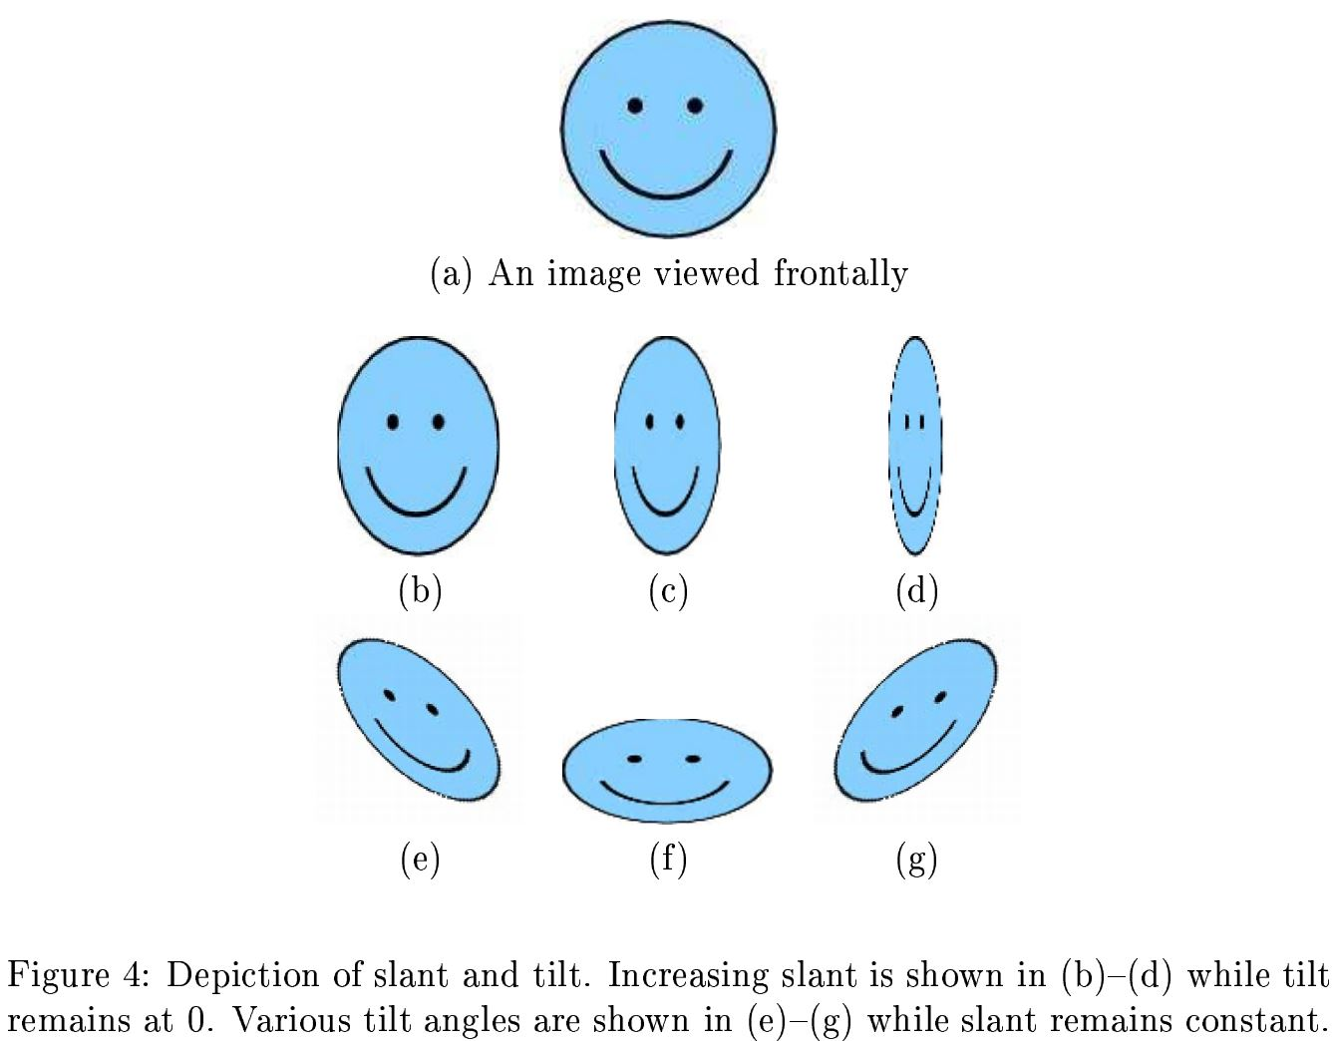
Definitions of Terms – frontal, slant, tilt
σ – slant angle
τ – tilt angle

Slide 8
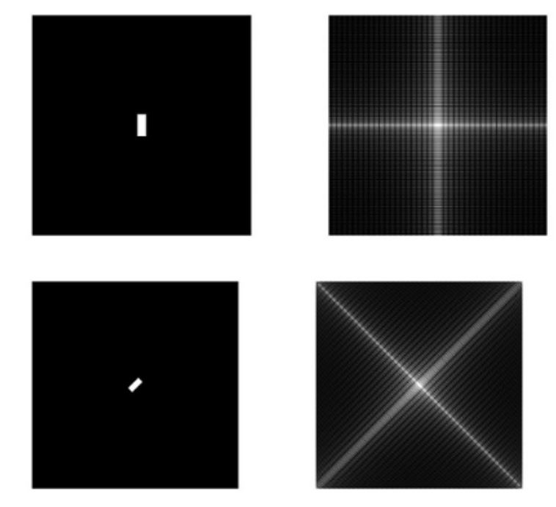
Definitions of Terms – Fourier Transfer
Notes:
In spatial domain , we deal with images as it is. The value of the pixels of the image change with respect to scene. Whereas in frequency domain , we deal with the rate at which the pixel values are changing in spatial domain.
Tilt in image feature, tilts fourier transform

Slide 9
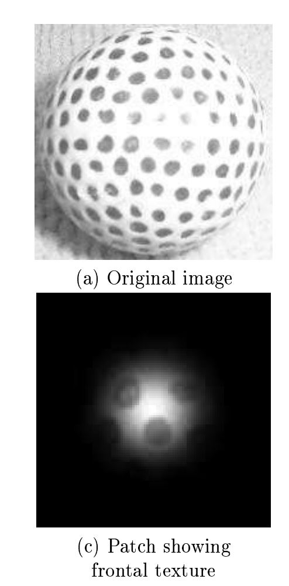
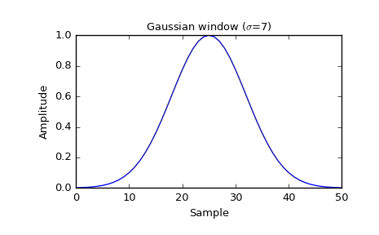
Definitions of Terms – Gaussian Window
Notes:
Gaussian window is a mathematical function that is zero-valued outside of some chosen interval, normally symmetric around the middle of the interval, usually near a maximum in the middle, and usually tapering away from the middle
Like a mask used to filter out irrelevant information

Slide 10
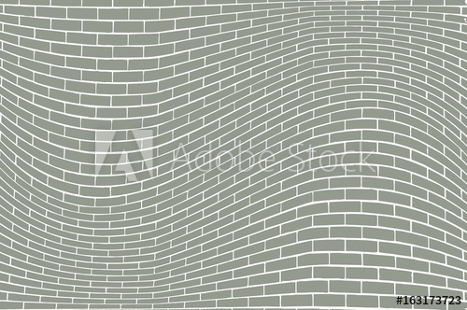
Algorithm
1) Input a texture image to the system

Slide 11
Algorithm
2) Extract frontal patch from input image
Notes:
Frontal patch is the texel element viewed frontally from the camera, contrary to other texels which would be slanted away from the camera
Slant – angle b/w the surface normal and optical/camera axis
Tilt – angle b/w projection of surface normal onto image plane and x axis of image

Slide 12
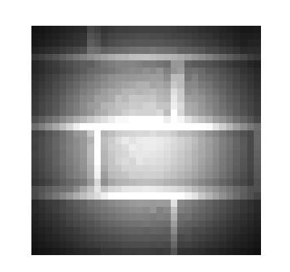

Algorithm
3) Apply gaussian window on patch

Slide 13
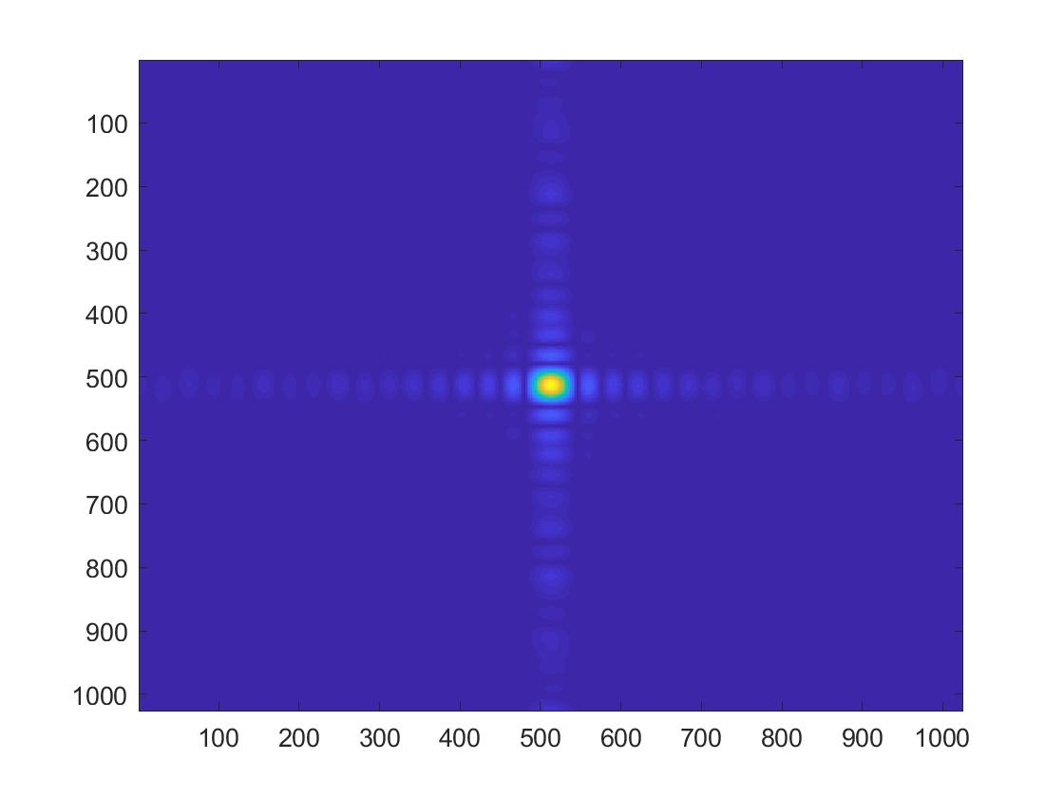
Algorithm
4) Take fourier transform of frontal patch

Slide 14
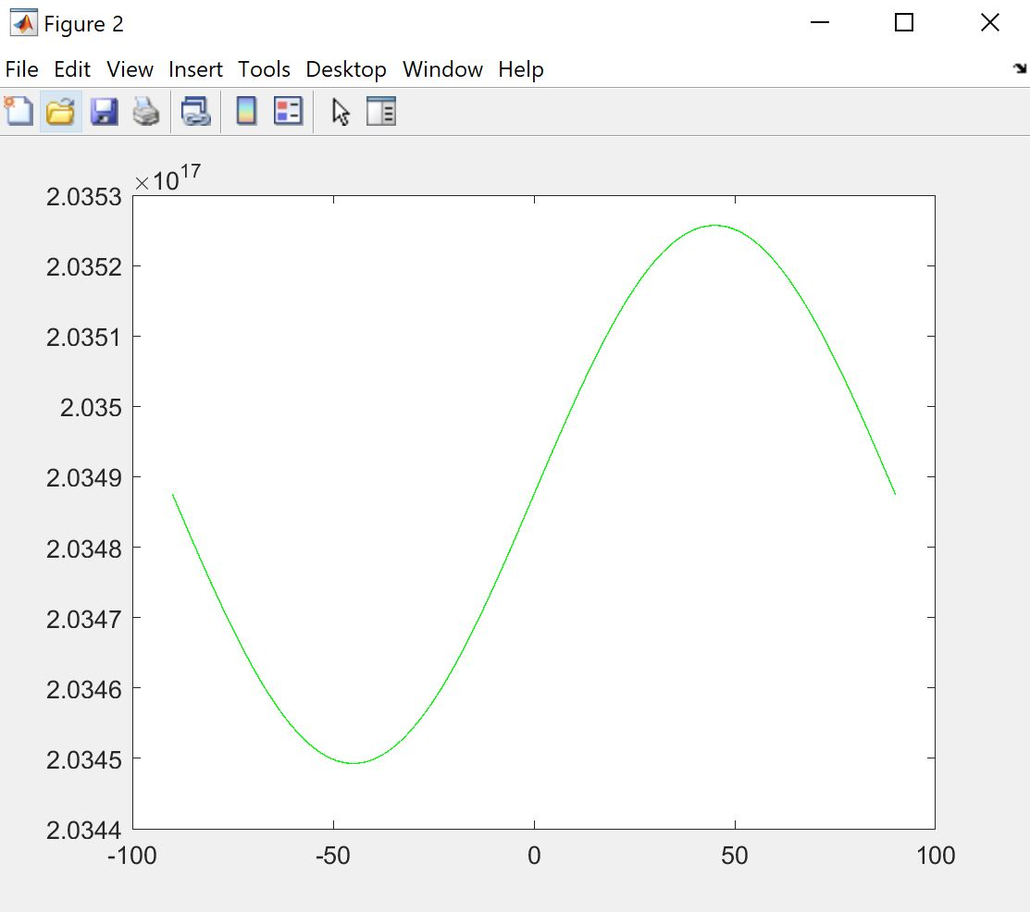
Algorithm
5) Take spectral inertia of fourier transform

Slide 15
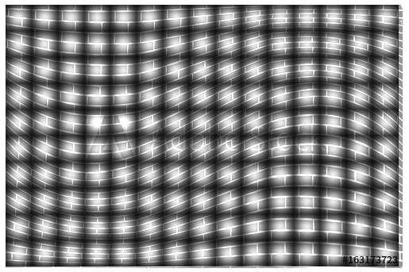
Algorithm
6) Repeat the process with each local patch in original image

Slide 16
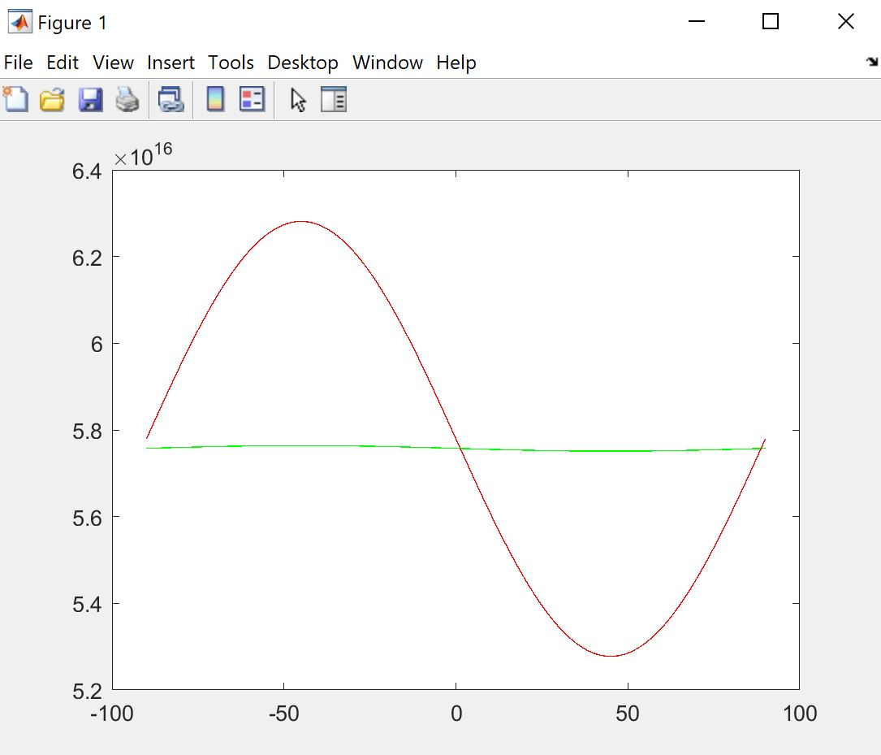
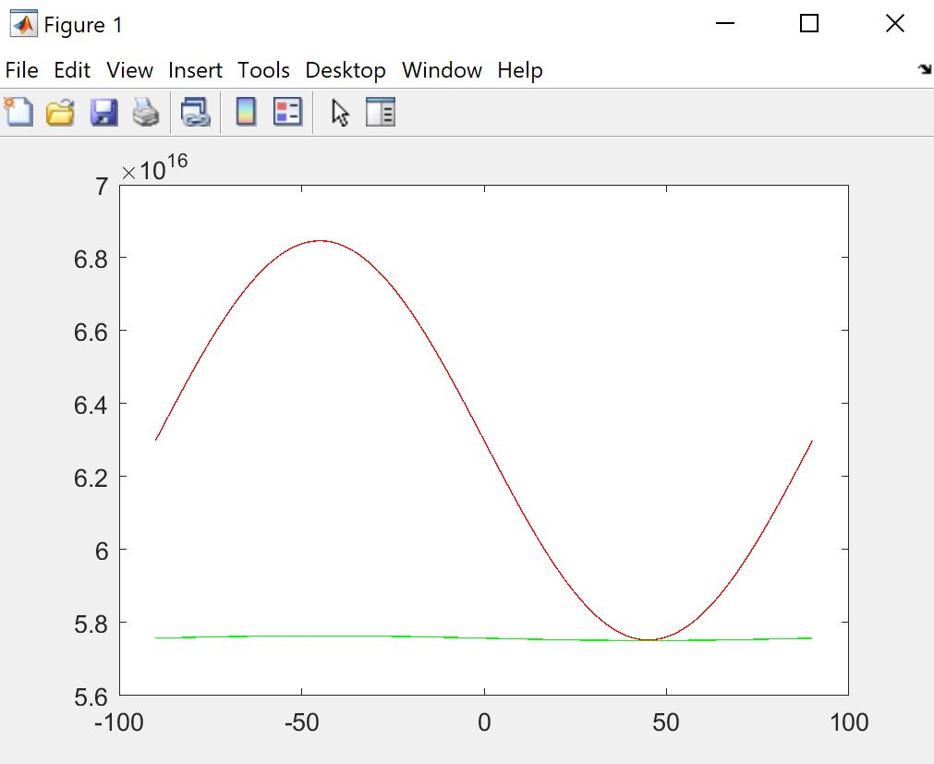
Algorithm
Tilt angle
7a) Scale to eliminate blur/illumination
b) Intersection of two graphs gives tilt angle

Slide 17
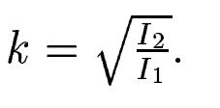
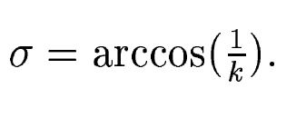
Algorithm
Tilt angle
8) Find k at the angle orthogonal to the tilt angle, and use that to find slant

Slide 18
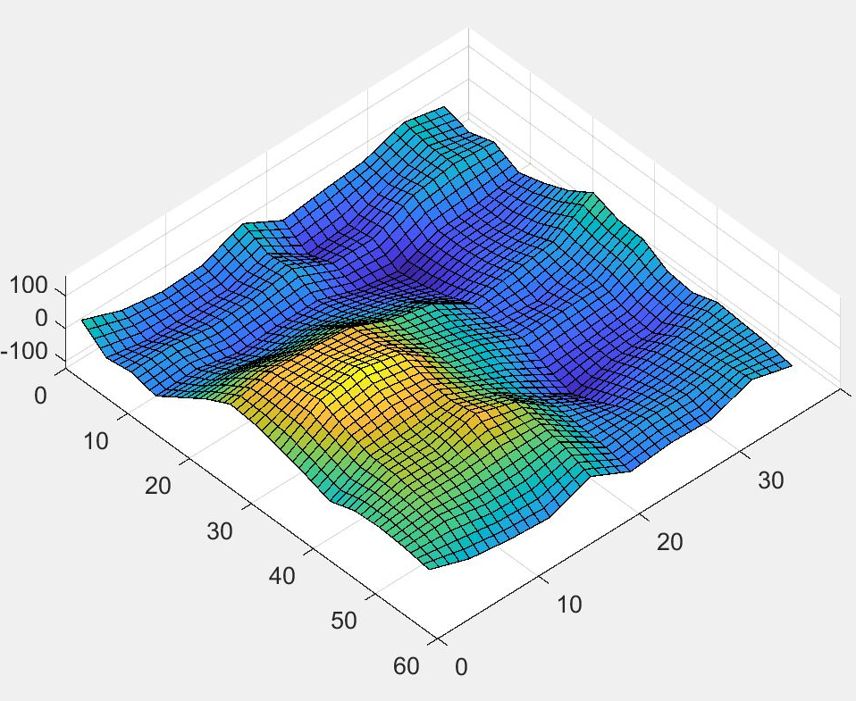
Results
9) Use Peter Kovesi’s shapelet method to reconstruct mesh using slant and tilt angles

Slide 19
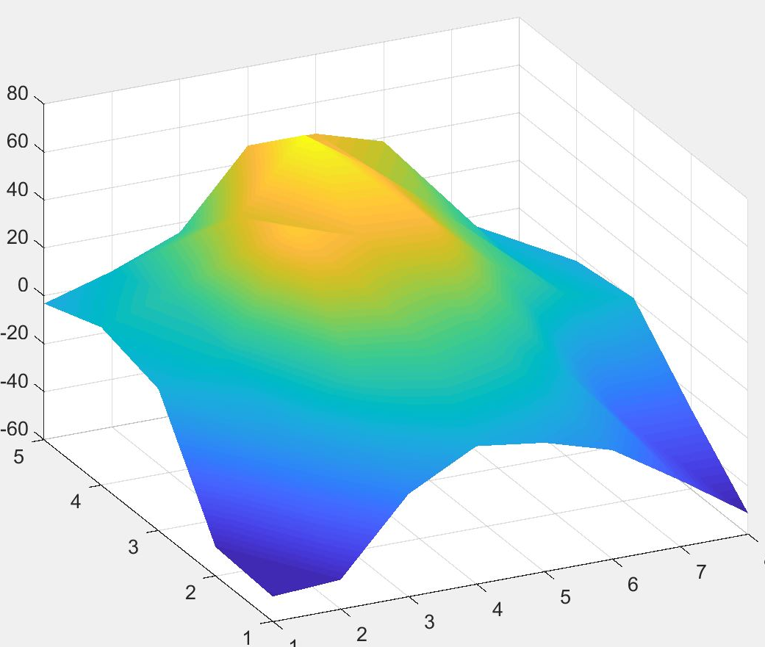

Results

Slide 20

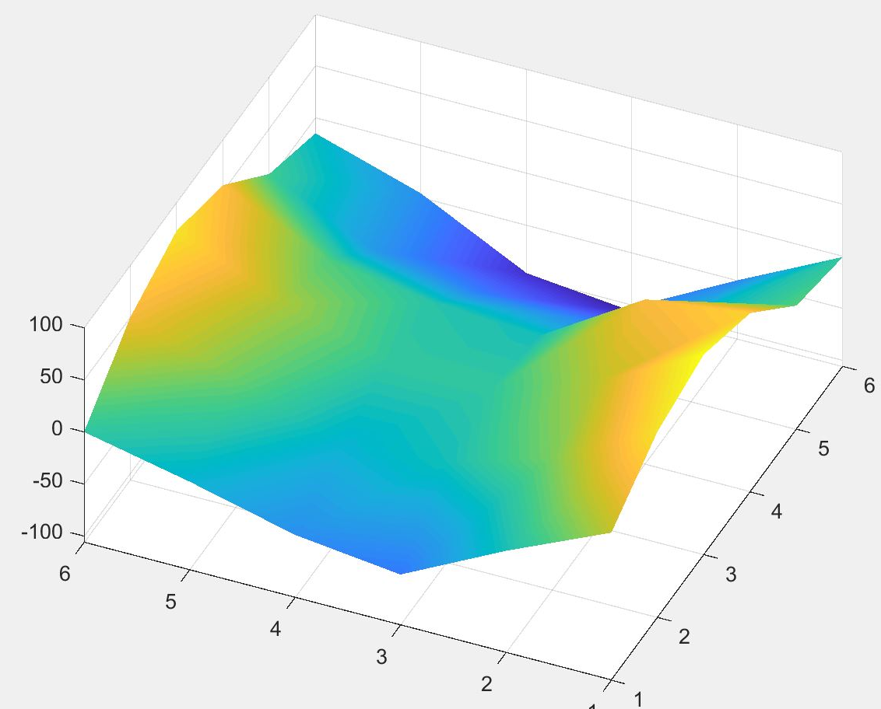
Results

Slide 21
Issues and constraints
Frontal texel not always found in image
Gaussian window size has to be adjusted
Algorithm only works with smooth surfaces

Slide 22
Future work
Automatic estimation of frontal texel
Try edge detection to extract shape of texels and eliminate noise and blur
Try other reconstruction algorithms

Slide 23
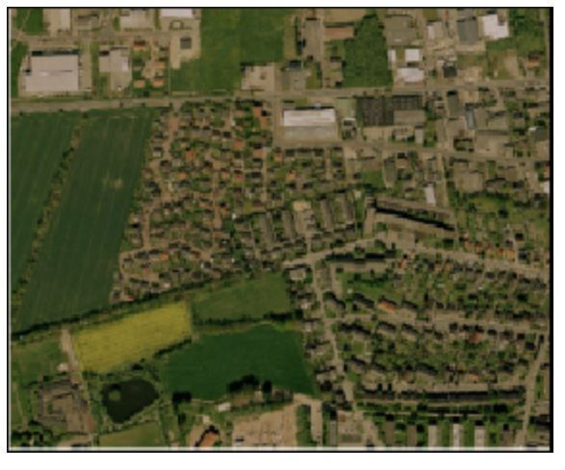
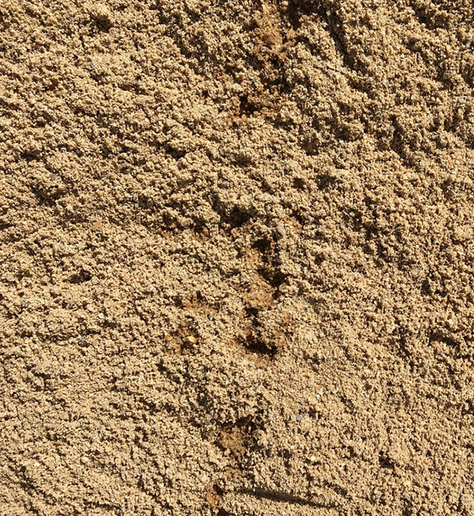
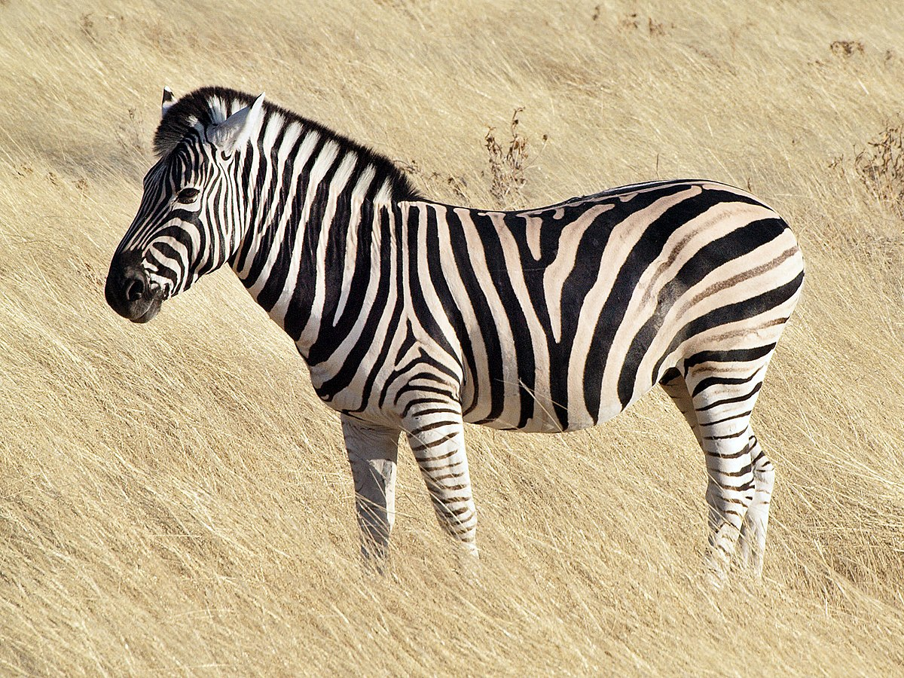
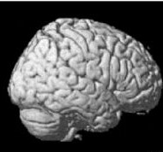
Significance and applications
recovering true surface orientation
reconstructing surface shape, and inferring the 3D layout of objects, in many applications.
For example, the plane vanish line could be computed from texture deformation in an image, which could be used to affine rectify the image.
In the case of a single image and absence of other visual cues
Notes:
Recovering true orientation surfaces – AR apps, placing objects.

Slide 24
References
http://homepages.inf.ed.ac.uk/rbf/CVonline/LOCAL_COPIES/AV0506/s0565925.pdf

