Slide 1
Project
By
Israel Agwu Etu
Topic: Design Of A Buffered Operational Amplifier
1
Israel Etu

Slide 2
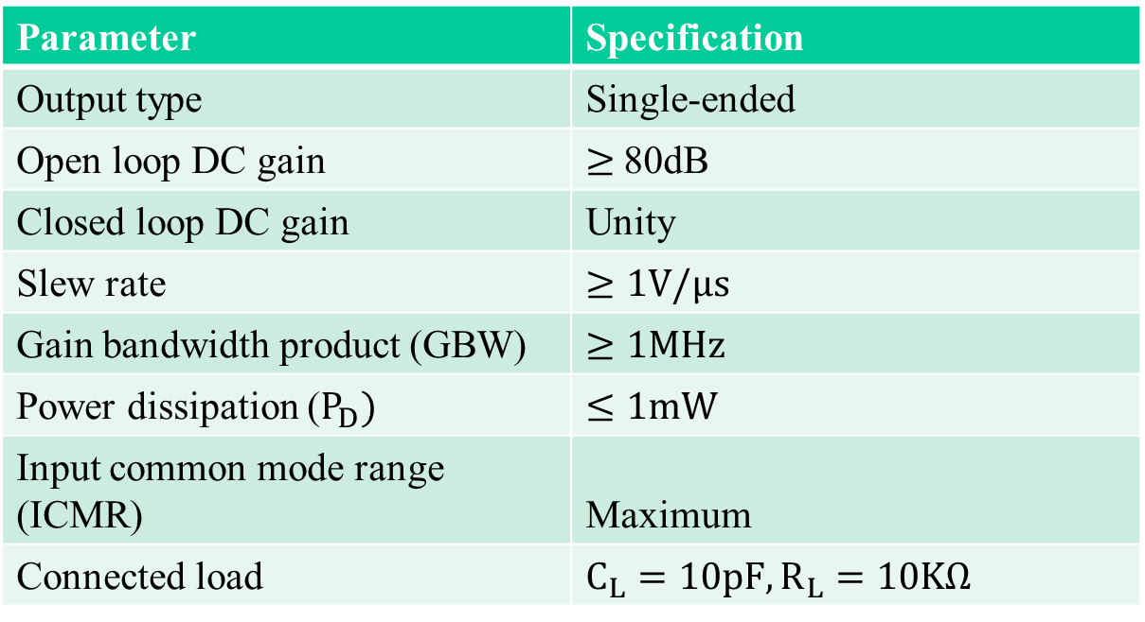
Specifications
Table 1: Design Specifications
Parameter | Specification
Output type | Single-ended
Open loop DC gain | $≥$80dB
Closed loop DC gain | Unity
Slew rate | $≥1V/μs$
Gain bandwidth product (GBW) | $≥1MHz$
Power dissipation ($P_{D})$ | $≤1mW$
Input common mode range (ICMR) | Maximum
Connected load | $C_{L}=10pF, R_{L}=10KΩ$
2
Israel Etu

Slide 3
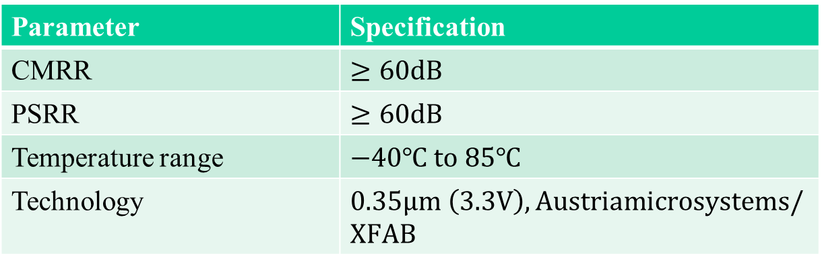
Specifications
Table 1: Design Specifications (contd.)
Parameter | Specification
CMRR | $≥60dB$
PSRR | $≥60dB$
Temperature range | $−40℃ to 85℃$
Technology | $0.35μm \left(3.3V\right), Austriamicrosystems/XFAB$
3
Israel Etu

Slide 4
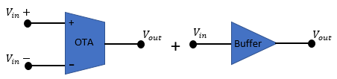
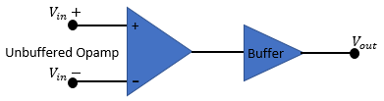
Introduction
Definition
A buffered op amp is an op amp that is capable of driving a load of large capacitance or low resistance [3].
Could be realized thus:
Fig. 1a: Buffered Opamp [1]
Fig. 1b: Buffered Opamp [2, 3]
4
Israel Etu

Slide 5
Introduction
OTA – Operational Transconductance Amplifier – An amplifier whose differential input voltage produces an output current [4, 5].
Can be referred to as voltage-controlled current source (VCCS) [5].
Usually forms the input stage of an opamp.
Mostly comprises current mirrors, current sources and current sinks.
5
Israel Etu

Slide 6
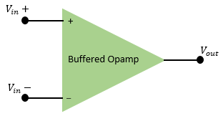
Introduction
Buffer – Usually forms the output stage of an opamp.
Generally with low output resistance.
Has the ability to sink and source sufficient current [3].
Can be achieved by using relatively large driving transistors [6].
Fig. 2: Buffered Opamp
6
Israel Etu

Slide 7


Design Procedure
Stages in this Design
OTA – Differential input plus wide-swing cascode current mirrors.
Class AB output buffer.
Diff. Amp. + Current Mirrors + Buffer
7
Israel Etu

Slide 8
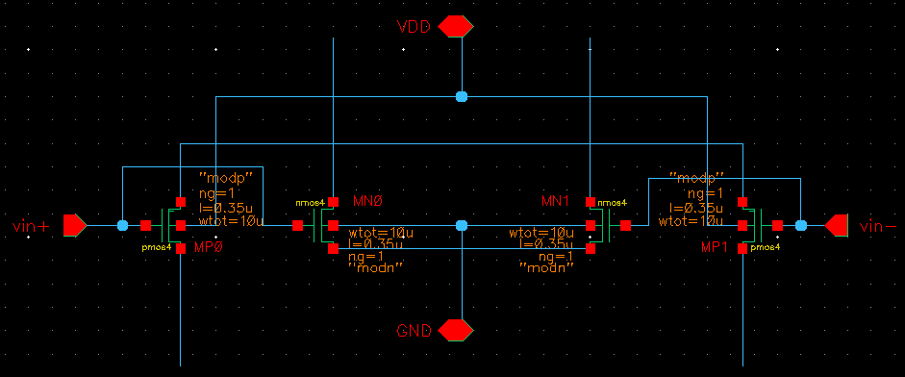
Design Procedure
The Differential Amplifier Stage
Complementary differential pairs for wide input voltage swing [7];
Also for SNR improvement [8, 9].
Fig. 3: Differential amplifier stage
8
Israel Etu

Slide 9
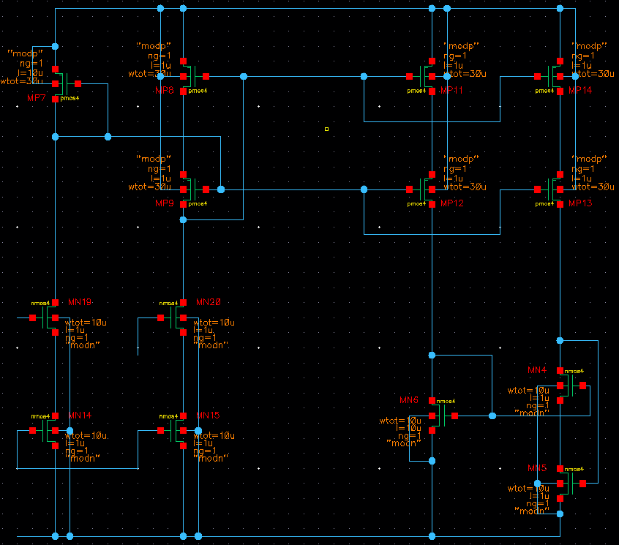
Design Procedure
Current Mirror Stage
Cascode current mirror for improved current sourcing and sinking [4, 5].
But increases impedance [4, 5].
Fig. 4: Current mirror stage
9
Israel Etu

Slide 10
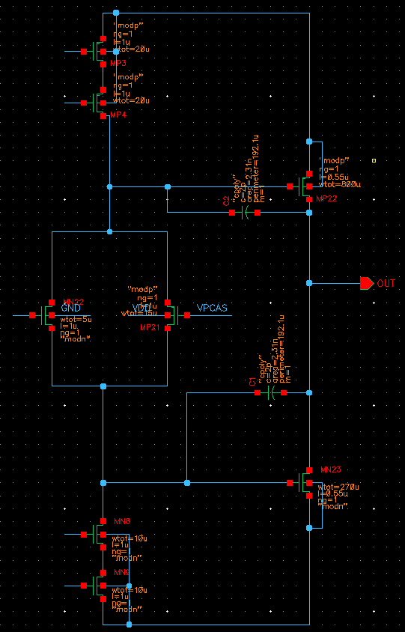
Design Procedure
Buffer Stage
Large complementary output transistors in class AB amplifier mode.
For low output resistance and high output voltage swing.
Fig. 5: Buffer stage
10
Israel Etu

Slide 11

Design Procedure
Shutdown Scheme
For shutting down the circuit instead of switching off power.
Achieves that by varying biasing voltages into cut-off region.
$V_{G} of PMOS=0V; V_{G} of NMOS=3.3V$ (for normal circuit operation).
Fig. 6: PMOS shutdown transistors
Fig. 7: NMOS shutdown transistors
11
Israel Etu

Slide 12
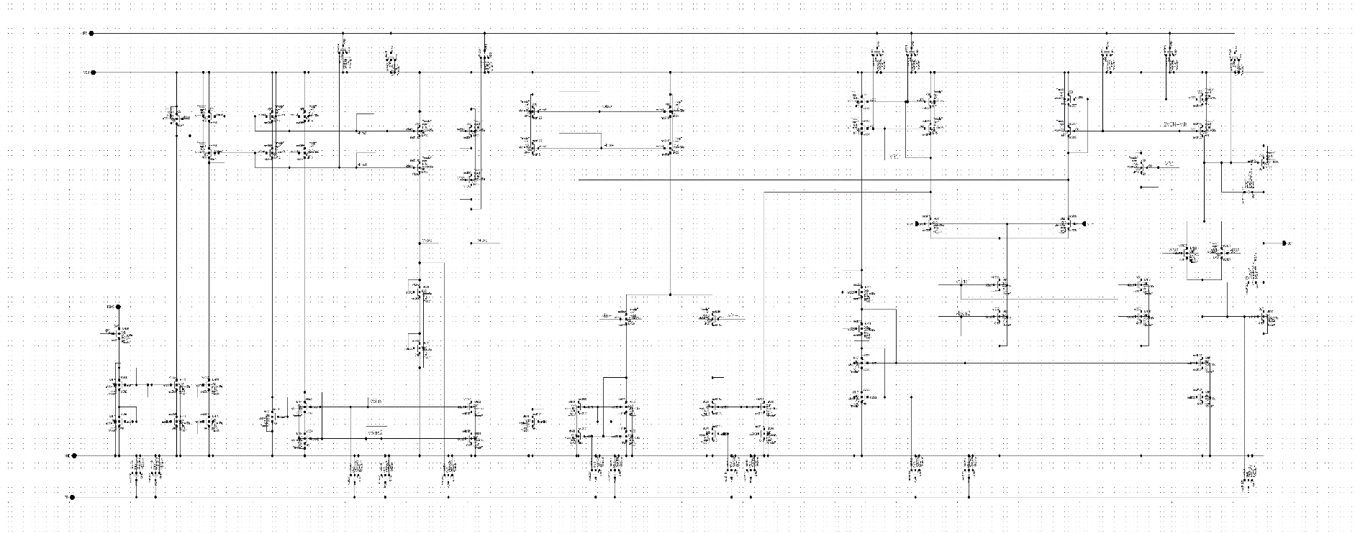
Design Procedure
The Complete Schematic (Click here)
Fig. 8: Complete schematic
12
Israel Etu

Slide 13
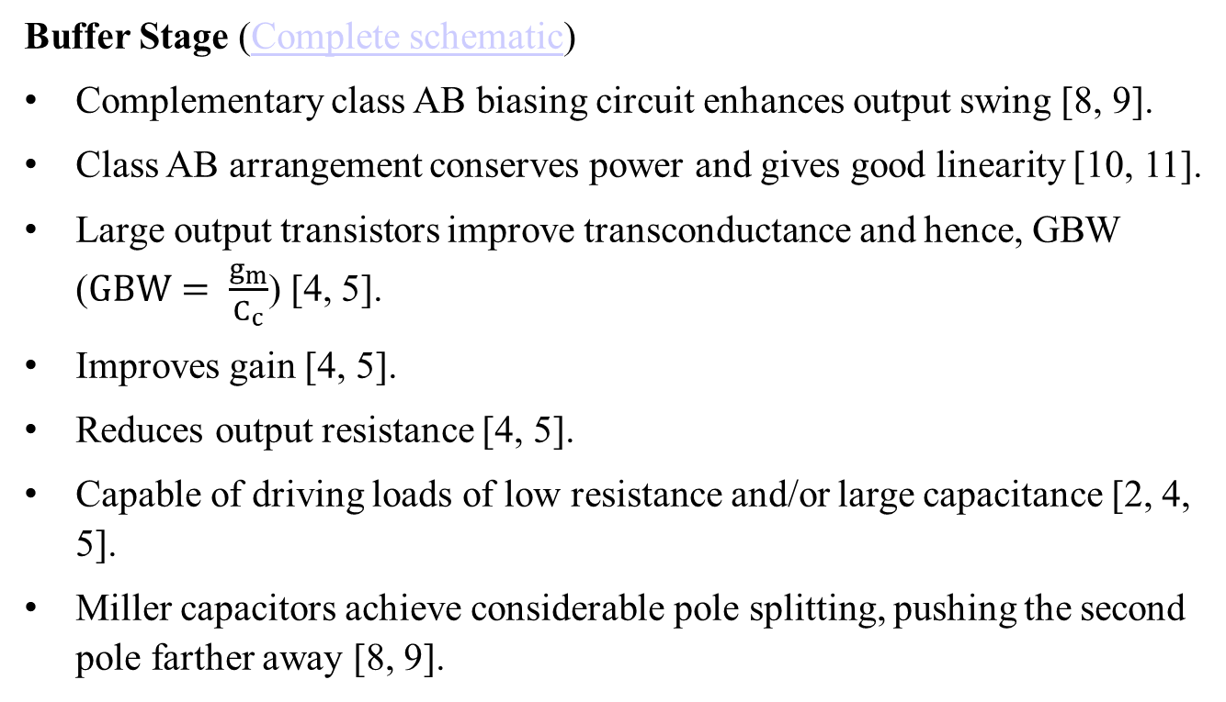
Design Procedure
Buffer Stage (Complete schematic)
Complementary class AB biasing circuit enhances output swing [8, 9].
Class AB arrangement conserves power and gives good linearity [10, 11].
Large output transistors improve transconductance and hence, GBW ($GBW= \frac{g_{m}}{C_{c}}$) [4, 5].
Improves gain [4, 5].
Reduces output resistance [4, 5].
Capable of driving loads of low resistance and/or large capacitance [2, 4, 5].
Miller capacitors achieve considerable pole splitting, pushing the second pole farther away [8, 9].
13
Israel Etu

Slide 14
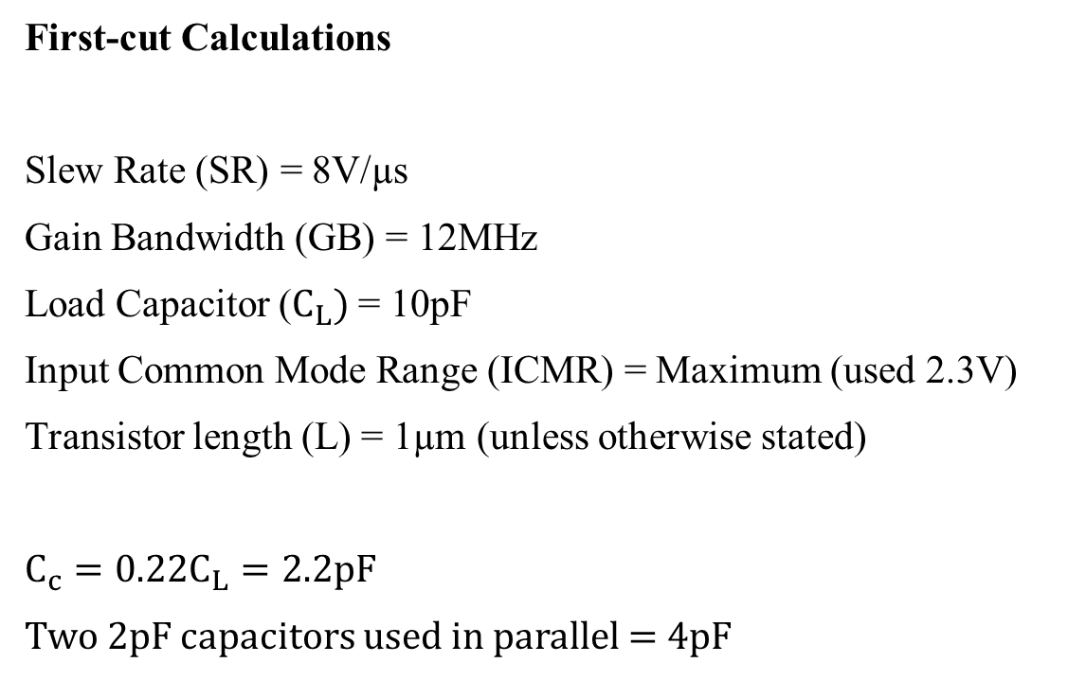
Calculations
First-cut Calculations
Slew Rate (SR) = 8V/µs
Gain Bandwidth (GB) = 12MHz
Load Capacitor ($C_{L})$ = 10pF
Input Common Mode Range (ICMR) = Maximum (used 2.3V)
Transistor length (L) = 1µm (unless otherwise stated)
$$C_{c}=0.22C_{L}=2.2pF$$
Two 2pF capacitors used in parallel = 4pF
14
Israel Etu

Slide 15
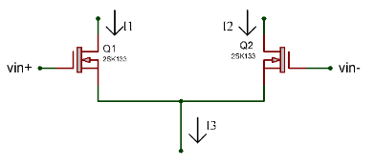
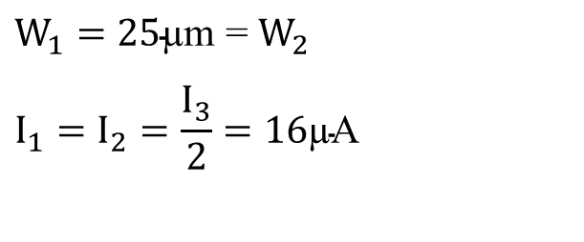

Calculations
Differential Input Transistors
$$I_{3}=SR.C_{c}=32\text{µ}\text{A}$$
$$g_{m1}=GB.C_{c}.2π\text{ = 301}\text{µ}\text{S}$$
$$K_{N}^{′}=110\text{µ}{A/V}^{2}$$
$$S_{1}= \frac{g_{m1}^{2}}{K_{N}^{′}I_{3}} ≈\text{25}$$
$$W_{1}=25\text{µ}\text{m}\text{ = }W_{2}$$
$$I_{1}=I_{2}=\frac{I_{3}}{2}=16\text{µ}\text{A}$$
Fig. 9: Differential input transistors
15
Israel Etu

Slide 16
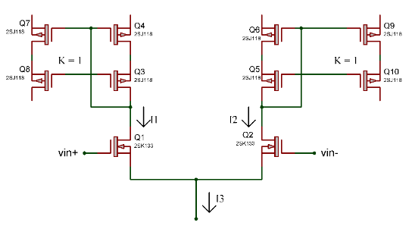


Calculations
Mirror Transistors
Since K = 1
$$W_{3} to W_{10} equal$$
$$K_{P}^{′}=50\text{µ}{A/V}^{2}$$
$$V_{in(max)}=2.8V$$
$$V_{TP(max)}=0.85V$$
$$V_{TP(min)}=0.55V$$
$$V_{DD}=3.3V; V_{SS}=0V$$
$$S_{3}= \frac{{2I}_{1}}{\left(K_{P}^{′}{\left(V_{DD} − V_{in(max)} − V_{TP(max)}+ V_{TP(min)}\right)}^{2}\right)}$$
$$=16$$
$$Since L=1\text{µ}\text{m}$$
$$W_{3}=16\text{µ}\text{m}$$
Fig. 10: Mirror transistors
16
Israel Etu

Slide 17
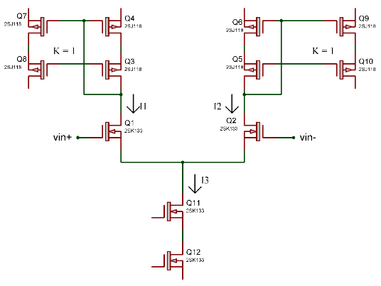


Calculations
Tail Transistors
$$V_{in(min)}=1.1V$$
$$V_{DS3(sat)}= V_{in(min)}−V_{SS}−\sqrt{\frac{I_{3}}{K_{N}^{′}.\frac{W_{1}}{L_{1}}}}−V_{TN\left(max\right)}$$
$$V_{DS3(sat)}=142mV$$
$$S_{11}= \frac{{2I}_{3}}{K_{N}^{′}{\left(V_{DS§(sat)}\right)}^{2}}$$
$$S_{11}=28.85= S_{12}$$
Fig. 11: Tail transistors
17
Israel Etu

Slide 18
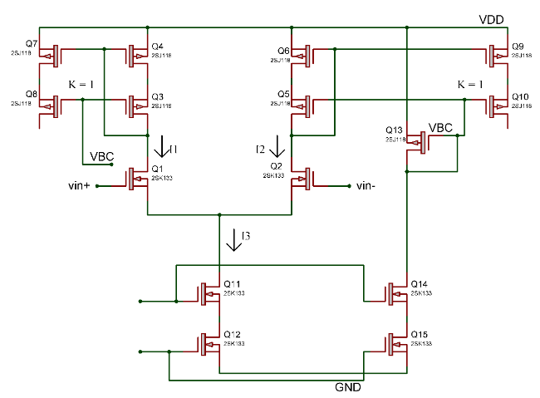
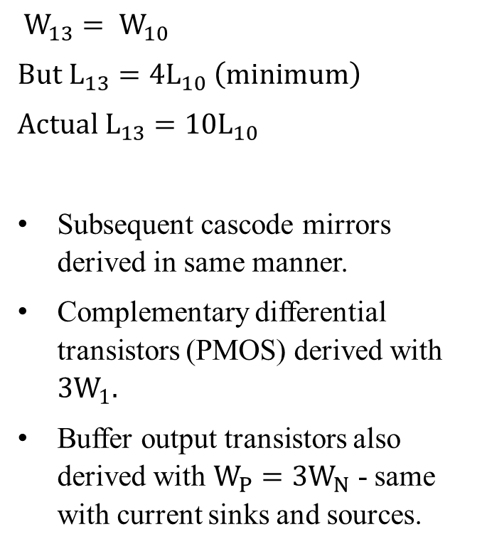

Calculations
Cascode Transistors
$$Since K=1$$
$$W_{3} to W_{10} equal$$
$$W_{13}= W_{10}$$
$$But L_{13}=4L_{10} \left(minimum\right)$$
$$Actual{ L}_{13}=10L_{10}$$
Subsequent cascode mirrors derived in same manner.
Complementary differential transistors (PMOS) derived with ${3W}_{1}.$
Buffer output transistors also derived with $W_{P}={3W}_{N}$ - same with current sinks and sources.
Fig. 12: Cascode transistors
18
Israel Etu

Slide 19
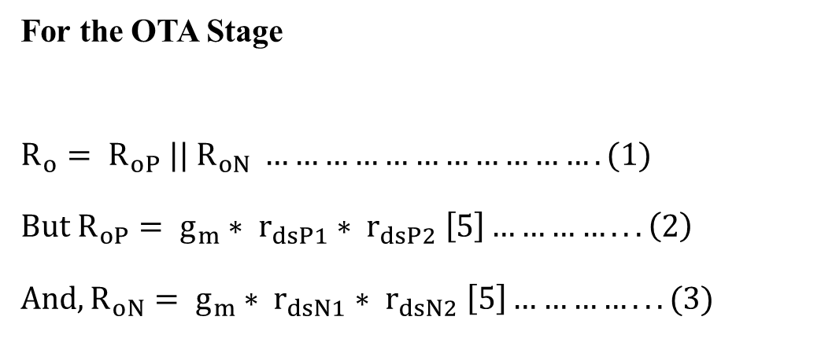
Calculations
For the OTA Stage
$$R_{o}= R_{oP} || R_{oN} ……………………………. (1)$$
$$But R_{oP}= g_{m}∗ r_{dsP1}∗ r_{dsP2} \left[5\right]…………... \left(2\right)$$
$$And, R_{oN}= g_{m}∗ r_{dsN1}∗ r_{dsN2} \left[5\right]…………... (3)$$
19
Israel Etu

Slide 20

Calculations
$$g_{m}= \sqrt{2K_{P}^{′}\left(\frac{W}{L}\right)I_{D}}…………………(4)$$
$$And r_{dsP}= \frac{1}{λ_{P}I_{D}} ……………….. \left(5\right)$$
$$From \left(2\right),$$
$$R_{oP}= \left(\sqrt{2K_{P}^{′}\left(\frac{W}{L}\right)I_{D}}\right)\left(\frac{1}{λ_{P1}I_{D}}\right)\left(\frac{1}{λ_{P2}I_{D}}\right) ………………….. \left(6\right)$$
20
Israel Etu

Slide 21
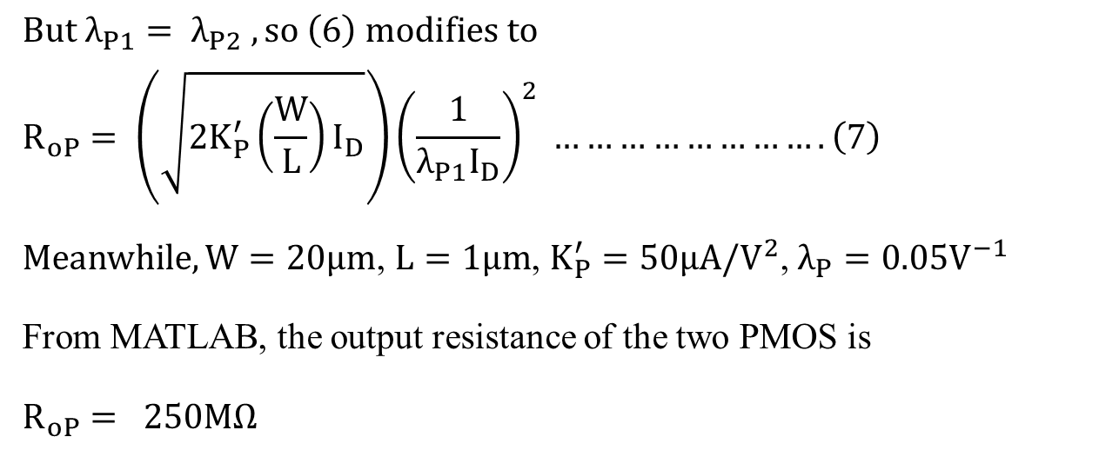
Calculations
$But λ_{P1}= λ_{P2} , so \left(6\right) modifies to$
$$R_{oP}= \left(\sqrt{2K_{P}^{′}\left(\frac{W}{L}\right)I_{D}}\right){\left(\frac{1}{λ_{P1}I_{D}}\right)}^{2} ……………………. \left(7\right)$$
$Meanwhile, W=20μm$, $L=1μm$, $K_{P}^{′}=50μA/V^{2}$, $λ_{P}=0.05V^{−1}$
From MATLAB, the output resistance of the two PMOS is
$$R_{oP}= 250MΩ$$
21
Israel Etu

Slide 22
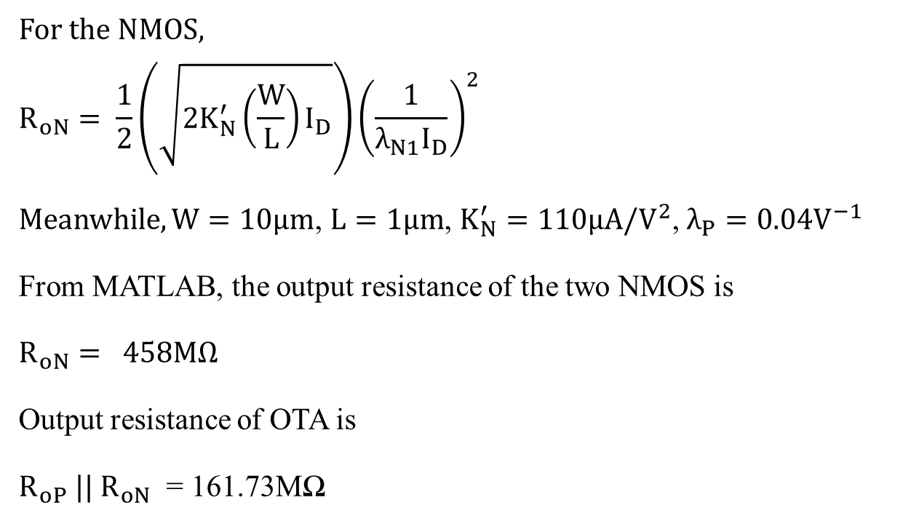
Calculations
For the NMOS,
$$R_{oN}= \frac{1}{2}\left(\sqrt{2K_{N}^{′}\left(\frac{W}{L}\right)I_{D}}\right){\left(\frac{1}{λ_{N1}I_{D}}\right)}^{2}$$
$Meanwhile, W=10μm$, $L=1μm$, $K_{N}^{′}=110μA/V^{2}$, $λ_{P}=0.04V^{−1}$
From MATLAB, the output resistance of the two NMOS is
$$R_{oN}= 458MΩ$$
Output resistance of OTA is
$R_{oP} ||{ R}_{oN}$ = 161.73MΩ
22
Israel Etu

Slide 23
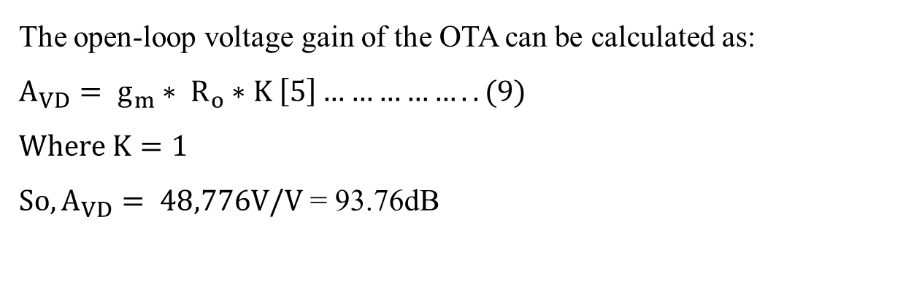
Calculations
The open-loop voltage gain of the OTA can be calculated as:
$$A_{VD}= g_{m}∗ R_{o}∗K \left[5\right]…………….. (9)$$
$$Where K=1$$
$So, A_{VD}= 48,776V/V$ = 93.76dB
23
Israel Etu

Slide 24
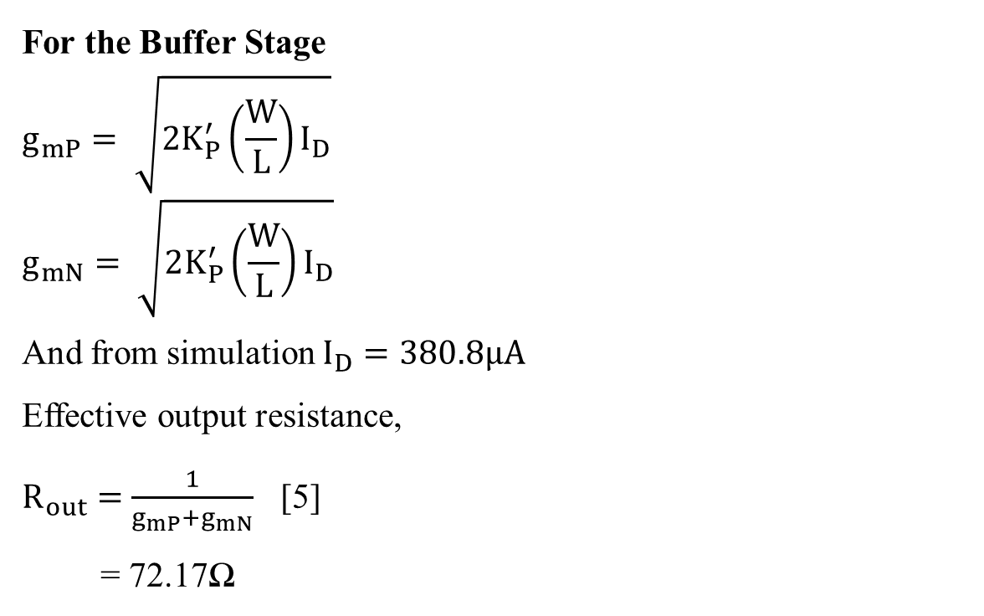
Calculations
For the Buffer Stage
$$g_{mP}= \sqrt{2K_{P}^{′}\left(\frac{W}{L}\right)I_{D}}$$
$$g_{mN}= \sqrt{2K_{P}^{′}\left(\frac{W}{L}\right)I_{D}}$$
And from simulation $I_{D}=380.8μA$
Effective output resistance,
$R_{out}=$ $\frac{1}{g_{mP}+g_{mN}}$ [5]
= 72.17Ω
24
Israel Etu

Slide 25
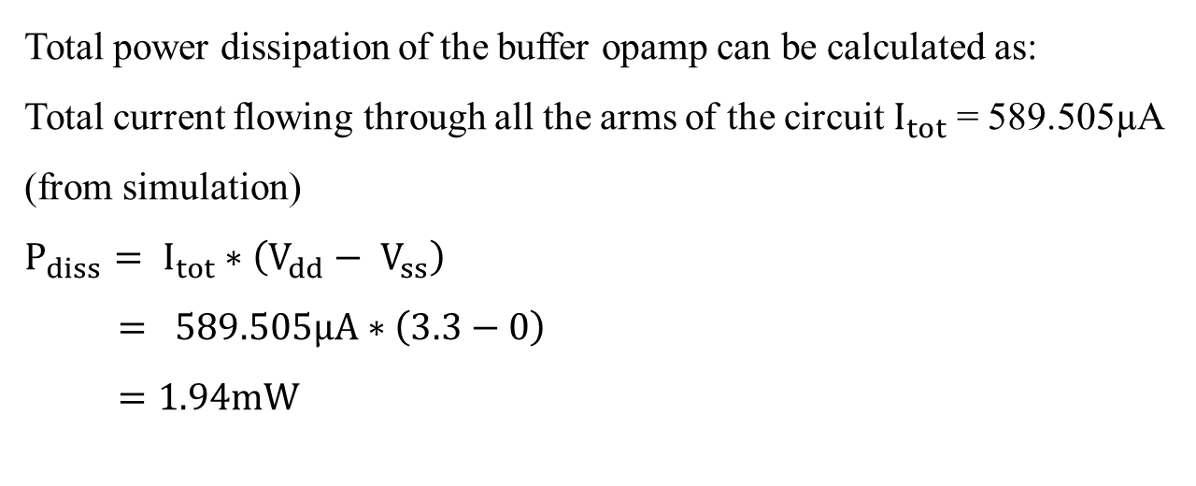
Calculations
Total power dissipation of the buffer opamp can be calculated as:
Total current flowing through all the arms of the circuit $I_{tot}$ = 589.505µA (from simulation)
$$P_{diss}= I_{tot}∗\left(V_{dd}− V_{ss}\right)$$
$$= 589.505µA∗\left(3.3−0\right)$$
$$=1.94mW$$
25
Israel Etu

Slide 26
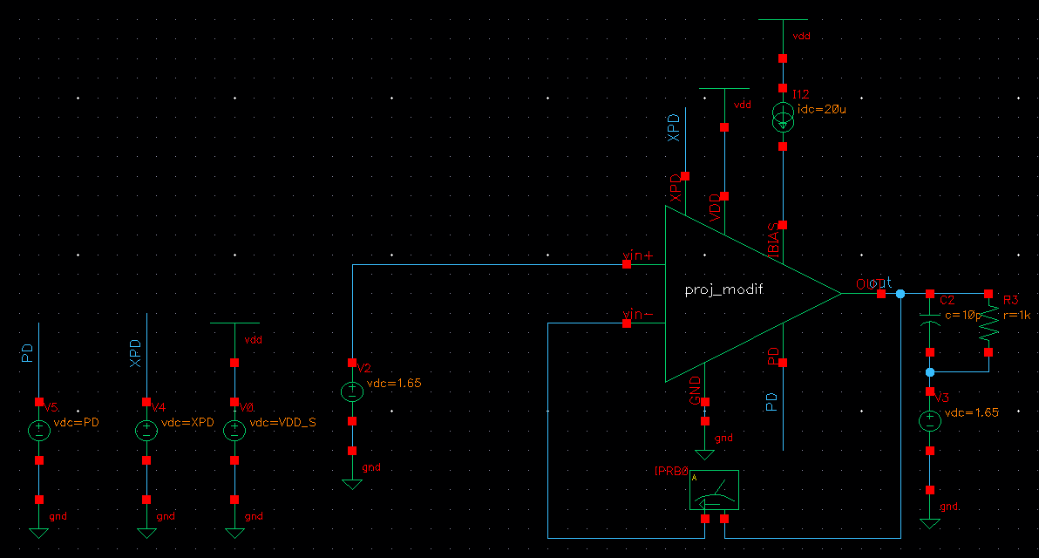
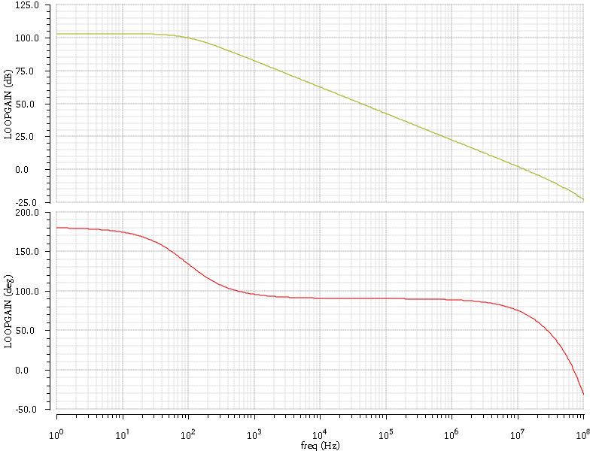
Tests, Results and Discussion
AC Test
Fig. 13a: Ac test (schematic)
Fig. 13b: Ac test (simulation plot)
26
Israel Etu

Slide 27
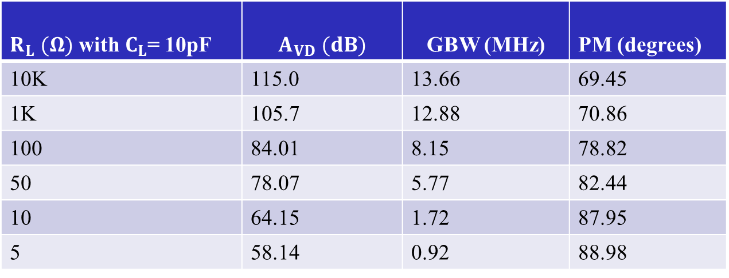
Tests, Results and Discussion
AC Test
Table 2: AC Test Result with Varying Load Resistance
$R_{L} (Ω)$ with $C_{L}$= 10pF | $A_{VD} (dB)$ | GBW (MHz) | PM (degrees)
10K | 115.0 | 13.66 | 69.45
1K | 105.7 | 12.88 | 70.86
100 | 84.01 | 8.15 | 78.82
50 | 78.07 | 5.77 | 82.44
10 | 64.15 | 1.72 | 87.95
5 | 58.14 | 0.92 | 88.98
27
Israel Etu

Slide 28
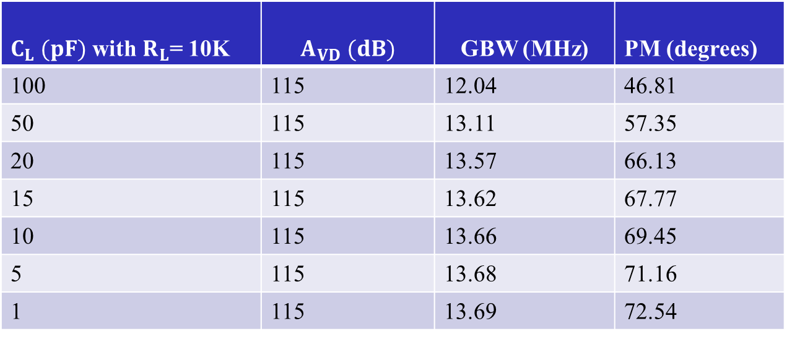
Tests, Results and Discussion
AC Test
Table 3: AC Test Result with Varying Load Capacitance
$C_{L} (pF)$ with $R_{L}$= 10K | $A_{VD} (dB)$ | GBW (MHz) | PM (degrees)
100 | 115 | 12.04 | 46.81
50 | 115 | 13.11 | 57.35
20 | 115 | 13.57 | 66.13
15 | 115 | 13.62 | 67.77
10 | 115 | 13.66 | 69.45
5 | 115 | 13.68 | 71.16
1 | 115 | 13.69 | 72.54
28
Israel Etu

Slide 29
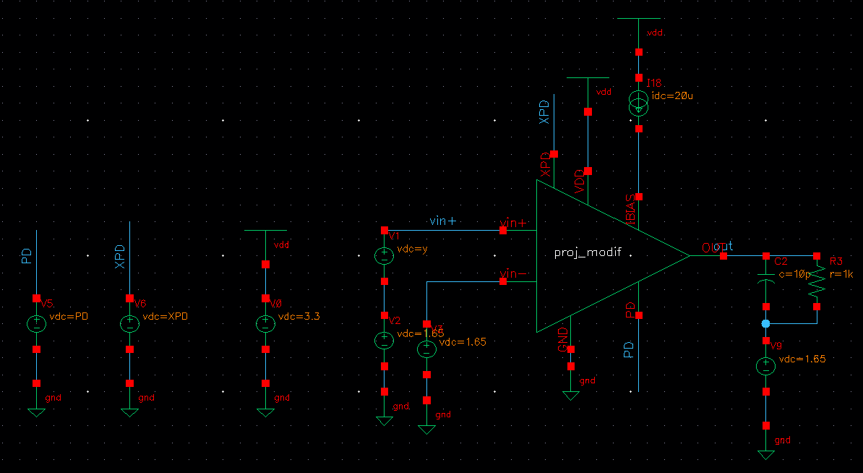
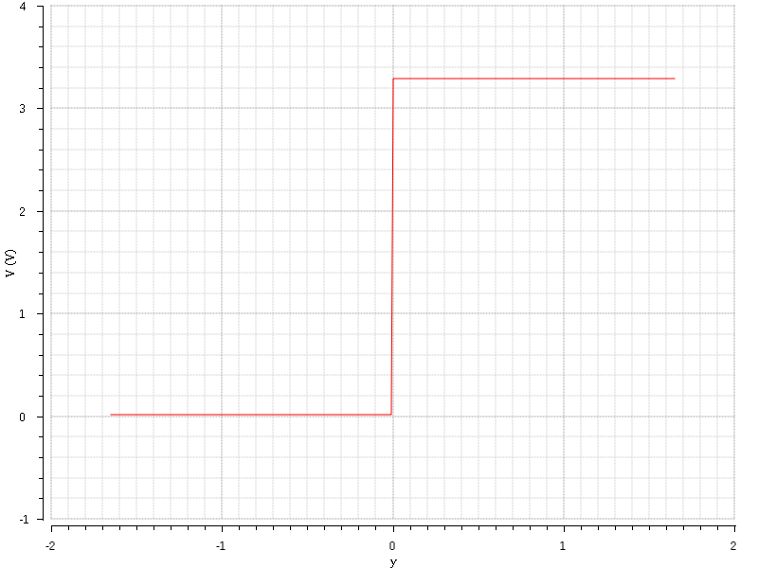
Tests, Results and Discussion
DC Test
Fig. 14a: Dc test (schematic)
Fig. 14b: Dc test (simulation plot)
29
Israel Etu

Slide 30
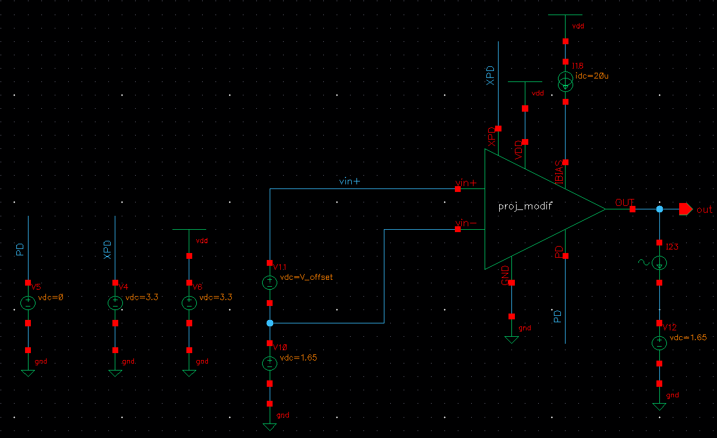
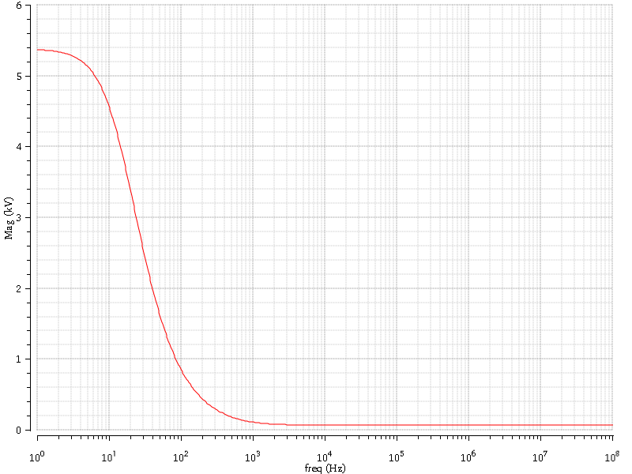

Tests, Results and Discussion
Open-loop Output Impedance Test
$$V_{out(max)}=5.361KV;I=1A; Z_{out}=V_{out(max)}/I=5.36KΩ$$
Fig. 15a: Open-loop output impedance (schematic)
Fig. 15b: Open-loop output impedance (simulation plot)
30
Israel Etu

Slide 31
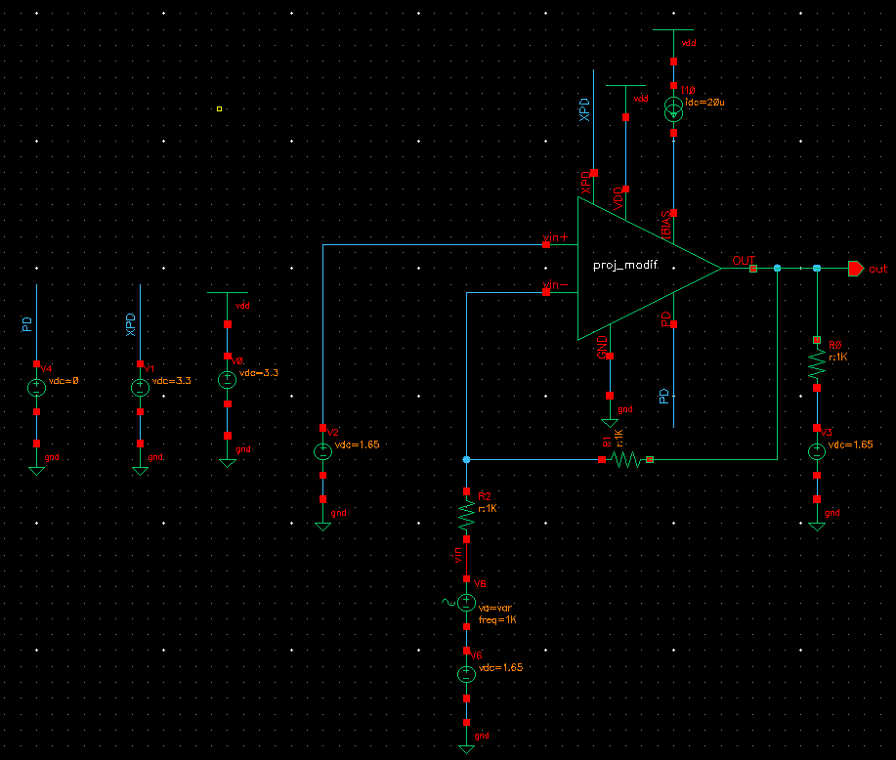
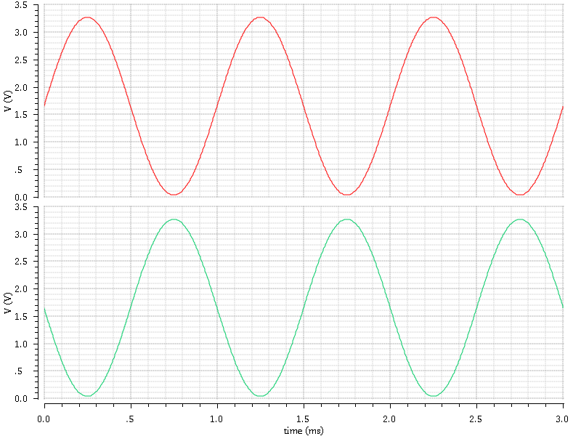
Tests, Results and Discussion
Drive Test
Maximum normal input voltage = 3.26V
Fig. 16a: Drive test (schematic)
Fig. 16b: Drive test (simulation plot)
31
Israel Etu

Slide 32
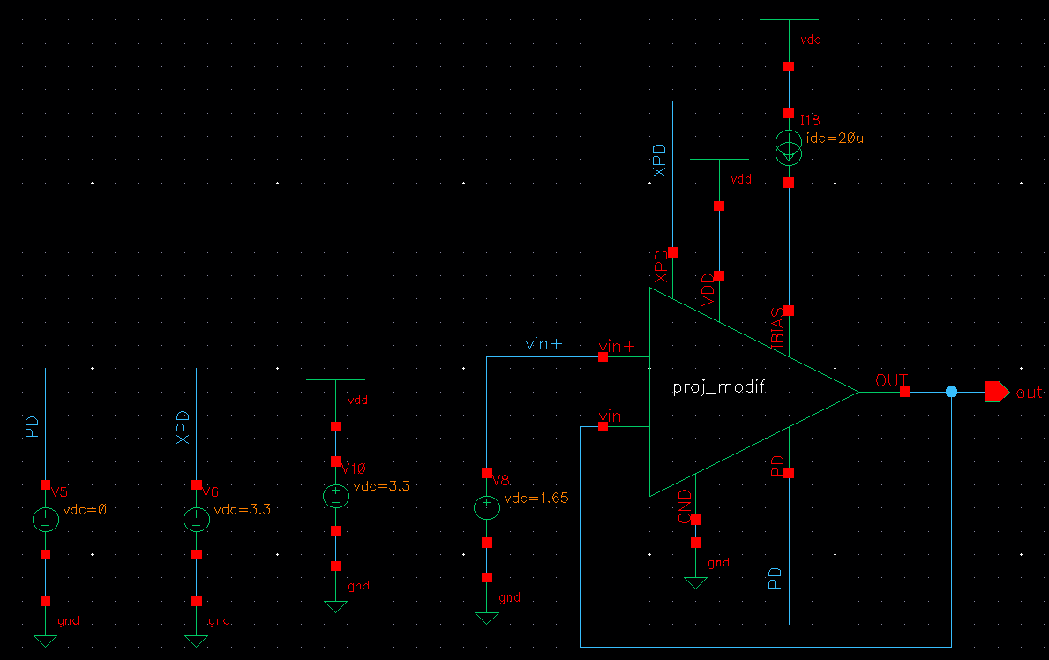
Tests, Results and Discussion
Offset Voltage Test
Offset voltage = -21.1µV
Fig. 17: Offset voltage (schematic)
32
Israel Etu

Slide 33
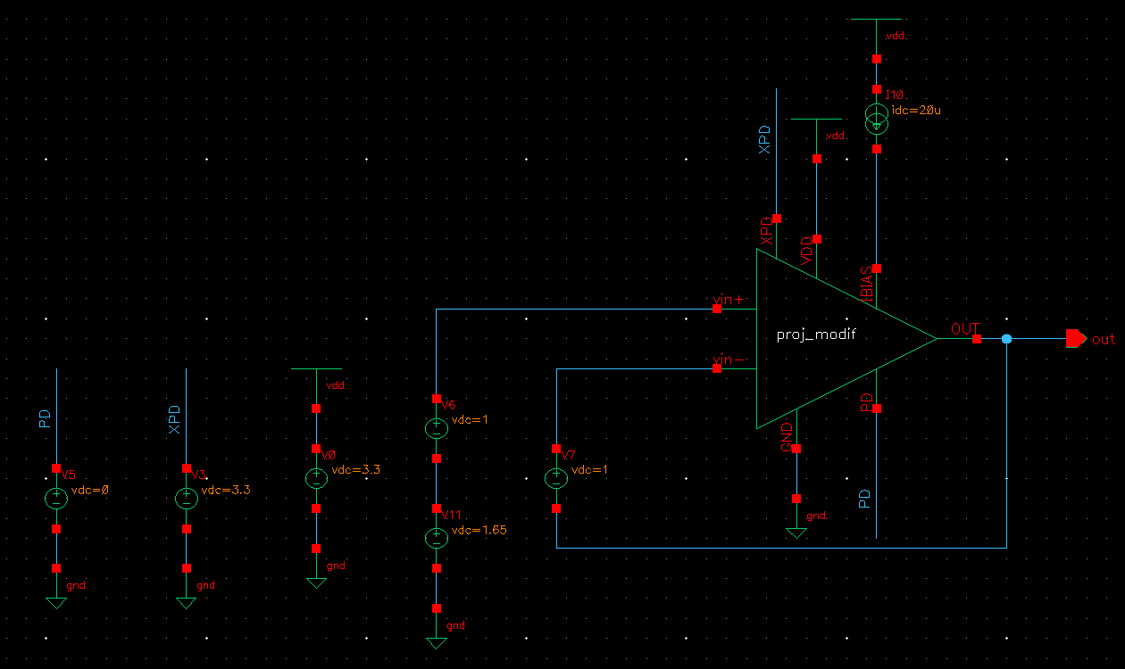
Tests, Results and Discussion
CMRR Test
Fig. 18: CMRR (schematic)
33
Israel Etu

Slide 34
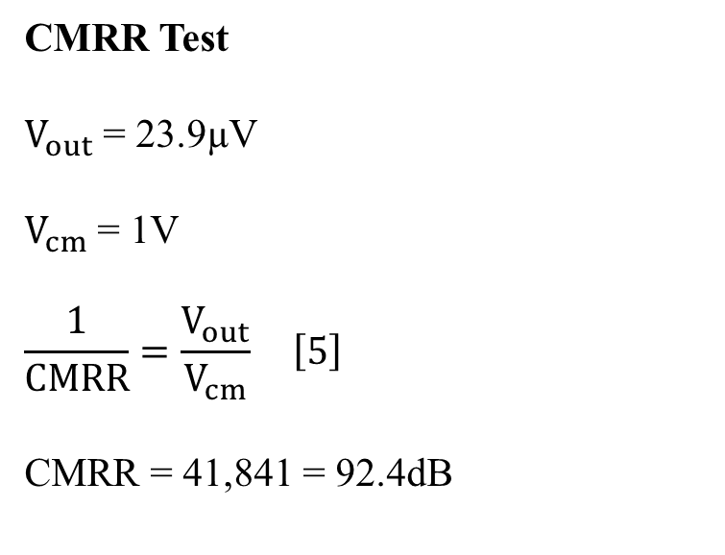
Tests, Results and Discussion
CMRR Test
$V_{out}$= 23.9µV
$V_{cm}$= 1V
$$\frac{1}{CMRR}=\frac{V_{out}}{V_{cm}} \left[5\right]$$
CMRR = 41,841 = 92.4dB
34
Israel Etu

Slide 35
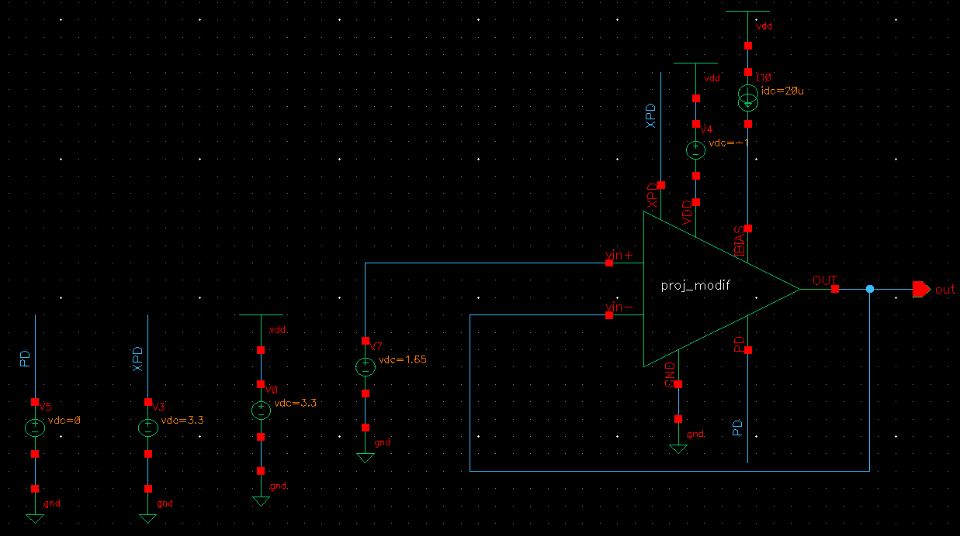
Tests, Results and Discussion
PSRR Test
Fig. 19: PSRR (schematic)
35
Israel Etu

Slide 36
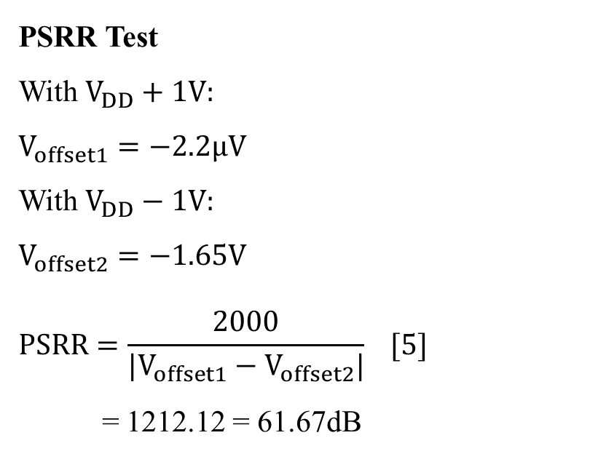
Tests, Results and Discussion
PSRR Test
With $V_{DD}+1V:$
$$V_{offset1}=−2.2μV$$
With $V_{DD}−1V:$
$$V_{offset2}=−1.65V$$
$$PSRR=\frac{2000}{|V_{offset1}−V_{offset2}|} [5]$$
= 1212.12 = 61.67dB
36
Israel Etu

Slide 37
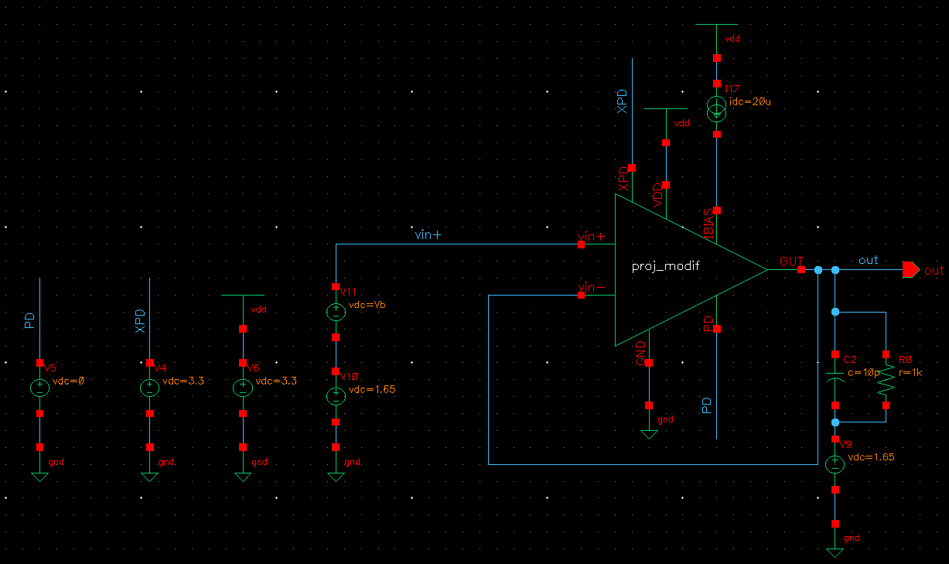
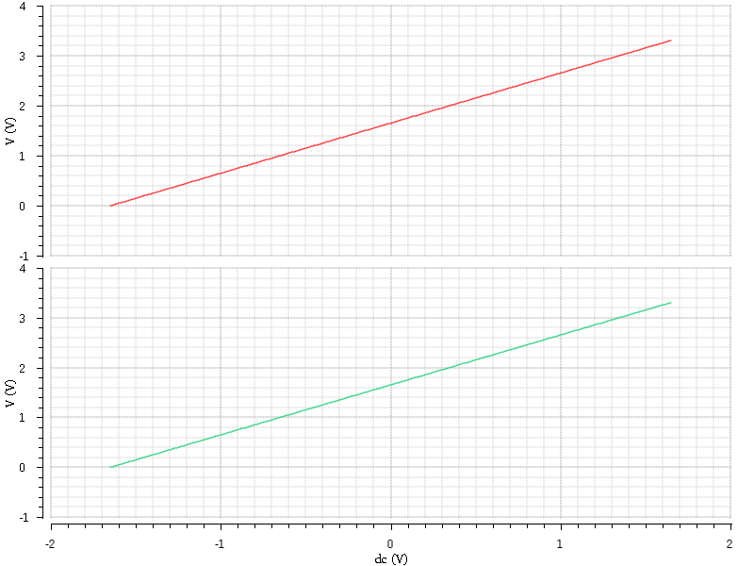

Tests, Results and Discussion
ICMR Test
Range: $−1.462V to+1.524V$
Fig. 20a: ICMR (schematic)
Fig. 20b: ICMR (simulation)
37
Israel Etu

Slide 38



Tests, Results and Discussion
Transient Test
${Slewrate}^{+}=8.45V/μs$; ${Slewrate}^{−}=8.60V/μs$
Fig. 21a: Transient test (schematic)
Fig. 21b: Transient test (simulation)
38
Israel Etu

Slide 39

Tests, Results and Discussion
Monte Carlo Check
Phase Margin: > 45 deg
Gain Bandwidth: > 8MHz
DC Voltage Gain: > 80dB
Fig. 22: Monte Carlo result
39
Israel Etu

Slide 40

Tests, Results and Discussion
Table 4: Result Summary
Parameter | Value
Output Resistance | 72.17Ω
Power Dissipation | 1.94mW
Open-loop DC Gain (with $R_{L}=10K and C_{L}=10pF)$ | 115dB
Gain Bandwidth | 13.66MHz
Phase Margin | 69.45˚
Maximum Normal Input Voltage | 3.26V
Offset Voltage | -21.1µV
CMRR | 92.4dB
PSRR | 61.67dB
40
Israel Etu

Slide 41

Tests, Results and Discussion
Table 4: Result Summary (contd.)
Parameter | Value
ICMR | -1.462V to +1.524V
$${Slewrate}^{+}$$ | 8.45V/µs
$${Slewrate}^{−}$$ | 8.60V/µs
Open-loop dc gain and gain bandwidth vary directly with load resistance.
Phase margin varies inversely with load resistance and load capacitance.
Gain bandwidth varies inversely with load capacitance (very slightly).
41
Israel Etu

Slide 42
Tests, Results and Discussion
Open-loop dc gain remains unchanged with change in load capacitance.
Buffer can drive a resistive load of, as low as 5Ω and a capacitive load of, as high as 100pF.
Has reduced output resistance.
42
Israel Etu

Slide 43


Layout
Block 4
Original aspect ratio = 10/8 = 1.25/1
To arrange 4 transistors in series implies 1.25 x 4 = 5
New aspect ratio = 5/1 (into 4 in series) [4, 12]
All layout blocks at Appendix
Fig. 23a: Block 4 (schematic)
Fig. 23b: Block 4 (layout)
43
Israel Etu

Slide 44





Layout
Block 10
Cell arrangement:
$W_{A}=W_{B}=25μm$; $\frac{25μm}{4}=6.25μm$
A
B
Dum
Dum
Fig. 24a: Block 10 (schematic)
Fig. 24b: Block 10 (layout)
ABBA
BAAB
$$6.25μm$$
Dum
Dum
s
s
d
A
s
B
d
B
s
A
d
s
d
B
s
A
A
s
d
s
$$6.25μm$$
Dum
d
B
Dum
44
Israel Etu

Slide 45


Layout
Block 16
Cell arrangement: Number of gates = 24. But total cell length > 20µm.
Subdivided into 2 (12 gates each) with NDIFF in between.
Fig. 25a: Block 16 (schematic)
Fig. 25b: Block 16 (layout)
45
Israel Etu

Slide 46




Layout
Block 23
Cell arrangement:
$W_{A}=W_{B}=15μm$; $\frac{15μm}{2}=7.5μm$
$W_{C}=W_{D}=30μm$; $\frac{30μm}{4}=7.5μm$
Fig. 26a: Block 23 (schematic)
Fig. 26b: Block 23 (layout)
CDABCD
DCBADC
$$7.5μm$$
s
A
d/s
d
C
s/d
s
d
d
C
s/d
d
D
Dum
Dum
D
s
s
B
s
$$7.5μm$$
s
d/s
s
d/s
Dum
d
D
d
B
s/d
d
Dum
s
C
d
A
s
D
C
s
46
Israel Etu

Slide 47


Layout
Block 30
Cell arrangement: $W_{A}=W_{B}=W_{C}=W_{D}=30μm$; $\frac{30μm}{4}=7.5μm$
Fig. 27a: Block 30 (schematic)
Fig. 27b: Block 30 (layout)
BACD BACD
DCAB DCAB
s
d
s
d
B
A
C
d/s
d
Dum
d
d
B
A
C
d/s
d
s/d
s
D
$$7.5μm$$
Dum
s/d
s
D
s
d
d
D
C
A
d/s
d
Dum
s
d
d
D
A
d/s
s/d
s
B
$$7.5μm$$
Dum
C
B
d
s/d
s
47
Israel Etu

Slide 48




Layout
Block 31
Cell arrangement: $W_{A}=W_{B}=W_{C}=W_{D}=W_{E}=W_{F}=10μm$; $\frac{10μm}{4}=2.5μm$
Fig. 28a: Block 31 (schematic)
Fig. 28b: Block 31 (layout)
AB CD EF
EF CD AB
$$2.5μm$$
s
d
s
Dum
A
B
s
E
F
s
d
s
A
B
d
C
D
s
s
E
s/d
F
d
Dum
d
s/d
s
d
C
s/d
D
d
d
s
E
F
s
C
D
s
s
A
A
B
s
d
s
d
s
E
s/d
d
s
C
s/d
d
B
d
$$2.5μm$$
Dum
d
F
d
D
d
s/d
Dum
48
Israel Etu

Slide 49



Layout
Block 35a
2 Caps. = 2pF each; $→{2pF}/4 =500fF;→Two 500fF layout above=1pF$
Remaining 1pF $→ {1pF}/4=250fF→$ Four 250fF
Layout cells above – 500fF each.
Fig. 29a: Block 35a (schematic)
Fig. 29b: Block 35a (layout)
49
Israel Etu

Slide 50

Layout
Block 35b
Layout cells – 250fF each.
Fig. 30: Block 35b (layout)
50
Israel Etu

Slide 51


Complete Layout
249.4µm
168.5µm
Fig. 31: Complete layout
Total cell area: ${42.03mm}^{2}$
51
Israel Etu

Slide 52
Simulation Checks
For all layout blocks
Design Rule Checker (DRC): Passed.
Layout Versus Schematic (LVS) – Without switches: Passed.
Layout Versus Schematic (LVS) – Switch set to “Resimulate Extracted”: Passed.
Quality Rule Checker (QRC) – Parasitics set to RC: Passed.
Extracted view files saved and used for simulation.
52
Israel Etu

Slide 53


Post-layout Simulation Graphs
Fig. 32: AC simulation graph for schematic
Fig. 33: AC simulation graph for layout
53
Israel Etu

Slide 54



Post-layout Simulation Graphs
Fig. 34: DC simulation graph for layout
Fig. 36: Transient simulation graph for layout
All graphs same with those of schematic.
Fig. 35: Drive simulation graph for layout
54
Israel Etu

Slide 55

Schematic Versus Layout
Table 5: Schematic Versus Layout ($R_{L}=10KΩ and C_{L}=10pF$)
Parameter | Schematic | Layout
DC Voltage Gain (dB) | 117.70 | 116.90
Gain Bandwidth (MHz) | 13.87 | 12.91
Phase Margin (Degrees) | 70.30 | 65.27
Offset Voltage | -21.1µV | 8.3µV
CMRR | 92.4dB | 95.19dB
PSRR | 61.67dB | 61,67dB
ICMR | -1.462V to +1.524V | -1.540V to +1.558V
$${Slewrate}^{+}$$ | 8.45V/µs | 8.37V/µs
$${Slewrate}^{−}$$ | 8.60V/µs | 8.57V/µs
Slight changes in schematic results due to circuit modifications during layout.
55
Israel Etu

Slide 56
References
[1] L. König, “Amplifiers,” in Lecture Notes on EEECS240 (Unpublished), 2010, pp. 1–2.
[2] A. König, “Operational Amplifier Design,” in TESYS Lecture Note (Unpublished), 2010, pp. 2–13.
[3] P. Allen and D. Holberg, “Buffered Op Amps,” in Online Lecture Series (unpublished), 2010, pp. 354–370.
[4] J. Baker, CMOS Circuit Design, Layout, and Simulation, 3rd ed. Hoboken, NJ: John Wiley & Sons, Inc., 2010.
[5] P. Allen and D. Holberg, CMOS Analog Circuit Design, 3rd ed. New York: Oxford University Press, 2012.
[6] K. Keikhosravy, P. Kamalinejad, S. Mirabbasi, and V. Leung, “A wideband unity-gain buffer in 0.13-µm CMOS,” Proc. IEEE Int. Conf. Electron. Circuits, Syst., vol. 0, no. 1, pp. 9–12, 2013.
[7] G. Caiulo, P. Malcovati, C. Bona, and F. Maloberti, “Novel Circuit Solutions for Rail-to-Rail CMOS Buffer,” IEEE J. Solid-State Circuits, pp. 1980–1983, 1995.
[8] R. Hogervorst, J. P. Tero, R. G. H. Eschauzier, and J. H. Huijsing, “Compact power-efficient 3V CMOS rail-to-rail input/output operational amplifier for VLSI cell libraries,” Dig. Tech. Pap. - IEEE Int. Solid-State Circuits Conf., vol. 29, no. I, pp. 244–245, 1994.
56
Israel Etu

Slide 57
References
[9] R. Hogervorst and J. Huijsing, Design of Low-Voltage, Low-Power Operational Amplifier Cells, 1st ed. Dordrecht: Springer Science+Business Media, 2000.
[10] https://www.electronics-tutorials.ws/amplifier/amplifier-classes.html (Acc. 29th June, 2020).
[11] https://www.electronics-notes.com/articles/analogue_circuits/amplifier-design/amplifier-class-a-b-ab-c-d-f-g-i-s-t.php (Acc. 29th June, 2020).
[12] A. Hastings, The Art of Analog Layout. Upper Saddle River, NJ: Prentice Hall, 2001.
[13] W. Aloisi, G. Palumbo, and S. Pennisi, “Design methodology of Miller frequency compensation with current buffer/amplifier,” IET Circuits Devices Syst., vol. 2, no. 2, pp. 227–233, 2008.
[14] B. Aggarwal, M. Gupta, and A. K. Gupta, “Analysis of low voltage bulk-driven self-biased high swing cascode current mirror,” Microelectronics J., vol. 44, no. 3, pp. 225–235, 2013.
[15] D. Johns and K. Martin, “Analog Integrated Circuit Design.” John Wiley & Sons, Inc., New York, 1997.
[16] R. Zurla, A. Cabrini, M. Pasotti, and G. Torelli, “Enhanced voltage buffer compensation technique for two-stage CMOS operational amplifiers,” 2016 IEEE Int. Conf. Electron. Circuits Syst. ICECS 2016, pp. 121–124, 2017.
[17] A. Far, “Enhanced gain, low voltage, rail-to-rail buffer amplifier suitable for energy harvesting,” 2017 IEEE Int. Autumn Meet. Power, Electron. Comput. ROPEC 2017, vol. 2018-Janua, no. Ropec, pp. 1–6, 2018.
57
Israel Etu

