Slide 1

EMOTIONAL & LATENT FEEDBACK INTERPRETATION

Slide 2
ELFI
EMOTIONAL & LATENT FEEDBACK INTERPRETATION
01 How do employees feel?
02 What are employees talking about?
03 How do their emotions relate to engagement?
CAPSTONE MIDTERM by Iris Detemple · NLP · CORE AFFECT · POWER BI · DATA: HIGH5 EMPLOYEE SURVEY
2 / 8
Notes:
My project is called ELFI — Emotional & Latent Feedback Interpretation.
ELFI is designed to answer three questions:
How do employees feel?
What are employees talking about?
And how do those emotions relate to engagement?
The main idea is to transform open survey comments into a structured analytical layer that can be used in a dashboard.

Slide 3
PROBLEM · WHY THIS PROJECT EXISTS
Thousands of comments are collected. Few of them are used.
COMMENTS ARE READ, NOT ANALYSED
LOCAL VIEW, GLOBAL CLAIMS
SCORES TELL US WHAT CHANGED, NOT WHY
GUIDING QUESTION
ELFI turns comments into a structured, comparable data layer!
ELFI · MIDTERM
2 / 8
Notes:
Three things are wrong with the status quo.
First, free-text comments are often read, but not analysed systematically. A lot of valuable information remains hidden in the text corpus.
Second, every unit only sees its own comments and may generalise from a small local sample. It is difficult to understand whether a topic is local or organisation-wide.
Third, survey scores tell us what changed, but not why it changed. The explanation often sits in the comments, but the comments are rarely linked back to the scores.
ELFI addresses this by turning comments into a structured, comparable data layer that can be analysed by unit, topic and time.

Slide 4
FRAMEWORK · WHY EMOTIONS, NOT POLARITY
Constructed Emotions instead of rigid boxes
The conceptual foundation of the ELFI dashboard
CLASSIC SENTIMENT
POSITIVE
NEUTRAL
NEGATIVE
CORE AFFECT — VALENCE × AROUSAL Lisa Feldman Barrett's Theory of Constructed Emotion
↑ AROUSAL + (ACTIVATED)
Stress
tension, anger, overload
Enthusiasm
energy, pride, momentum
Resignation
withdrawal, fatigue
Satisfaction
calm, trust, stability
← VALENCE −
VALENCE + →
ELFI · MIDTERM
3 / 8
Notes:
Most sentiment systems classify comments as positive, neutral or negative.
For employee feedback, that is too coarse. A negative comment can express anger, uncertainty, frustration or exhaustion, and those states require different organisational responses.
This is why I use Lisa Feldman Barrett’s Theory of Constructed Emotion as the conceptual foundation.
Instead of fixed emotion categories, I work with two dimensions:
Valence: describes the hedonic experience. It ranges from unpleasant (displeasure) to pleasant (pleasure). It is the fundamental classification of whether a state feels good or bad in the moment.
Arousal: The vertical axis describes the neural and physiological energy level. It ranges from low activation (calm, sleepy, still) to high activation (excited, tense, fidgety).
Das ist der sogenannte Kernaffekt (Core Affect) aus dem Circumplex-Modell des Psychologen James Russell.
This later becomes the Core Affect Map in the dashboard.
--
Explanation – when s.o. asks
Valence: The horizontal axis describes the hedonic experience. It ranges from unpleasant (displeasure) to pleasant (pleasure). It is the fundamental classification of whether a state feels good or bad in the moment.
Arousal: The vertical axis describes the neural and physiological energy level. It ranges from low activation (calm, sleepy, still) to high activation (excited, tense, fidgety).
Together, these axes form the Circumplex Model of Affect:
Example State
Top right Positive (Pleasant) High (Activated) Excited / Enthusiastic
Bottom right Positive (Pleasant) Low (Deactivated) Calm / Relaxed
Top left Negative (Unpleasant) High (Activated) Stressed / Anxious
Bottom left Negative (Unpleasant) Low (Deactivated) Tired / Depressed

Slide 5
DATA · TWO DATASETS, ONE PIPELINE
Datasets
Developed on real Data. Demonstrated on synthetic Data.
REAL HIGH5 DATA
SYNTHETIC DATA
46,000+ survey responses
4,297 free-text comments
17 survey exports
54 Likert items
Confidential
7,000 survey responses
5,000 comments
Same schema
Publicly shareable
Used for demos
THE PRIVACY RULE
Every model runs on both datasets. Statistical properties may be shown. Original comments may not.
ELFI · MIDTERM
4 / 8
Notes:
The project is developed on real High5 survey data.
The real dataset contains more than 46,000 survey responses and 4,297 free-text comments across 17 survey exports.
Because the comments are confidential, I cannot show original comment text. I can only report aggregated statistics and structural characteristics.
For presentation, reproducibility and dashboard demos, I therefore use a synthetic dataset with a similar schema and survey logic.
The important privacy rule is: model development happens on confidential data, but anything shown externally uses the synthetic dataset.

Slide 6
ARCHITECTURE · SURVEY DATA TO DASHBOARD
ELFI pipeline
From employee comments to actionable insights
01
Survey data
Comments and Scores
02
EDA & Data Quality
03
Feature Engineering
Recoding, reverse coding, scores
04
Sentiment Analysis
German Sentiment BERT
→ Continuous Valence
05
Topic Modeling
BERTopic
Topics & Trends
06
Emotion Mapping
Valence & Arousal
07
Analytics Layer
Prediction Models, Relationships & Correlations
08
Power BI Dashboard
›
›
›
›
›
›
›
DESIGN DECISIONS
Two independent layers. Emotion and topic are modelled separately, then joined per comment — each layer stays interpretable on its own.
German-specific models. The comments are German; multilingual defaults lose nuance.
One analytical table. The pipeline ends in a flat, dashboard-ready dataset, not in a notebook.
IN EVALUATION — CACHING
Embeddings, sentiment inference and BERTopic fits are the expensive steps.
I am currently evaluating persisting intermediate results as Parquet files so they are not recomputed on every run.
Evaluated, not yet implemented — details in the appendix.
One full pass over 5,000 comments takes about five minutes for the sentiment and topic layers together — the cost sits in tuning, not in production.
ELFI · MIDTERM
5 / 8
Notes:
This slide shows the full ELFI architecture.
The process starts with survey comments and survey scores.
First, I perform EDA and data quality checks. Then I create survey scores through feature engineering, including recoding, reverse coding and score calculation.
The comment corpus then enters two NLP layers.
The first layer is sentiment analysis using German Sentiment BERT. The output is continuous valence.
The second layer is topic modelling using BERTopic. Here I identify latent topics and topic trends.
The next planned step is emotion mapping, where I want to add arousal and map comments into the Core Affect framework.
After that, the analytics layer will analyse relationships and predictive models, including train-test split and model comparison.
Finally, all outputs are joined into one dashboard-ready analytical table for Power BI.
--
Explanation – when s.o. asks
The process starts with survey comments and survey scores.
In the EDA phase I analyse data quality, missing values and reliability. I also create survey scores such as engagement, leadership or culture scores from the questionnaire items.
For sentiment analysis I use German Sentiment BERT. Instead of assigning only positive or negative labels, I calculate a continuous valence score between minus one and plus one.
For topic modelling I use BERTopic. The pipeline combines sentence embeddings, dimensionality reduction using UMAP and density-based clustering with HDBSCAN. I evaluated multiple configurations using grid searches and compared them using topic quality metrics.
The next planned step is the emotion layer. Here I want to move from sentiment to psychologically meaningful emotional states by combining valence and arousal. Idea: German Sentiment BERT → Valence + Emotion Classifier → Emotion Probabilities → Valence + Arousal Mapping; possible Models: maybe ChrisLalk/German-Emotions; Output: Valence, Arousal, Emotion per comment
→ How do the Employees feel
Afterwards I will analyse how emotions and topics relate to engagement, leadership and culture scores. → Can I predict an Engagement Score by comments Features: TF-IDF Features, Topic ID, Valence, Emotion Scores, Comment Length; maybe I can use the likert scaled items from the survey as additional features Baseline: TF-IDF + Linear Regression → then Random Forest and XGBoost Evaluation: MAE, RMSE, R²
What relationships are there between language and engagement?
Finally, all information is integrated into a Power BI dashboard for organisational analysis and decision support.
---
Explanation – when s.o. asks
UMAP (Uniform Manifold Approximation and Projection)
UMAP is a modern algorithm for dimensionality reduction.
Task: High-dimensional vectors (e.g., text embeddings from BERT, which often have hundreds of dimensions) are projected into a low-dimensional space (usually 2 or 3 dimensions).
Advantage: Unlike older methods like PCA, UMAP preserves the mathematical and semantic structure of data clusters extremely well. This means similar documents remain close to each other even in the reduced space.
HDBSCAN (Hierarchical Density-Based Spatial Clustering of Applications with Noise)
HDBSCAN is a density-based clustering algorithm.
Task: It automatically finds groups (clusters) of documents in the space reduced by UMAP.
Special Feature: You do not need to specify a fixed number of clusters (topics) beforehand. It detects clusters purely based on their data density and automatically filters out noise (documents that do not fit any topic) as "outliers".
How They Work Together in Topic Modeling
Texts are converted into numerical vectors by a language model (e.g., BERT).
UMAP reduces these vectors to make them easier to process.
HDBSCAN groups the reduced vectors into dense clusters.
Ultimately, each of these clusters represents a distinct, standalone topic.

Slide 7
METRICS · HOW SUCCESS IS MEASURED
Model Evaluation & Validation How model quality is assessed
Topic Modeling Key Finding: Stopword Engineering mattered most
Predictive Layer
Model: BERTopic
Topic Coherence (C_v): 0.350 Current best configuration. Higher = more consistent, more interpretable topics.
Outlier Rate: 18,1 % Share of comments in the noise cluster (−1). Coverage metric.
Manual Topic Review
Planned Models: Linear Regression, Random Forest, XGBoost
Evaluation: MAE, RMSE, R²
Topic Coherence (C_v) Measures how well the terms inside one topic belong together semantically.
ELFI · MIDTERM
7 / 8
Notes:
For topic modelling, there is no ground truth label, so I cannot use accuracy or F1.
Instead, I evaluate BERTopic using C_v coherence, outlier rate and manual topic review.
C_v coherence measures whether the words inside a topic belong together semantically.
C_v coherence is mainly useful for comparing different model configurations on the same dataset. Absolute values are harder to interpret because they depend strongly on the corpus, language, preprocessing and topic structure.
The current BERTopic configuration achieved a C_v coherence of 0.350. This is a moderate result and indicates that the topics are interpretable, but still leave room for improvement.
One interesting finding was that hyperparameter tuning helped, but the largest improvement in topic coherence actually came from feature engineering. Extending the stopword list with a german stopword-vocabulary I found on github with more than 1800 stopwords from Marco Götze, Steffen Geyer had a stronger effect than any single UMAP or HDBSCAN parameter change.
This was an important learning for the project: model quality was not only improved by tuning algorithms, but also by understanding the language and structure of the survey data.
For the predictive layer, which is still planned, I will use the classical machine-learning workflow from the bootcamp: train-test split, model comparison and evaluation with MAE, RMSE and R².
---
I would describe 0.350 as acceptable for a midterm result, especially given the synthetic dataset. It shows that the model identifies meaningful structures, but topic consolidation and further optimisation are still part of the remaining work.
Explanation – when s.o. asks
Topic Coherence measures how semantically meaningful and interpretable the words assigned to a topic by a topic model (BERTopic) are.
The calculation usually follows a standardized four-step model (according to Röder et al.), Library: Gensim
Segmentation (top N into subsets),
Probability Estimation (how often they co-occur),
Confirmation Measure (C_v: combines word co-occurrences with vector space similarities (cosine similarity) via word embeddings and is considered particularly close to human judgment),
Aggregation (the individual values of the word pairs are aggregated into an overall score for the topic, e.g., using the arithmetic mean).

Slide 8
PRODUCT · TARGET DASHBOARD & ROADMAP
Target Product How ELFI creates actionable insights
PAGE 1
Overview
Comment volume, average valence, participation, iteration filter.
What is the current emotional and thematic state?
PAGE 2
Core Affect Map
Comments and topic clusters positioned on valence × arousal. The centrepiece.
How do employees feel?
PAGE 3
Topics & Trends
Topic frequency, movement across iterations, emotion per topic.
What are employees talking about?
PAGE 4
Organizational Comparison
Business units side by side, valence against survey scores.
Where should action be taken?
Comments → Emotions → Topics → Insights → Actions
Turning employee feedback into organizational decisions!
7 / 8
ELFI · MIDTERM
Notes:
This is the target product.
The dashboard is organised around four questions.
The overview page shows the current emotional and thematic state.
The Core Affect Map is the centrepiece. It positions comments and topic clusters using valence and arousal.
The Topics & Trends page shows what employees are talking about and how topics move across iterations.
The Organisational Comparison page shows where action should be taken by comparing units, emotions, topics and survey scores.
The goal is to move from comments to emotions, topics, insights and finally actions.

Slide 9
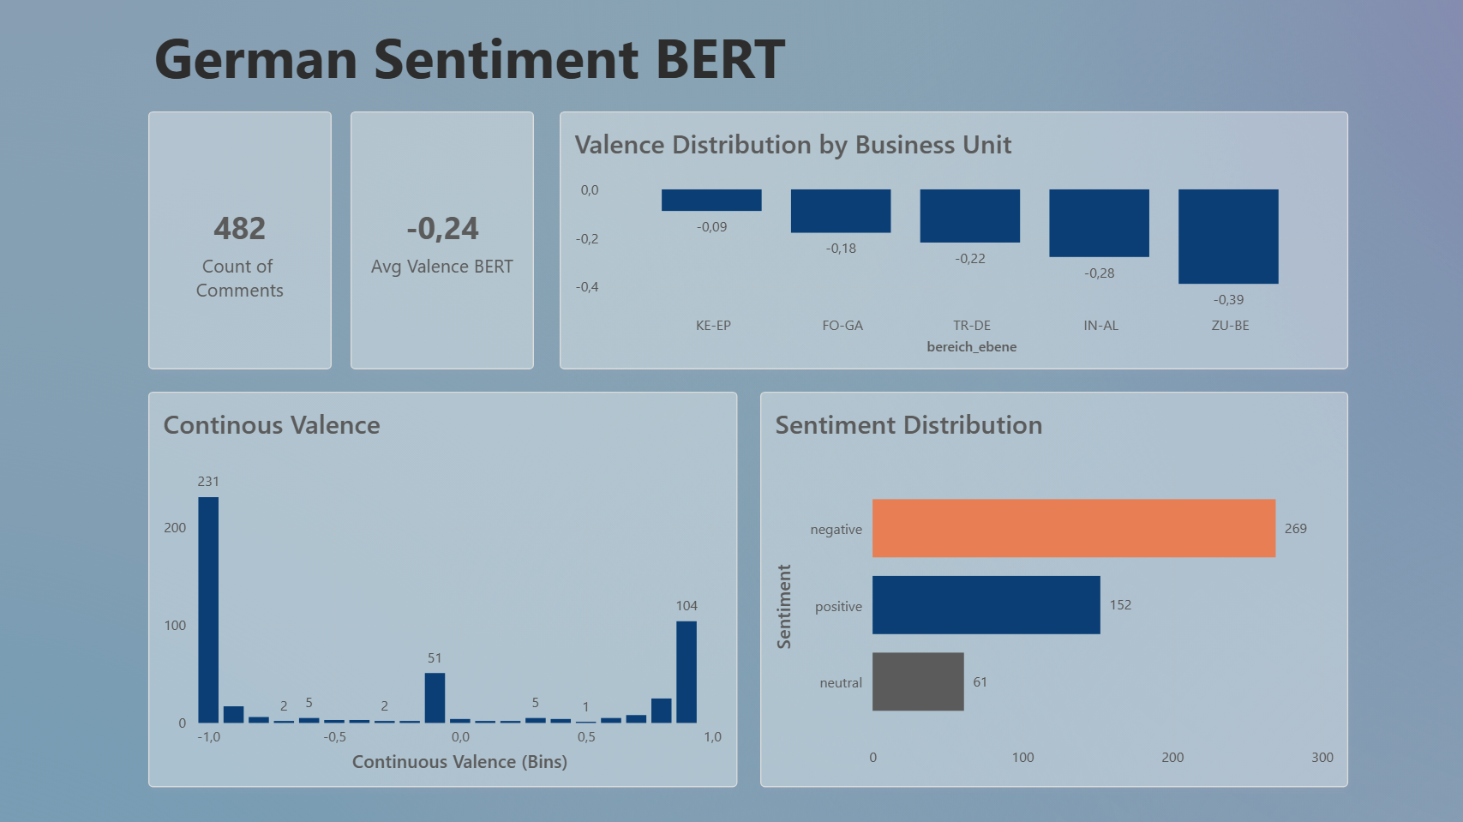
Notes:
This is a first prototype of the sentiment layer in Power BI. German Sentiment BERT generates a continuous valence score for every comment. The dashboard already allows me to compare sentiment distributions across business units and to identify areas with more positive or more critical feedback. One interesting observation is that the distribution is still highly polarised, with many comments close to the positive and negative extremes. Improving that emotional resolution is part of the future work.

Slide 10
OUTLOOK · RISKS & NEXT STEPS
Roadmap, Risks & Next Steps
Current status and path to the final product
01
EDA & Data Quality
02
Survey
Scoring
03
Synthetic
Dataset
04
Zero Shot
Baseline
05
German
Sentiment
BERT
06
BERTopic
& Trends
07
Dashboard
Concept
08
Arousal Dimension
09
Predictive Modelling
10
Dashboard
Finalisation
›
›
›
›
›
›
›
›
›
✅
✅
✅
✅
✅
✅
✅
RISKS
Synthetic text quality.
Arousal model not validated yet. Valence could differentiate even more.
Topic granularity.
NEXT STEPS
Emotion mapping
Topic consolidation
Topic trends & organizational comparison
Predictive modelling
Dashboard finalisation
Evaluation & validation
ELFI · MIDTERM
8 / 8
Notes:
At the moment, the data layer, survey scoring, synthetic dataset, zero-shot baseline, German Sentiment BERT, BERTopic and the dashboard concept are completed.
The open parts are the arousal dimension, predictive modelling and dashboard finalisation.
The main risks are, first, synthetic text quality. The synthetic dataset is useful for demos, but it cannot fully match the richness of real employee feedback. And you can invest the time of a full capstone project on designing a good synthetic data set… I decided to leave as it is right now…
Second, arousal is still open. Valence is implemented, but I still need a validated approach for the second Core Affect axis.
Valence could differentiate even more; currently, on a scale from 1 to 1, it is still very polarized – just like sentiment. I think it‘s enough to show the idea… but could be better
Third, topic granularity is still a challenge. Some topics are too fine-grained and need to be consolidated into actionable business themes.
The next steps are emotion mapping, topic consolidation, topic trends, predictive modelling, dashboard finalisation and final evaluation.

Slide 11
Thank You!
Open for Questions – Let‘s discuss!
CAPSTONE MIDTERM by Iris Detemple · NLP · CORE AFFECT · POWER BI · DATA: HIGH5 EMPLOYEE SURVEY
Notes:
Thank you for listening. I am looking forward to your questions.

