Slide 1

ELFI
Emotional Language Feedback Insights
Can free-text comments be analysed just as
systematically as classic survey data?
Iris Detemple · Capstone Project · neuefische

Slide 2
01
ELFI
Why?
Scores say what. Comments say why.
An engagement score of 3.6 is correct. It does not say why anyone answered that way.
THE GOAL
Patterns and developments, analysable at organisational level.
— The background sits in the free text — situations, themes, reasons.
— But free text is unstructured, and several thousand comments cannot be read systematically.
— So a handful get read and generalised from. Human, and often wrong.
NOT ONE, BUT TWO QUESTIONS
— What do employees talk about?
— And how do they talk about it?
2

Slide 3
02
ELFI
The data
A real survey behind it, a synthetic twin on screen
46,777
questionnaires
4,328
with a comment
9.3 %
comment rate
54
rating-scale items
THE REAL SURVEY
— A business-unit assignment on every questionnaire
— Confidential employee data — it does not leave the company
— No manual valence ratings exist for any of it
THE SYNTHETIC TWIN — WHAT YOU SEE TODAY
— Gemma 2 · 9B, run locally via Ollama
— Every comment made to a prescribed theme and target valence — so the truth is known and the method can be checked
— 5,000 questionnaires · 50 % comment rate · 35 themes
Structure is the same, distributions are not: in the synthetic data the four circumplex corners each hold about a quarter of the comments. In the real data they do not.
3

Slide 4
03 · LIVE DEMO
ELFI
What ELFI delivers
Live in Power BI — on the synthetic dataset
Every comment gets a position, not a label.
Valence on the horizontal axis, arousal on the vertical. Russell's circumplex — and Barrett's argument that fixed emotion categories depend too much on context to predict.
1 Emotional Landscape
Where the mood of a unit sits in the four corners
2 Topic Landscape
Which themes come up, and the comments behind them
unpleasant · activated
frustrated, tense
pleasant · activated
excited, energised
3 Topic & Emotion
One bubble per theme — position is mood, size is volume
unpleasant · deactivated
exhausted, resigned
pleasant · deactivated
content, calm
4 Topic Evolution
How the themes move between survey iterations
5 Business Unit Explorer
Theme profiles and emotional patterns side by side
Russell (1980) · Lisa Feldman Barrett
4

Slide 5
04
ELFI
Valence — two routes
Which one agrees with the survey?
No comment was ever rated by hand. So the survey answers become the external criterion: whoever writes negatively should, on average, have ticked lower.
0.39
Not a percentage. Not a hit rate.
A clear relationship, far from perfect — and that is what to expect. A person can be satisfied and still criticise one thing.
German sentiment model — simple
0.24
German sentiment model — adjusted
0.26
two scoring variants, nearly the same result
Gemma 2 · 9B, judging blind
0.39
better on all six criteria, not just on the average
Rank correlation with six survey metrics, averaged. Blind means the model sees the comment and nothing else — no scale answers, no business unit.
5

Slide 6
05
ELFI
Arousal — the same test, the opposite outcome
Where the language model fell over
Emotion classifier, 28 categories
0.07
Gemma 2 · 9B, judging blind
0.11
− 0.66
The model's arousal against its own valence.
It did not measure a second dimension. It described the first one a second time — negative equals agitated. Plausible values, useless axis.
WORD NORMS — FOUR WAYS TO AGGREGATE
peak word
0.11
three most extreme
0.12
mean, all words
0.19
mean, stopwords removed
0.22
this last step is the stopword list alone
The more a method interprets the text, the worse it does here.
And the biggest single gain in the project was the last step: dropping filler words. They are emotionally neutral but the most frequent words in any comment, so they pull every average to the middle.
Checked against BAWL-R, a word list rated by people, independent of the norms the measure is built from.
6

Slide 7
06
ELFI
The pipeline
Six notebooks, each one checking the one before
01
Prepare
clean, recode, quality signals
02
Valence
Gemma 2 · 9B scores blind
03
Arousal
affective word norms
04
Circumplex
both axes into four corners
05
Topics
BERTopic finds them, Gemma names them
06
Publish
star schema for Power BI
›
›
›
›
›
QUALITY ASSURANCE WAS THE FOCUS
Every stage checks its inputs and its results before processing continues. Reliable analysis does not depend on good models alone — it depends on a pipeline you can trace.
7

Slide 8
07
ELFI
Four findings
Who speaks up, and why that group matters
The people who write are the ones who cared enough to.
Only around 9 percent comment at all, and they are the ones who rate the survey most critically. That is not a flawed sample — it is the group that took the time to say what is not working. Every finding here belongs to them, and they are the ones worth listening to.
The more critical the comment, the more effort went into it.
People who are content need a few words. People with criticism supply context — which makes exactly those comments the most informative ones in the set.
Critical comments are not all alike.
Some are shaped by frustration and tension, others by exhaustion and resignation. Frustration still carries energy — that is where something can be moved. Resignation is the state where it has already gone. A single positive/negative scale loses that difference; this is what the second axis buys.
Language explains part of the survey results, not all of them.
The emotional analysis adds information and makes patterns visible. It does not replace the rating-scale questions. ELFI is a complement, not a replacement.
8

Slide 9
08
ELFI
Where it stands
What holds, what is next, what it cannot do
WHAT STANDS TODAY
— The pipeline runs from raw data to dashboard — on synthetic and on real data.
— Every step validated and secured with plausibility checks.
— Model choice rests on external criteria, not on subjective plausibility.
WHAT COMES NEXT
— Valence is solid. Arousal still has room — test larger models, including OTTO-internal ones such as OGGPT.
— Sharpen the substantive structure with colleagues from the survey field.
— Examine alternative emotional dimensions, in the sense of Warr.
THE LIMITATION THAT STAYS
ELFI reveals patterns and relationships. It does not explain causes. It can show where something stands out — why, and what to do about it, remains a task for people.
9

Slide 10

ELFI
Thank you — questions?
THE CODE, THE NOTEBOOKS, THE WRITE-UP
github.com/IzziePy/ELFI-capstone
Six notebooks running end to end on the synthetic dataset, the process documented step by step, and every source listed.
Iris Detemple · Capstone Project · neuefische
10

Slide 11
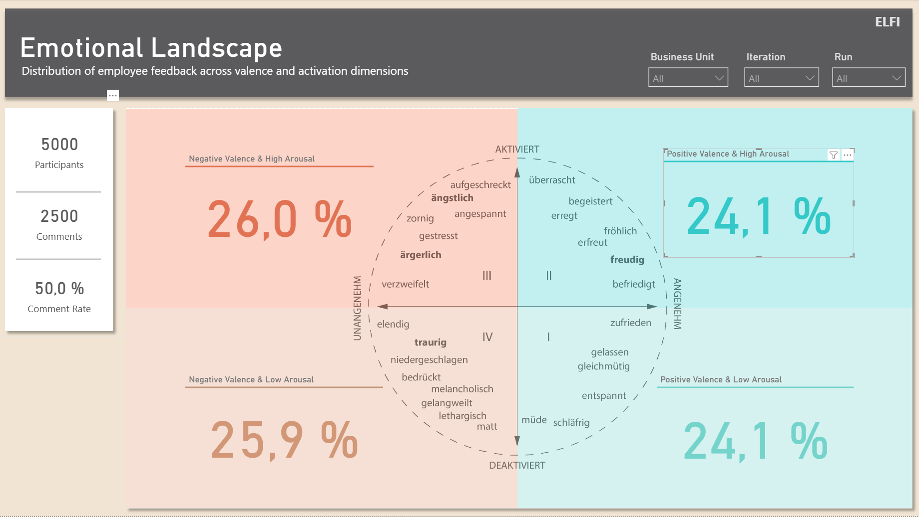
BACKUP · LIVE-DEMO FALLBACK
ELFI
Emotional Landscape
Where the mood of a unit sits. Cells with fewer than five respondents stay empty.
Notes:
Backup for the live demo. Not part of the speaking time.

Slide 12
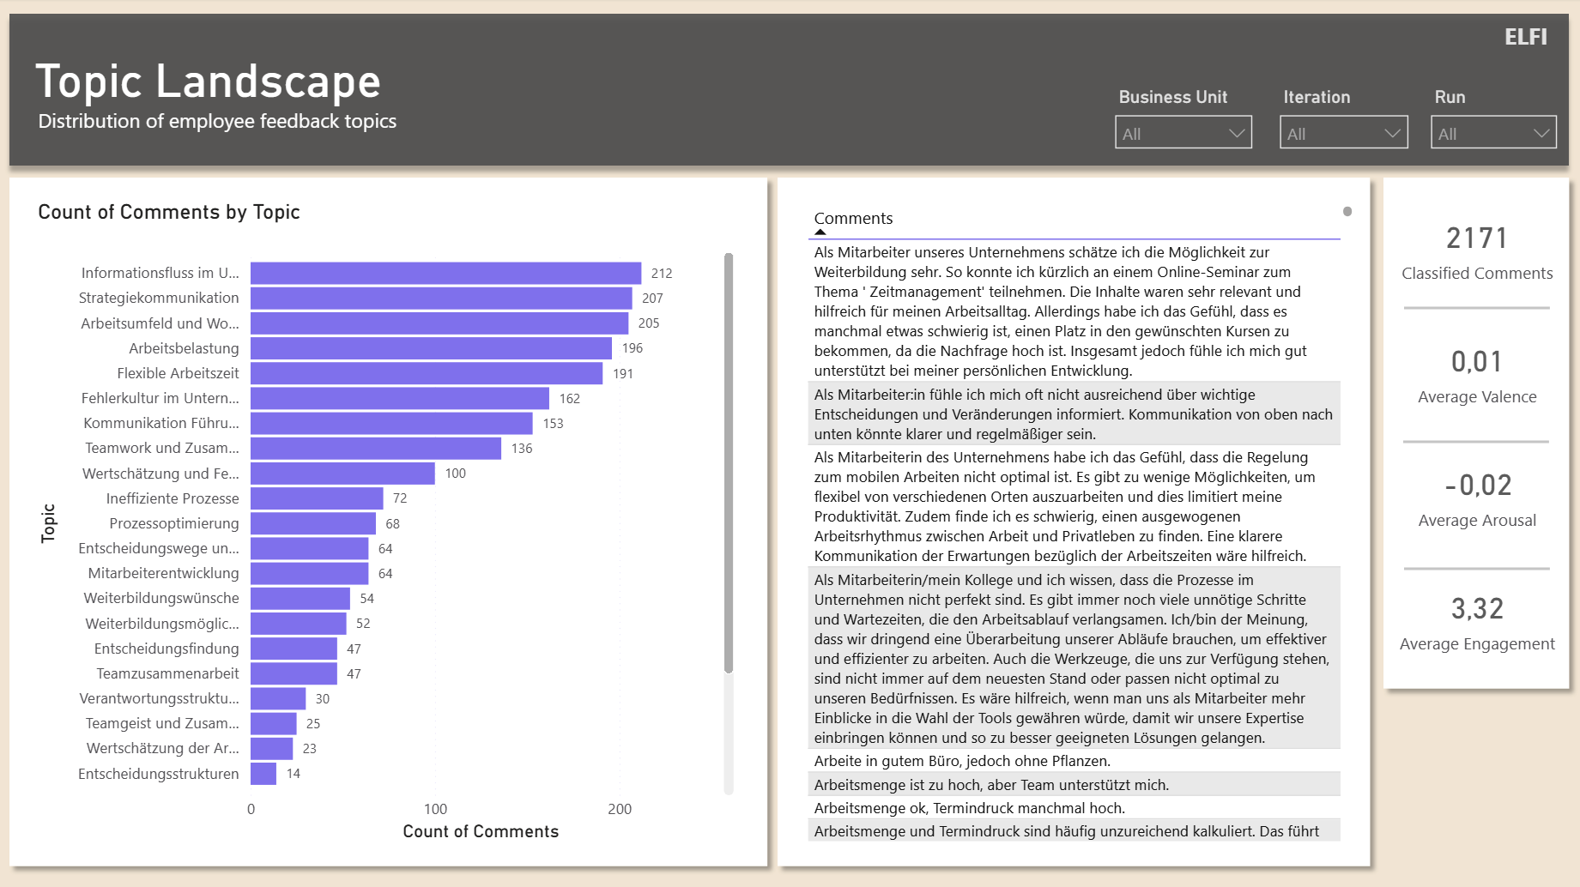
BACKUP · LIVE-DEMO FALLBACK
ELFI
Topic Landscape
What is written about, and how often — themes come from the comments themselves.
Notes:
Backup for the live demo. Not part of the speaking time.

Slide 13
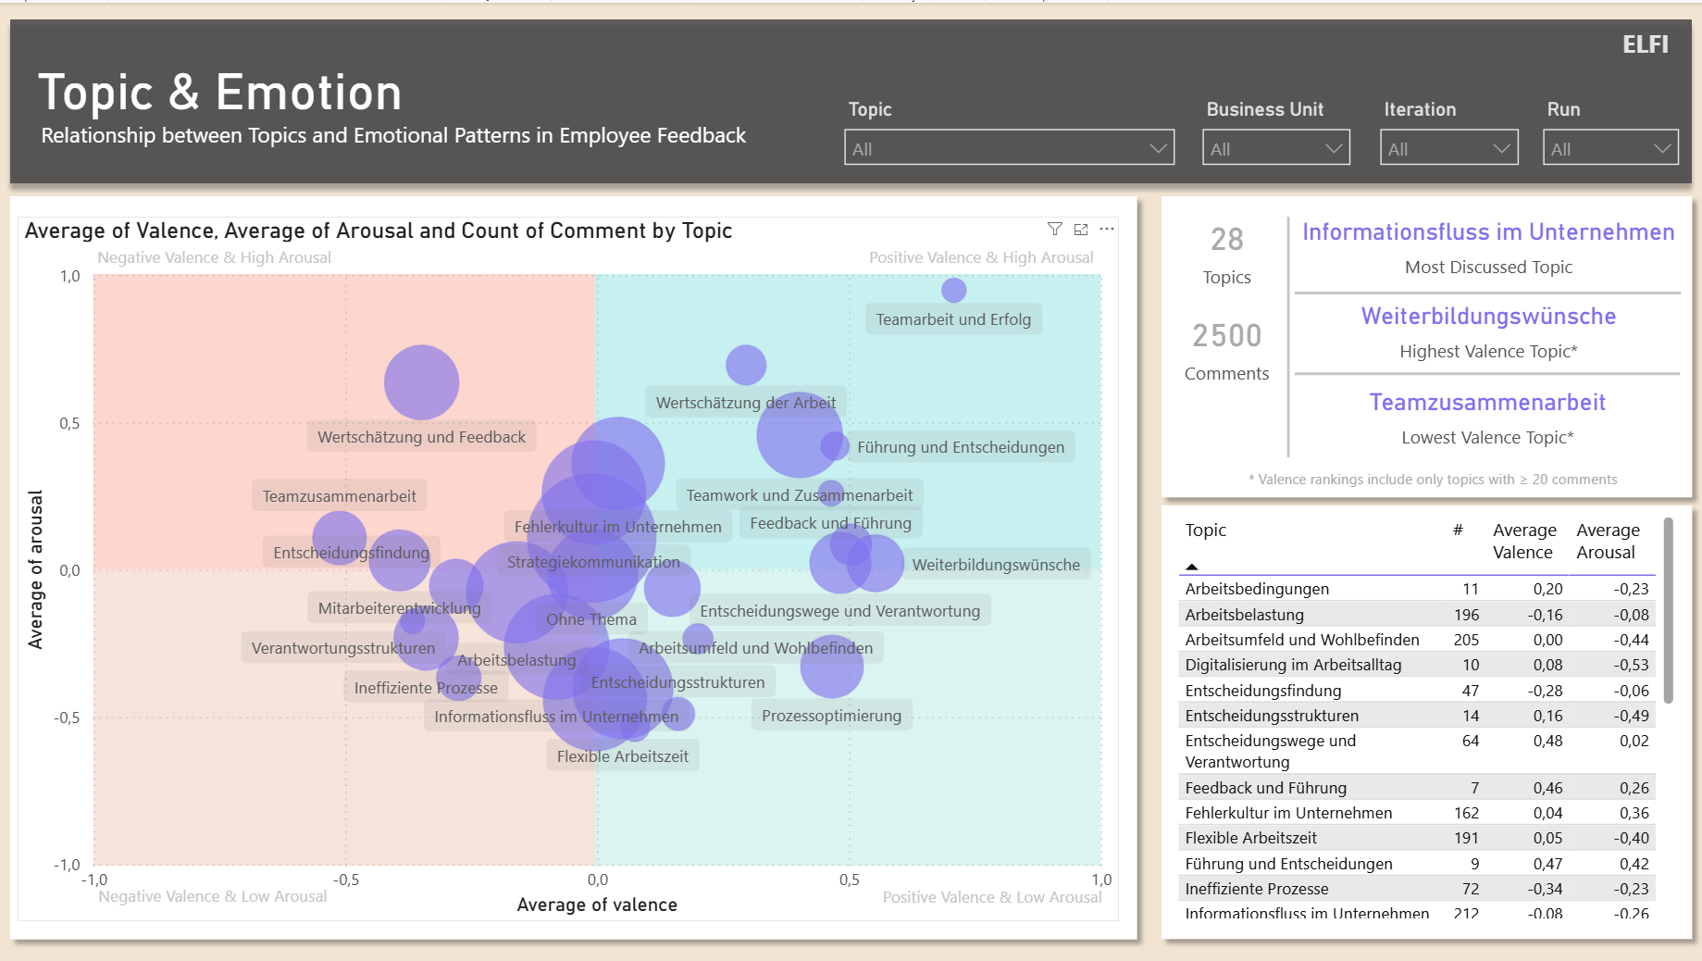
BACKUP · LIVE-DEMO FALLBACK
ELFI
Topic & Emotion
Bubble size is volume, position is mood. This is where the pressure shows.
Notes:
Backup for the live demo. Not part of the speaking time.

Slide 14
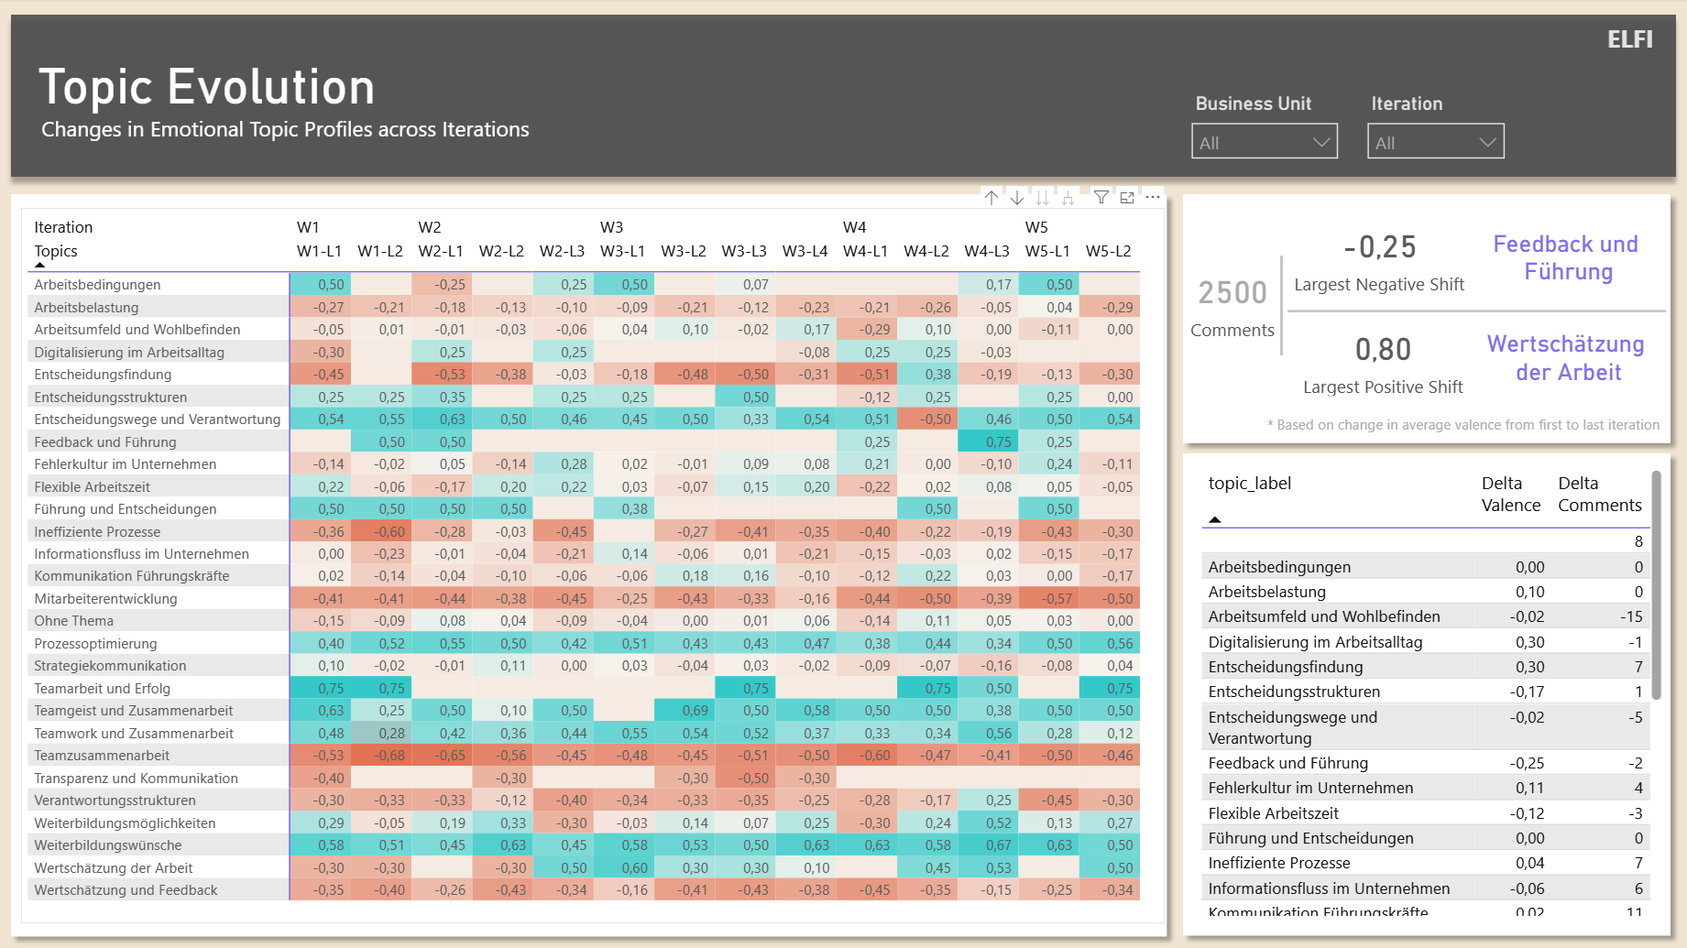
BACKUP · LIVE-DEMO FALLBACK
ELFI
Topic Evolution
The same themes across iterations. Teal is better, coral is worse.
Notes:
Backup for the live demo. Not part of the speaking time.

Slide 15
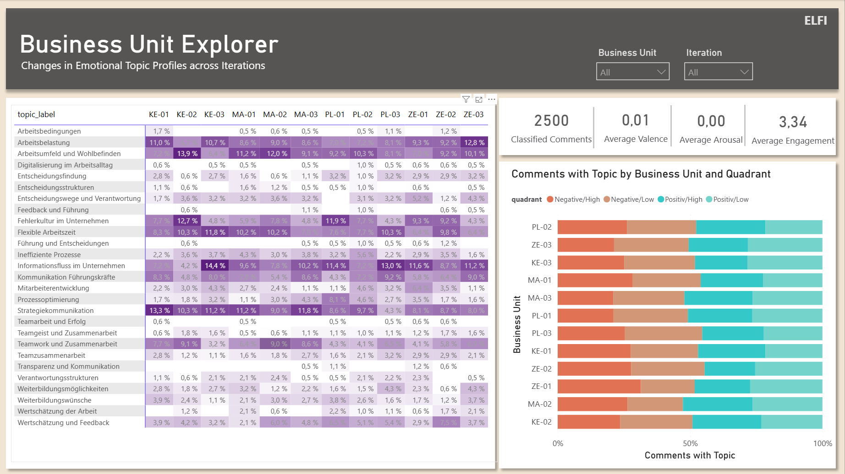
BACKUP · LIVE-DEMO FALLBACK
ELFI
Business Unit Explorer
Topic share per unit next to the quadrant split.
Notes:
Backup for the live demo. Not part of the speaking time.

