Slide 1
AI Customer
Churn Prediction
Business Intelligence · Telecom Analytics · Machine Learning
7,043
26.5%
5
~88%
Customers
Churn Rate
Models Trained
F1 Score
4-Member Team Project | Computer Science & Engineering

Slide 2
Review of Existing Systems
1.1 CRM-Based Systems
1.2 Enterprise Platforms
1.3 Proprietary Telecom
Salesforce – Einstein Analytics
AI-driven churn risk scoring with CRM workflows
Microsoft Dynamics 365 – Customer Insights
ML-based segmentation and churn prediction
HubSpot – Predictive Scoring
Engagement-based churn indicators
Limitation: Expensive, black-box, limited customisation
IBM – SPSS Modeler
SAS – Customer Intelligence
Oracle – Customer Experience Analytics
Statistical modelling and ML for churn prediction
Limitation: High licensing costs; require specialist expertise
AT&T, Vodafone use internal AI systems
Analyse call patterns, billing history, contract duration
Limitation: Not publicly accessible; lack methodological transparency
Common Gap: High cost • Black-box models • Reactive, not proactive • Limited customisation

Slide 3
Gap in Existing Systems
High Cost
What's Needed
Enterprise tools require costly licences and infrastructure beyond academic or SME reach
Cost-effective solution using open-source tools
Transparent, interpretable model outputs
Customisable pipeline for different datasets
Deployable system with a business-facing UI
Proactive — predict before the customer leaves
Academic research accessible and reproducible
Black-Box Models
Limited transparency — businesses cannot understand or trust the model's reasoning
Low Customisation
Vendors lock features; organisations cannot tune models for their specific customer profiles
Poor Accessibility
Proprietary systems unavailable for research or smaller telecom operators
Reactive Only
Most tools identify churn after it has begun, not before — missing the intervention window
Our system addresses all five gaps with a fully open-source, deployable, and interpretable churn prediction pipeline.

Slide 4
Project Feasibility Analysis
4.1
Technical Feasibility
4.2
Economic Feasibility
Technical
Python, Scikit-learn, XGBoost, Flask
Standard laptop sufficient
Public datasets available
No specialised hardware required
Economic
Uses open-source software only
No licensing or API costs
Economically viable and low-cost
4.3
Operational Feasibility
4.4
Schedule Feasibility
Operational
Simple user interface
Minimal training required
Clear prediction outputs
Easily adopted in business environments
Schedule
Data preprocessing
Model training & evaluation
Backend integration
Frontend development
4–5 weeks realistic for 4-member team

Slide 5
Objectives of the Proposed Work
Primary Objective
Design and develop an AI-based Customer Churn Prediction System that accurately identifies at-risk customers, enabling proactive retention strategies.
01
Analyse Customer Behaviour
02
Develop Predictive Models
Study demographic, billing & service usage patterns
Identify key churn-driving features
Understand churner vs. non-churner differences
Binary classification: Low / Medium / High risk
Implement supervised ML algorithms
Compare baseline and advanced models
03
Improve Predictive Reliability
04
Build a Deployable System
Address class imbalance with SMOTE
Optimise with evaluation metrics
Generate probability-based risk scores
Integrate trained model into prediction pipeline
Provide interpretable outputs to business users
Support real-time predictions via web dashboard

Slide 6
Methodology – Data & Model Development
Step 1
Data Collection
Step 2
Data Preprocessing
Structured historical customer dataset
Demographics, account details, usage patterns, churn label
Handle missing values & inconsistencies
Encode categoricals, normalise numericals
Split into train/test; apply SMOTE if imbalance detected
Step 3
Exploratory Data Analysis
Step 4
Model Development
Analyse churn distribution
Identify high-impact features
Visualise correlations and behavioural trends
Train Logistic Regression (baseline), Decision Tree, AdaBoost
Train Random Forest and XGBoost (advanced)
Fair comparison on same train/test split

Slide 7
Methodology – Evaluation & Deployment
Step 5
Step 6
Step 7
Model Evaluation
Selection & Optimisation
Deployment
Accuracy, Precision, Recall, F1-Score, ROC-AUC
Special focus on Recall for churn class
Select best-performing model by balanced metrics
Hyperparameter tuning with GridSearchCV / RandomizedSearchCV
5-fold cross-validation for stability
Feature importance analysis
Save trained model with joblib (model.pkl)
Flask REST API: POST /predict, GET /stats
Browser-based business intelligence dashboard
Overall Workflow
Data Collection
Preprocessing
EDA
Model Training
Evaluation
Selection
Deployment

Slide 8
System Architecture
Data & Model Layer
API Layer (Flask)
Presentation Layer
WA_Fn-UseC_-Telco-Customer-Churn.csv
backend/app.py
churn_dashboard.html
save_model.py → Preprocessing pipeline
POST /predict
Customer input form (Fetch API)
XGBoost Classifier (best model)
GET /stats
Churn probability bars
→
→
model.pkl | scaler.pkl | feature_columns.pkl
GET /analysis
Risk classification badge
joblib artefacts
JSON / HTTP
build_feature_vector()
Contributing factors panel
get_risk_level() | get_factors()
Retention action table
Offline — run once
http://127.0.0.1:5000
Browser — no framework
Each layer is independently replaceable — the model can be retrained without touching the frontend; the API can be extended without modifying the dashboard.

Slide 9
Prediction Request Flow
Business
User
Browser
(Dashboard)
Flask API
/predict
XGBoost
Model
Flask API
Response
Browser
UI Update
Fills form:
tenure, charges
contract type...
POST /predict
JSON payload
via Fetch API
build_feature_
vector() maps
30+ columns
predict_proba()
returns churn
probability
get_risk_level()
get_factors()
JSON response
Updates bars,
badge, factors
action panel
← response flows back: JSON { churnProbability, riskLevel, contributingFactors, recommendedAction }
Key Technical Details
Port:
5000 (local)
CORS:
flask-cors enabled
Scaling:
scaler.pkl — same as training
Feature vector:
30+ columns, zero-initialised
Threshold:
0.5 default (tunable)
Response time:
< 200ms

Slide 10
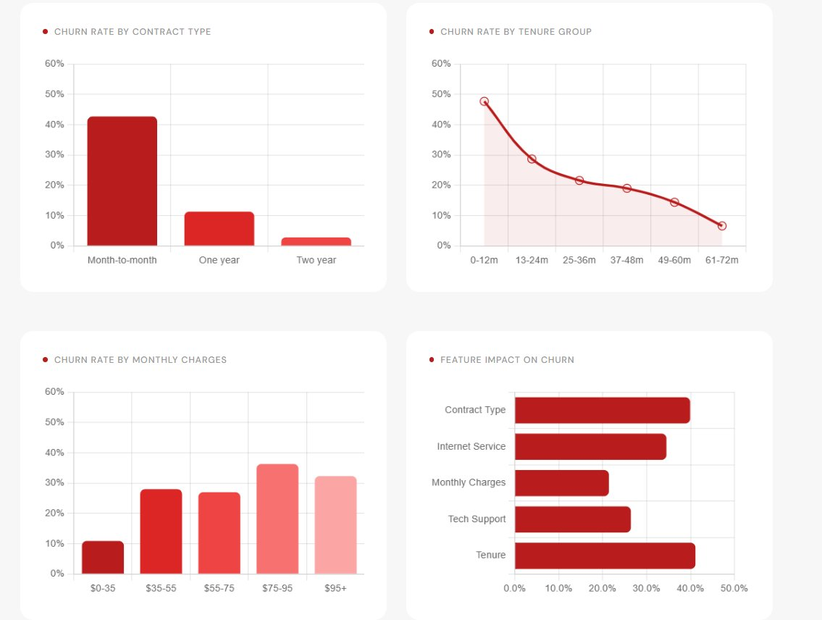
Live Dashboard — Customer Prediction
Live stat cards
Real data from GET /stats
Prediction form
Sends POST /predict
Probability bars
Churn vs retention %
Risk badge
High / Medium / Low
84.9% churn
Month-to-month + Fiber + 2mo

Slide 11
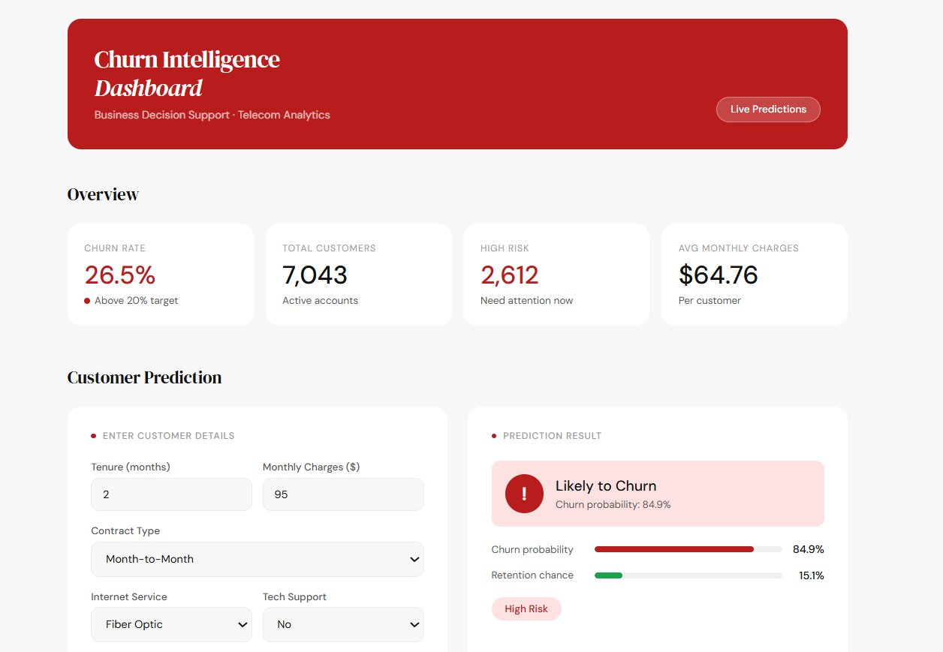
Churn Trends & Feature Analysis
Key Insights
3×
M-to-M customers churn more than 2-year contract holders (43% vs 11%)
48%
Churn rate in first 0–12 months — highest risk window
$75+
High-charge customers (>$75/mo) show 35%+ churn rate
#1
Contract Type has the single greatest impact on churn
58%
Fiber Optic users without tech support — danger zone

Slide 12
Relevance of Algorithms & Techniques
Problem: Binary classification on structured tabular customer data — predict churn probability to enable proactive retention
Logistic Regression
Baseline
Decision Tree
Baseline
AdaBoost
Baseline
Binary outcomes with probabilistic output
Highly interpretable — business explainability
Establishes benchmark for comparison
Non-linear feature interactions
Handles categorical + numerical data
Rule-based customer segmentation
Boosting with re-weighted samples
Shallow stumps corrected iteratively
More powerful than single DT
Random Forest
Advanced
XGBoost
Selected
Bagging — multiple trees in parallel
Reduces variance, handles noisy data
Built-in feature importance
Sequential residual correction
L1/L2 regularisation built-in
Best ROC-AUC on this dataset

Slide 13
Relevance of Supporting Techniques
01
Data Preprocessing
02
SMOTE — Class Imbalance
Missing value treatment (TotalCharges whitespace bug fixed)
Categorical encoding — binary + one-hot (30+ features)
StandardScaler normalisation before SMOTE
26.5% churn vs 73.5% no-churn in raw data
Synthetic interpolation between minority samples
Balanced to 5,164 vs 5,164 — fair model training
04
Cross-Validation
03
Feature Importance
5-fold CV during hyperparameter tuning
Reduces variance in metric estimates
Ensures model generalises beyond training data
Built into Random Forest and XGBoost
Top features: contract type, tenure, monthly charges
Actionable insight: tells businesses WHY customers churn
05
Hyperparameter Tuning
06
Threshold Optimisation
GridSearchCV for LR, DT, AdaBoost (small spaces)
RandomizedSearchCV for RF, XGBoost (large spaces)
100 iterations, scored by F1 for churn class
Default 0.5 is not always optimal
Sweep thresholds 0.1–0.9, select best F1
Allows precision–recall trade-off control

Slide 14
Results — Model Comparison
Selected Model
XGBoost
~88%
~88%
Accuracy
F1-Score
~0.95
~0.89
ROC-AUC
Recall
SMOTE improved recall from ~71% (without balancing) to ~89% • XGBoost ranks a churning customer above a non-churning one 95% of the time (ROC-AUC)

Slide 15
Conclusion & Future Work
What We Achieved
Future Improvements
✓
End-to-end ML pipeline from raw data to deployed prediction system
SHAP values for genuine model explainability (not rule-based)
✓
5 models compared with consistent evaluation framework
Temporal modelling — LSTM or survival analysis for behaviour trends
✓
XGBoost achieving ~88% accuracy and ~0.95 ROC-AUC
Cloud deployment with authentication and rate limiting
✓
Flask REST API serving real-time predictions
Automated retraining on data drift detection
✓
Business-facing dashboard with risk tiers and retention actions
✓
Full customer database view with cohort analysis
Proper VS Code project structure — production-ready architecture
AI Customer Churn Prediction · 4-Member Team Project · Computer Science & Engineering

