Slide 1
HACKATHON
SoluServe
By N/A © 2023

Slide 2
CONTENTS OF THIS TEMPLATE
* Introduction
* Penyataan Masalah
* Teknologi yang digunakan
* Bagaimana masalah ditangani dengan projek

Slide 3
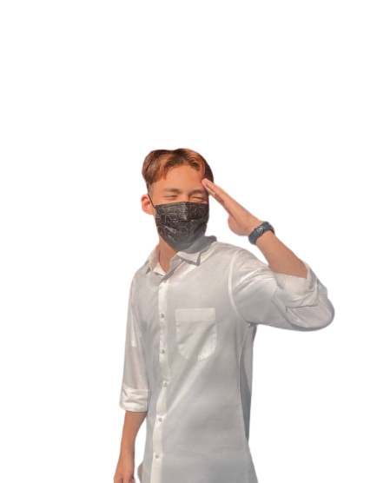
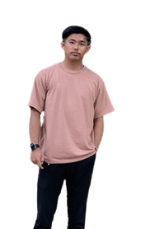
Introduction
Name : Izzrieq Illhan (NIKO)
Course : Programming
Name : Muhammad Amirul
Course : Programming

Slide 4
Penyataan Masalah
Attendance
Order Cafe
25%
50%
Kehadiran ke Surau menjadi perkara sulit
Booking makanan kafe atas talian
“Sesat”
75%
Pelajar baru tidak mengetahui kedudukan bangunan

Slide 5
Teknologi yang digunakan
 | Figma | JS | PHP | Tailwind
Readability | High | Medium | High | High
Performance | High | High | High | High
Used inside system | 100% | 20% | 100% | 100%

Slide 6
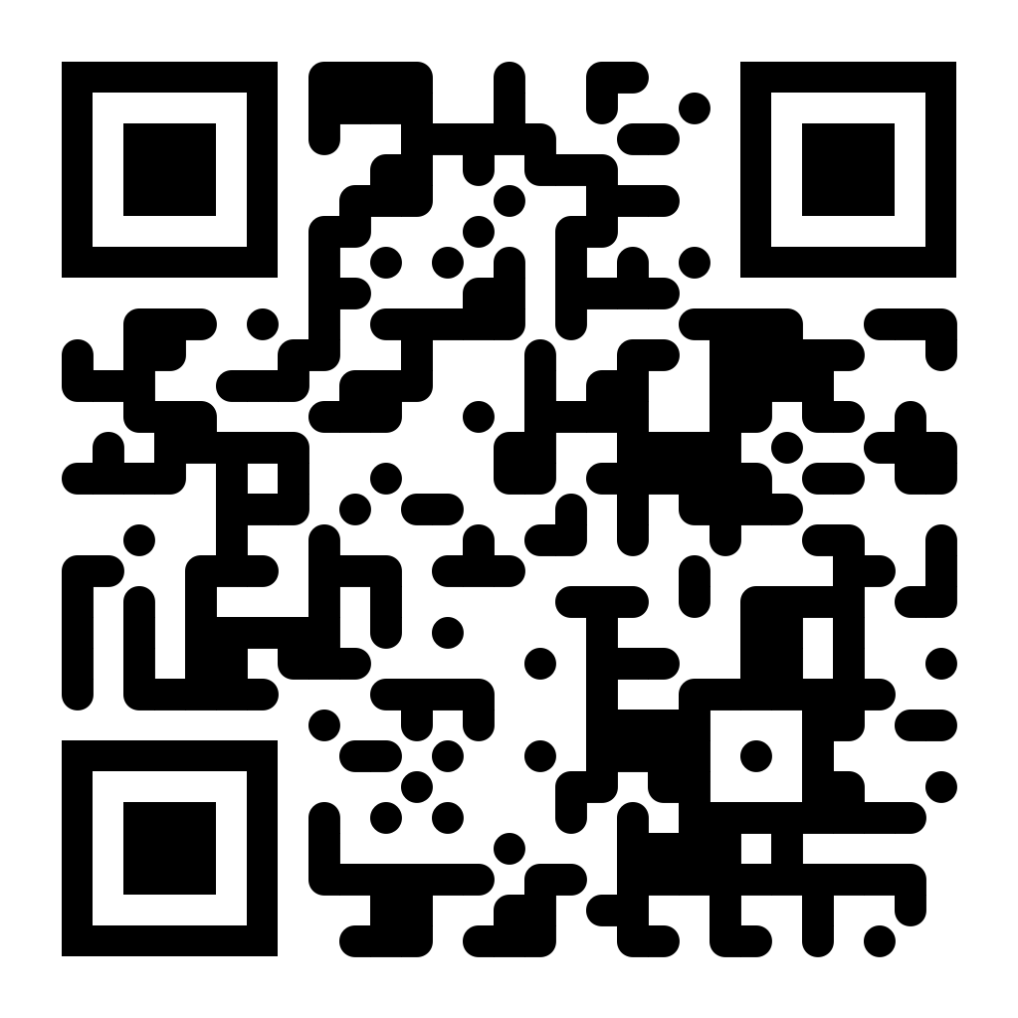
Prototype

Slide 7
RolePlay
Student | MPP | ADMIN | Admin Cafe
23221111 | 23221101 | 0001 | 0002
12345 | 12345 | 12345 | 12345

Slide 8
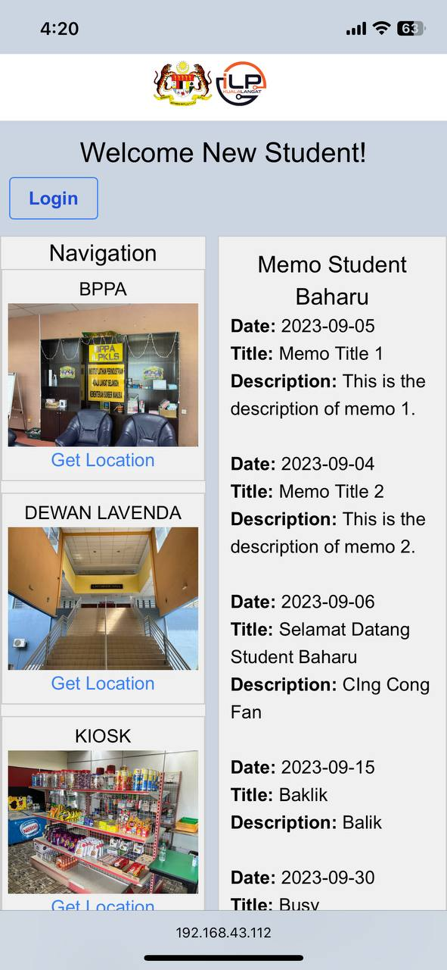
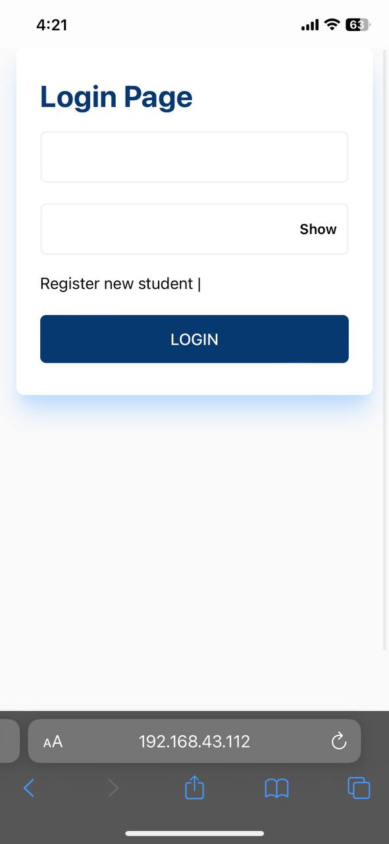
Prototype
Login choice
User where type=pelajar
User where jawatan=MPP
User where type=admin
User where type=admin & jawatan=cafe

Slide 9
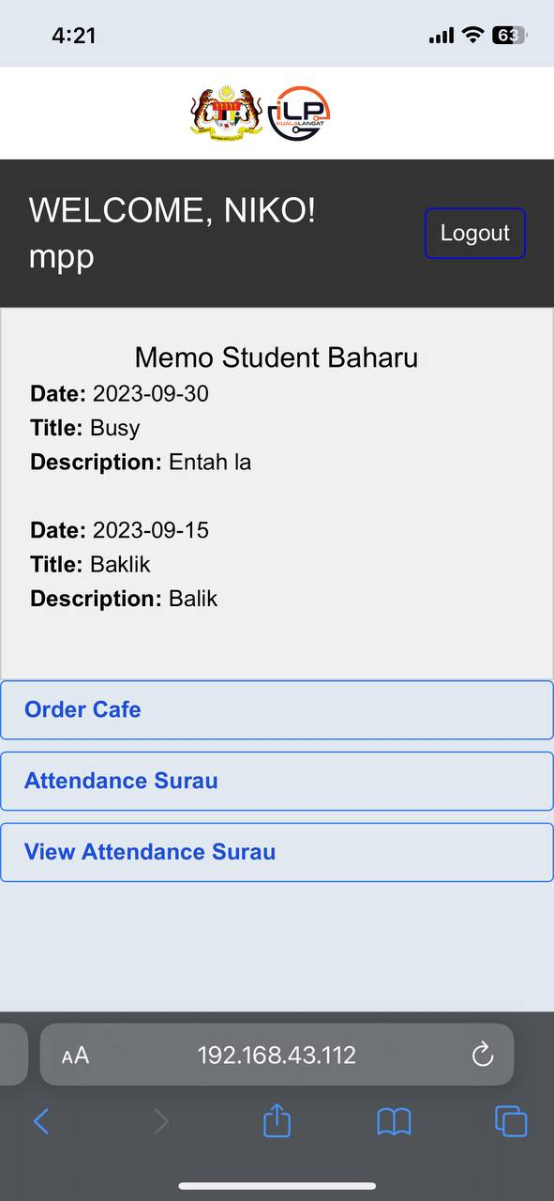
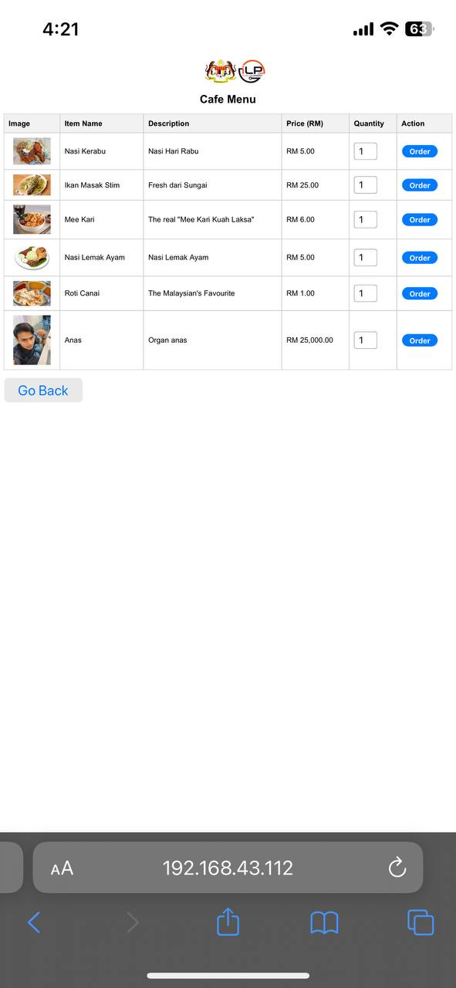
Prototype
Login = pelajar || MPP

Slide 10
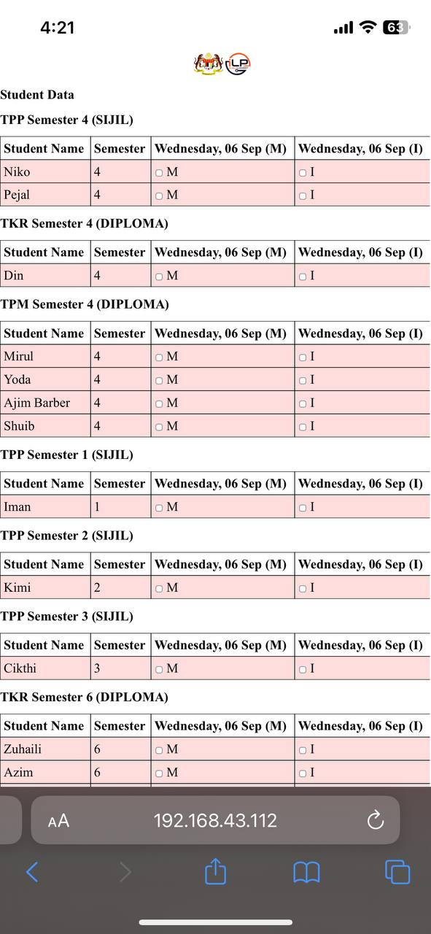
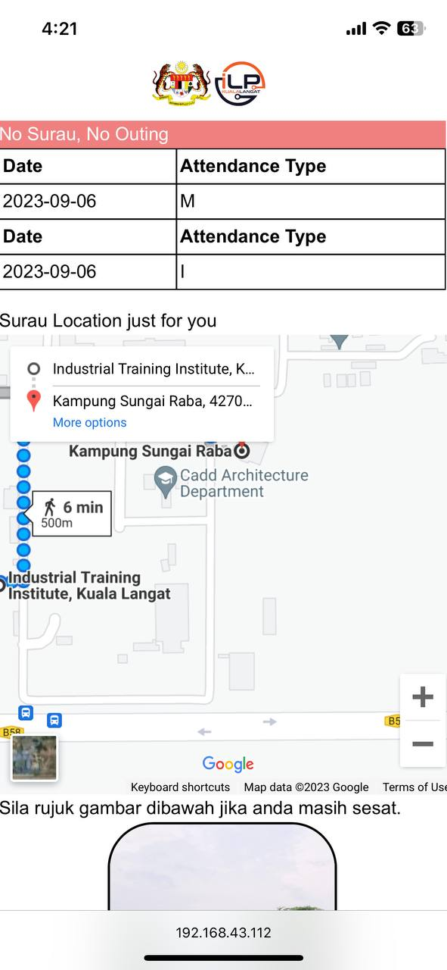
Prototype
Attendance =< 3

Slide 11
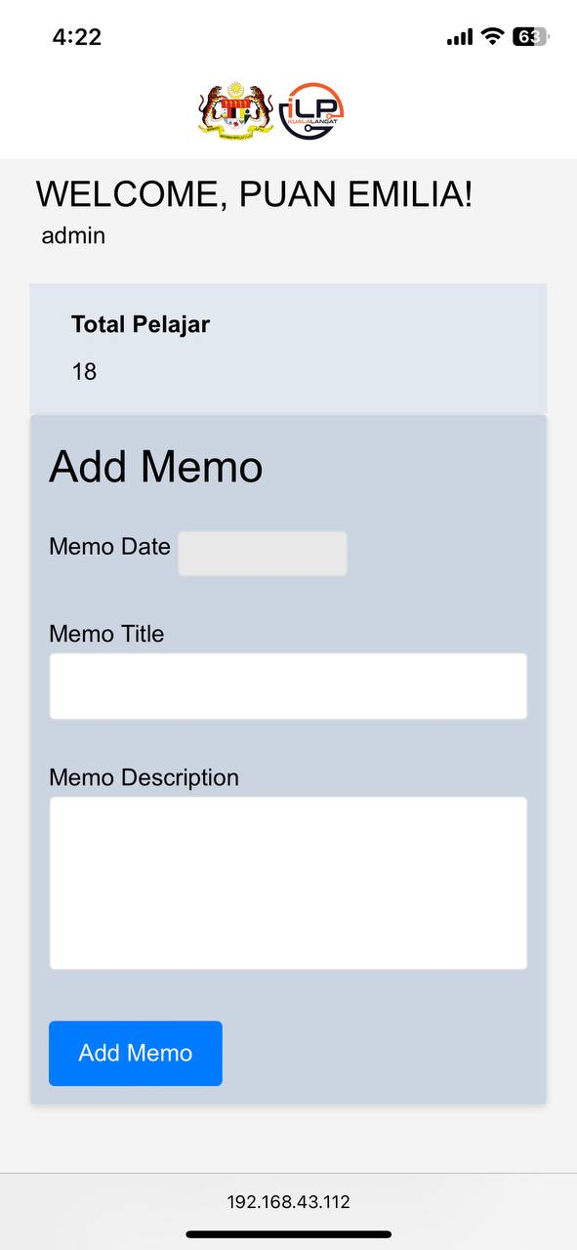
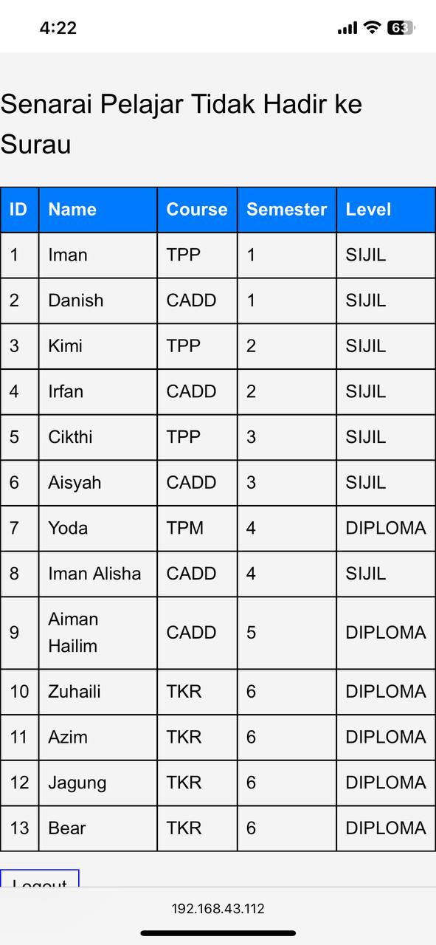
Prototype
Admin Dashboard

Slide 12
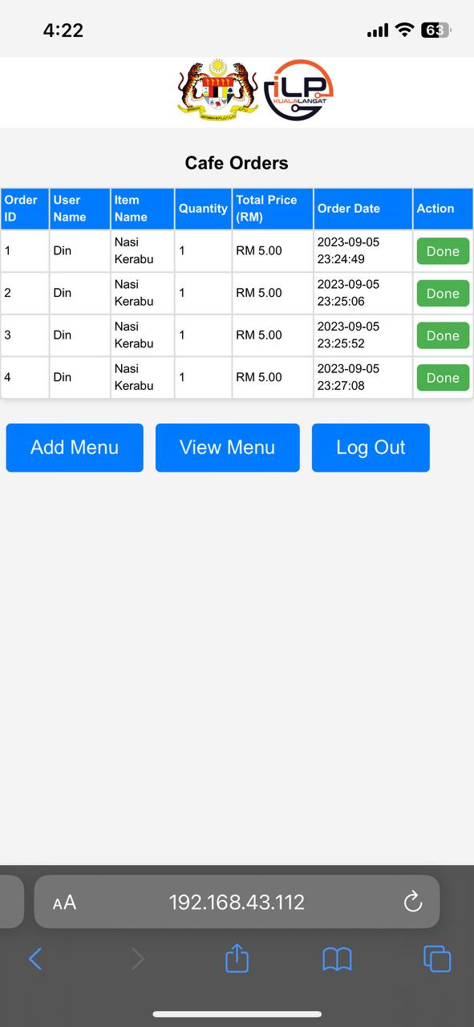
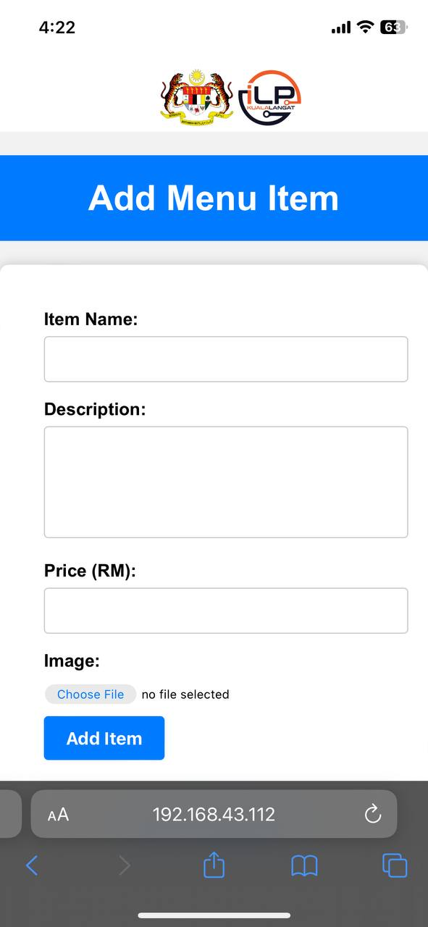
Prototype
Cafe Admin Dashboard

Slide 13
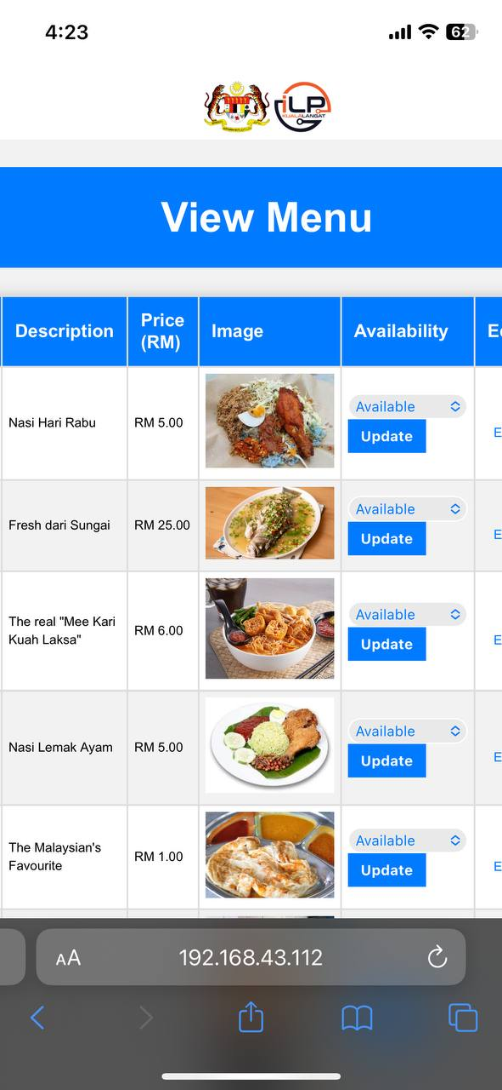
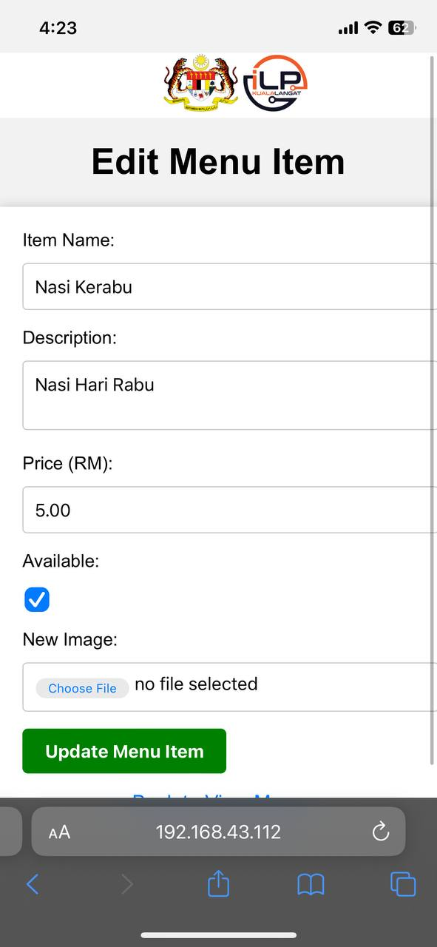
Prototype
Cafe Admin Dashboard

Slide 14
Thank You
Github
https://github.com/Izzrieq/Hackathon
Figma
https://www.figma.com/file/yXfsdXRXasnMkP2MTlVMFL/Untitled?type=design&node-id=0-1&mode=design&t=6JrIXFBncOK6TR17-0

