Slide 1
Zomato Data Analysis Presentation
Analyzing restaurant trends using Excel, Power BI, and Tableau.

Slide 2
Group 2 -Team Members
Bharat Gopakumar
Swathi Dasi
Vasipalli Vamsi
Sarika Kailas Kakulte
Dinkar Kumar
Pooja Akshay Shivankar
Kripa K

Slide 3
Zomato Company Overview
Zomato is a multinational restaurant aggregator and food delivery company.
Founded in 2008, headquartered in India
This platform connects customers, restaurant partners and delivery partners, serving their multiple needs.
The company has expanded its presence globally, offering services such as restaurant listings, reviews, online table bookings, and food delivery.

Slide 4
Dataset & Key Performance Indicators (KPIs)
Dataset contains restaurant information from Zomato.
- Key KPIs:
Total restaurants by country & city.
Restaurant openings by year, quarter, and month.
Restaurant count by average ratings.
Price bucket distribution.
Percentage of restaurants with table booking & online delivery.
Cuisine & location trends.

Slide 5
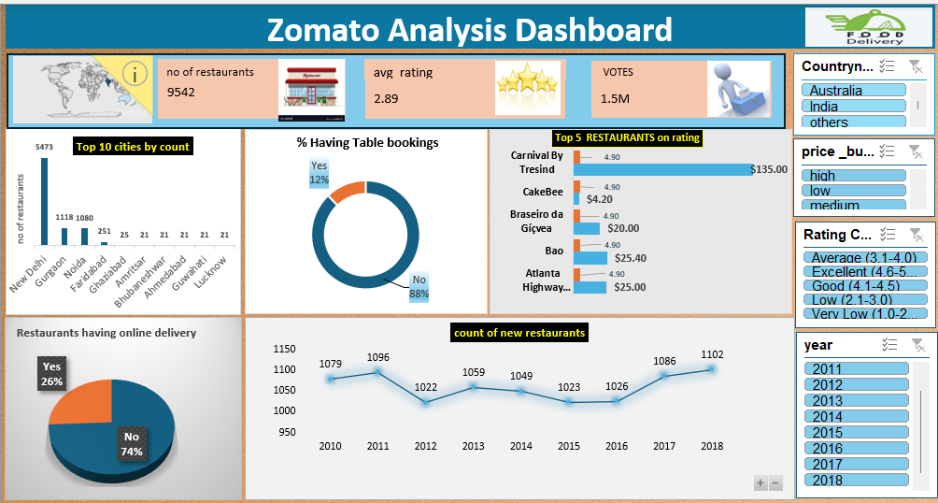
Excel Dashboard

Slide 6
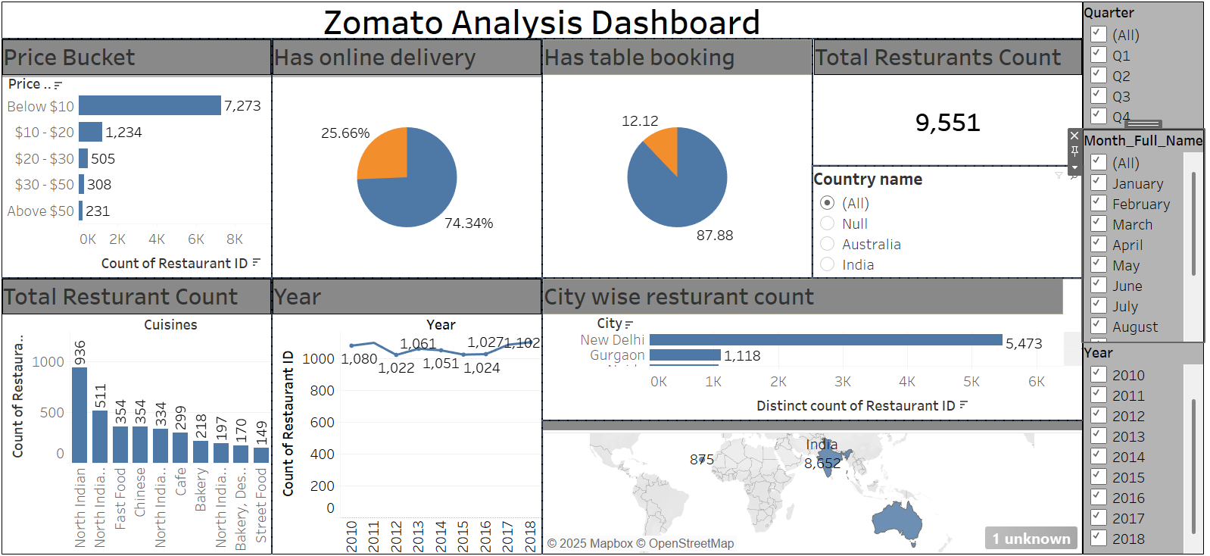
Tableau Dashboard

Slide 7
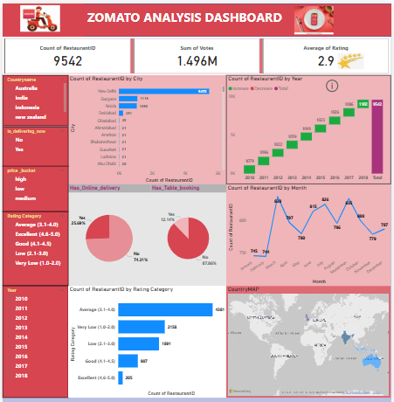
Power BI Dashboard insights

Slide 8
Insights
Most restaurants are in India, especially New Delhi.
Majority of restaurants do not offer table booking.
Small Number of restaurants provide online delivery.
Most affordable restaurants fall in the ‘Below $10’ category.
Growth trend in restaurant openings over time.

Slide 9
Conclusion & Recommendations
Most restaurants do not offer table booking, but there is an opportunity for online delivery expansion
With the growing trend of new restaurant openings, businesses should focus on differentiating themselves through pricing, location, and unique offerings.
Recommendation: Restaurants should consider implementing online delivery services to reach a wider customer base and enhance revenue opportunities.

Slide 10
Thank You !

