Slide 1
Web Scripting 1
Day 09

Slide 2
Agenda
Game Progress Check-In
Progress Check-In
Form Validation
JSON
Fetch
Async / Await
API’s

Slide 3
Game Progress Check-In
Please add your name to the Google Sheet in order to reserve a day and time for your game progress check-in meeting

Slide 4
Progress Check-In
At this time you should have a rough idea of the following concepts
A basic understanding of:
Objects
Classes

Slide 5
Quick Introduction to Forms

Slide 6
Quick Introduction to Forms
You will have a full lesson on forms in the Web Development 2 course
Today’s lesson will just provide a quick introduction:
What is an HTML form
How an HTML form works
Why to validate forms with HTML, CSS, and JavaScript
How to validate forms with HTML, CSS, and JavaScript

Slide 7
Forms - Introduction
Forms allow web sites users to interact with your web site
You can use forms to do the following:
Collect data from users
Logging into a site
To perform calculations
Enable users to contact you
To pay for items online
To search for something online

Slide 8
How a Form Works
User fills in the form
User submits the form
Data from the form is sent to the form processor which is a server script that runs on a web server
Not all forms are sent to the server, some forms such as calculators can be processed locally and never require data to be sent to a server
The form is processed
Feedback can optionally be given to the user to assure them that their information has been received

Slide 9


How a Form Works
4. Form processed
1. Form filled in
2. Form submitted
3. Form sent to server
Internet
5. Feedback sent to user
Desktop computer photo: This Photo by Unknown Author is licensed under CC BY-SA-NC
Wed server photo: This Photo by Unknown Author is licensed under CC BY-NC

Slide 10
Form Validation

Slide 11
Why Validate Forms on the Front-End
User Experience: Client-side validation can provide immediate feedback to the user as they fill out the form. This can help to prevent errors and improve the overall user experience
Performance: By validating the form data on the client side, you can reduce the number of requests sent to the server, which can improve the performance of the web site
Reduced Server Load: By catching errors on the client side, you can reduce the load on the server. This can be especially important for web sites with high traffic or a limited server resources
Security: Client-side validation can also help to prevent malicious users from submitting invalid or malicious data. It can also help to prevent cross-site scripting (XSS) and SQL injection attacks
Accessibility: Client-side validation can also improve the accessibility of web forms. It can help users who are using assistive technology to understand the requirements of the form and ensure that they are providing valid input
Text generated by: https://chat.openai.com/chat

Slide 12
How to Validate Forms on the Front-End
Using HTML5 Validation: You can use HTML5 required and pattern attributes to check if the input is empty or matches a certain pattern. It also provides some built-in error messages that can be displayed to the user.
Using JavaScript: You can use JavaScript to check the form input values and display error messages if the validation fails.
Provides for more flexibility and control over the validation process
Requires more code to be written.
Using a JavaScript Library or Framework: There are several libraries and frameworks available that can be used to validate forms in JavaScript
Validation (jQuery)
https://jqueryvalidation.org
Formik (React)
https://formik.org
React-Form (React)
https://github.com/TanStack/form
These libraries typically provide a more comprehensive set of validation rules and error handling
Text modified from text generated by: https://chat.openai.com/chat

Slide 13
HTML Form Validation
HTML5 introduced simple HTML form validation without any need for JavaScript
You can use the ”required” attribute on an input to make sure the user enters data on an input element
If you want more custom looking form validation then you will need to turn to JavaScript
Note: HTML form validation using the built-in HTML validation or using custom JavaScript validation is not secure. Always validate the data a 2nd time on the server when receiving data from an HTML form

Slide 14
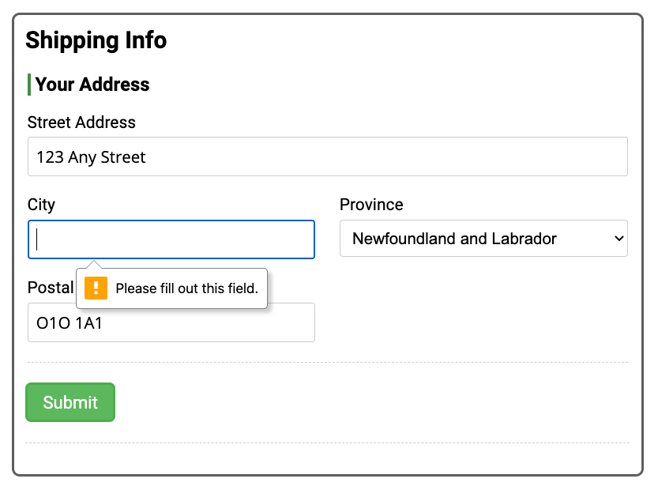
HTML Form Validation
<label for="city">City</label>
<input type="text" id="city" name="city" required>

Slide 15
Form Validation with the Pattern Attribute
Using the required attribute alone allows for basic validation to make sure the user at least inputted something into an input
If you require something a bit more custom, you can use the “pattern” attribute to make the browser validate an input against a regular expression
A regular expression is a pattern that the computer uses to test a string of text against
With a pattern attribute you can validate for Credit Card numbers, postal codes, phone numbers and other common types of data
For some pre-written HTML5 pattern values visit this web site:
http://html5pattern.com/
Use the title attribute to provide helper text to the user if they input invalid data

Slide 16
Form Validation with the Pattern Attribute
<input type="text"
id="postal-code"
name="postal-code"
pattern="[A-Za-z][0-9][A-Za-z](\s)?[0-9][A-Za-z][0-9]"
title="Format: A1A 1A1"
required>
You can use the title attribute to display a helper message to the user if they enter incorrectly formatted data
The pattern attribute tells the browser to test the input entered by the user against the regular expression set in the pattern attribute. The pattern here will test for a Canadian postal code (A1A 1A1)

Slide 17
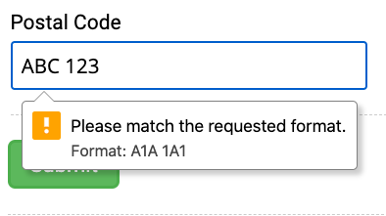
Form Validation with the Pattern Attribute
This input is being validated against a custom pattern set via the “pattern” attribute on the input element. This input is being validated for a Canadian postal code (A1A 1A1).
Visit http://html5pattern.com/ to get some common pattern values for things such as telephone numbers, credit cards, postal codes and other common types of information
The text “Format: A1A 1A1” comes from the title attribute on the input element

Slide 18
JavaScript Form Validation
Many ways to validate forms in JavaScript
See the code demos for today’s files for two examples of JavaScript form validation

