Slide 1
JavaScript
JavaScript Image Spinner – Step by Step Instructions

Slide 2
Notes on these Instructions
These instructions are not the only way to complete this assignment
Usually JavaScript provides multiple ways to complete the same task
If you find an alternative method to creating this image spinner, I encourage you to explore it and give it a try

Slide 3
What We Are Going to Build
According to the a-02 instruction sheet we need to:
Create a script file and attach it to the index.html file
Write the JavaScript that will rotate the image clockwise when we "click" the "< Turn" button
Write the JavaScript that will rotate the image counter-clockwise when we "click" the "Turn >" button

Slide 4
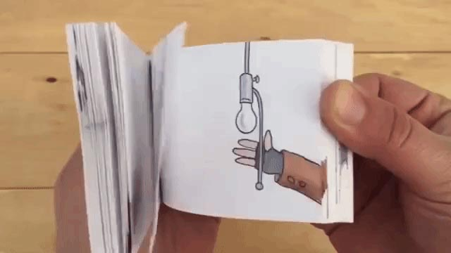
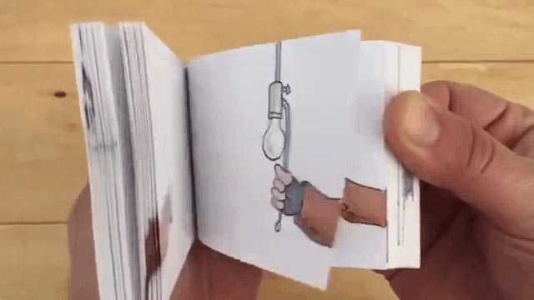
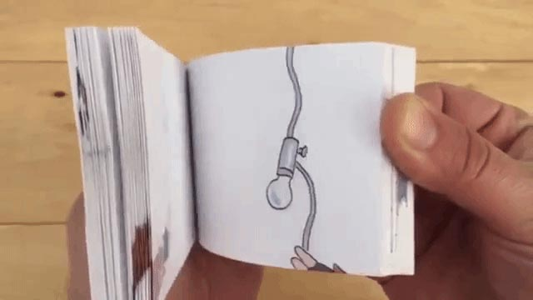
How This Spinner Works
The "3D" rotation of the image is a bit of an illusion created with a similar technique from that used in "flip-book" animation books that you flip through quickly to create the illusion of motion
Click the link below to see this flip book animating
https://laughingsquid.com/flipbook-every-booby-trap-in-home-alone/
Images from: https://laughingsquid.com/flipbook-every-booby-trap-in-home-alone/

Slide 5
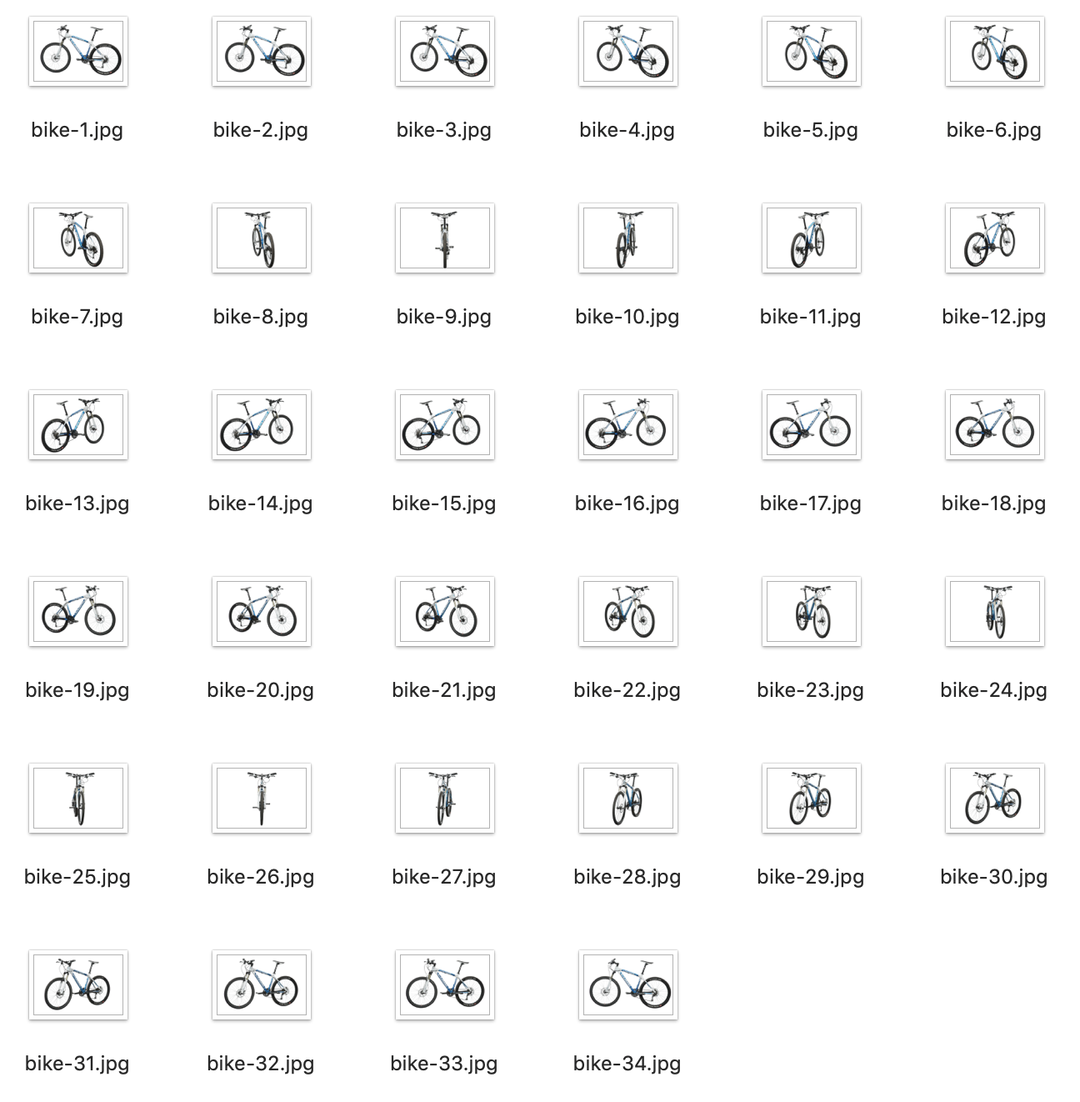
How This Spinner Works
For our bike spinner we use 34 single images of the bike
The images are stored in the images folder and named:
bike-1.jpg, bike-2.jpg, bike-3.jpg…
Each of the 34 images is a photo of the bike at a different degree of rotation

Slide 6
How This Spinner Works
To create the illusion of the bike rotating we will write functions that move through the images sequentially
Rotate Clockwise function
Increments images - (1, 2, 3…)
Rotate Counter-Clockwise function
Decrements images - (7, 6, 5…)
These functions will be triggered when we click our "< Turn" and "Turn >" buttons

Slide 7
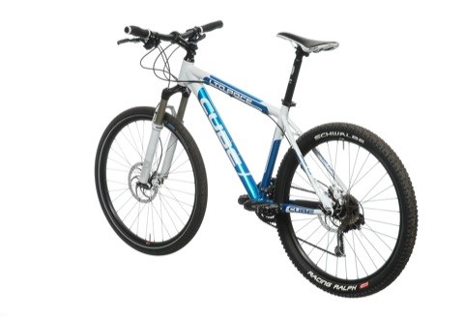
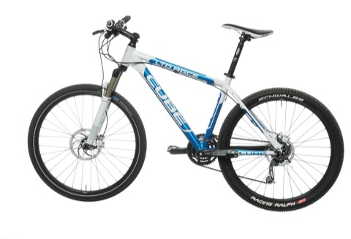
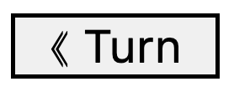
How this Spinner Works – Rotate Clockwise
Rotate Clockwise function
Reset image counter to 0
bike-2.jpg
yes
Are we on the last image?
no
Set the bike image to the bike image that is equal to the counter
Add 1 to image counter
bike-1.jpg
Call the Rotate Clockwise function
Click the button to trigger the rotate clockwise function

Slide 8
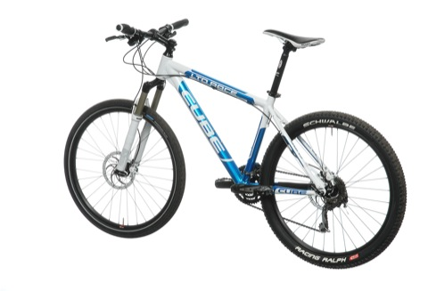
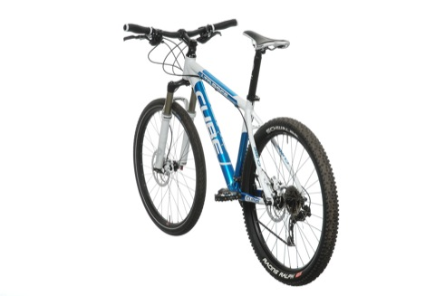
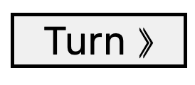
How this Spinner Works – Rotate Counter-Clockwise
*Note: We have 34 bike images stored in an array, so we set the counter to 34 – 1 (33) because arrays start at zero and the last bike image is at position 33
Rotate Counter-Clockwise function
Reset image counter to 33*
bike-6.jpg
yes
Are we on the first image?
no
Set the bike image to the bike image that is equal to the counter
Subtract 1 from the image counter
bike-7.jpg
Call the Rotate Counter-Clockwise function
Click the button to trigger the rotate counter-clockwise function

Slide 9
The Code
For the Bike Spinner

Slide 10
Step 1
Creating the script.js File

Slide 11
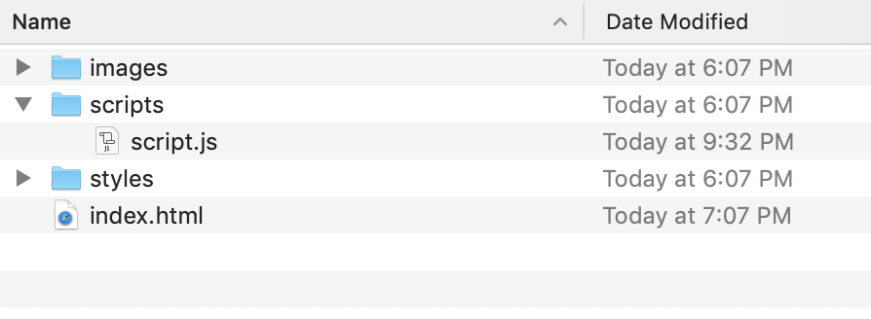
Create the Script File
a-02-start folder
Create a JavaScript file called "script.js"
Save this file inside the "scripts" folder
Create a new "script.js" file and store it in the "scripts" folder

Slide 12
Step 2
Attaching the script.js File to the HTML Document

Slide 13
Attaching the JS File to the HTML Document
Attach the newly created "script.js" file to the "index.html" document by using a script tag placed immediately before the closing "body" element
index.html file
<script src="scripts/script.js"></script>
</body>
</html>
Use the "script" element with a "src" attribute to attach an external script file to an HTML document

Slide 14
Step 3
Grabbing the HTML Elements

Slide 15
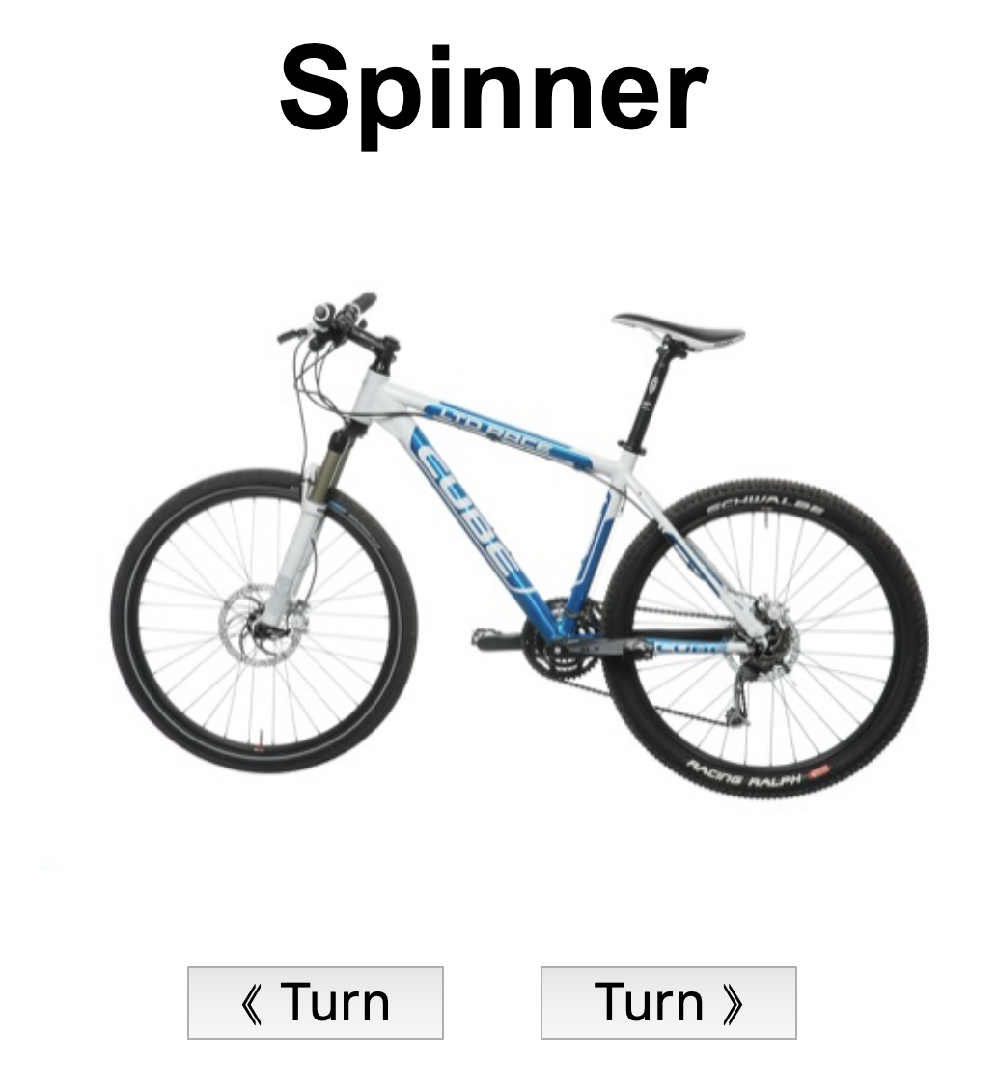
Grabbing the HTML Elements
Determine the HTML elements that we need to interact with
Slide
The image element that displays the bike image
Buttons
Turn Clockwise Button
Turn Counter-Clockwise Button
The bike image (the slide)
Turn counter-clockwise button
Turn clockwise button

Slide 16
Grabbing the HTML Elements – The Clockwise Button
The HTML for the Turn Clockwise Button
<button id="btn-turn-clockwise">&Lang; Turn</button>
Select this element with JavaScript and store it in a variable called "btnTurnCW"
JS (place this code in the "script.js" file)
const btnTurnCW = document.getElementById('btn-turn-clockwise');
The Turn Clockwise button

Slide 17
Grabbing the HTML Elements – The Counter-Clockwise Button
The HTML for the Turn Counter-Clockwise Button
<button id="btn-turn-counter-clockwise">Turn &Rang;</button>
Select this element with JavaScript and store it in a variable called "btnTurnCCW"
JS (place this code in the "script.js" file)
const btnTurnCCW = document.getElementById('btn-turn-counter-clockwise');
The Turn Counter-Clockwise button

Slide 18
Grabbing the HTML Elements – The Slide
The HTML for the Bike Slide
<img id="slide" src="images/bike-1.jpg" alt="Bike">
Select this element with JavaScript and store it in a variable called "slide"
JS (place this code in the "script.js" file)
const slide = document.getElementById('slide');
The bike image (the slide)

Slide 19
Grabbing the HTML Elements – The Complete JS Code
Add the following code to the top of the script.js file
script.js
// Button Elements
const btnTurnCW = document.getElementById('btn-turn-clockwise');
const btnTurnCCW = document.getElementById('btn-turn-counter-clockwise');
// HTML Slide Element (the bike image element)
const slide = document.getElementById('slide');

Slide 20
Pause and Check Your Code

Slide 21
Check your code for errors before proceeding
Check early and check often when writing a script
Test to make sure your buttons and the slide have been selected correctly
Test by entering your variable names into the console
If your variables return HTML elements you are good to go
If your variables return "null":
Check your code, and make sure the ID in the HTML match the ID in the "document.getElementById()" method

Slide 22
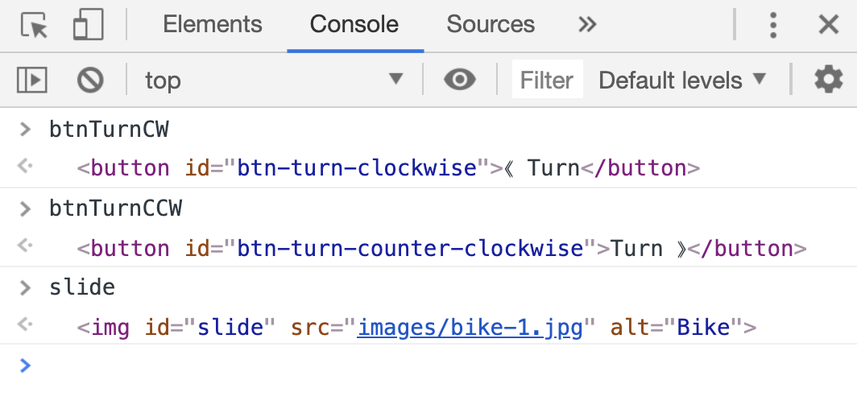
Check your code for errors before proceeding
✓
All our HTML element variables return HTML elements, so we are good to go!
✓
✓

Slide 23
Step 4
Set the Slide Variables

Slide 24
Slide Variables
Our slide variables will store the following
numberOfSlides
The number of slides we will be using in this slide show
34 -> the number of bike images
counter
Used to keep track of the current slide being displayed in the HTML document
This is based on the position of the image in our slides array (more on that later)
Since the counter is based on an array we initialize it with a starting value of zero

Slide 25
Slide Variables – The Complete JS Code
Add the following code to the script.js file after the HTML element variables
script.js
// Number of slides
const numberOfSlides = 34;
// Counter - used to keep track of the current slide
// *** We start out at slide 1, which is position
// zero in our slides array (set later on)
let counter = 0;

Slide 26
Step 5
Create our Array of Bike Images

Slide 27
Creating our Array of Bike Images
We need to create an array of 34 bike images
We could hand code 34 bike images into an array, but instead we will have JavaScript do the monotonous work for us by utilizing a loop

Slide 28
createImages() Function
To keep our code clean and organized we will create a "createImages()" function that will take two parameters
numberOfSlides
This sets the number of images we will need to create and add to our slides array
This will be set to 34 when we call this function
imageName
This sets the core image name
This will be set to "bike" when we call this function

Slide 29
createImages() Function
The createImages() function will first create an empty array which we will eventually fill with bike images
The function will then run a loop which does the following
Creates a new image using JavaScript's built-in new Image() constructor function
Sets the "src" property of the newly created image to a file path that points to a bike image
Example: "images/bike-1.jpg", "images/bike-2.jpg", "images/bike-3.jpg"…
Inserts the newly created image at the end of the array
Finally, our function will "return" the array of images

Slide 30
createImages() function
createImages function
Create an empty array of images
Array of bike images
for loop (repeats 34 times)
Return the images array
Create a new image
set "src" property of the new image to a bike image path
Add the new image to the images array

Slide 31
createImages() Function Code
script.js
// createImages
// - Creates an array of images
function createImages(numberOfImages, imageName){
const imageList = [];
// Use a loop to generate the array of
// 34 bike images
for(let i = 1; i <= numberOfImages; i++){
const img = new Image();
// Set the "src" property of the newly
// created image object
img.src = `images/${imageName}-${i}.jpg`;
// Append the new image to the
// imageList
imageList.push(img);
}
return imageList;
} // end createImages
Add the following code to the end of the script.js file

Slide 32
Call the createImages() Function
With our createImages() function created we now need to call it and pass in the values needed for our slide show
We store the returned images array in a variable

Slide 33
Call the createImages() Function - Code
Add the following code to script.js after the slide variables code
script.js
// Create Slides
const slides = createImages(numberOfSlides, 'bike');
Store the returned array of images in a variable
Pass in our numberOfSlides (34) variable into the function
Pass in our image name (bike) into the function

Slide 34
Pause and Check Your Code

Slide 35
Check your code for errors before proceeding
Check your code often when writing a script
We created and called a function, we should test it to see if it works before proceeding
We should test if our function returned an array of bike images
Test by entering the slides variable name into the console
If your variable returns an array of 34 bike images you are probably good to go
If your variables returns an empty array or another value, check your code

Slide 36
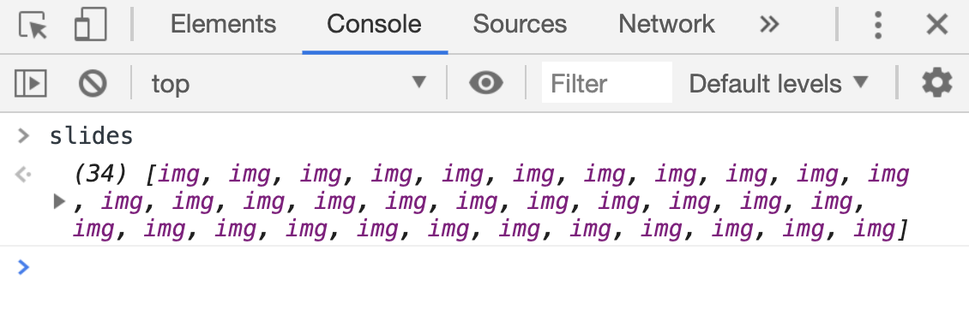
Check your code for errors before proceeding
✓
Our slides variable returns an array of images, so we are probably good to go!

Slide 37
Check your code for errors before proceeding
In the previous slide I said we are "probably" ok
To be 100% sure, we should check to make sure that our images contained inside our "slides" array have "src" properties that point to our bike images
We can check this in the console by opening one of the image items in the array and checking it's "src" property
See the next slide for details

Slide 38
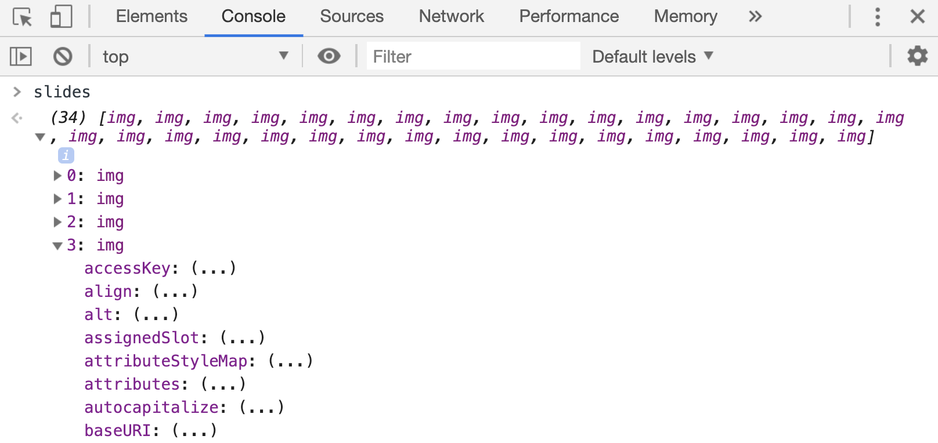
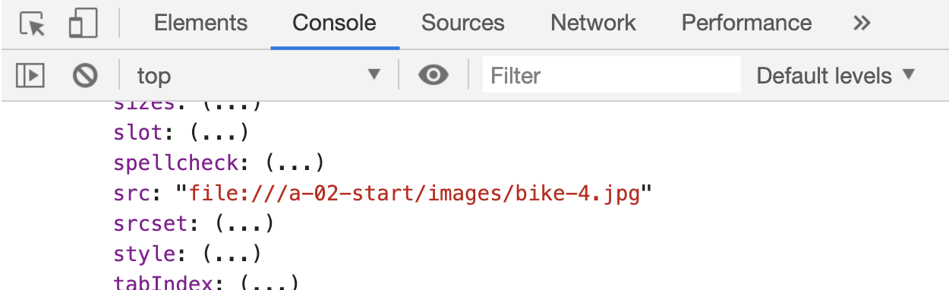
Check your code for errors before proceeding
✓
Click the arrow on the slides array to crack open the array. Then click on the down arrow of any one of the "img" array items
Scroll through the long list of properties and methods until you find the "src" property. Check to make sure it points to one of the bike images
Looks like our "src" points to one of our bike images, so we are now good to go!

Slide 39
Step 6
Define our turn clockwise function

Slide 40
The turnCW() Function
The turnCW function adds one to the counter variable
The function then checks to make sure we have not reached the end of our images
If we have reached the end of our images we reset the counter to zero and output the first image
Lastly the function outputs the next image (or the first image) in our array of bike images to the HTML page

Slide 41
turnCW() Function
turnCW function
Reset image counter to 0
bike-2.jpg
yes
Are we on the last image?
no
Set the bike image to the bike image that is equal to the counter
Add 1 to image counter
bike-1.jpg
Call the turnCW function
Click the button to trigger the turnCW function

Slide 42
turnCW() Function Code
script.js
function turnCW(){
// add 1 to the counter
counter++;
// If the counter is equal to the length of
// our array of bike images we have reached the
// last slide. We then reset the counter to zero
// to return to the first slide
if(counter === numberOfSlides){
counter = 0;
}
// Update the image on the screen
slide.src = slides[counter].src;
} // end turnCW
Add the following code to the end of the script.js file

Slide 43
Step 7
Define our turn counter-clockwise function

Slide 44
The turnCCW() Function
The turnCCW function subtracts one from the counter variable
The function then checks to make sure we have not reached the start of our images
If we have reached the start of our images we reset the counter to the numberSlides variable less 1 (numberOfSlides – 1)
The minus 1 is because arrays are zero indexed which means to select the 34th image in the array we need to set the counter to 33 (numberOfSlides - 1)
Lastly the function outputs the previous image (or the last image) in our array of bike images to the HTML page

Slide 45
turnCCW() Function
*Note: We have 34 bike images stored in an array, so we set the counter to 34 – 1 (33) because arrays start at zero and the last bike image is at position 33
turnCCW function
Reset image counter to 33*
bike-6.jpg
yes
Are we on the first image?
no
Set the bike image to the bike image that is equal to the counter
Subtract 1 from the image counter
bike-7.jpg
Call the turnCCW function
Click the button to trigger the turnCCW function

Slide 46
turnCCW() Function Code
script.js
function turnCCW(){
// subtract 1 from the counter
counter--;
// If the counter is less than zero, we have
// reached the beginning of our bike images.
// We reset the counter to point to the
// last bike image in the array
if(counter < 0){
counter = numberOfSlides - 1;
}
// Update the image on the screen
slide.src = slides[counter].src;
} // end turnCCW
Add the following code to the end of the script.js file

Slide 47
Step 8
Add Our Click Event Handlers to the Buttons

Slide 48
Add Click Handlers to the Buttons
Add a click handler to the "btnTurnCW" button
This event handler should call the turnCW() function
Add a click handler to the "btnTurnCCW" button
This event handler should call the turnCCW() function

Slide 49
Button Event Handler Code
script.js
// Add event handlers to the buttons
btnTurnCW.addEventListener('click', turnCW);
btnTurnCCW.addEventListener('click', turnCCW);
Add the following code to the script.js anywhere after button variable definitions

Slide 50
Success!!!
(Hopefully : |)

Slide 51
Step 9
Testing

Slide 52
Testing your Application
Your script should now be fully functional
You should be able to click either button and turn the image clockwise or counter clockwise
Errors
If your script does not function
Check your browser's console for errors reported by the browser

Slide 53
Complete
Awesome Work!!! : )

