Slide 1
Web Scripting 1
Day 03

Slide 2
Agenda
Assignment 2 walkthrough
Conditionals
Arrays
Loops
Assignment 3

Slide 3
Assignment 02
Walkthrough

Slide 4
Progress Check-In
At this time you should have a rough idea of the following concepts
What are the three most common JavaScript data type
Strings
Numbers
Booleans
A basic understanding of what functions do and where to use them

Slide 5
Conditionals

Slide 6
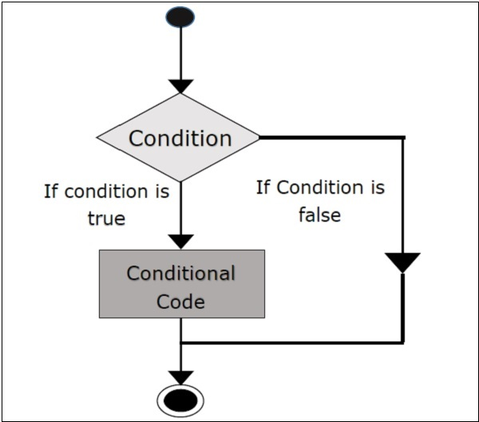
Conditionals
Conditionals allow you to direct your script in different directions depending on a conditions
If a statement is true do one thing, if not, do another thing (or nothing at all)
Image from: https://www.tutorialspoint.com/scala/scala_if_else.htm

Slide 7
JavaScript Conditionals
JavaScript has many types of conditional statements
"if", "if/else" & "if/else if/else"
Switch statements
Not covered today
Look up "switch" statements on MDN Docs
Ternary operator
Not covered today
Useful for simple conditions
Look up "ternary" operator on MDN Docs

Slide 8
JavaScript "if" Statements
The "if" statement runs code between the "{ … }", if a statement placed between the "( …conditional statement… )" is true
const fruit = 'apple';
if(fruit == 'apple'){
console.log('I love apples!');
}
This code will only run "if" the "fruit" variable is equal to "apple

Slide 9
Why "==" or "===" and Not "="?
In many computer languages if you wish to ask the question:
is "x" equal to "y"? …
...you would write "=="
Note: JavaScript also has "==="…more on that in an upcoming slide…
x == y -> means "is x equal to y?"
The single "=" is called an assignment operator
x = y -> means the variable "x" has been assigned the value of "y"

Slide 10
Watch out for the single "=" in "if" Statements
The "I love oranges!" console log will always run, no matter what you set the fruit variable to because in your "if" statement you are using a single "=" assignment operator which assigns the fruit variable the value of "orange". Doing this always results in a "true" statement
const fruit = 'apple';
if(fruit = 'orange'){
console.log('I love oranges!');
}
*** Note ***: This is bad code!!!

Slide 11
Watch out for the single "=" in "if" Statements
✔
Now we are using the "==" comparison operator, which tells the computer to compare two values.
Since fruit is not equal to orange the code between the "{}" will not run
const fruit = 'apple';
if(fruit == 'orange'){
console.log('I love oranges!');
}

Slide 12
"==" vs "==="
JavaScript has two different comparison operators
"=="
Tests only if the value is the same
Does NOT test the data type
Testing string numbers against numbers will result in true
"3" == 3 -> this is true when using the "==" operator
"==="
Strict equivalence
Tests the value along with the data type
Testing string numbers against numbers will result in false
"3" == 3 -> this is false when using the "===" operator since the value is the same but the data type is not the same
3 === 3 -> results in true, since the values (3) and the data type (number) are the same

Slide 13
"==" vs "==="
Testing for value only using "=="
Since we are using the "==" operator the console.log() statement will run because we are just testing the values of the variables and not the data type
const x = '3'; // Data type of string
const y = 3; // Data type of number
if(x == y){
console.log('x equals y!');
}
Testing for value and data type only using "==="
Since we are using the "===" operator the console.log() statement will NOT run because we are testing the values and the data type
const x = '3'; // Data type of string
const y = 3; // Data type of number
if(x === y){
console.log('x equals y!');
}

Slide 14
else if
const a = 5;
const b = 7;
if(a > 7){
console.log('a is greater than b');
}else if(a < 7){
console.log('a is less than b');
}
If your first statement fails, you can test another condition using an "else if"
You are not limited to a single "else if", you can have as many "else if" statements as you need
The "else if" part of this statement will only run if the first "if" condition statement fails and the second "else if" condition statement is true

Slide 15
else
You can optionally have an "else" that follows your "if" or any number of "else if" statements
The "else" will run only if all of the "if" and "else if" statements fail
The "else" part of an "if/else" statement is optional
Writing an "if" statement without an "else" is perfectly valid code
const animal = 'elephant';
if(animal === 'giraffe'){
console.log('The animal is a giraffe');
}else if(a === 'lion'){
console.log('The animal is a lion');
}else {
console.log('The animal is neither a giraffe or a lion');
}
The "else" part of this statement will only run if all of the above "if" and "else if" statements fail

Slide 16
Conditional Statement Operators
==
Equivalence (value only)
===
Equivalence (strict – value and data type)
>
Greater than
>=
Greater than or equal to
<
Less than
<=
Less than or equal to

Slide 17
Conditional Statement Operators
!
Not
!=
Not equal to (value only)
!==
Not equal to (strict – value and data type)
||
Or (this is the pipe character - "Shift+\")
&&
And (this is the ampersand character – "Shift+7")

Slide 18
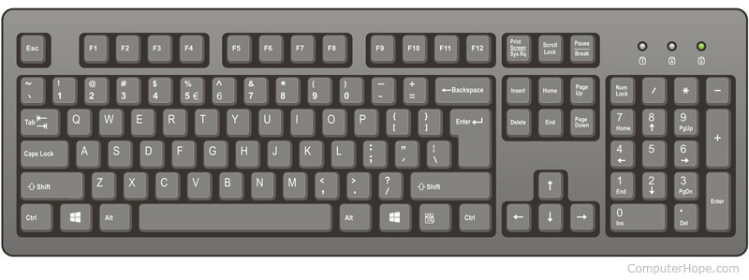
Where are the "|" (pipe) and "&" (and) Characters
The "&" pipe character (You need to press "Shift+7"
The "|" pipe character (You need to press "Shift+\"
Keyboard image from: https://www.computerhope.com/jargon/k/keyboard.htm

Slide 19
Testing a negative
The console.log() statement will run because we are testing if the "animal" is NOT equal to "giraffe" using the "!" character combined with the "==" characters
The "!" character always represents "not" or not true or false
const animal = 'elephant';
if(animal !== 'giraffe'){
console.log('The animal is not a giraffe');
}

Slide 20
Testing Multiple Conditions
You can test multiple conditions using the "||" (or) and/or the "&&" (and) operators
The console.log() statement will only run if the "animal" variable is equal to "cat" AND (&&) the "animalName" variable is equal to "Fluffy"
const animal = 'cat';
const animalName = 'Fluffy';
if(animal === 'cat' && animalName === 'Fluffy'){
console.log('Hello Fluffy!');
}

Slide 21
Using && (and)
Using the && (and) operator means all the conditions must be true
The JavaScript will not test any further conditions after the first failure in an && (and) statement
Use this behaviour to your advantage in your script
The console.log() state will only if the "animal" variable is equal to "cat" AND (&&) the "animalName" variable is equal to "Fluffy"
const animal = 'cat';
const animalName = 'Fluffy';
if(animal === 'cat' && animalName === 'Fluffy'){
console.log('Hello Fluffy!');
}

Slide 22
Using && (and)
Since running the built-in "trim()" method on a "null" value will result in your script crashing, we can test for "null" first and then safely run the "trim" method on our second condition.
JavaScript will not test any condition after the first failure in an "&&" (and) condition. The 2nd condition will never be executed if the "username" variable is equal to "null"
const username = prompt('What is your name?');
if(username !== null && username.trim() !== ''){
console.log(`Hello ${username}!`);
}

Slide 23
Using "||" (or)
With the "||" operator only one of the conditions has to be true
JavaScript will not test any further conditions in an "or" statement after the first condition that results in true
Only one condition has to be true in order for our console.log() message to run. In this example the "pet" variable could be equal to "cat" OR (||) "dog" for the console.log() message to run
const pet = 'cat';
if(pet === 'cat' || pet === 'dog'){
console.log('The pet is either a cat or a dog');
}

Slide 24
Combining "||" with "&&"
Your conditional statements can contain any combination of "||" and "&&" statements
Just Beware of difficult to read code when making overly complex conditional statements
const e = 3;
const f = 5;
const g = 3;
const h = 9;
const i = 12;
if( (e < 5 && e == g) || (h < i) ){
console.log('Ok!!! : ( ...');
}

Slide 25
Truthy Values in JavaScript
A truthy value is a value that is consider true by a computer language when encountered in a Boolean contaxt¹ such as in an "if" statement
Values that are considered truthy by JavaScript¹
if(true)
if({})
if([])
if(23) -> Any number other than zero
if("0") -> The string number zero is considered true
if("any string with at least one character") -> Any string other than an empty string ("")
if(new Date())
if(-23) -> As above any number (even negative numbers) are consider true other than zero
if(Infinity)
if(-Infinity)
https://developer.mozilla.org/en-US/docs/Glossary/Truthy

Slide 26
Falsy Values in JavaScript
The following values are considered falsy¹ (false in a Boolean context)
if(0) -> The number zero is considered false
if("") -> An empty string is considered false
if(null)
if(undefined)
if(NaN) -> Not a Number is considered false
https://developer.mozilla.org/en-US/docs/Glossary/Falsy

Slide 27
Using Truthy and Falsy Values in JavaScript
Since truthy values are considered true in the context of an "if" statement you can just write the variable in the condition part of an "if" statement
We can do a similar thing with falsy values, except that we precede the variable name with a "!" (NOT) character
Only do the above if you just want to test for truthiness or falseness
If you want to test for exactly true, then use "… === true"
If you want to test for exactly false, then use "… === false"
https://developer.mozilla.org/en-US/docs/Glossary/Truthy

Slide 28
Using Truthy and Values in JavaScript
In this example we test if the "user" variable has a falsy value. To do this we place just the variable name in the conditional statement preceded by the "!" (NOT) character
In this example we test if the "cat" variable has a truthy value. To do this we place just the variable name in the conditional statement
cat = 'fluffy';
if(cat){
console.log(`Hello ${cat}!`);
}
user = null;
if(!user){
console.log('The user is not set');
}

Slide 29
Arrays

Slide 30
What is an Array
An array is:
A collection or list of usually related values that are stored in a single variable
Example
An Array of fruits might store the following values in an array variable with the label of fruit
Apples
Bananas
Oranges

Slide 31
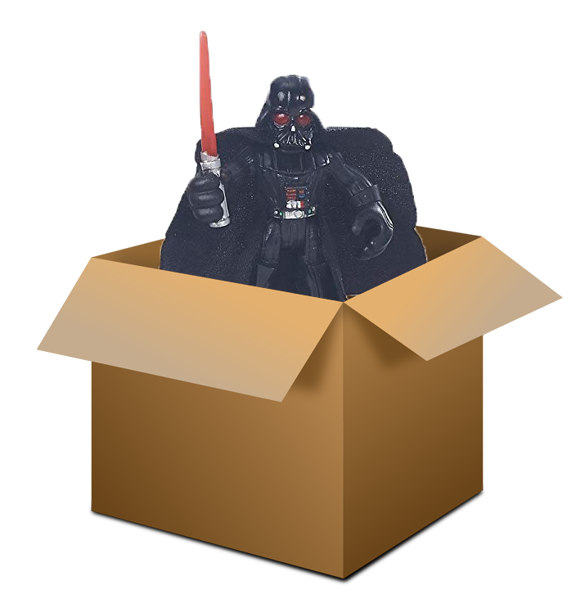
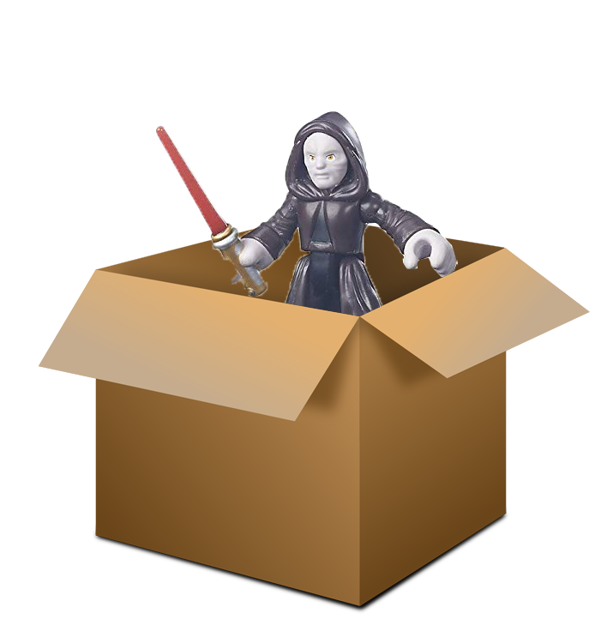

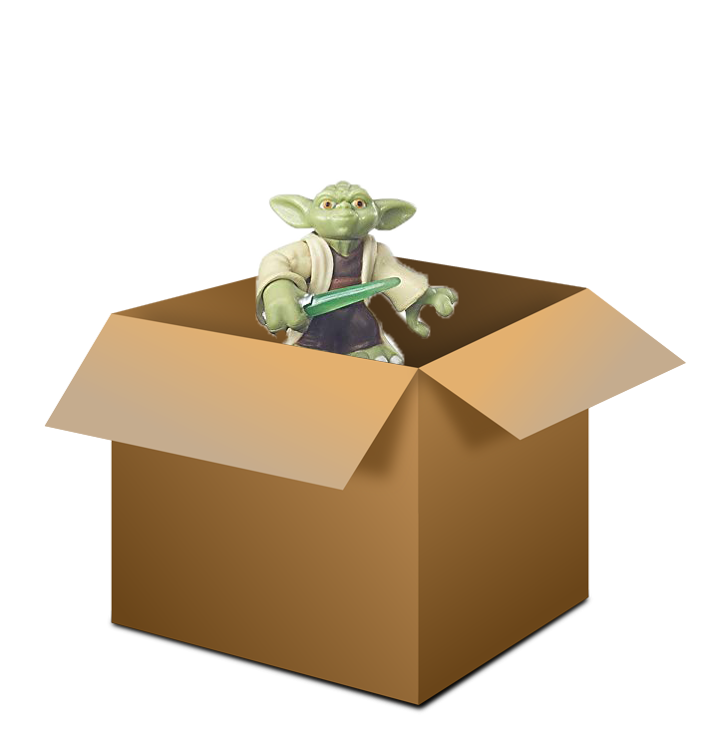

Why we need arrays?
We could store a bunch of related items in individual variables…
const actionFigure01 = 'Chewbacca';
const actionFigure02 = 'Darth Vader';
const actionFigure03 = 'Palpatine';
const actionFigure04 = 'Luke';
const actionFigure05 = 'Yoda';
…but for anything larger than a few items this becomes difficult to maintain and is memory inefficient…
Image Credits:
Box image: https://pixabay.com/vectors/box-open-cardboard-box-cardboard-152428/
Action Figures: https://www.amazon.com.au/Galactic-Heroes-Rivals-Action-Figure/dp/B01BMW5QCQ

Slide 32

Why we need arrays?
…Instead of individual variables for each individual item, we can create a list or an "array", and store all the items in a single variables
const actionFigures = [
'Chewbacca',
'Darth Vader',
'Palpatine',
'Luke',
'Yoda'
]
…having a single variable, means it is much easier to maintain, read and update
Image Credits:
Box image: https://pixabay.com/vectors/box-open-cardboard-box-cardboard-152428/
Action Figures: https://www.amazon.com.au/Galactic-Heroes-Rivals-Action-Figure/dp/B01BMW5QCQ

Slide 33
JavaScript Arrays
You do not need to declare a length of an array or a data type when creating an array with JavaScript
The length of an array in JavaScript is set dynamically by the number of items in the array
JavaScript arrays can have any combination of data types stored in them
const myArray = ['foo', 'bar', 23, true];
The above code is valid JavaScript
*** Note ***: Although the above code is valid, usually arrays store related values, such as a list of fruits, or a list of provinces or a list of student names

Slide 34
Creating an Array in JavaScript
You can create an array by calling the array constructor
const myArray = new Array();
Most JavaScript developers do not use this method
The more popular way to create an array in JavaScript is to do the following:
const fruits = [];
Setting the value of the fruits variable to [] (square brackets) creates an empty array

Slide 35
Adding Values to an Array
You can add items to an array at the time of the variables initialization
const fruits = ['apples', 'bananas', 'oranges'];
Array values added to the fruit array at the time of the variable's initialization

Slide 36
Adding Values to an Array
You can add items to an array using the myArray[index number] syntax
// Create an array called fruits
const fruits = [];
// Add items to the Fruits Array
fruits[0] = 'Apples';
fruits[1] = 'Bananas';
fruits[2] = 'Oranges';
fruits[7] = 'Blueberries';
*** Note ***: There is no requirement to declare array values sequentially.
In this example we create a value for "fruits[7]" without declaring any values for position 3,4,5 or 6. JavaScript will create empty array values for positions 3,4,5 and 6 with the value of "undefined" if you do this

Slide 37
Why Do JavaScript Arrays Start at Zero?
Good question
JavaScript borrows some syntax from the C family of languages
In C an array points to the location in the memory, so in expression array[n], n should not be treated as an index, but as an offset from the array’s head¹
Confused? Or want to know more? Give this short Medium article a quick read
Why Do Arrays Start With Index 0?
https://medium.com/@albertkoz/why-does-array-start-with-index-0-65ffc07cbce8

Slide 38
Getting the Length of an Array
Finding out the length of an array is a common task
The length property will return the length of the array
const animals = [];
animals[0] = 'hedgehog';
animals[1] = 'tiger';
animals[2] = 'moose';
// Get the length of the animals array
console.log( animals.length ) // Outputs -> 3
The "animals" array contains 3 items
The "length" property returns the length of an array

Slide 39
Adding an Item to the End of An Array
Adding an item to the end of an array is a common task
Below are a couple of ways to do it with JavaScript
const carsCompanies = [];
carCompanies[0] = 'Buick';
carCompanies[1] = 'Toyota';
carCompanies[2] = 'BMW';
// Add item to the end of the
// carCompanies array using the
// push() method
carsCompanies.push('Kia');
const carsCompanies = [];
carsCompanies[0] = 'Buick';
carsCompanies[1] = 'Toyota';
carsCompanies[2] = 'BMW';
// Add item to the end of the
// carCompanies array using the
// length property
carsCompanies[carsCompanies.length] = 'Kia';
Adding an item to the end of an array using the push() method
Adding an item to the end of an array using the the "length" property

Slide 40
Array Methods
Manipulating arrays is a common requirement for many scripts
JavaScript provides a myriad of built-in Array methods for doing things such as:
Iterating over an array – forEach()
Running a function on each item in the array – map()
Sorting an array – sort()
Searching an array – every(), find()
Filtering an array – filter()
Plus many more…
If you need to do something to an array try Googling it and see if JavaScript provides a built-in method
Example: "find an element in an array JavaScript"

Slide 41
Array Methods
No need to memorize all the JavaScript array methods
Just know that they exist and get the syntax when needed
JavaScript Array Methods Resources:
MDN Docs Page on JavaScript Arrays
Contains information about arrays plus links to further documentation on all the array methods
https://developer.mozilla.org/en-US/docs/Web/JavaScript/Reference/Global_Objects/Array

Slide 42
Loops

Slide 43
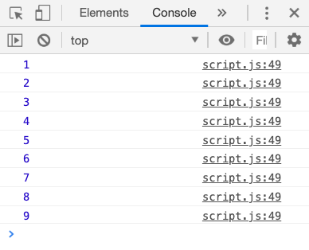
What is a Loop
A loop is a set of instructions that your program will execute repeatedly until a stop condition is met
This is the stop condition. As long as this condition results in "true" the loop will run
Console Output
let counter = 1;
while(counter < 10){
console.log(counter);
counter++; // add 1 to the counter
}
This is an example of a "while" loop. This code will run over and over again until the counter is no longer less than 10

Slide 44
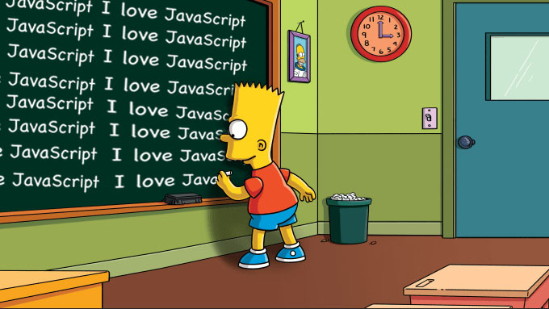
Why use Loops?
Humans don't enjoy doing repetitive tasks repeatedly
If I asked you to hand in a handwritten piece of paper that said, "I love JavaScript!" 100 times, you would not be happy… : (
A script does not think or care either way if it executes a line of code once or a 1000 times
If your code requires repeated code, consider using a loop
Image modified from: https://www.fiverr.com/drazzzv/write-your-angry-message-by-bart-simpson-on-chalkboard

Slide 45
Why Use Loops
Loops are useful for iterating over arrays
Manual Method
Using a forEach() Loop
const students = [
'Sally',
'Marie',
'Joe',
'Kate',
'Frank'
];
console.log(students[0]);
console.log(students[1]);
console.log(students[2]);
console.log(students[3]);
console.log(students[4]);
students.forEach(function(student){
console.log(student);
});
This works, but is tedious to write and error prone. Imagine if we had a 100 students!
Since the code we need to run is repetitive we can use a loop.
In this example we use a special type of loop available on arrays called a forEach() loop to "iterate" over each item in the array and output each item's value to the console

Slide 46
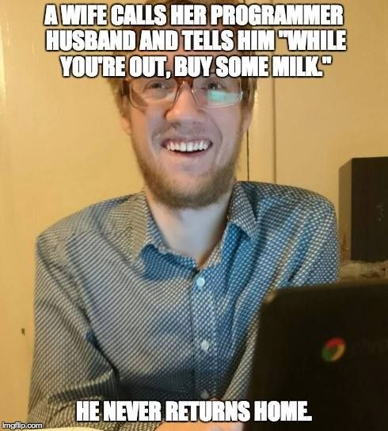
Beware of Endless Loops
Be careful when writing your loop code
Always make sure your loop will eventually stop
If the browser crashes when running your script, it is often caused by your script running an endless loop
Image from: https://www.pinterest.ca/pin/336573772132618143/

Slide 47
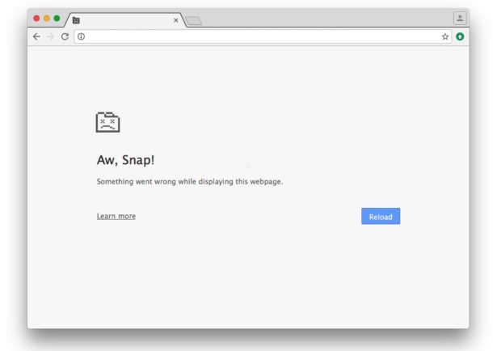
Beware of Endless Loops
Since we never update the value of the "counter" variable, the script will enter an endless loop because the counter variable will always remain less than 10. This will eventually cause your browser to crash
let counter = 1;
while(counter < 10){
console.log(counter);
}
*** Note ***: This is bad code!!!
Image from: http://osxdaily.com/2016/07/27/fix-aw-snap-page-error-crash-chrome/

Slide 48
Types of JavaScript Loops
While
Useful for when you are not sure how many times you need to run the loop
Do While
Similar to a "while" loop, except the condition is always run at least once
For
Useful for when you know exactly how many times you need to run the loop
For Each
Only available on arrays and on some DOM collections
For…in (not covered today, but look it up on MDN Docs)
Useful for iterating over an object (more on objects in a future class)
For…of (not covered today, but look it up on MDN Docs)
Useful for iterating over arrays and other iterable objects

Slide 49
While Loops
Useful when you are not sure how many times you want to run the loop
Since we are not sure how many times our user will not enter a name we can use a while loop. The computer will keep repeating the loop code until the user enters a name into the prompt box
let user = prompt('What is your name?');
while(user == null || user.trim() == ''){
prompt('You must enter a name to proceed.
Please enter a name.');
}
out.innerHTML = `Hello ${user}.`;

Slide 50
Do While Loops
Similar to "while" loops, except that the conditional loop code will always execute at least once
let user;
do {
// This code will run at least once,
// even if the while condition is never
// false
user = prompt('What is your name?');
}while(user == null || user.trim() == '');
out.innerHTML = `Hello ${user}.`;

Slide 51
For Loop
Useful when you know the number of times that you need to run the loop
const colours = ['red', 'orange', 'purple', 'green', 'blue'];
for(i = 0, l = colours.length; i < l; i++){
out.innerHTML += `${colours[i]} <br>`;
}

Slide 52
For Loop Syntax
The syntax between the "( … )" in a for loop can be a bit confusing
The code between the "( … )" contains three parts separated by a ";"
The first part is used to setup any starting variables used in the loop
We often set our counter here (often set as "i" for index)
The second part is used as the condition for the loop
This condition must eventually result in a false value to prevent an endless loop
The third part is used for code that runs after each iteration of the loop
This is often used to increment the counter set up in the first part

Slide 53
For Loop Syntax
The third part is used for running code after each iteration of the loop. This is often used to increment the counter
The second part is used for the loop condition. This statement must eventually result in a false value in order to prevent an endless loop
The first part is used for setting an variables used in the loop
for(let i = 0, l = colours.length; i < l; i++){
out.innerHTML += `${colours[i]} <br>`;
}

Slide 54
What Does "++" Mean?
Programmers like to save keystrokes
Adding "1" to an existing number is a common task that many scripts require
Since adding "1" to a number is a common task many languages provide a shorthand syntax for doing this
Writing "x++" is the same as writing "x = x + 1"
let x = 1;
// Add 1 to x
x++; // x -> 2
These two code snippets do essentially the same thing
let x = 1;
// Add 1 to x
x = x + 1; // x -> 2

Slide 55
forEach() Loop
The forEach() method provides an easy way to iterate over an array
The forEach() method is only available on arrays and on the elements returned by the document.querySelectorAll() method
forEach() works on
Arrays
DOM collections returned by:
document.querySelectorAll();

Slide 56
forEach() Loop with Arrays
let html = '<ul>';
const colours = ['red', 'green', 'blue'];
// forEach() will run over each item
// in an array
colours.forEach(function(item){
html += `<li>${item}</li>`;
});
html += ’</ul>';
// html ->
// <ul>
// <li>red</li>
// <li>green</li>
// <li>blue</li>
// </ul>
The "item" parameter will be set to the value of each item in the array as the loop iterates over each item in the array

Slide 57
What is the "+=" Operator
Another common programming task is to add to an existing value of a variable
The long hand way of doing this would be to write the following:
let sayHello = 'Hello';
sayHello = sayHello + ' World'; // sayHello -> Hello World
The shorthand way uses the "+=" operator
x += 'bar' -> means adds the string "bar" to whatever value "x" is
See the syntax on the next page

Slide 58
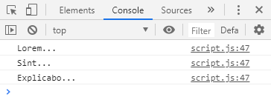
forEach() Loops with querySelectorAll()
// This creates an HTML collection of all the HTML
// elements that would be selected by the CSS
// selector ".special"
const elSpecial = document.querySelectorAll('.special');
// Use a forEach() loop to iterate over each HTML element
// in the the elSpecial HTML collection and output
// their HTML text
elSpecial.forEach(function(el){
console.log( el.innerHTML );
});
// The above code will output the following to the
// console:
// Lorem...
// Sint...
// Explicabo...
The HTML
<p class="special">Lorem...</p>
<p class="special">Sint...</p>
<p class="special">Explicabo...</p>
The Console

Slide 59
What is the "+=" Operator
Another common programming task is to add to an existing value of a variable
The long hand way of doing this would be to write the following:
let sayHello = 'Hello';
sayHello = sayHello + ' World'; // sayHello -> Hello World
The shorthand way uses the "+=" operator
x += 'bar' -> means adds the string "bar" to whatever value "x" is
See the syntax on the next page

Slide 60
What is the "+=" Operator
Adding to an existing value using longhand syntax
let sayHello = 'Hello';
sayHello = sayHello + ' World'; // sayHello -> Hello World
Adding to an existing value using the "+=" syntax
let sayHello = 'Hello';
sayHello += ' World'; // sayHello -> Hello World
The "+=" operator adds a value to an existing value

