Slide 1
Web Scripting 1
Day 04

Slide 2
Agenda
Assignment 3 walkthrough
Review
Selectors
DOM Traversal
DOM Manipulation
jQuery Introduction

Slide 3
Assignment 03
Walkthrough

Slide 4
Progress Check-In
At this time you should have a rough idea of the following concepts
A basic understanding of:
Conditional statements
Loops
Arrays

Slide 5
JavaScript DOM Selector Methods

Slide 6
getElementById()
Selects an HTML element that has an “id” attribute that is equal to the string passed into the “getElementById()” method
Each ID attribute on an HTML page must be unique
You can’t have multiple HTML elements with the same ID value
Since ID attribute values must be unique, JavaScript will select the first DOM element that equals the ID value passed into the “getElementById()” method
The “getElementById()” is a very performant JavaScript selector method

Slide 7

getElementById()
HTML
<p id="foo">Select me...</p>
JS
const para1 = document.getElementById('foo');
para1.style.color = 'red';
Browser output

Slide 8
Live Selectors
Live Selectors allow you to select DOM elements by an HTML tag or by a class name
Live Selectors will automatically update if DOM elements that match the selection are added or removed
JS live Selector methods
getElementByTagName()
getElementByClassName()
These methods can select multiple DOM elements,
These methods return an HTML collection, which is similar to an array
An HTML collection does not include the forEach() method

Slide 9
getElementsByTagName()
Selects all elements in the DOM that match an HTML tag passed into the ”getElementsByTagName()” method
Returns an HTML collection which is similar to an array
You can access individual items in an HTML collection in a similar way to how you access items in an array
Example:
Select the first item in an HTML collection stored in a variable called “paras”
paras[0] // returns the first DOM element in the collection

Slide 10
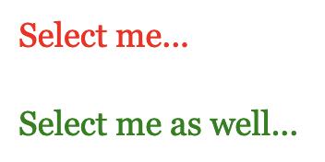
getElementsByTagName()
HTML
<p>Select me...</p>
<p>Select me as well...</p>
JS
const paras = document.getElementsByTagName(‘p');
paras[0].style.color = 'red';
paras[1].style.color = 'green';
Browser output

Slide 11
getElementsByClassName()
Selects all the DOM elements that have a “class” attribute that is equal to the string passed into the “getElementsByClassName()” method
Returns an HTML collection which is similar to an array
You can access individual items in an HTML collection in a similar way to how you access items in an array
Example:
Select the first item in an HTML collection stored in a variable called “elFoo”
elFoo[0] // returns the first DOM element in the collection

Slide 12
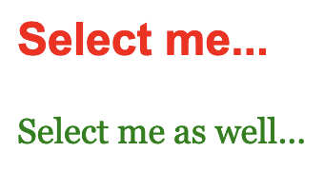
getElementsByClassName()
HTML
<h2 class="foo">Select me...</h2>
<p class="foo">Select me as well...</p>
JS
const elFoo = document.getElementsByClassName('foo');
elFoo[0].style.color = 'red';
elFoo[1].style.color = 'green';
Browser output

Slide 13
Query Selectors
Query selectors allow the selection of DOM elements by passing in a CSS selector to a query selector
Query selectors will not automatically update if DOM elements that match the selection are added or removed
JS query Selector methods
querySelector()
Selects the first DOM element that matches a CSS selector passed into the method
querySelectorAll()
Selects all DOM elements that match a CSS selector passed into the method
Returns a NodeList which is similar to an array
A NodeList has access to the forEach() method, which enables easier looping through all the DOM elements in the selection

Slide 14
querySelector()
Selects the first DOM element that matches a CSS selector passed into the “querySelector()” method
Returns a single HTML

Slide 15
querySelector()
HTML
<div class="container">
<p>Select me...</p>
</div>
JS
const para1 = document.querySelector('.container p');
para1.style.color = 'red';
Browser output

Slide 16
querySelectorAll()
Selects all the DOM elements that matches a CSS selector passed into the “querySelectorAll()” method
Returns a NodeList which is similar to an array
You can access individual items in a NodeList in a similar way to how you access items in an array
Example:
Select the first item in an HTML collection stored in a variable called “elFoo”
elFoo[0] // returns the first DOM element in the collection
NodeLists have a forEach() method for easier looping over all the DOM elements in a NodeList

Slide 17
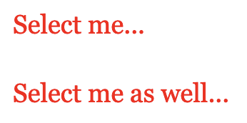
querySelectorAll()
HTML
Browser output
<div class="container">
<p>Select me...</p>
<p>Select me as well...</p>
</div>
JS
const paras = document.querySelectorAll('.container p');
paras.forEach(el => el.style.color = 'red');

Slide 18
Narrowing the Selection Search
Usually, all the DOM selection methods are called from the document object
Example:
document.querySelectorAll(‘.container p’)
You can also call any DOM selection method from any variable that contains a DOM element as its value
Example:
const container = document.querySelector(‘.container’);
const containerParas = container.querySelector(‘p’);
This can have some performance benefits as the browser only has to search part of the DOM for a selection as opposed to searching the entire DOM

Slide 19
JavaScript DOM Traversal

Slide 20
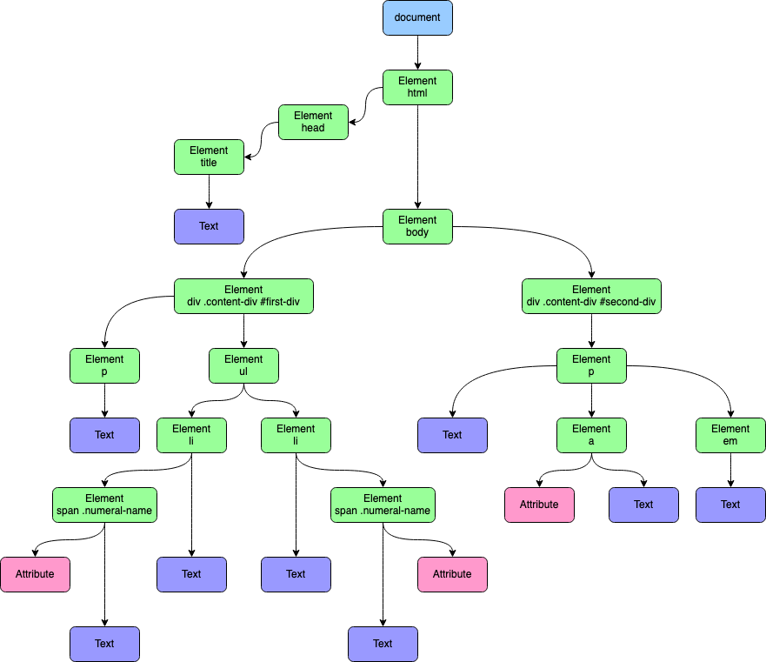
JavaScript DOM Traversal
DOM tree graphic from: https://www.linode.com/docs/guides/traversing-the-dom/

Slide 21
JavaScript DOM Traversal
DOM Traversal, means moving around the document from one DOM element to another
JavaScript for the browser provides several methods for traversing the DOM
These DOM traversal methods allow you to traverse up the DOM tree, down the DOM tree, and laterally at the same level of the DOM tree

Slide 22
JavaScript DOM Traversal
Traversing up the DOM
Traversing down the DOM
Traversing laterally across DOM
DOM tree graphic from: https://www.linode.com/docs/guides/traversing-the-dom/

Slide 23
JavaScript DOM Traversal
JavaScript DOM Traversal learning resources
W3Schools – Javascript DOM Navigation
https://www.w3schools.com/js/js_htmldom_navigation.asp
MDN - Using the DOM
https://developer.mozilla.org/en-US/docs/Web/API/Document_object_model/Using_the_W3C_DOM_Level_1_Core
JS in Plain English – How to Traverse the DOM
https://javascript.plainenglish.io/how-to-traverse-the-dom-in-javascript-d6555c335b4e

Slide 24
JavaScript DOM Manipulation

Slide 25
JavaScript DOM Manipulation
DOM Manipulation, means adding, removing or changing DOM elements
JavaScript for the browser provides several methods for manipulating the DOM
These DOM manipulation methods allow you to clone elements, remove elements and modify elements
Use Google to find JavaScript syntax for manipulating the DOM
Try these search phrases
“clone DOM element JavaScript”
“remove DOM element JavaScript” or “delete DOM element JavaScript”
“change text of DOM element JavaScript”
“change attribute of DOM element JavaScript”

Slide 26
jQuery

Slide 27
About Jquery
Created by John Resig and introduced on August 26, 2006
John originally wanted to call the library “jselect”…but all the domains were taken…so he chose jQuery, even though jQuery has little to do with making queries
JQueries goal was to simplify the process of writing cross browser JavaScript code
Currently used by over 52% of the 10,000 most visited sites on the internet

Slide 28
About JQuery
jQuery is JavaScript
jQuery is simply a large JavaScript object with methods
jQuery is a JavaScript Library that sits on top of JavaScript
jQuery will not run if JavaScript is turned off by the user
A JavaScript Library is a library of pre-written JavaScript that allows for easier use of JavaScript
Since jQuery is JavaScript it is client side scripting and is used for front-end development
jQuery does not completely replace JavaScript syntax, it only makes some elements of JavaScript easier to write and use, such as selecting elements or DOM traversal
Other areas of JavaScript are still written in plain JavaScript, such as loops and “if” statements
jQuery = JavaScript

Slide 29
Benefits of JQuery
jQuery makes writing JavaScript easier
jQuery includes easy ways to select elements on the DOM using common CSS syntax to select elements on a web page
jQuery helps with cross-browser compatibility issues that are present in native JavaScript
jQuery helps you to separate scripting behaviour from presentation
jQuery encourages you to keep your scripting coding separate from your HTML code by making scripts easier to write that do not require JavaScript to be mixed in with the HTML code
This is similar to the way CSS works by separating style from presentation
jQuery is widely used, consequently there are a lot of resources available on the web to help you with your jQuery code

Slide 30
Downsides of jQuery
It is extra code that sits on top of JavaScript
Some purists may argue that it is more efficient to write pure JavaScript
Due to jQuery’s ease of use it can often be easily overused
Be careful to only use jQuery if it is truly needed
Extra animations and special effects should be thought of as icing on the cake and not the cake itself
Always keep the ideals of progressive enhancement in mind
Not everyone surfs the web with JavaScript enabled
Be mindful of how your web page will appear if JavaScript is disabled

Slide 31
jQuery Resource
For general information on learning jQuery visit this web site:
http://learn.jquery.com
For information on the jQuery API visit this web site:
http://api.jquery.com

Slide 32
Adding the JQuery Library to a Web Page
The jQuery library requires JavaScript to run
jQuery is just a single .js JavaScript file that must be included on your web page, just like any other external JavaScript file
You have a couple of options for including jQuery on your web page
You can download the jQuery source code and store it in a file locally or on your web server and then link to that file in your HTML file
You can link to a jQuery file that is hosted by a CDN (Content Delivery Network)

Slide 33
jQuery CDN
The best way to include the jQuery library is through their CDN
Visit the link below to get the CDN link code to include on your HTML page
https://code.jquery.com

Slide 34
Adding the JQuery Library to a Web Page
Compressed vs Uncompressed
Use compressed or minified version wherever possible
Use the uncompressed version if you wish to look at the code of the library and give it a read and explore the inner workings of jQuery

Slide 35
JQuery Code
jQuery uses a single function called jQuery
Using this function prevents code conflicts between the jQuery library and custom code that developers create
Writing the function name jQuery can quickly become tiresome
The jQuery function name can be shortened to just “$”
Both “jQuery” and “$” will work for your jQuery scripts
jQuery = $

Slide 36
JQuery Code
Each jQuery command is made up of four parts
jQuery object (“jQuery” or “$”)
Selector
Actions
Parameters
jQuery object
Selector
Actions
Parameters
$('.box').css('background-color', 'orange’);

