Slide 1
JavaScript Frameworks
Day 1

Slide 2
What you will learn
Introduction to React including
JSX
Components
Event Handling
Props and State
Routing
How to Create an interactive web application using a REST API with React

Slide 3
Emmet with React Components in VS Code
Emmet may not be enabled when typing HTML in React JSX components (more on JSX and components in upcoming lessons)
To enable Emmet auto complete in your React JSX components add the following code to your “settings.json” file in VS Code
Note: if you have other code in your “settings.json” file, then make sure to add a “,” after the last ”}” before you add the ”emmet.include…” code
"emmet.includeLanguages": {
"javascript": "javascriptreact"
}

Slide 4
Access the settings.json File in VS Code
To access the ”settings.json” file in VS Code do the following:
Open the Command Palette
CTRL+SHIFT+P Windows
CMD+SHIFT+P macOS
Via the menus by clicking View -> Command Palette
With the Command Palette open type "settings.json"
Click on "Preferences: Open Settings (JSON)"

Slide 5
React Developer Tools for Chrome
To help with developing and troubleshooting your React apps, the people behind React have created a Chrome extension called React Developer Tools
Navigate to the URL below from within Chrome to install the extension
https://chrome.google.com/webstore/detail/react-developer-tools/fmkadmapgofadopljbjfkapdkoienihi?hl=en

Slide 6
React Documentation
Visit the official React JS web page for documentation on React and for some tutorials on how to use React
https://reactjs.org/

Slide 7
Lesson Demos
For each day of the course you will be provided with lesson demo files
Since React application development requires many Node dependencies, it is not practical to share demos with all the Node dependencies downloaded
In order to run the code demos you will need to run “npm install” on any code demo folder that uses React
The command “npm install” tells the terminal to go to the internet and download and install all the Node dependencies that are required for the application
We walk you through the process of how to do this together in class

Slide 8

Introduction to React
React logo from: https://en.wikipedia.org/wiki/React_(web_framework)

Slide 9
What is React
React is a JavaScript library
Developed by Facebook
MIT licensed (free to use)
Designed to facilitate easier development of interactive user interfaces
React creates a virtual DOM that compares the states of elements and will only update the part or parts of the DOM that need updating
This makes DOM manipulation very performant when using React

Slide 10
Why use React?
Easy to get started in React (once your dev environment is setup)
If you know JavaScript, you can work in React
No new syntax (except for JSX)
React leans heavily on standard ES6 JavaScript Syntax
React uses JSX
JSX makes creating interactive HTML templates easy
JSX allows you to write HTML directly in JavaScript

Slide 11
Why use React?
One of the most popular front-end frameworks
React has large and active community
Lots of free online tutorials on how to use React
React has good documentation
Developers who know how to use React are in demand

Slide 12

Why use React?
It is one of the most loved frameworks as decided by you, developers!!!
See the 2020 Stack Overflow Developer survey:
Most Loved Web Frameworks
React logo with heart from: https://www.redbubble.com/people/happydev/works/26616034-reactjs-love

Slide 13
How React Views the World
(Hint: It's all about the component)

Slide 14
Everything is a Component
When building a React web application, it is best to think about everything in your application as a component
A component could be:
A static header or footer element
An interactive log in form element
An interactive shopping cart element
A blog post
A search component
A component can have child components

Slide 15
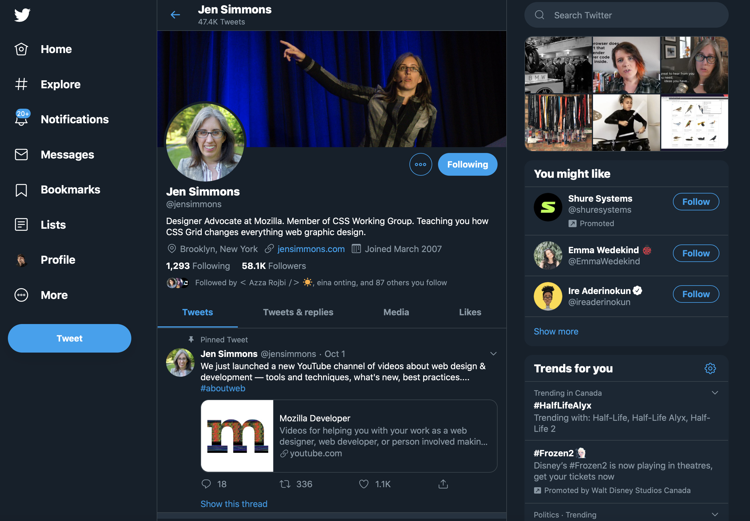
Think in Components
I don't know if Twitter uses React, but we could easily build a Twitter clone with React

Slide 16
Think in Components

Slide 17
Create React App
Create React App provides a simple one click install that installs all the basic tools you need for creating a React web application including:
React
JSX Transpiler
ES6 Support
A development web server
A build tool for production

Slide 18
Create React App – How to Setup
Easy…
Make sure your version of npm is at least at version 5.2 (for an easier install experience)
CD (change directory) to the parent directory of where you want to install your application from within Terminal or CMD prompt or PowerShell
Run the install command (details on next slide)
CD into your applications folder (details on next slide)
Type: npm start

Slide 19
Create React App – Terminal Install
This is the folder name where you want to install the React app. It can be called whatever you like (use web safe file names to be safe)
Installation
Run the command below to install the react starter app
Change directory into the parent directory of where you want to install your React app
cd /Users/joe/Documents/Apps
npx create-react-app my-app
npm start
cd my-app
This command will fire up a web server. To view your app in the browser, use this URL:
http://localhost:3000/
Change directory into the directory where the React app was installed into

Slide 20
Create React App Install Error
If you get the error:
You are running `create-react-app` [old version number], which is behind the latest release…
Then run the modified install command below:
npx create-react-app@latest my-app
Add @latest to the install command to fix the error listed above

Slide 21
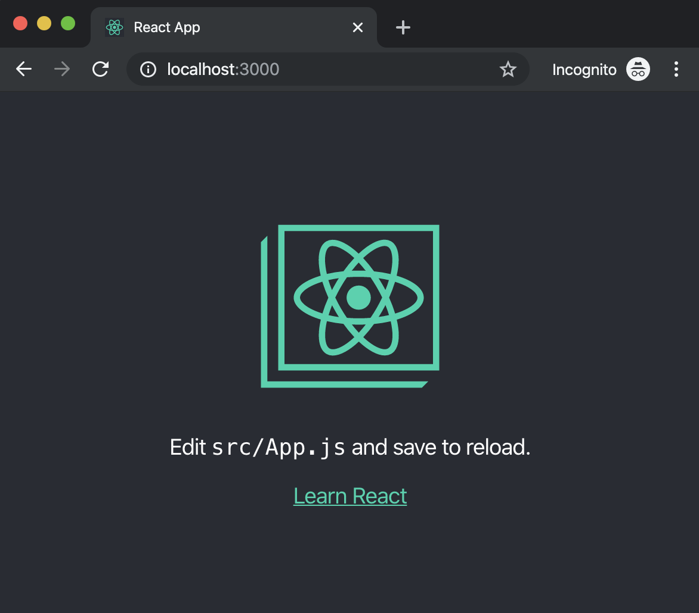
Create React App – Initial Page Load
The first time you run the app you will see this default screen

Slide 22
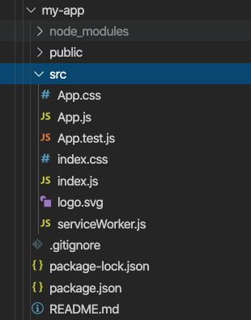
Create React App – Folder Structure
You will do your developing in the "src" folder
Edit the JavaScript in "App.js"
App styles can be edited in "App.css"
More on styling your app in a future lesson
The main entry point and render of your app is done in the "index.js” file

Slide 23
Modern Alternatives to Create React App
Create React App has been deprecated by React
Create React App still works and can still be used for new applications
React is pushing developers that are creating new applications to use modern frameworks which include many of the features needed when building a full-stack web application
Some modern alternative frameworks
NextJS
Remix
Gatsby
This course will not cover other frameworks that use React, but it will teach you the core concepts of React. Understanding these core concepts will enable you to quickly learn any existing or future frameworks that use React.
You’re welcome to use any modern framework for any of your upcoming projects in this course
If using a modern framework for another course, be sure to ask your instructor for approval first

Slide 24
Alternative React Tooling System
Vite is not a framework but it offers an alternative way to start and build a React-based web application
If you want to learn more about Vite, you can visit vitejs.dev
You’re welcome to use Vite on any future projects for this course
If using a Vite for another course, be sure to ask your instructor for approval first

Slide 25
Why Are We Still Learning Create React App?
Foundation for React Development: Create-React App (CRA) is a widely used tool. By learning CRA, you'll gain a solid understanding of React project structure, which is essential for any developer starting with React.
Community Support: CRA is a widely adopted tool, which means you'll find a wealth of resources, documentation, and support from the React community. This makes troubleshooting and learning much easier.
Transferable Skills: The knowledge you gain from working with CRA can be transferred to other tools and frameworks, as the concepts of project setup, build process, and dependency management are common across modern web development.
Future-Proof: Even as new tools and frameworks emerge, the skills and knowledge you gain from learning CRA will remain valuable, as it continues to be a popular choice for developers and businesses alike.
Legacy Applications: Create React App (CRA) has been around for a long time and has been used by many developers to create React applications. As a result, there are many legacy React applications that were built using CRA. If you’re working on one of these applications, it might make sense to continue using CRA for consistency and ease of maintenance.
Note: The above text is modified from text generated by Chat GTP and Bing Chat

Slide 26
JSX 101
An Introduction to JSX Syntax

Slide 27
What is JSX
Writing HTML markup in JavaScript is a pain
Making strings like this:
'<div><h1>React</h1><p>Hello from React</p></div>';
...is no fun…hard to read…and hard to maintain
JSX allows us to write HTML code in our JavaScript using regular tags and without crazy string concatenation or using hard to read template strings
JSX allows us to easily output variable values and write JavaScript expressions directly in our template HTML code

Slide 28
Template String vs JSX
Regular JavaScript Template String
JSX
const content =
`<div class="special">
<h1>${title}</h1>
<p>Hello ${fName(fn, ln)}</p>
</div>`;
const content = (
<div className="special">
<h1>{title}</h1>
<p>{formatName(fn,ln)}</p>
</div>
);
vs
This is JSX. HTML in JavaScript. Much easier to write and to read

Slide 29
One Minor Downside to JSX
Native JavaScript does not understand JSX syntax
JSX syntax will cause an error in native JavaScript
This problem is easily solved by using a transpiler to convert our JavaScript code with JSX to native JavaScript code that the browser can understand

Slide 30
What is a transpiler?
A transpiler converts code from one format or language into another without altering the functionality of the code

Slide 31


How a Transpiler Works?
You send the code through a transpiler program
The transpiler converts your code into a format that your output device can understand…
Some Gulp plugin that does magic to your files
Transpiler
Plain old JavaScript
JS with JSX

Slide 32
Create React App Includes a JSX Transpiler
The good news is that if you use Create React App to build your React application then you are all set as Create React App includes a JSX transpiler
If you prefer to roll your own build system than you will need to add a JSX transpiler into your build system
Babel is a popular JavaScript Transpiler
https://babeljs.io

Slide 33


JSX Syntax Rules and Best Practices
JSX must always have a single parent element
const template = <h1>Welcome</h1><p>This is some information.</p>;
This is invalid. Only a single parent element can be output in a JSX statement
To fix this error, simply wrap your HTML in a container element (usually a plain div works, but any valid HTML element is fine)***
const template = (
<div>
<h1>Welcome</h1>
<p>This is some
information.</p>
</div>
);
*** Alternatively you can use React Fragment to output multiple child elements. Give the React document article on Fragments a read for more details: https://reactjs.org/docs/fragments.html

Slide 34
JSX Syntax Rules and Best Practices
Parenthesis
Wrap your templates in parenthesis "( )" characters
Not a requirement, but a best practice
Can help with eliminating the chance of a JavaScript parser performing auto semi-colon insertion and breaking your code
const template = (
<div>
<h1>Welcome</h1>
<p>This is some
information.</p>
</div>
);
Parenthesis

Slide 35
JSX Syntax Rules and Best Practices
Watch out for the "class" HTML attribute and other JavaScript reserved words in JSX
The word "class" is a reserved word in JavaScript and if used in JSX it will break the code
To fix this, simply change all mentions of the "class" attribute to "className"
const template = (
<div className="special">
<h1>Welcome</h1>
<p>This is some information.</p>
</div>
);
Use "className" instead of "class" in your templates

Slide 36
Commenting in JSX
JSX comment
Standard HTML and JavaScript comments (single and multi-line) do NOT work in JSX
To write a comment in JSX you must wrap the comment in "{ }"
Multi-line comments work best inside the "{ }"
Comments must go inside the parent element
const template = (
<div className="special">
{/* This is a JSX comment... */}
<h1>Welcome</h1>
<p>This is some information.</p>
</div>
);

Slide 37
JSX Expressions
Like native template strings in JavaScript, JSX allows you to output JavaScript expressions inside your template
You can output variable values that are strings and numbers
You can call a function in JSX that outputs data that is a string or a number

Slide 38
JSX Expressions
const template = (
<div>
<h1>{app.title}</h1>
<h2>{app.subtitle}</h2>
<ol>
<li>Item 01</li>
<li>Item 02</li>
<li>Item 03</li>
<li>Item 04</li>
<li>Item 05</li>
</ol>
<h3>Selected Item</h3>
<p>{ selectItem(app.items) }</p>
</div>
);
JSX Template with JavaScript expressions
JavaScript expressions are always wrapped in "{ }"

Slide 39
Conditional Rendering with JSX
Although you cannot use an "if" statement in JSX as an "if" statement is a JavaScript statement and not a JavaScript expression, we still have several other options to render content conditionally in JSX
We can render conditional content in JSX using:
A function call with conditional code inside of it that returns data
Ternary operators
Logical && (and) operator and logical || (or) operators

Slide 40
Conditional Rendering with JSX
JSX Template with conditional rendering using a ternary operator, a logical && (and) operator and a function call
const template = (
<div>
<h2>About You</h2>
{/* Using a ternary operator to render different values
* Line below will either render the value of user.name
* if it exists, otherwise it will render the text
* "Anonymous" */}
<h2>{user.name ? user.name : 'Anonymous'}</h2>
{/* Using the logical && to conditionally render elements.
* Line below will only render if user.age exists and
* user.age has an age greater then 18 */}
{(user.age && user.age >= 18) && <p>Age: {user.age}</p>}
{/* Using a function call to conditionally render elements
* Line below will only render if location exists and the
* the location is not listed as unknown */}
{getLocation(user.location)}
</div>
);

Slide 41
Arrays in JSX
You can use regular array methods to parse arrays and render values as JSX
One common error is forgetting to output a unique key for each list item
The key attribute is how React keeps track of elements for rendering and updating the virtual DOM
Each key attribute must be unique for each list item
Usually we obtain the "key" value from a database key, for our early examples we will just use the array index value
Using array index values can have side effects, so it is preferable to use a key from a database entry when working on real applications

Slide 42
Arrays in JSX
A JavaScript function that returns an unordered list using JSX from an array
You must set a key attribute for each list item for React to keep track of each list item. Each key value must be unique. The key value is normally obtained from the "key" value of data coming from a database
function makeList(arr) {
const listItems = arr.map((item, i) => <li key={i}>{item}</li>);
return <ul>{listItems}</ul>;
}

Slide 43
Events in React

Slide 44
React Component Events
You can call events via an on+[The Event] attribute on the JSX component element
See syntax on the next page

Slide 45
React Component Events Syntax
function Main() {
function sayRandomNumber(){
const ranNum = Math.floor(Math.random() * 1000) + 1;
alert(ranNum);
}
return (
<main>
<div className="button-container">
<button onClick={sayRandomNumber}>Random Number</button>
</div>
</main>
);
}
Call the event handler function via an “on+[The event type] attribute on the component

Slide 46
Calling a React Event Handler with a Parameter
function Main({ user }) {
function sayHello(username){
alert(`Hello ${username}!`);
}
return (
<main>
<div className="button-container">
<button onClick={() => sayHello(user)}>Say Hello</button>
</div>
</main>
);
}
To call an event handler that has a parameter, simply wrap the event handler function in an anonymous arrow function

Slide 47
Data Binding & State

Slide 48
Data Binding
JSX does not have built in data binding
Data binding means connecting our templates to our data, so that when our data changes our template changes
In React we can use the “useState” hook to sync our data to our template’s output

Slide 49
React State
State in a react component is data that when changes causes the component to update with the new data
React keeps track of a components state through one or more state objects set on the functional component
You create a state objects via a React useState() hook
More on React hooks in a future lesson
Never change a state variable directly, always use a state setting function to change state

Slide 50
Creating state in a React Component
import { useState } from 'react';
const Main = () => {
const [num, setNum] = useState(1);
function add(){
setNum(num + 1);
}
return (
<main>
<div className="messages-container">
<p>The current number is: {num}</p>
</div>
<div className="button-container">
<button onClick={add}>Add to Number</button>
</div>
</main>
);
}
In order to use the “useState” hook in our component we have to make sure we import the “useState” function from React

Slide 51
Creating state in a React Component
import { useState } from 'react';
const Main = () => {
const [num, setNum] = useState(1);
function add(){
setNum(num + 1);
}
return (
<main>
<div className="messages-container">
<p>The current number is: {num}</p>
</div>
<div className="button-container">
<button onClick={add}>Add to Number</button>
</div>
</main>
);
}
We set state by calling the React “useState” method. The value we pass into “useState” sets the initial value of this state object

Slide 52
Creating state in a React Component
import { useState } from 'react';
const Main = () => {
const [num, setNum] = useState(1);
function add(){
setNum(num + 1);
}
return (
<main>
<div className="messages-container">
<p>The current number is: {num}</p>
</div>
<div className="button-container">
<button onClick={add}>Add to Number</button>
</div>
</main>
);
}
The “useState” returns an array with two values:
The initial state value
A function to update the state’s value

Slide 53
Creating state in a React Component
import { useState } from 'react';
const Main = () => {
const [num, setNum] = useState(1);
function add(){
setNum(num + 1);
}
return (
<main>
<div className="messages-container">
<p>The current number is: {num}</p>
</div>
<div className="button-container">
<button onClick={add}>Add to Number</button>
</div>
</main>
);
}
We use destructuring* to create two variables:
The state’s value
The update function that we use to update this state’s value
* Give this MDN doc a read for more information on how destructuring works: https://developer.mozilla.org/en-US/docs/Web/JavaScript/Reference/Operators/Destructuring_assignment

Slide 54
Creating state in a React Component
import { useState } from 'react';
const Main = () => {
const [num, setNum] = useState(1);
function add(){
setNum(num + 1);
}
return (
<main>
<div className="messages-container">
<p>The current number is: {num}</p>
</div>
<div className="button-container">
<button onClick={add}>Add to Number</button>
</div>
</main>
);
}
We use our state updater function to update the value of the corresponding state value
When we update the value of state and our component uses that state in its returned JSX, React will automatically update the component with the new state value

Slide 55
Thou Shalt Never Update State Directly
*** WARNING ***
NEVER, EVER update the value of state directly. ALWAYS use your defined state updater function for updating state

