Slide 1
Design and Verification of Asynchronous FIFO
ECE-593 Fundamentals of Pre-silicon Validation
Instructor: Venkatesh Patil
Winter 2024
GROUP 3
Asritha Manju Immadisetty
Email id : asritha@pdx.edu
PSU ID : 946467892
Term : 4th term
Track : Design Verification
and Validation
Bhavani Gunda
Email id : gunda@pdx.edu
PSU ID : 982797457
Term : 5th term
Track : Design Verification
and Validation
Vijayamanikanta Kotagiri
Email id : kotagiri@pdx.edu
PSU ID : 927606470
Term : 5th term
Track : Digital Integrated Circuits Design

Slide 2
Contribution of Team members
Asritha Manju Immadisetty
Design
Read pointer module
Read Synchronizer
SystemVerilog Verification Environment
Driver
Scoreboard
Coverage
tested the burst passing from
generator-> driver-> monitor
SV Test bench Hierarchy
UVM Verification Environment
read sequence
Driver
Agent
Scoreboard
tested the burst passing from sequence-> sequencer->driver
HLDS Document
PPT
Bhavani Gunda
Design
Write pointer module
Write Synchronizer
SystemVerilog Verification Environment
Transaction class
Generator
Monitor
tested the burst passing from generator -> driver-> monitor->.scoreboard
UVM Verification Environment
Sequence Item
Write Sequence
Sequencer
tested the burst passing from the
driver->monitor->scoreboard
UVM testbench hierarchy
HLDS Document
PPT
Vijaymanikanta Kotagiri
Design
Fifo Memory
Interface and top module
SystemVerilog Verification Environment
Environment
Test
Testbench top
Coverage
the burst passing from the
monitor->scoreboard
UVM Verification Environment
Environment
Test
Test Bench Top
Coverage
UVM Verification plan document
HLDS Document
PPT

Slide 3
Project Description
An async FIFO is a buffer where data is written in one clock domain and read in another, both clock domains being asynchronous.
Need for efficient and reliable data transfer in asynchronous systems like data handling in systems with different clock frequency
Asynchronous FIFOs to ensure orderly data flow in digital systems characterized by asynchronous operation
Specification
Producer clk1 freq = 250 Mhz
❑ Consumer clk2 freq = 100Mhz
❑ With duty-cycle of 50%
❑ Max write Burst size = 150
FIFO Depth = 130 (approximated to 2 power 8)

Slide 4
Design Style
Sunburst Design Style #1
1 bit extra for analyzing the FULL and EMPTY conditions
Use of Gray code and then compare the pointers MSB bit to check the condition
Modifications
All the module are connected to the top module using interface..
Full and empty signals are calculated separately and then assigned based on the comparison of the synchronized write pointer and the next read pointer.
Used more system Verilog constructs such as logic, always_ff for better clarity
On reset, both write and read pointers are set to zero
After writing the to the memory location that is pointed, write pointer will be incremented to point next location
Full & Empty Conditions
The FIFO is empty when the read and write pointers are both equal (Either Reset or read catches to write)
A FIFO is FULL when the pointers are again equal, that is, when the write pointer has wrapped around and caught up to the read pointer
Link: http://www.sunburst-design.com/papers/CummingsSNUG2002SJ_FIFO1.pdf

Slide 5
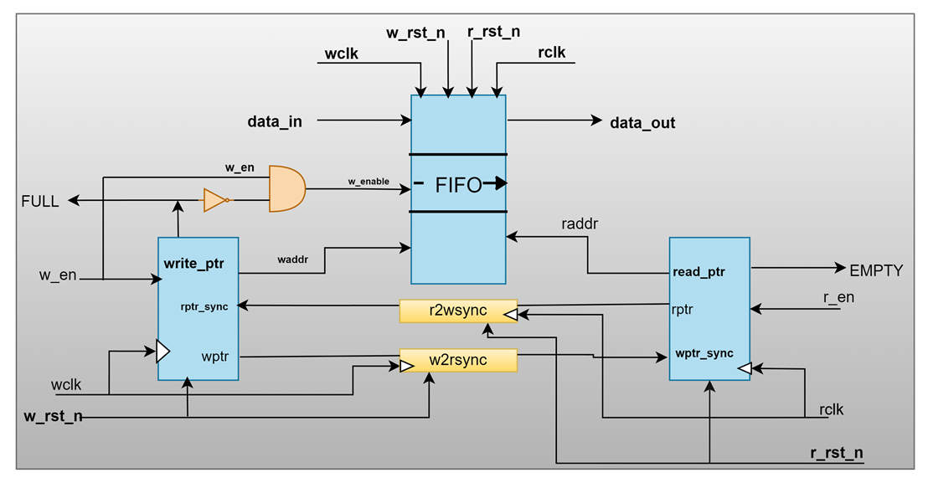
BLOCK DIAGRAM OF AYNCHRONOUS FIFO

Slide 6
Design Modules
Top
System Verilog Environment OR
UVM Environment
Interface
w2rsync
r2wsync
write_ptr
read_ptr
fifo_mem

Slide 7
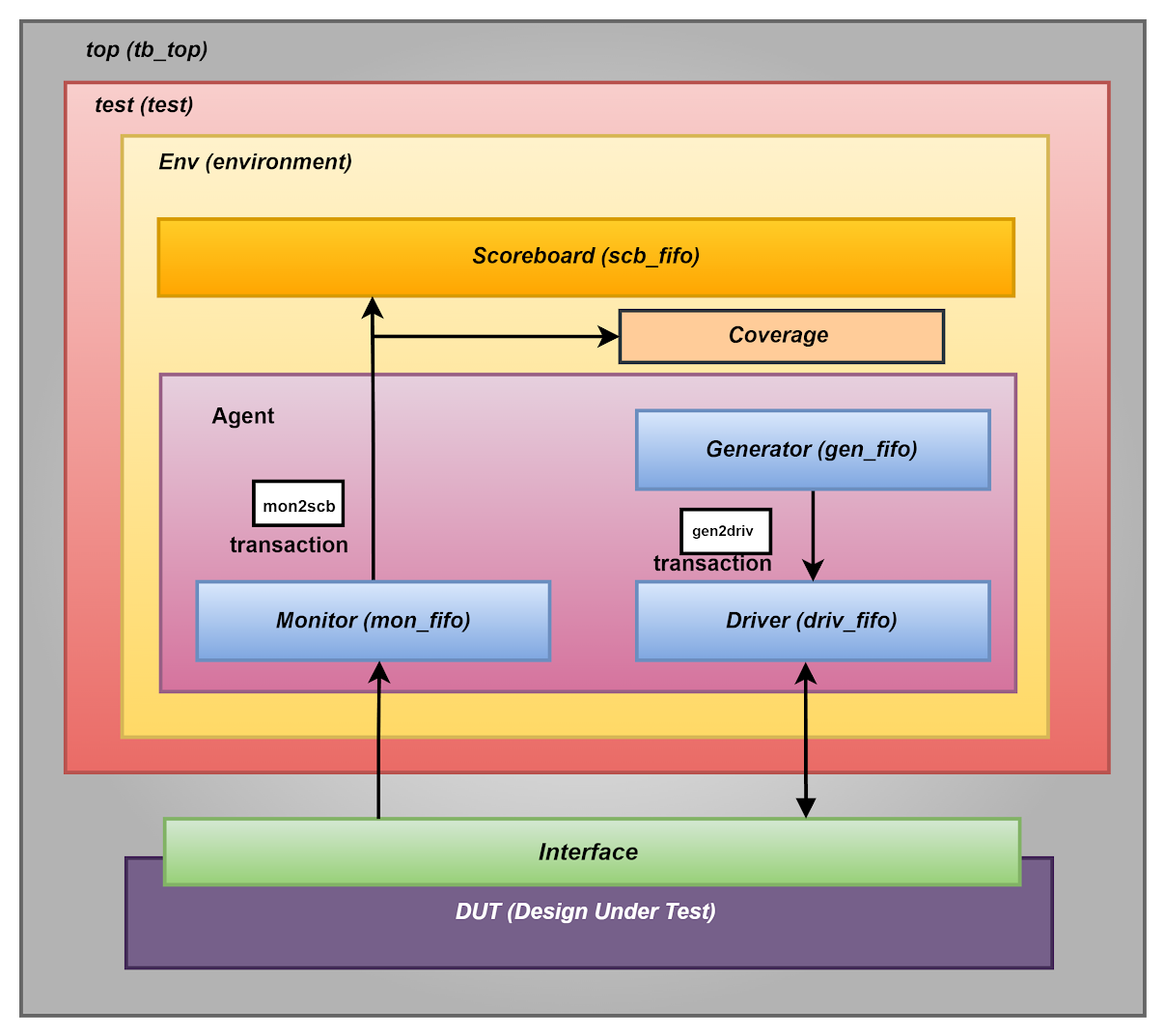
System Verilog Verifcation Environment

Slide 8
SV Test bench Components
Transaction class
Constraints dor read and write enable
constraint wr {w_en dist {1:/50, 0:/(50)};}
function void post_randomize();
r_en = ~w_en;
endfunction
Randomized inputs namely w_en, r_en, data_in
Constraint for read enable and write enable

Slide 9
Generator
Driver
Generated the randomized values for data_in with write enable being asserted for half of the burst length.
And read enable being asserted for the next half of the burst length.
The generated data is transferred to driver through mailbox.
The data from generator is collected through mailbox.
The received data such as w_en, r_en and data_in are sent to DUT through interface based on certain conditions.
for(int j=0;j<count;j++)
begin
trans =new(); //creating trans object
//randomizing the inputs
if(j<count/2)
assert(trans.randomize() with{trans.w_en==1;trans.r_en==0;});
if (j>=count/2)
assert(trans.randomize() with {trans.w_en==0;trans.r_en==1;});
//put method to transfer the data from genrator to driver
gen2driv.put(trans);
$display("[Generator][Generator trasaction no=%0d]:
data_in =%d, w_en = %d, r_en =%d ", gen_transfer,
trans.data_in, trans.w_en, trans.r_en);
gen_transfer++;
end
trans=new(); // creating object for transaction
gen2driv.get(trans);//getting data sent by generator
@(negedge vif.rclk);
if(!trans.flag)
begin
if(trans.w_en & !trans.r_en)
begin
vif.w_en <= trans.w_en;
vif.r_en <= trans.r_en;
vif.data_in <= trans.data_in;

Slide 10
Monitor
Scoreboard
The monitor receives input and output data from the DUT through interface.
The data is transferred to scoreboard through mailbox.
The scoreboard receives input and output data from the monitor through mailbox.
The reference model in the scoreboard compares the outputs and states whether the test is failed or passed
trans = new(); //creating trans object
trans.mflag=0; //setting mflag bit to zero
@(posedge vif.rclk);
wait(vif.w_en || vif.r_en);
// when write enable is high transfering the data from interface to mailbox
if( (!vif.r_en) & vif.w_en )
begin
@(posedge vif.wclk);
@(posedge vif.wclk);
trans.w_en = vif.w_en;
trans.r_en = vif.r_en;
trans.waddr = vif.waddr;
trans.raddr = vif.raddr;
trans.data_in = vif.data_in;
trans.full = vif.full;
trans.empty = vif.empty;
trans.data_out = vif.data_out;
if(check_fifo !== trans.data_out)//comparing the output data_out
begin
$error("[SCB-FAIL][Scb-transfer =%0d]
Data :: Expected_data_out = %0d Actual_data_out = %0d",
scb_transactions,check_fifo,trans.data_out);
fail_count++; //incrementing fail count
end
else
begin
$display($time,"[SCB-PASS][Scb-transfer =%0d]
Data :: Expected_data_out = %0d Actual_data_out = %0d",
scb_transactions,check_fifo,trans.data_out);
pass_count++; //incrementing pass count
end

Slide 11
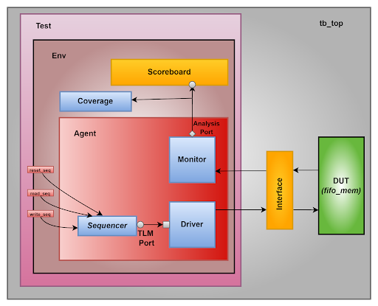
UVM Verification Environment

Slide 12
UVM Test bench Components
Sequence item
Sequencer
The actual randomization of all the inputs happens in the Sequence and sent through the sequencer to the driver.
Constraint for read enable and write enable
The sequencer controls the generation and sequencing of stimulus transactions..
Build phase and connect phase are the phases of UVM used in the Sequencer to connect to thedriver and pass on the item from sequencer to the driver.
//constraints for equal write and read enable
constraint wr {w_en dist {1:/50, 0:/(50)};}
function void post_randomize();
r_en = ~w_en;
endfunction
//Build phase
function void build_phase(uvm_phase phase);
super.build_phase(phase);
`uvm_info("SEQUENCER", "Build Phase!",UVM_LOW)
endfunction
//connect phase
function void connect_phase(uvm_phase phase);
super.connect_phase(phase);
`uvm_info("SEQUENCER", "Connect Phase!",UVM_LOW)
endfunction

Slide 13
Sequences control the generation of stimulus to drive the DUT.
Reset Sequence
task body();
begin
fifo_pkt = fifo_seq_item#(8,8,256)::type_id ::create ("fifo_pkt");
start_item(fifo_pkt);
fifo_pkt.no_rst.constraint_mode(0);
// randomizing with write_reset-0 and read reset-0
assert (fifo_pkt.randomize() with {fifo_pkt.w_rst_n==0;fifo_pkt.r_rst_n==0;});
finish_item(fifo_pkt);
end
endtask
Write Sequence
Read Sequence
for (int i=0; i<num;i++)
begin
fifo_pkt_wr = fifo_seq_item#(8,8,256)::type_id ::create
("fifo_pkt_wr");
start_item(fifo_pkt_wr);
// randomizing with write_enable-1 and read enable-0
assert (fifo_pkt_wr.randomize() with {w_en==1 ;r_en==0;});
finish_item(fifo_pkt_wr);
end
for (int i=0; i<num;i++)
begin
fifo_rd_pkt = fifo_seq_item#(8,8,256)::type_id::create
("fifo_rd_pkt");
start_item(fifo_rd_pkt);
//randomizing with write_enable-0 and read enable-1
assert (fifo_rd_pkt.randomize() with {w_en==0 & r_en==1;});
finish_item(fifo_rd_pkt);
end

Slide 14
Driver
Agent
The driver is responsible for converting transaction-level stimulus generated by the sequencer into signals.
It drives the actual interface
There are Build Phase, Connect Phase and Run Phase responsible for connecting and responsible for performing different operations.
It typically consists of a driver, monitor, sequencer
create method for the sequencer , driver, and monitor using the factory registration methods from the uvm_object class in build phase.
task drive(fifo_seq_item drv_pkt);
begin
if (!drv_pkt.w_rst_n & !drv_pkt.r_rst_n) begin
vif.w_rst_n <= drv_pkt.w_rst_n;
vif.r_rst_n <= drv_pkt.r_rst_n;
end
else begin
if(drv_pkt.w_en & !drv_pkt.r_en)
begin
vif.w_rst_n <= drv_pkt.w_rst_n;
vif.r_rst_n <= drv_pkt.r_rst_n;
vif.w_en <= drv_pkt.w_en;
vif.r_en <= drv_pkt.r_en;
vif.data_in <= drv_pkt.data_in;
@(posedge vif.wclk);
//build phase
function void build_phase (uvm_phase phase);
super.build_phase(phase);
`uvm_info("AGENT CLASS", "BUILD PHASE!",UVM_LOW)
s0 = sequencer::type_id::create("s0",this);
d0 = driver::type_id::create("d0",this);
mon = monitor:: type_id::create("mon", this);
endfunction

Slide 15
Monitor
Scoreboard
The monitor continually gathers input and output data from the DUT and transforms it to the scoreboard.
Monitor uses Build Phase to ensure proper connection with the interface using uvm_config_db
There is a write method to push the values into the queue and task read method to get the values from the reference queue and compare the output with the actual data_out.
Scoreboard contains an analysis port and that is connected to different components in the uvm testbench hierarchy.
forever
begin
mon_pkt = fifo_seq_item #(8,8,256)::type_id::create("mon_pkt");
wait (vif.w_rst_n && vif.r_rst_n);
if(vif.w_en & !vif.r_en)
begin
@(posedge vif.wclk);
mon_pkt.w_en=vif.w_en;
mon_pkt.r_en=vif.r_en;
mon_pkt.waddr= vif.waddr;
mon_pkt.raddr=vif.raddr;
mon_pkt.data_in= vif.data_in;
mon_pkt.data_out= vif.data_out;
mon_pkt.full= vif.full;
mon_pkt.empty= vif.empty;
//checking the output values from received from DUT nad the testbench(monitor)
if(actual != expected_data)
begin
`uvm_error("Comparing read", $sformatf("transaction failed
actual=%d, expected_data=%d", actual,expected_data))
end
else
begin
uvm_info("Comparing read", $sformatf("transaction passed)
actual=%d, expected_data=%d", actual,expected_data), UVM_LOW
end

Slide 16
Environment
Test
Environment follows the same pattern as the agent does but environment calls the create method for agent, scoreboard and coverage using the factory registration methods in the build phase.
Also connects the monitor analysis port to the scoreboard and coverage analysis port
The three sequences are used here.one for reset and other two to generate the tests for read and write separately.
task run_phase(uvm_phase phase);
super.run_phase(phase);
uvm_info("TEST CLASS", "INSIDE RUN PHASE!",UVM_LOW)
phase.raise_objection(this);
//reset sequence
reset_seq= fifo_sequence::type_id::create("reset_seq");
reset_seq.start(e0.agnt.s0);
#10;
//write sequence
write_seq= fifo_sequence_wr::type_id::create("write_seq");
write_seq.start(e0.agnt.s0);
#4;
//read sequence
read_seq= sequence_fifo_rd::type_id::create("read_seq");
read_seq.start(e0.agnt.s0);
#10;
phase.drop_objection(this);
endtask
//Build Phase
agnt = agent ::type_id::create("agnt",this); //Agent
scb = scoreboard:: type_id::create("scb", this); //Scoreboard
cov=coverage::type_id::create("cov",this); //Coverage
//Connect Phase
//connecting monitor analysis port to scoreboard analysis port
agnt.mon.monitor_port.connect(scb.scoreboard_port);
//connecting monitor analysis port to coverage analysis port
agnt.mon.monitor_port.connect(cov.coverage_port);

Slide 17
Functional Coverage
Cover points: Reset, Initial empty, fifo full condition, fifo empty, data_in (range)
Cover groups: Read and Write
Cross cover groups: Write and fifo full, Continuous reads, continuous writes etc.
System Verilog
Functional Coverage : 91.7%
UVM
Functional Coverage : 86.13%

Slide 18
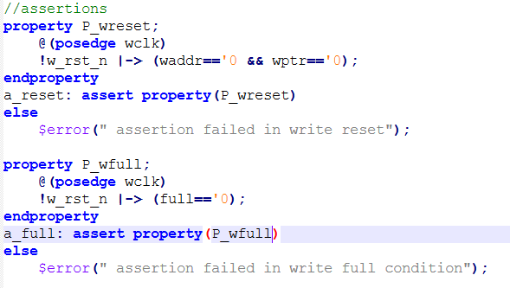
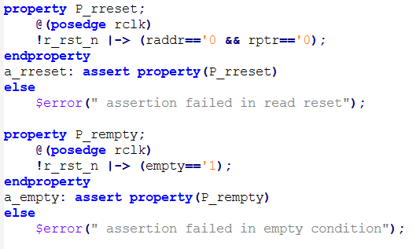
Assertions

Slide 19
Test Matrix
White Box testing
Basic test cases;
Testing under reset conditions
Basic read operation
Basic write operation
Complex test cases:
Concurrent events like read after write and write after read
Consecutive writes after read & Consecutive reads after write
Checking for the conditions like fifo_full, fifo_empty
Compare the data_in with data_out and check the errors if any.
Other testcase scenarios: bug injecting and testing scenario

Slide 20
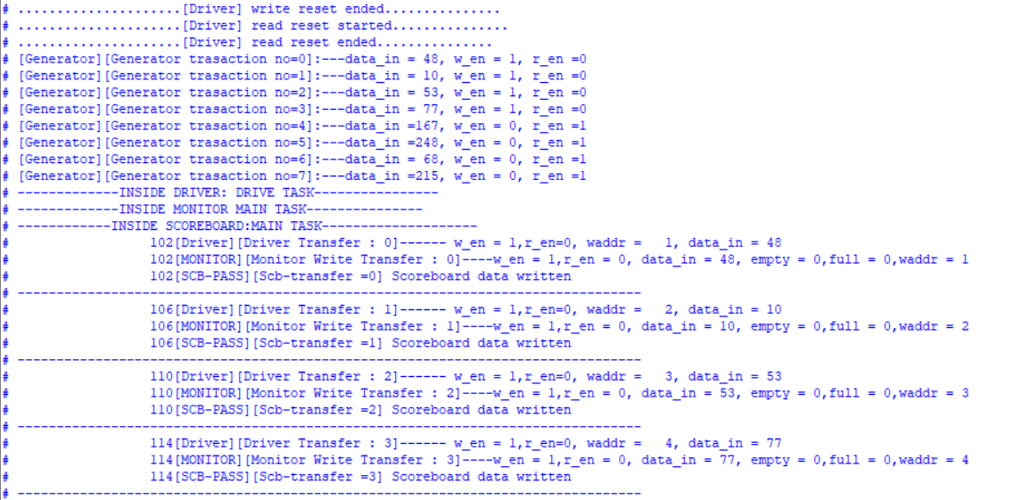
SV Simulation Results

Slide 21
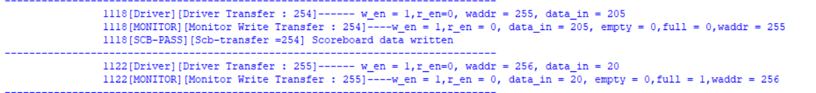
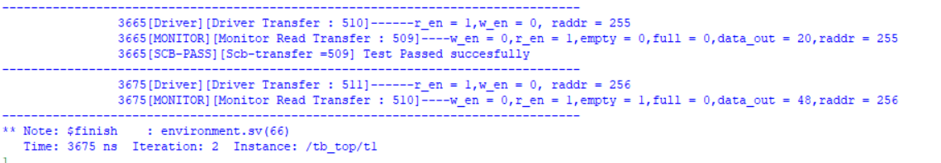
SV Simulation Results
FIFO Full
FIFO EMPTY

Slide 22
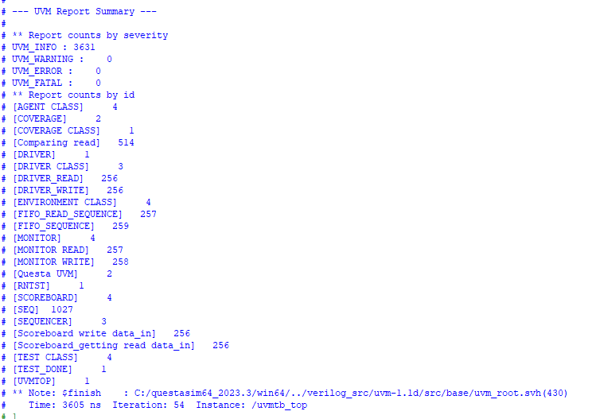
UVM Simulation Results

Slide 23
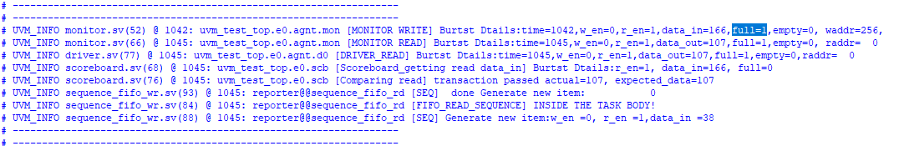
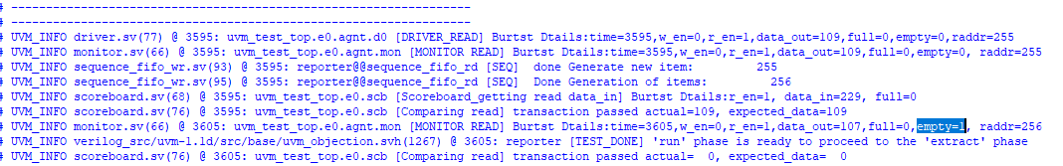
UVM Simulation Results
FIFO Full
FIFO EMPTY

Slide 24
Challenges Faced
Challenges Resolved
Received data_out value as ‘x’ initially due to improper connection during the initial run.
Incorrect values for read address increment.
Not received correct full and empty values after read and write transfers.
Not getting the updated data out after every read transfer in monitor and driver.
Did not implement the error correction and detection mechanism to correctly verify the asynchronous FIFO.
Race Conditions between write and read pointers.
Unable to reset back to the normal operation.
Checked thoroughly the entire testbench and identified the improper connection in between the classes and resolved the issue by placing a proper connection between the components
Identified the incorrect values for the read address increment due to extra delays in the few testbench components and resolved by reducing the delay and checking the proper flow
Resolved connectivity issues between the design and testbench for achieving full and empty conditions by meticulously verifying the interface connection, noting disparities in received values in the transcript, and ultimately resolving the issue by removing clocking blocks.
Identified the previous values getting updated in the monitor for two every two read operations performed and resolved the issue by providing the same delays in both driver and monitor
Identified the different values propagating from data_in to data_out resulted in race conditions between read and write pointers and resolved it by checking and modifying the code thoroughly in both design and testbench
Identified & corrected the incorrect reset value assigned in the top level testbench of uvm testbench verification hierarchy

Slide 25
Conclusion
Future work
The Asynchronous FIFO employs a pointer-based method to detect FULL & EMPTY conditions.
The Design uses the FIFO memory to manage data in sequential manner
2-level Synchronizers are used to reduce the risk of metastability
Implemented Testing strategies like functional testing, boundary conditions testing, random data transactions and asynchronous operation testing
Enhancing the UVM verification techniques such as property based testing
Optimizing the memory utilization and/ or implementing parallel processing techniques
Enhancing the Scalability, improving power efficiency.

Slide 26
References
https://vlsiverify.com/verilog/verilog-codes/asynchronous-fifo/
https://vlsiuniverse.blogspot.com/2013/09/synchronization-schemes.html
https://www.verilogpro.com/asynchronous-fifo-design
Clifford E. Cummings, Sunburst Design, “Simulation and Synthesis Techniques for Asynchronous FIFO Design” http://www.sunburst-design.com/papers/CummingsSNUG2002SJ_FIFO1.pdf
Karthik Rao, Nitin Goel, Prashant Bhargava, “Design Transition from Sync to Async: Design and Verification Challenges”, https://www.design-reuse.com/articles/31630/design-transition-from-sync-to-async-design-and-verification-challenges.html
https://verificationguide.com/uvm/uvm-testbench-architecture/
https://hardwaregeeksblog.files.wordpress.com/2016/12/fifodepthcalculationmadeeasy2.pdf
Venkatesh Patil-“ECE-593-Lecture Slides”.

Slide 27
Thank you

