Slide 1

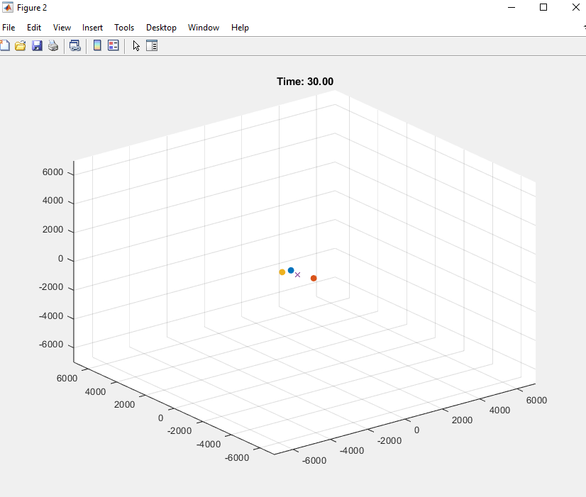
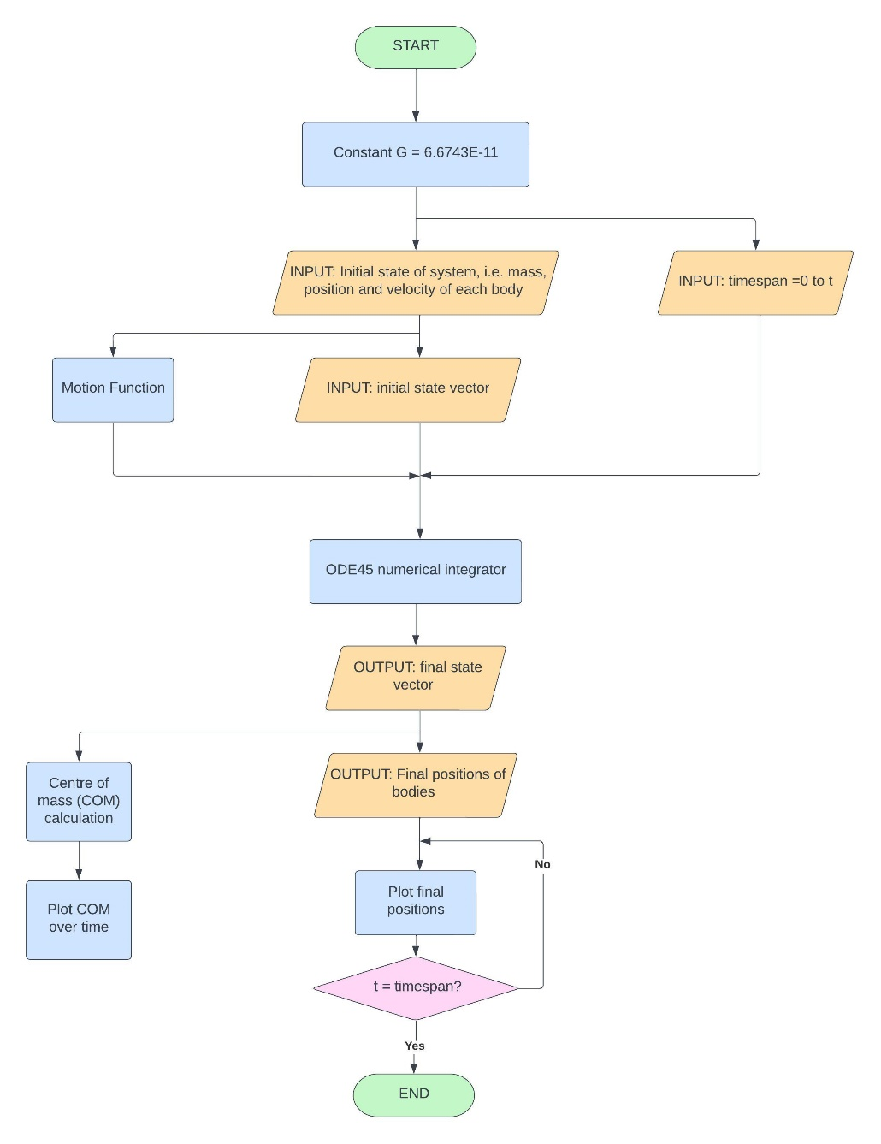

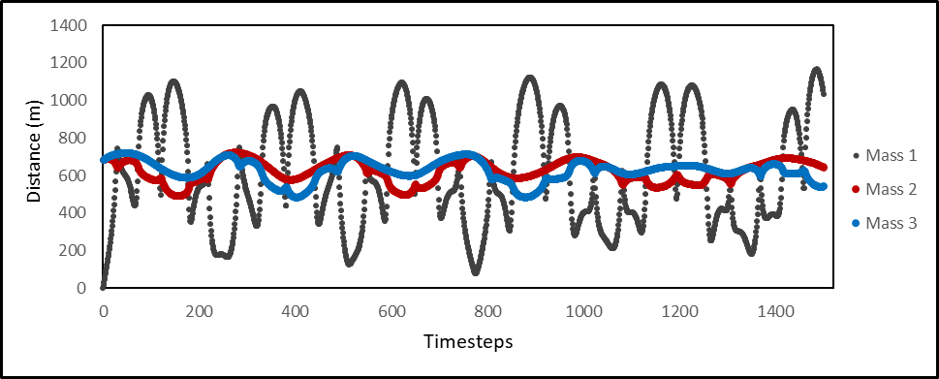
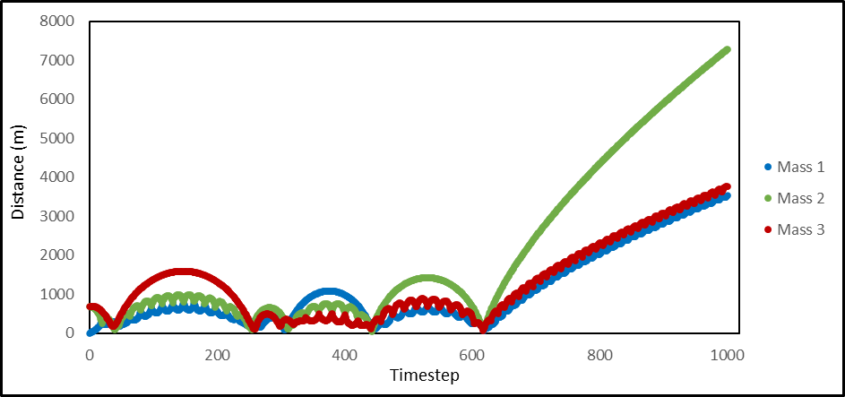
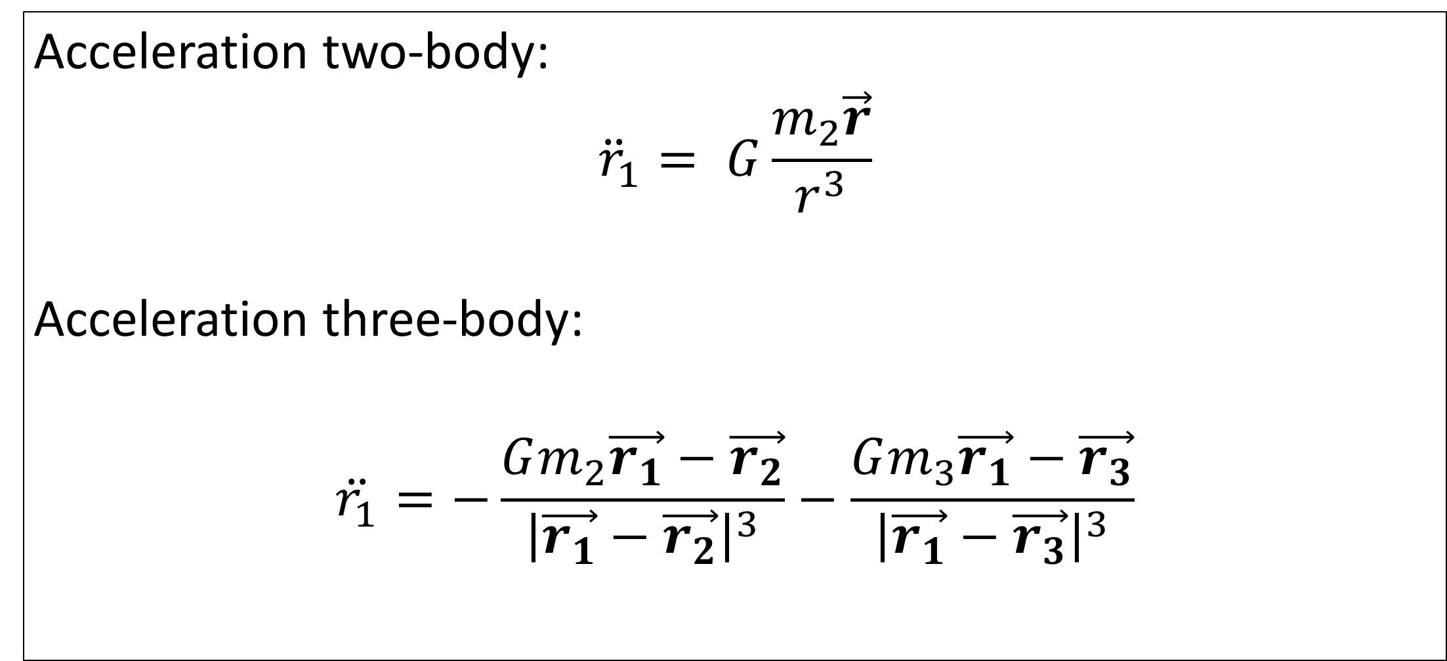
Jacob Aniyan
N0940068@my.ntu.ac.uk
Supervisor: Ian Shuttleworth
Three body simulation using numerical integration
Abstract
A two-body simulation was developed in MATLAB and used to build a three-body simulation. Each were first developed in 2D followed by 3D. An established method was also used in which the distances between the centre of mass (C.O.M.) and each body was plotted over time. This was analysed qualitatively for characteristics of ejection and chaos in three body systems of varying mass. These methods can be used in the field of celestial mechanics to investigate the formation of binary systems further and the relationship between chaos theory and the three-body problem.
Background
The three-body problem has been at the forefront of celestial mechanics ever since Newton devised the laws of motion and the universal law of gravitation.
An analytical solution can be found concerning an isolated two-body system.
No such solution exists for the three-body problem, however extremely accurate approximate solutions have been developed especially in the past few decades with the rise of computer simulations.
This lead on to finding approximate solutions to the n-body problem, which was vital when launching space missions within our solar system.
Development
Below is the flowchart of the overall program:
Key aspects of the code include the initial state vector, ode45 numerical integrator, motion function and plot loop.
Simulation
The three masses are represented as circles with the C.O.M. represented by a cross.
Distances between each mass and the C.O.M. were plotted over time in a hidden figure. Three variables contained the data for each body.
m1
m3
Results
F12
F13
F31
F32
F21
F23
m2
Acceleration two-body:
$${\ddot{r}}_{1}= G\frac{m_{2}\vec{r}}{r^{3}}$$
Acceleration three-body:
$$\ddot{r_{1}}=−\frac{Gm_{2}\vec{r_{1}}−\vec{r_{2}}}{{\left|\vec{r_{1}}−\vec{r_{2}}\right|}^{3}}−\frac{Gm_{3}\vec{r_{1}}−\vec{r_{3}}}{{\left|\vec{r_{1}}−\vec{r_{3}}\right|}^{3}}$$
Conclusion
A three-simulation was successfully produced, which can be used with sufficient background knowledge of MATLAB and classical mechanics. This has many applications in celestial mechanics for studying the formation of binary systems in particular.
Graphs showing distances between each body and the centre of mass over total timesteps.

