Slide 1
Final Project
J B Mugundh,
2021503524,
Department of Computer Technology,
Madras Institute of Technology, Anna University
04/05/2024 Annual Review

Slide 2
FACE MASK DETECTION USING NEURAL NETWORKS
04/05/2024 Annual Review

Slide 3


AGENDA
Welcome to our journey through cutting-edge technology in face mask detection using neural networks. We begin with an Introduction, addressing the Problem Statement, and providing a succinct Project Overview.
Transitioning into our Solution segment, we dissect the architecture and methodologies employed in our face mask detection system.
Moving forward, we explore Model Building, where we reveal the neural network frameworks and techniques used to train our model.
Finally, in the Predictive System segment, we showcase the real-world application of our solution. Join us as we navigate towards safer and more technologically advanced mask detection solutions.
04/05/2024 Annual Review
3/21/2024 Annual Review

Slide 4

PROBLEM STATEMENT
In today's fast-paced world, safety compliance is a top priority across industries. However, manual monitoring of protocols like mask-wearing is resource-intensive and prone to errors.
Finding an efficient solution to automate this process is essential for maintaining safety standards.
By leveraging technology for automated mask detection, businesses can enhance compliance monitoring, optimize resource allocation, and improve overall operational efficiency.
04/05/2024 Annual Review

Slide 5

PROJECT OVERVIEW
Our project endeavors to revolutionize safety monitoring by developing an intelligent system capable of autonomously detecting mask-wearing behavior.
By harnessing the power of machine learning, we aim to create a solution that not only enhances safety protocols but also optimizes resource allocation and streamlines operational efficiency.
04/05/2024 Annual Review

Slide 6

WHO ARE THE END USERS?
Healthcare: Hospitals, clinics, and medical facilities can use our solution to ensure staff and patients adhere to mask-wearing guidelines.
Transportation: Airlines, trains, and public transit systems can implement our system to enforce mask mandates among passengers.
Education: Schools, colleges, and universities can utilize our technology to monitor mask compliance among students and staff.
Public Spaces: Venues such as shopping malls, stadiums, and entertainment venues can enhance safety measures by employing our mask detection system.
04/05/2024 Annual Review

Slide 7

YOUR SOLUTION AND ITS VALUE PROPOSITION
Solution:
Our solution leverages Convolutional Neural Networks (CNNs) to analyze images and classify them into two categories: "with mask" and "without mask." The model is trained on a dataset comprising images of individuals wearing and not wearing masks, enabling it to accurately distinguish between the two.
Value Proposition:
Accuracy: Achieves high accuracy rates in detecting mask-wearing.
Efficiency: Automates the monitoring process, saving time and resources.
Scalability: Can be deployed in various settings and integrated with existing security systems.
Real-time Detection: Provides real-time analysis, enabling swift responses to non-compliance.
04/05/2024 Annual Review

Slide 8

THE WOW IN YOUR SOLUTION
Our solution impresses with its adeptness in training a deep learning model for image classification using TensorFlow and Keras. Here's why it stands out:
Proper Data Preprocessing:
Meticulous data preprocessing ensures dataset integrity and model performance, with data split into training, validation, and optionally test sets.
Custom CNN Architecture:
Our tailored CNN architecture extracts meaningful features from images, optimized for accuracy and efficiency in mask detection tasks.
Optimization and Robustness:
Advanced optimization techniques and fine-tuning of hyperparameters enhance model robustness and generalization to diverse scenarios.
Scalability and Flexibility:
Modular design allows easy customization and integration into various environments, promising scalability and adaptability.
04/05/2024 Annual Review
3/21/2024 Annual Review

Slide 9
MODELLING
Data Preparation:
Utilize dataset of mask and non-mask images.
Preprocess images and split for training/validation.
Model Architecture:
Implement CNN with TensorFlow/Keras for feature extraction.
Training and Evaluation:
Compile CNN with suitable optimizer/loss function.
Train model, evaluate on validation set, visualize metrics.
Predictive System Development:
Develop image preprocessing, implement prediction.
Deploy system for real-time mask detection.
Technology used:
TensorFlow and Keras for CNN implementation.
PIL for image processing.
NumPy for data handling.
Matplotlib for visualization.
04/05/2024 Annual Review

Slide 10
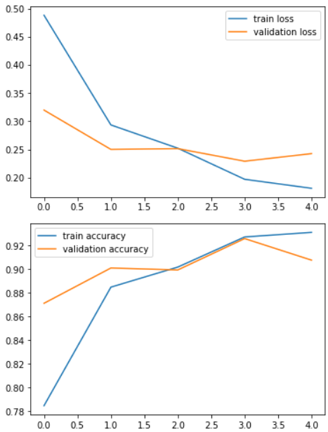
RESULTS
04/05/2024 Annual Review

Slide 11
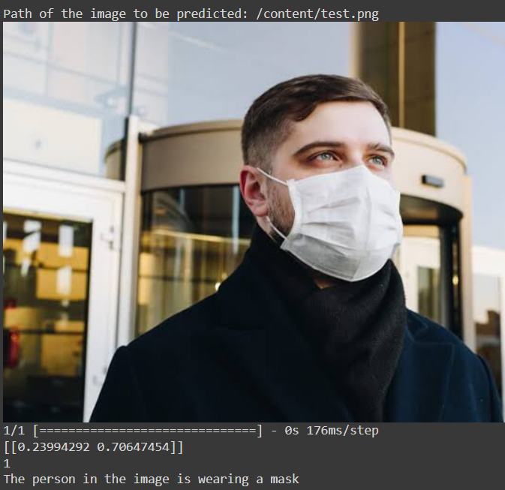
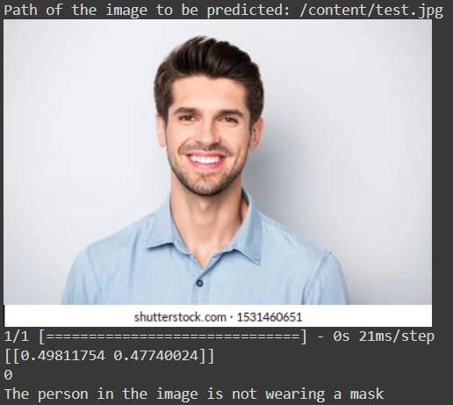
RESULTS
04/05/2024 Annual Review

Slide 12
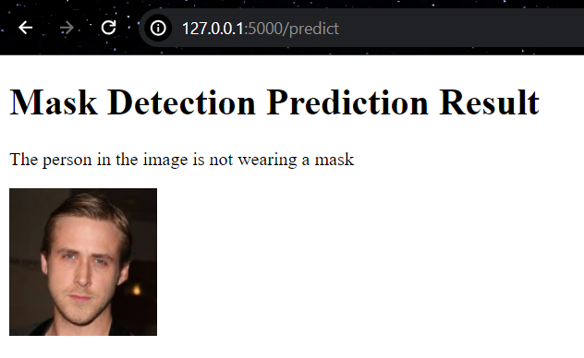
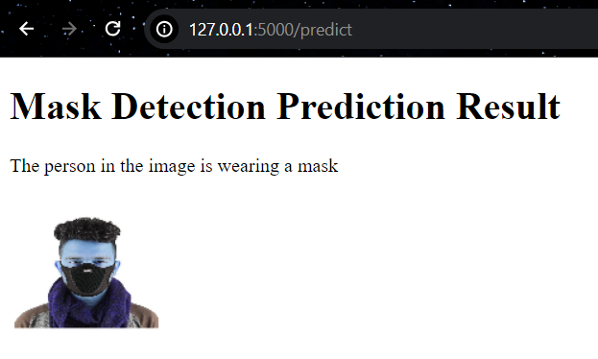
RESULTS
(ML model turned into App)
04/05/2024 Annual Review

Slide 13
THANK YOU!
04/05/2024 Annual Review

