Slide 1
BUSINESS INTELLIGENCE PROJECT
Minnesota Interstate
Traffic Volume
Patterns by time, holiday, and weather
Jahmoy Colquhoun
Notes:
Introduce the project as an analysis of how traffic volume changes across time, holidays, and weather conditions.
[Sources]
- User-provided Minnesota Interstate Traffic Volume Dashboard image.

Slide 2
Traffic planning must anticipate changing demand
Transportation teams need a clear view of when interstate demand rises or falls so they can plan operations and communicate travel risk.
BUSINESS QUESTIONS
1 When does traffic volume change most across the day?
2 Which holidays show the greatest average demand?
3 How does traffic vary by weather condition?
The dashboard converts a large traffic dataset into patterns that support staffing, congestion planning, and traveler messaging.
02
Notes:
Frame the project around operational decision-making. The goal is not only to display traffic counts, but to reveal useful patterns for planning.
[Sources]
- User-provided Minnesota Interstate Traffic Volume Dashboard image.

Slide 3
Three steps turned raw records into decision-ready views
01
02
03
PREPARE
ANALYZE
VISUALIZE
Reviewed date/time, holiday, weather, and traffic-volume fields; organized time dimensions for comparison.
Focused on average traffic volume by hour, holiday, and primary weather condition.
Built a calendar-style heatmap, packed bubbles, and a ranked bar chart in Tableau.
Interactive filters allow the audience to isolate a year and holiday status for focused comparison.
03
Notes:
Explain that the project used Tableau and centered on three metrics/views: time of day, holiday, and weather. Mention that filters make the dashboard interactive.
[Sources]
- User-provided Minnesota Interstate Traffic Volume Dashboard image.

Slide 4
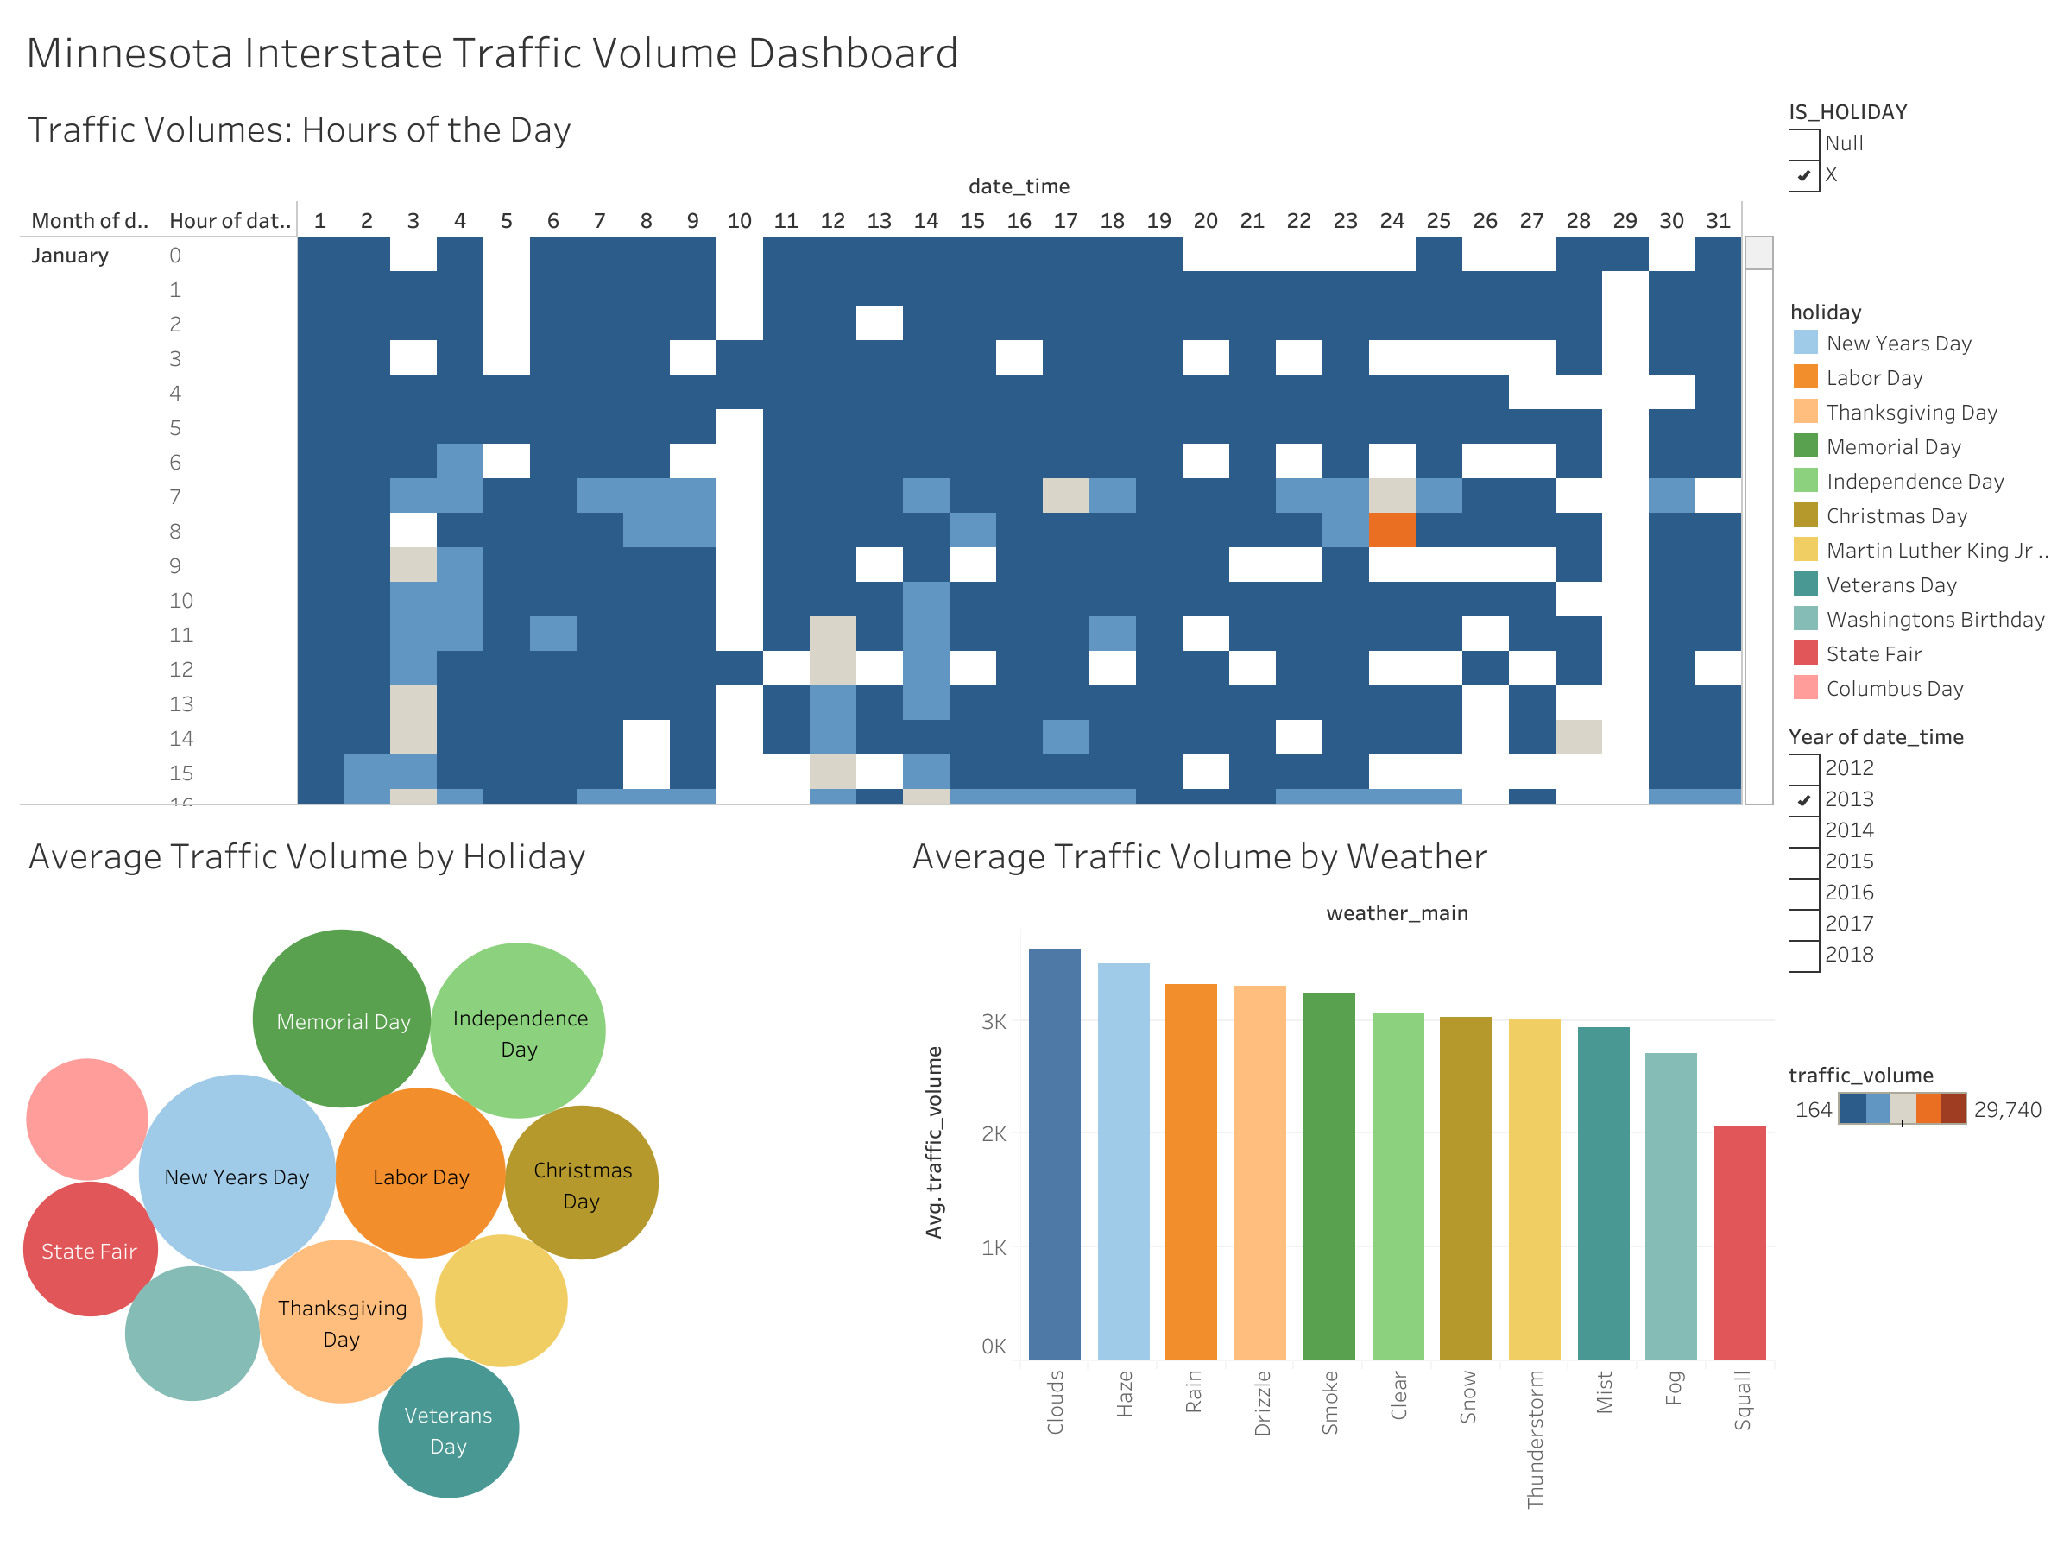
Holiday and weather patterns stand out
01
New Years Day appears as the highest-volume holiday.
02
Clouds and haze lead the weather categories; squall is lowest.
03
Traffic varies substantially by hour and date, supporting time-specific planning.
04
Notes:
Walk through the three views. Treat the statements as directional insights visible in the dashboard rather than exact estimates.
[Sources]
- User-provided Minnesota Interstate Traffic Volume Dashboard image.

Slide 5
Target operations to specific traffic conditions
Plan around predictable demand peaks, then adjust for holiday and weather context.
01
Prioritize peak periods
Align staffing, traffic messaging, and incident readiness with the busiest hours and dates.
02
Prepare for holiday demand
Use New Years Day and other high-volume holidays as planning benchmarks.
03
Improve the next analysis
Add roadway direction, location, crashes, and travel speed to explain where congestion creates the greatest impact.
05
Notes:
Close by translating the analysis into operational actions and suggesting useful variables for a future version of the dashboard.
[Sources]
- User-provided Minnesota Interstate Traffic Volume Dashboard image.

