Slide 1
Lecture (Recitation) 21: Wiltshire-Clohessy
Paul McKee
Spaceflight Mechanics T.A.
4/8/19

Slide 2
Pros and Cons of attending this recitation
Pros | Cons
Interesting Information This is a power-point lecture - less likely to make a mistake - entire page fits on screen - don’t need to take notes At least a few minutes of Kerbal We talk about the Rocket Problem | I’m not Dr. Anderson None of this will be on the exam This is a power-point lecture - sometimes pacing is wrong … at the end

Slide 3
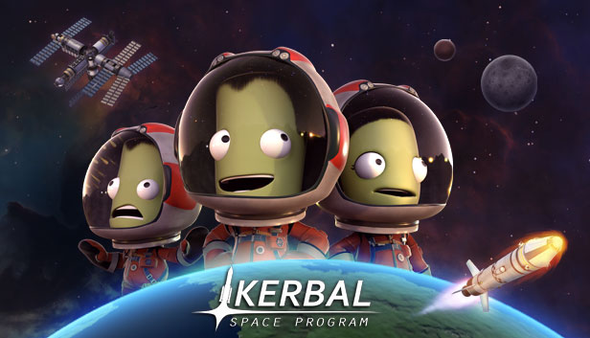
Introduction to Kerbal Space Program

Slide 4
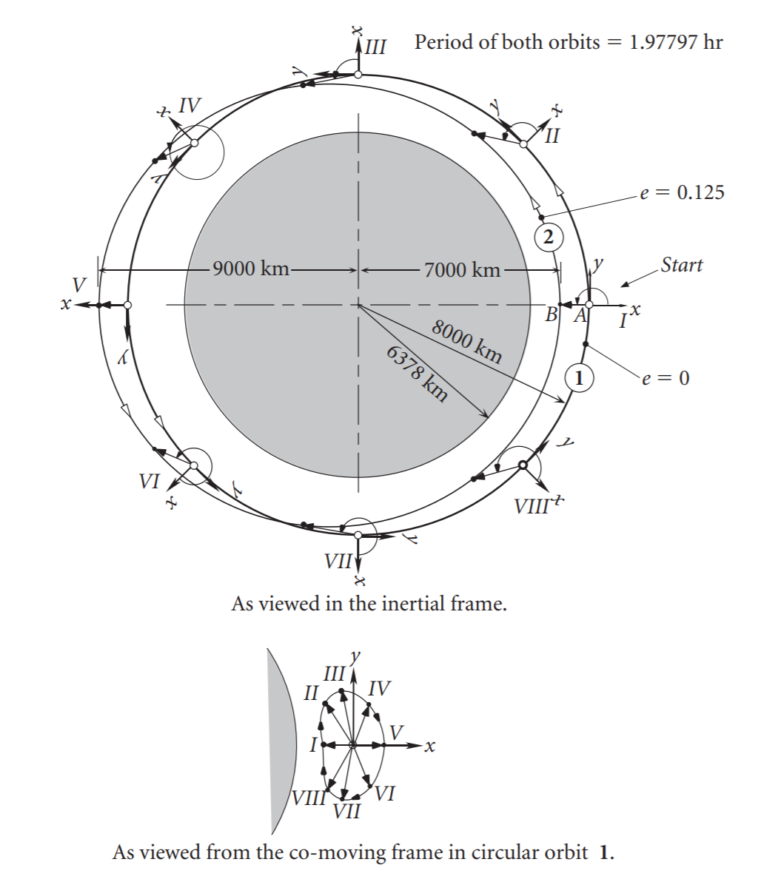
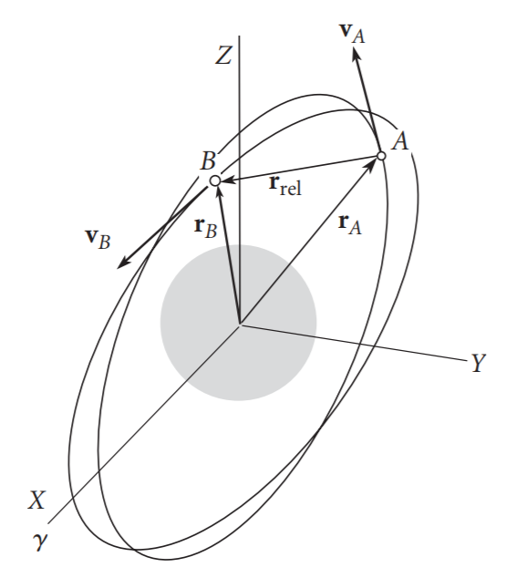
Here’s what is going on:
Curtis, Figure 7.2
Curtis, Figure 7.3

Slide 5



Chaser, Q
Target, P
$${\vec{r}}^{PQ}$$
$${\vec{r}}^{OQ}$$
$${\vec{r}}^{OP}$$
Center of Earth, O

Slide 6







$$\hat{e_{r}}$$
Q
$$\hat{e_{θ}}$$
$$δθ$$
$$δ\vec{r}$$
$$δr$$
P
$$r_{0}=const.$$
$$δθ$$
O

Slide 7







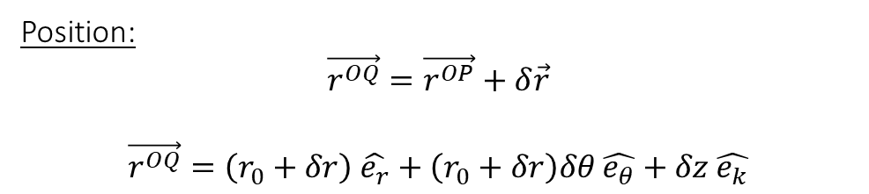
$$\hat{e_{r}}$$
Position:
$$\vec{r^{OQ}}=\vec{r^{OP}}+δ\vec{r}$$
$$\vec{r^{OQ}}=\left(r_{0}+δr\right) \hat{e_{r}}+\left(r_{0}+δr\right)δθ \hat{e_{θ}}+δz \hat{e_{k}}$$
Q
$$\hat{e_{θ}}$$
$$δθ$$
$$δ\vec{r}$$
$$δr$$
P
$$r_{0}=const.$$
$$δθ$$
O

Slide 8

$$\hat{e_{r}}$$
Velocity:
We will need to use the kinematic derivative (from Dynamics)
${= }^{N}\frac{d}{dt}\left(_\right){= }^{A}\frac{d}{dt}\left(_\right){+ }^{N}{\vec{ω}}^{A}×(_)$
$$=^{N}\vec{v^{Q}}=\left(δ\dot{r}\right) \hat{e_{r}}+\left(r_{0}\right)δ\dot{θ} \hat{e_{θ}}+δ\dot{z} \hat{e_{k}}+$$
$ω\hat{e_{k}} ×\left(\left(r_{0}+δr\right) \hat{e_{r}}+\left(r_{0}+δr\right)δθ \hat{e_{θ}}+δz \hat{e_{k}}\right)$
…
$$=^{N}\vec{v^{Q}}=\left(δ\dot{r}−ωr_{0}δθ\right)\hat{e_{r}}+\left(r_{0}δ\dot{θ}+ω(r_{0}+δr)\right)\hat{e_{θ}}+\left(δ\dot{z}\right)\hat{e_{k}}$$
Q
$$\hat{e_{θ}}$$
$$δθ$$
$$δ\vec{r}$$
$$δr$$
P
$$r_{0}=const.$$
$$δθ$$
O

Slide 9
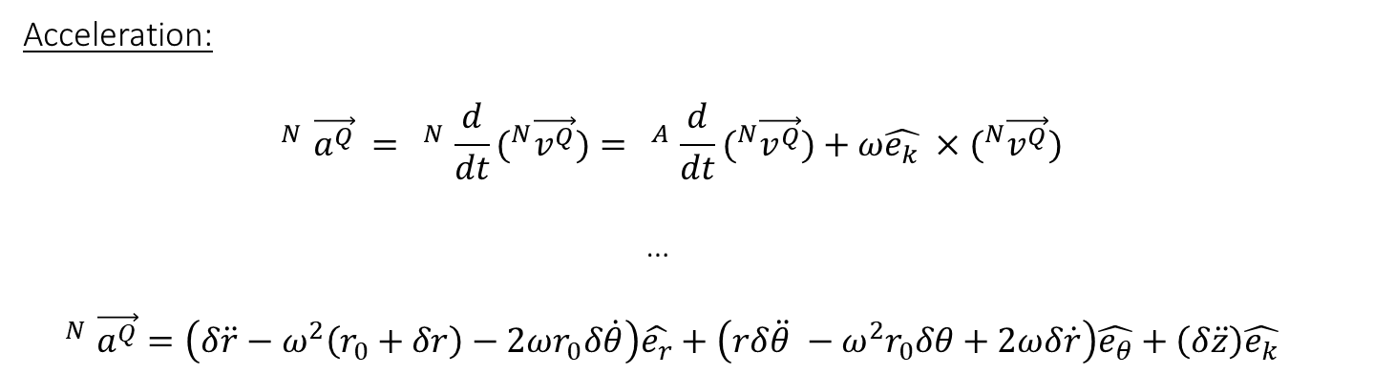
$$\hat{e_{r}}$$
Acceleration:
$$=^{N}\vec{a^{Q}} {= }^{N}\frac{d}{dt}(^{N}\vec{v^{Q}}){= }^{A}\frac{d}{dt}(^{N}\vec{v^{Q}})+ω\hat{e_{k}} ×(^{N}\vec{v^{Q}})$$
…
$$=^{N}\vec{a^{Q}}=\left(δ\ddot{r}−ω^{2}\left(r_{0}+δr\right)−2ωr_{0}δ\dot{θ}\right)\hat{e_{r}}+\left(rδ\ddot{θ} −ω^{2}r_{0}δθ+2ωδ\dot{r}\right)\hat{e_{θ}}+\left(δ\ddot{z}\right)\hat{e_{k}}$$
Q
$$\hat{e_{θ}}$$
$$δθ$$
$$δ\vec{r}$$
$$δr$$
P
$$r_{0}=const.$$
$$δθ$$
O

Slide 10
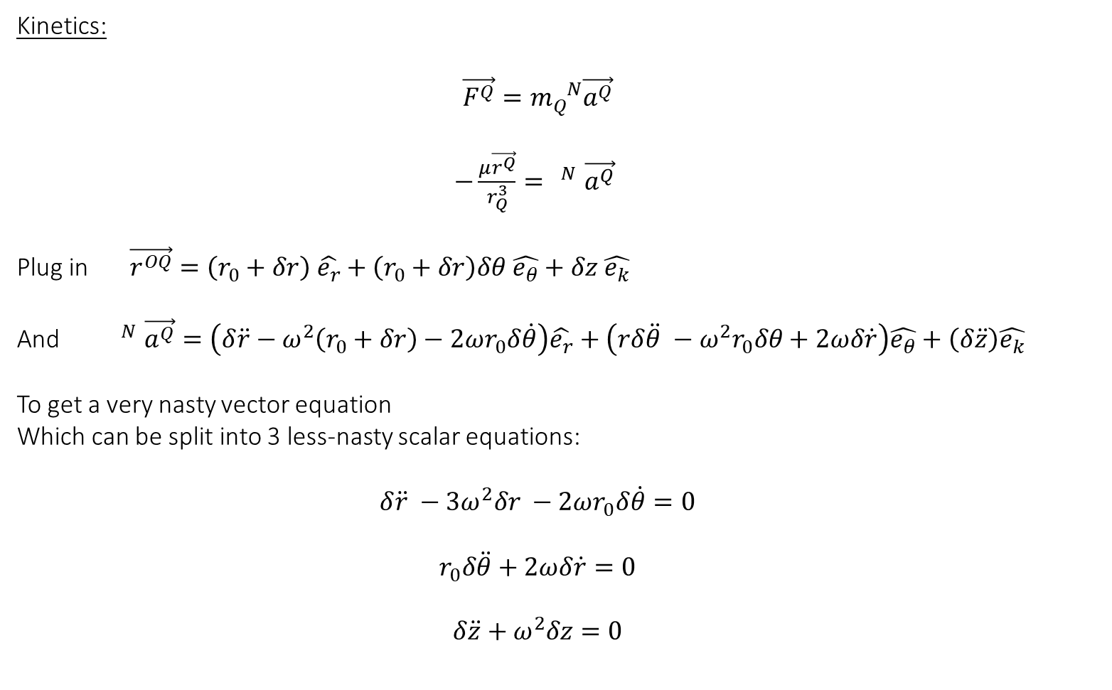
Kinetics:
$$\vec{F^{Q}}=m_{Q}^{ N}\vec{a^{Q}}$$
$−\frac{μ\vec{r^{Q}}}{r_{Q}^{3}}=^{ N}\vec{a^{Q}}$
Plug in $\vec{r^{OQ}}=\left(r_{0}+δr\right) \hat{e_{r}}+\left(r_{0}+δr\right)δθ \hat{e_{θ}}+δz \hat{e_{k}}$
And $=^{N}\vec{a^{Q}}=\left(δ\ddot{r}−ω^{2}\left(r_{0}+δr\right)−2ωr_{0}δ\dot{θ}\right)\hat{e_{r}}+\left(rδ\ddot{θ} −ω^{2}r_{0}δθ+2ωδ\dot{r}\right)\hat{e_{θ}}+\left(δ\ddot{z}\right)\hat{e_{k}}$
To get a very nasty vector equation
Which can be split into 3 less-nasty scalar equations:
$$δ\ddot{r} −3ω^{2}δr −2ωr_{0}δ\dot{θ}=0$$
$$r_{0}δ\ddot{θ}+2ωδ\dot{r}=0$$
$$δ\ddot{z}+ω^{2}δz=0$$

Slide 11
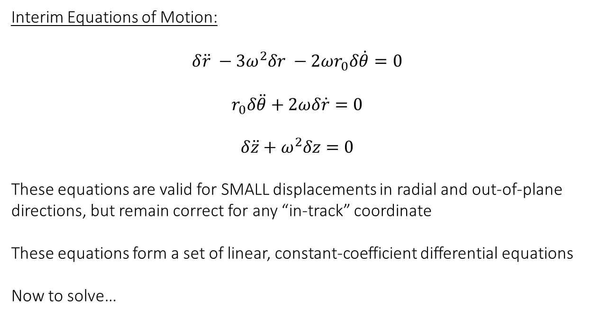
Interim Equations of Motion:
$$δ\ddot{r} −3ω^{2}δr −2ωr_{0}δ\dot{θ}=0$$
$$r_{0}δ\ddot{θ}+2ωδ\dot{r}=0$$
$$δ\ddot{z}+ω^{2}δz=0$$
These equations are valid for SMALL displacements in radial and out-of-plane directions, but remain correct for any “in-track” coordinate
These equations form a set of linear, constant-coefficient differential equations
Now to solve…

Slide 12
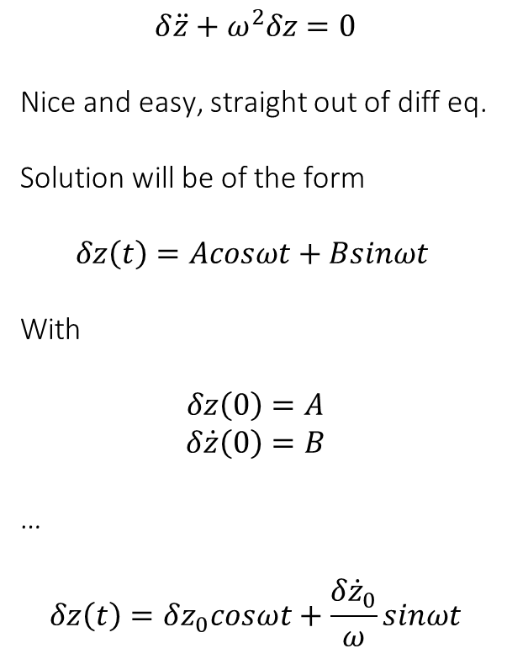
Solving for $δz(t)$
$$δ\ddot{z}+ω^{2}δz=0$$
Nice and easy, straight out of diff eq.
Solution will be of the form
$$δz\left(t\right)=Acosωt+Bsinωt$$
With
$$δz\left(0\right)=A$$
$$δ\dot{z}\left(0\right)=B$$
…
$$δz\left(t\right)=δz_{0}cosωt+\frac{δ{\dot{z}}_{0}}{ω}sinωt$$

Slide 13
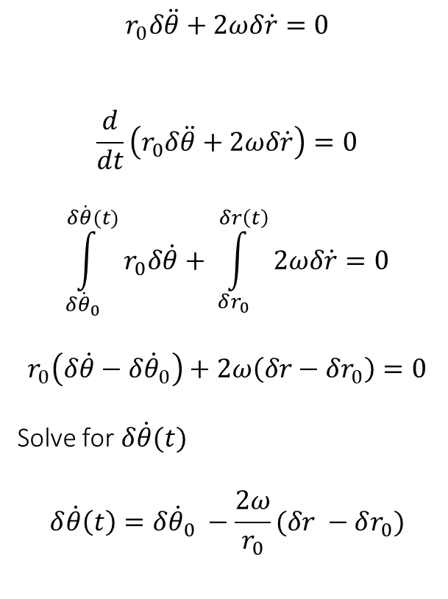
Solving for $δ\dot{θ}(t)$
$$r_{0}δ\ddot{θ}+2ωδ\dot{r}=0$$
$$\frac{d}{dt}\left(r_{0}δ\ddot{θ}+2ωδ\dot{r}\right)=0$$
$$\int_{δ{\dot{θ}}_{0}}^{δ\dot{θ}(t)}{r_{0}δ\dot{θ}}+ \int_{δr_{0}}^{δr\left(t\right)}{2ωδ\dot{r}}=0$$
$$r_{0}\left(δ\dot{θ}−δ{\dot{θ}}_{0}\right)+2ω\left(δr−δr_{0}\right)=0$$
Solve for $δ\dot{θ}(t)$
$$δ\dot{θ}\left(t\right)=δ{\dot{θ}}_{0} −\frac{2ω}{r_{0}}(δr −δr_{0})$$

Slide 14
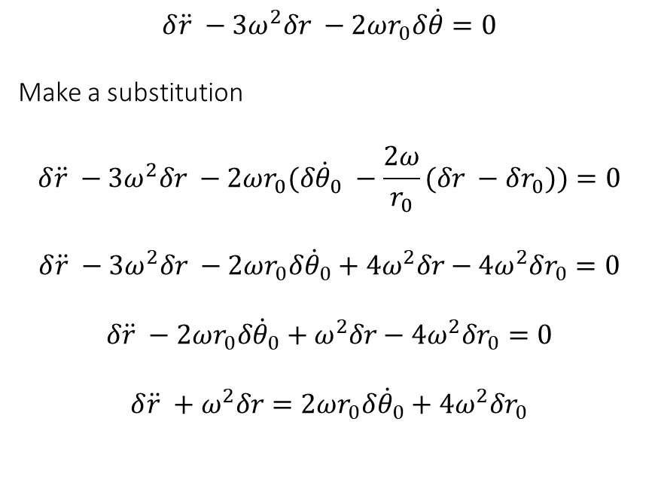
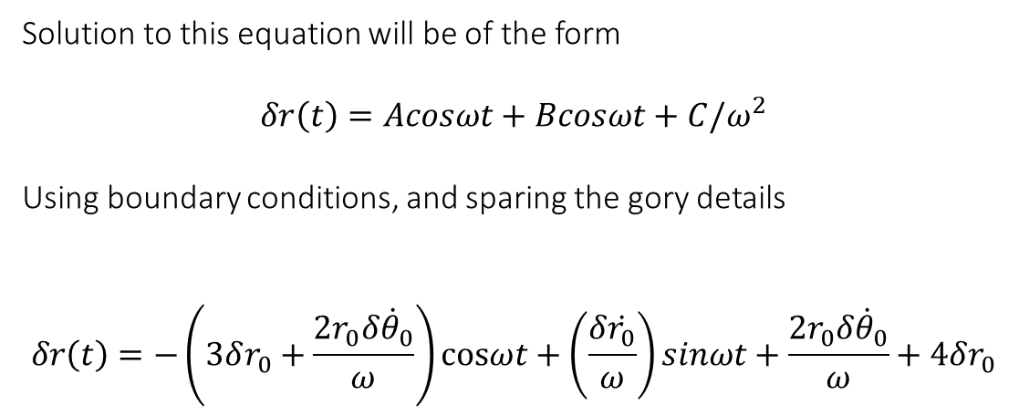
Solving for $δr(t)$
$$δ\ddot{r} −3ω^{2}δr −2ωr_{0}δ\dot{θ}=0$$
Make a substitution
$$δ\ddot{r} −3ω^{2}δr −2ωr_{0}(δ{\dot{θ}}_{0} −\frac{2ω}{r_{0}}(δr −δr_{0}))=0$$
$$δ\ddot{r} −3ω^{2}δr −2ωr_{0}δ{\dot{θ}}_{0}+4ω^{2}δr−4ω^{2}δr_{0}=0$$
$$δ\ddot{r} −2ωr_{0}δ{\dot{θ}}_{0}+ω^{2}δr−4ω^{2}δr_{0}=0$$
$$δ\ddot{r} +ω^{2}δr=2ωr_{0}δ{\dot{θ}}_{0}+4ω^{2}δr_{0}$$
Solution to this equation will be of the form
$$δr\left(t\right)=Acosωt+Bcosωt+C/ω^{2}$$
Using boundary conditions, and sparing the gory details
$$δr\left(t\right)=−\left(3δr_{0}+\frac{2r_{0}δ{\dot{θ}}_{0}}{ω}\right)cosωt+\left(\frac{δ\dot{r_{0}}}{ω}\right)sinωt+\frac{2r_{0}δ{\dot{θ}}_{0}}{ω}+4δr_{0}$$

Slide 15
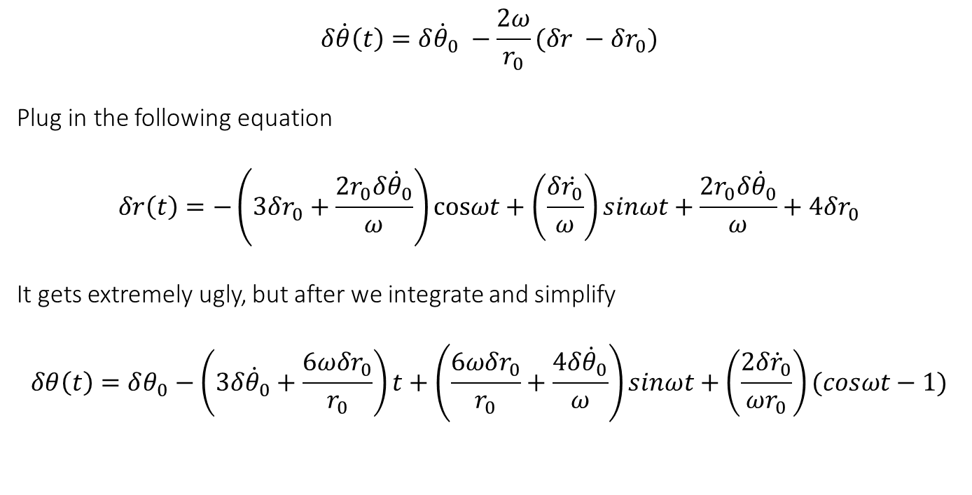
Solving for $δθ(t)$
$$δ\dot{θ}\left(t\right)=δ{\dot{θ}}_{0} −\frac{2ω}{r_{0}}(δr −δr_{0})$$
Plug in the following equation
$$δr\left(t\right)=−\left(3δr_{0}+\frac{2r_{0}δ{\dot{θ}}_{0}}{ω}\right)cosωt+\left(\frac{δ\dot{r_{0}}}{ω}\right)sinωt+\frac{2r_{0}δ{\dot{θ}}_{0}}{ω}+4δr_{0}$$
It gets extremely ugly, but after we integrate and simplify
$$δθ\left(t\right)=δθ_{0}−\left(3δ{\dot{θ}}_{0}+\frac{6ωδr_{0}}{r_{0}}\right)t+\left(\frac{6ωδr_{0}}{r_{0}}+\frac{4δ{\dot{θ}}_{0}}{ω}\right)sinωt+\left(\frac{2δ{\dot{r}}_{0}}{ωr_{0}}\right)(cosωt−1)$$

Slide 16
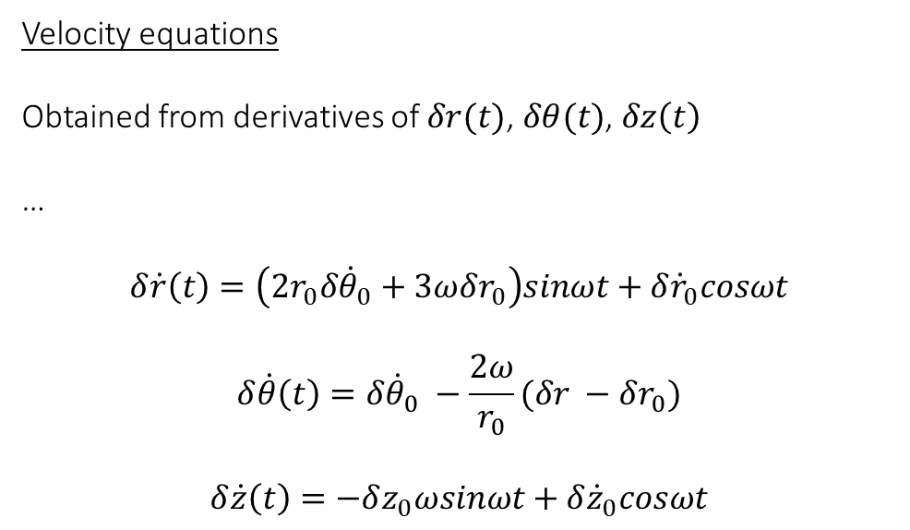
Velocity equations
Obtained from derivatives of $δr(t)$, $δθ(t)$, $δz\left(t\right)$
…
$$δ\dot{r}\left(t\right)=\left(2r_{0}δ{\dot{θ}}_{0}+3ωδr_{0}\right)sinωt+δ{\dot{r}}_{0}cosωt$$
$$δ\dot{θ}\left(t\right)=δ{\dot{θ}}_{0} −\frac{2ω}{r_{0}}(δr −δr_{0})$$
$$δ\dot{z}\left(t\right)=−δz_{0}ωsinωt+δ{\dot{z}}_{0}cosωt$$

Slide 17
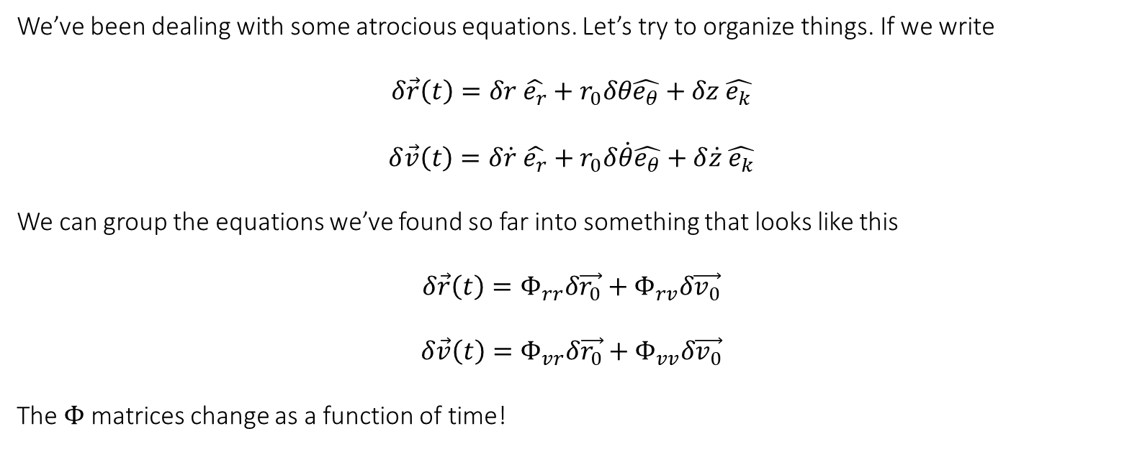
Almost at Final equations
We’ve been dealing with some atrocious equations. Let’s try to organize things. If we write
$$δ\vec{r}\left(t\right)=δr \hat{e_{r}}+r_{0}δθ\hat{e_{θ}}+δz \hat{e_{k}}$$
$$δ\vec{v}\left(t\right)=δ\dot{r} \hat{e_{r}}+r_{0}δ\dot{θ}\hat{e_{θ}}+δ\dot{z} \hat{e_{k}}$$
We can group the equations we’ve found so far into something that looks like this
$$δ\vec{r}\left(t\right)=Φ_{rr}δ\vec{r_{0}}+Φ_{rv}δ\vec{v_{0}}$$
$$δ\vec{v}\left(t\right)=Φ_{vr}δ\vec{r_{0}}+Φ_{vv}δ\vec{v_{0}}$$
The $Φ$ matrices change as a function of time!

Slide 18
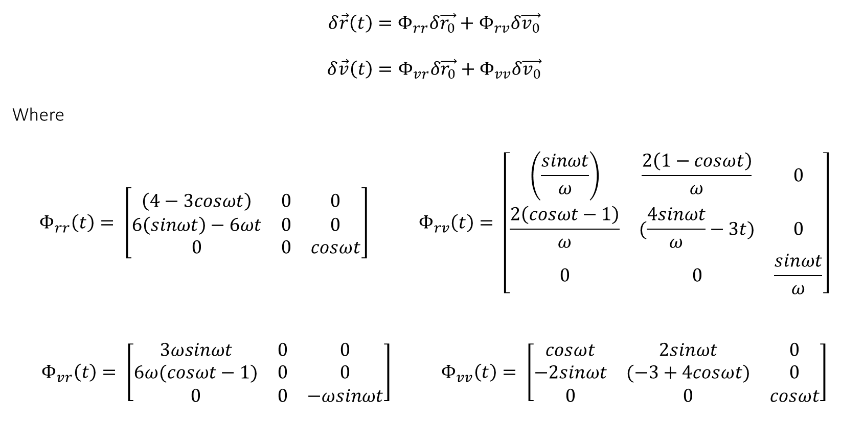
Wiltshire Clohessy equations
$$δ\vec{r}\left(t\right)=Φ_{rr}δ\vec{r_{0}}+Φ_{rv}δ\vec{v_{0}}$$
$$δ\vec{v}\left(t\right)=Φ_{vr}δ\vec{r_{0}}+Φ_{vv}δ\vec{v_{0}}$$
Where
$$Φ_{rr}\left(t\right)= \left[\begin{matrix}\left(4−3cosωt\right) & 0 & 0 \\ 6\left(sinωt\right)−6ωt & 0 & 0 \\ 0 & 0 & cosωt\end{matrix}\right] Φ_{rv}\left(t\right)= \left[\begin{matrix}\left(\frac{sinωt}{ω}\right) & \frac{2\left(1−cosωt\right)}{ω} & 0 \\ \frac{2\left(cosωt−1\right)}{ω} & (\frac{4sinωt}{ω}−3t) & 0 \\ 0 & 0 & \frac{sinωt}{ω}\end{matrix}\right]$$
$$Φ_{vr}\left(t\right)= \left[\begin{matrix}3ωsinωt & 0 & 0 \\ 6ω(cosωt−1) & 0 & 0 \\ 0 & 0 & −ωsinωt\end{matrix}\right] Φ_{vv}\left(t\right)= \left[\begin{matrix}cosωt & 2sinωt & 0 \\ −2sinωt & (−3+4cosωt) & 0 \\ 0 & 0 & cosωt\end{matrix}\right]$$

Slide 19

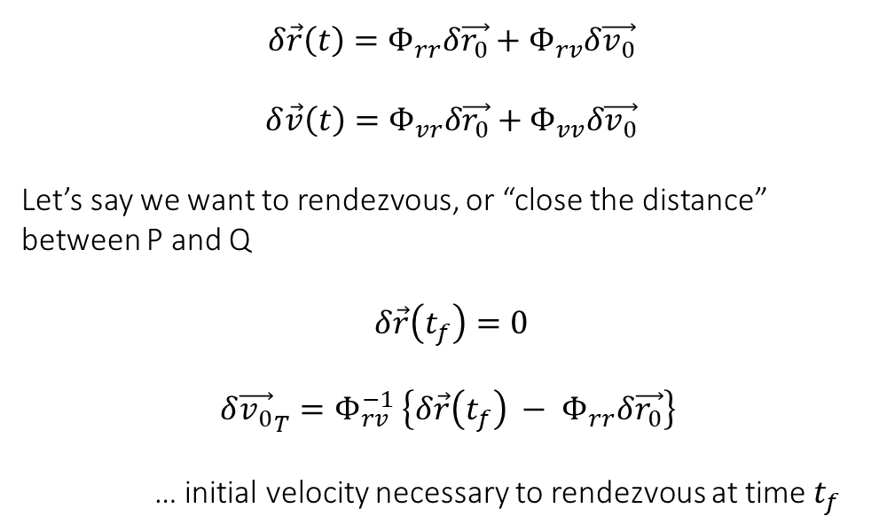
So how do we use any of this?
$$δ\vec{r}\left(t\right)=Φ_{rr}δ\vec{r_{0}}+Φ_{rv}δ\vec{v_{0}}$$
$$δ\vec{v}\left(t\right)=Φ_{vr}δ\vec{r_{0}}+Φ_{vv}δ\vec{v_{0}}$$
Let’s say we want to rendezvous, or “close the distance” between P and Q
$$δ\vec{r}\left(t_{f}\right)=0$$
$$δ{\vec{v_{0}}}_{T}=Φ_{rv}^{−1} \left\{δ\vec{r}\left(t_{f}\right) − Φ_{rr}δ\vec{r_{0}}\right\}$$
… initial velocity necessary to rendezvous at time $t_{f}$
$$\hat{e_{r}}$$
Q
$$\hat{e_{θ}}$$
$$δθ$$
$$δ\vec{r}$$
$$δr$$
P
$$r_{0}=const.$$
$$δθ$$
O

Slide 20

So how do we use any of this? (cont.)
$$\hat{e_{r}}$$
So we need to do two burns, one “right now” and another at $t_{f}$
Right now…
$$ΔV_{1}=δ{\vec{v_{0}}}_{T} −δ\vec{v_{0}}$$
Later…
$$ΔV_{2}=−δ\vec{v}\left(t_{f}\right)$$
Q
$$\hat{e_{θ}}$$
$$δθ$$
$$δ\vec{r}$$
$$δr$$
P
$$r_{0}=const.$$
$$δθ$$
O

Slide 21
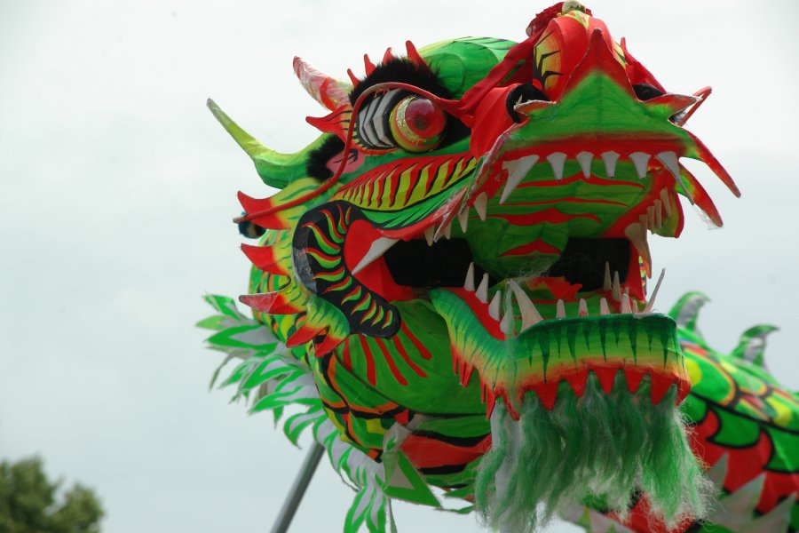

Some Dragons…
$$\hat{e_{r}}$$
We assumed the target is in a circular orbit
These are linear approximations of HIGHLY nonlinear behavior
One approach:
Use Wiltshire Clohessy “recursively” to edge closer and closer
Q
$$\hat{e_{θ}}$$
$$δθ$$
$$δ\vec{r}$$
$$δr$$
P
$$r_{0}=const.$$
$$δθ$$
O

Slide 22
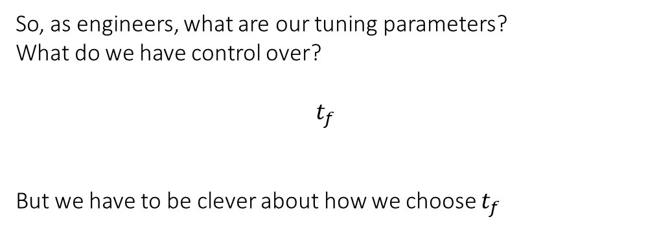
The kicker…
$$\hat{e_{r}}$$
So, as engineers, what are our tuning parameters?
What do we have control over?
$$t_{f}$$
But we have to be clever about how we choose $t_{f}$
Q
$$\hat{e_{θ}}$$
$$δθ$$
$$δ\vec{r}$$
$$δr$$
P
$$r_{0}=const.$$
$$δθ$$
O

Slide 23
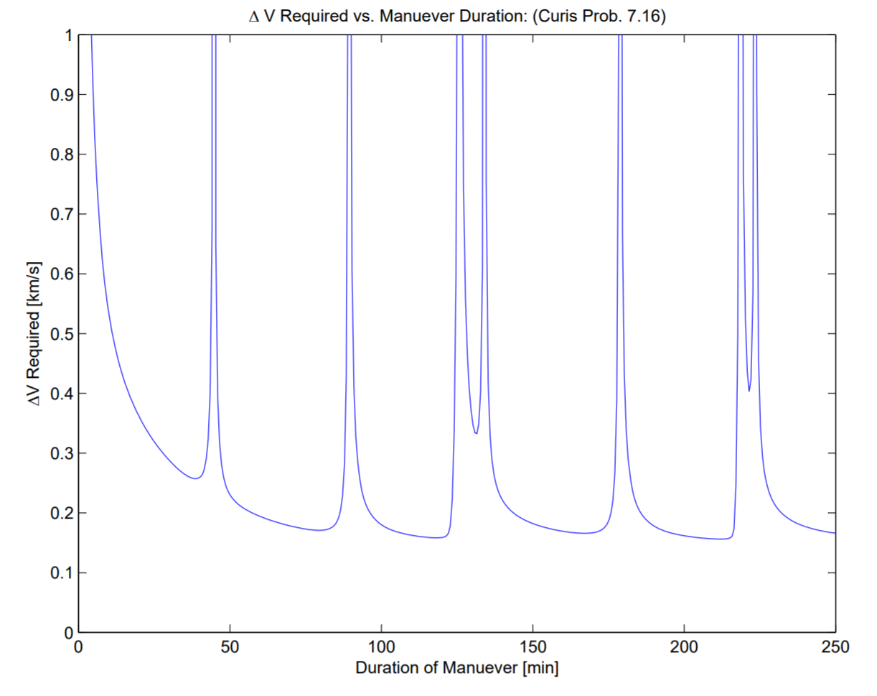

Slide 24
Thanks for your patience!

