Slide 1
2.Hardware Description Languages
Computer Architecture

Slide 2
Executive Summary
Motivation: Hardware functionality and complexity in the processor design is increasing over the years.
Problem: Computer Architect needs to reduce the project complexity to implement diverse hardware
Overview:
- Installation of Hardware Description Language (HDL) tools in the designer environment.
- Motivate the usage of Verilog HDL for designing at a higher level of abstraction.
- Design and testing based on modules for efficient reuse.
Conclusion: Using Verilog HDL the computer architect can reduce the design effort of designing complex hardware.

Slide 3
Outline
Introduction
Working Environment
Verilog Syntax
Design Examples
Conclusions

Slide 4
Introduction
Building blocks allows to implement large and complex systems.
A building block can be defined on each abstraction level
User programs: classes, functions, etc.
Hardware: modules, gates, transistors, etc.
Allows to focus on the function of the building block, instead of the lower-level details (e.g.: transistors timing).
Complex design needs to be verified and tested.
First the design is simulated.
Then, the design is synthetized (translated and ported) to a Field Programmable Gate Array (FPGA) for prototyping.
In our course we design a microprocessor, create a prototype using Verilog and an FPGA.

Slide 5

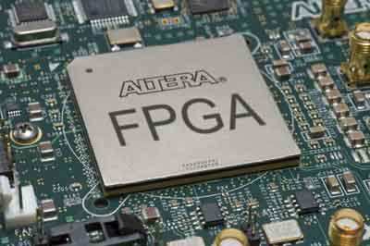
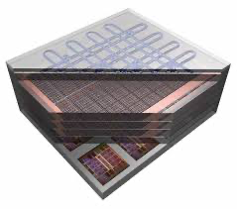
Types of devices
 | Microprocessors | FPGAs | ASICs
 | Processor | FPGA | ASIC
Characteristics | General purpose hardware | Reconfigurable hardware | Custom design
Purpose | General | Prototyping | Max performance
Programming | Executable file | Bit file | Design masks
Program Development Time | minutes | days | months
Languages | C/C++,Python, etc. | Verilog/VHDL | Verilog/VHDL
Main Companies | Intel, ARM, AMD | AMD Xilinx, Intel Altera, Lattice | TSMC, UMC, ST, Global foundries
Examples | Intel i9 14900 | Xilinx Artyx 7 | NVIDIA H100, Google TPU v2

Slide 6
Hardware Design
Computer Architect needs a Hardware Description Language (HDL) to work at a higher level of abstraction.
HDL allows to create complex designs, and provide both:
Simulation
- Inputs applied to circuit
- Outputs checked for correctness
- Millions of dollars saved by debugging in simulation instead of hardware
Synthesis
- Transforms HDL code into a netlist describing the hardware (i.e., a list of gates and the wires connecting them)

Slide 7
Hardware Description Languages
HDLs specifies logic function or models the electronic design.
Additional computer-aided design (CAD) tool produces or synthesizes the optimized gates.
Verilog
developed in 1984 by Gateway Design Automation
IEEE standard (1364) in 1995
More popular in US than VHDL

Slide 8
What is an FPGA?
https://www.youtube.com/watch?v=iHg0mmIg0UU

Slide 9







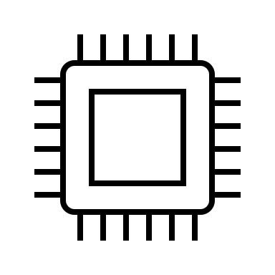
General processor programming vs hardware description
Techniques used to exploit parallelism and concurrency because the program is restricted by the processor (CPU, GPU) characteristics.
Result after compilation: binary
Idea/requirement
Implement and testing C++/C, go, etc.
Final program or app
Hardware is inherently parallel and concurrent (signals).
Compilation (almost) equivalent to synthesis
Result after synthesis: netlist
Netlist used to map and represent connectivity between gates.
Netlist can be used to create a chip.
Implement and simulate VHDL, Verilog, etc.
Final chip (additional testing)
Idea/requirement

Slide 10
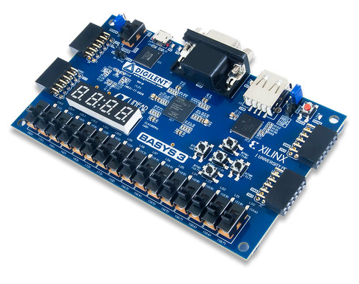
Basys 3
This is an FPGA board
The FPGA is on-board
AMD/Xilinx Artyx 7

Slide 11
Outline
Introduction
Working environment
Verilog Syntax
Design Examples
Conclusions

Slide 12
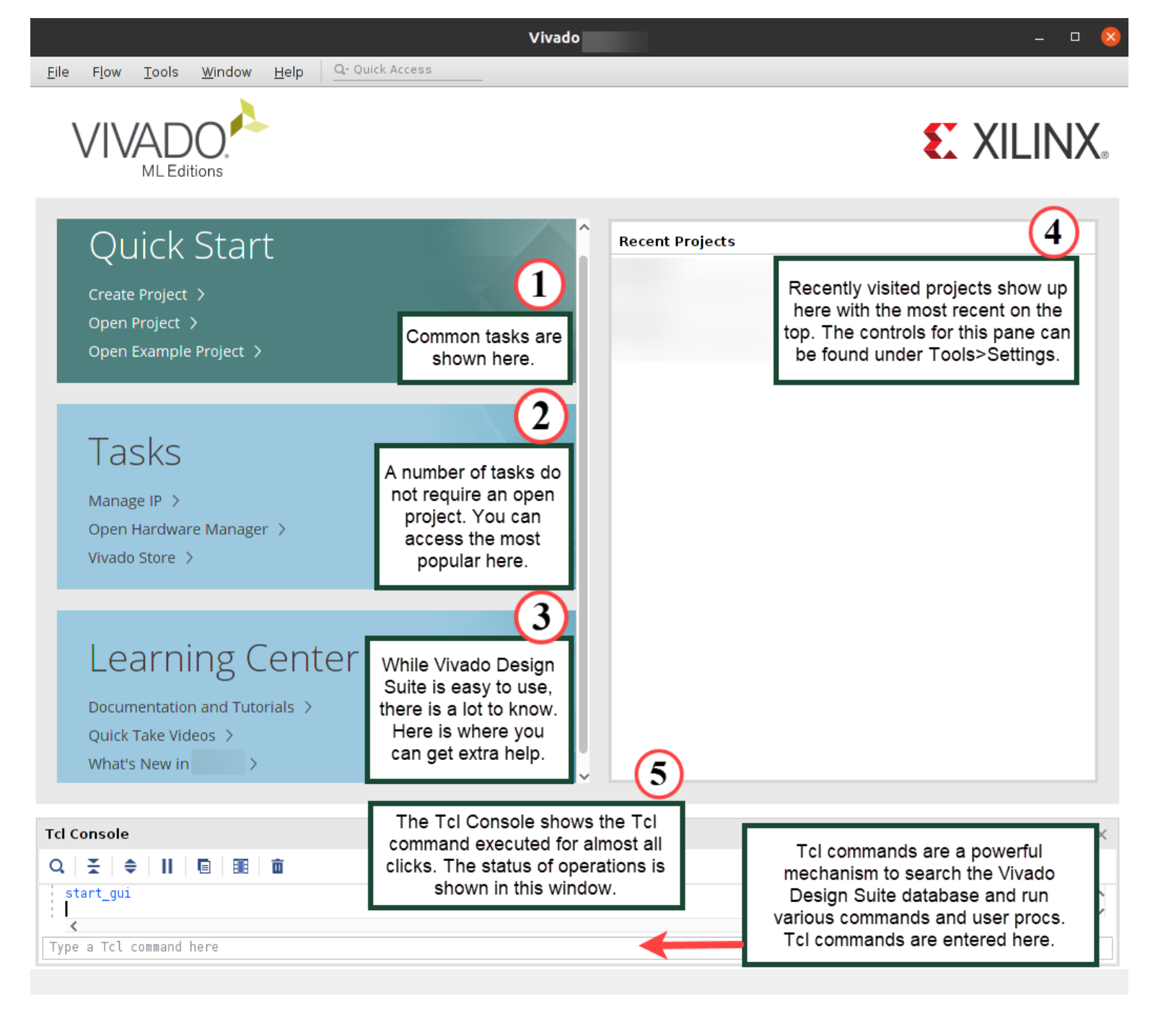
Xilinx Vivado Suite
We use Vivado in Utec Labs
Lab computers have Vivado already installed.
Vivado Standard (40GB, less than a pc game) in your laptop/desktop. – This is OPTIONAL
You can use EDAplayground for quick testing: https://edaplayground.com

Slide 13
Outline
Introduction
Working environment
Verilog Syntax
Design Examples
Conclusions

Slide 14
Basic Syntax
Verilog is case sensitive
SomeName and somename are not the same!
Names cannot start with numbers:
2good is not a valid name
Whitespaces are ignored
// Single line comments start with a //
/* Multiline comments
are defined like this */

Slide 15
Precedence of Operations in Verilog
Highest
~ | NOT
*, /, % | mult, div, mod
+, - | add,sub
<<, >> | shift
<<<, >>> | arithmetic shift
<, <=, >, >= | comparison
==, != | equal, not equal
&, ~& | AND, NAND
^, ~^ | XOR, XNOR
|, ~| | OR, NOR
?: | ternary operator
Lowest

Slide 16
Number Representation in Verilog
Verilog | Stored Number | Verilog | Stored Number
4’b1001 | 1001 | 4’d5 | 0101
8’b1001 | 0000 1001 | 12’hFA3 | 1111 1010 0011
8’b0000_1001 | 0000 1001 | 8’o12 | 00 001 010
8’bxX0X1zZ1 | XX0X 1ZZ1 | 4’h7 | 0111
‘b01 | 0000 .. 0001 | 12’h0 | 0000 0000 0000
Format: N’Bxx: 8’b0000_0001
(N) Number of bits (default is 32 bits):
- Expresses how many bits will be used to store the value
(B) Base : Can be b (binary), h (hexadecimal), d (decimal), o (octal)
(xx) Number: The value expressed in base
Can also have X (invalid) and Z (floating), as values
Underscore _ can be used to improve readability

Slide 17
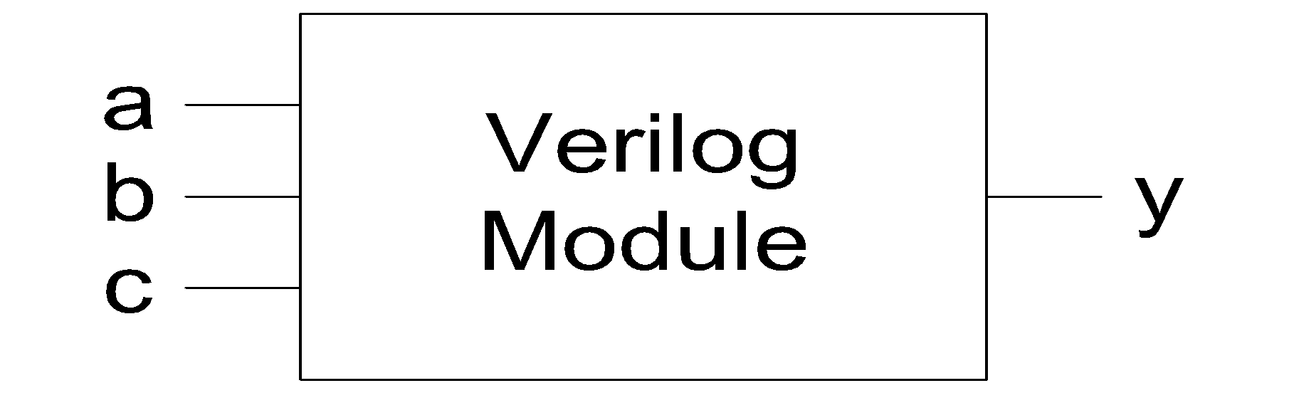
Define a Module in Verilog
example
name of module
Port list
(inputs and outputs)
module example (a, b, c, y);
input a;
input b;
input c;
output y;
// here comes the circuit description
endmodule
ports have a declared type
a module definition

Slide 18
Code Style
Codes are functionally equivalent:
module test ( a, b, y );
input a;
input b;
output y;
endmodule
module test ( input a,
input b, output y );
endmodule
We recommend using this
port name and direction declaration can be combined

Slide 19
Defining Multi-bit Input and Output
You can also define multi-bit Input/Output (Bus)
[range_end : range_start]
Number of bits: range_end – range_start + 1
Example:
a represents a 32-bit value, so we prefer to define it as: [31:0] a
It is preferred over [0:31] a which resembles array definition
It is good practice to be consistent with the representation of multi-bit signals, i.e., always [31:0] or always [0:31]
input [31:0] a; // a[31], a[30] .. a[0]
output [15:8] b1; // b1[15], b1[14] .. b1[8]
output [7:0] b2; // b2[7], b2[6] .. b2[0]
input c; // single signal

Slide 20
Manipulating Bits
Verilog allows to manipulate bits in different ways:
// Bit Slicing: assign partial buses
wire [15:0] longbus;
wire [7:0] shortbus;
assign shortbus = longbus[12:5];
// Concatenation: Concatenating is by {}
assign y = {a[2],a[1],a[0],a[0]};
// Duplication: Possible to define multiple copies
assign x = {a[0], a[0], a[0], a[0]}
assign y = { 4{a[0]} }

Slide 21
Two Main Styles of HDL Implementation
Structural
Each module contains other modules (instances)
Describes a hierarchy
Can contain gate-level description
Behavioral
Module body contains functional description of the circuit
Contains logical and mathematical operators
Level of abstraction is higher than gate-level
Many possible gate-level realizations of a behavioral description
Real implementations can use a combination of both
Notes:
TODO: stick to those rather than dataflow, switch level

Slide 22
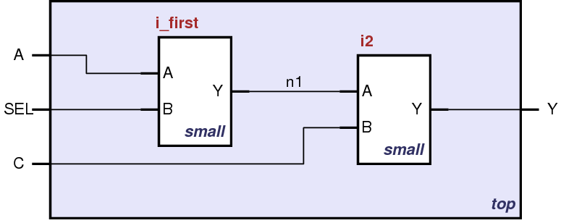
Structural HDL: Instantiating a Module
i_first
i_second
Module “top” is built from two instances of module “small”

Slide 23
Structural HDL Example
Module Definitions in Verilog
module top (A, SEL, C, Y);
input A, SEL, C;
output Y;
wire n1;
endmodule
i_first
i_second
module small (A, B, Y);
input A;
input B;
output Y;
// description of small
endmodule

Slide 24
Structural HDL Example
Defining wires (module interconnections)
module top (A, SEL, C, Y);
input A, SEL, C;
output Y;
wire n1;
endmodule
i_first
i_second
module small (A, B, Y);
input A;
input B;
output Y;
// description of small
endmodule

Slide 25
Structural HDL Example
The first instantiation of the “small” module
module top (A, SEL, C, Y);
input A, SEL, C;
output Y;
wire n1;
// instantiate small once
small i_first ( .A(A),
.B(SEL),
.Y(n1) );
endmodule
i_first
i_second
module small (A, B, Y);
input A;
input B;
output Y;
// description of small
endmodule

Slide 26
Structural HDL Example
The second instantiation of the “small” module
module top (A, SEL, C, Y);
input A, SEL, C;
output Y;
wire n1;
// instantiate small once
small i_first ( .A(A),
.B(SEL),
.Y(n1) );
// instantiate small second time
small i_second ( .A(n1),
.B(C),
.Y(Y) );
endmodule
i_first
i_second
module small (A, B, Y);
input A;
input B;
output Y;
// description of small
endmodule

Slide 27
Structural HDL Example
Short form is not good practice as it reduces code maintainability
module top (A, SEL, C, Y);
input A, SEL, C;
output Y;
wire n1;
// alternative
small i_first ( A, SEL, n1 );
/* Shorter instantiation,
pin order very important */
// any pin order, safer choice
small i_second ( .B(C),
.Y(Y),
.A(n1) );
endmodule
i_first
i_second
module small (A, B, Y);
input A;
input B;
output Y;
// description of small
endmodule

Slide 28
Behavioral HDL: Defining Functionality
a
b
c
AND
AND
OR
y
AND
module example (a, b, c, y);
input a;
input b;
input c;
output y;
// here comes the circuit description
assign y = ~a & ~b & ~c |
a & ~b & ~c |
a & ~b & c;
endmodule

Slide 29
Outline
Introduction
Working environment
Verilog Syntax
Design Examples
Conclusions

Slide 30
Exercise
Draw the logic diagram of the circuit using logic gates.
Write a Verilog description of the circuit.
Write a testbench to simulate all input combinations and verify correctness.

Slide 31
Verilog
// Boolean function:
// Y = ((A & B) | (~C & D)) & (A | ~B | C)
module logic_circuit ( A, B, C, D, Y);
input A, B,C, D;
output Y;
assign Y = ((A & B) | (~C & D)) & (A | ~B | C);
endmodule

Slide 32
Testbench v1
`timescale 1ns/1ps
module tb_logic_circuit;
reg A, B, C, D; //only on testbench for ‘writing’ values
wire Y;
// Instantiate the circuit under test
logic_circuit uut (
.A(A), .B(B), .C(C), .D(D), .Y(Y) //connect each one
);
initial begin
$display("Time | A B C D | Y");
$display("--------------------");
// Test case 1
A = 0; B = 0; C = 0; D = 0;
#10 $display("%4t | %b %b %b %b | %b", $time, A, B, C, D, Y); //this represents time passing
// Test case 2
A = 0; B = 1; C = 0; D = 1;
#10 $display("%4t | %b %b %b %b | %b", $time, A, B, C, D, Y);
// Test case 3
A = 1; B = 0; C = 1; D = 0;
#10 $display("%4t | %b %b %b %b | %b", $time, A, B, C, D, Y);
// Test case 4
A = 1; B = 1; C = 0; D = 1;
#10 $display("%4t | %b %b %b %b | %b", $time, A, B, C, D, Y);
// Test case 5
A = 1; B = 1; C = 1; D = 1;
#10 $display("%4t | %b %b %b %b | %b", $time, A, B, C, D, Y);
$finish;
end
endmodule
test
testbench
dut
(design under test)

Slide 33
Testbench v2
`timescale 1ns/1ps
module tb_logic_circuit;
reg A, B, C, D;
wire Y;
// Instantiate the circuit under test (UUT)
logic_circuit uut (
.A(A), .B(B), .C(C), .D(D), .Y(Y)
);
initial begin
$display("A B C D | Y");
$display("----------------");
// Iterate over all 16 input combinations
for (integer i = 0; i < 16; i = i + 1) begin //be careful using for
{A, B, C, D} = i;
#10; //this represents time passing
$display("%b %b %b %b | %b", A, B, C, D, Y);
end
$finish;
end
endmodule
Loops are common in testbenches, not so much in hardware modules. Be careful.

Slide 34
Outline
CS3501-COMPUTER ARCHITECTURE
Introduction
Working environment
Verilog Syntax
Design Examples
Conclusions

Slide 35
Summary
Hardware Description Languages (HDLs) abstracts the digital design to a model.
Simulation as a tool for verification, programming as a tool for creation.
We introduced the Verilog syntax.
Verilog is an HDL, used for hardware description not for user program implementation.
Logic gates (with transistors) as a starting point.
We can evaluate our designs using a high-level language.
Testbenches are used as a testcase evaluation of the hardware block.
Testbenches are not part of the module. Remember: only used for testing.
We conclude that using the logic gate arrays, we can create our own designs!

Slide 36
2.Hardware Description Languages
Computer Architecture

