Slide 1
Evolution of cooperative personalities
By Joris Damhuis and Anna Wolters
Supervisor: Franjo Weissing

Slide 2
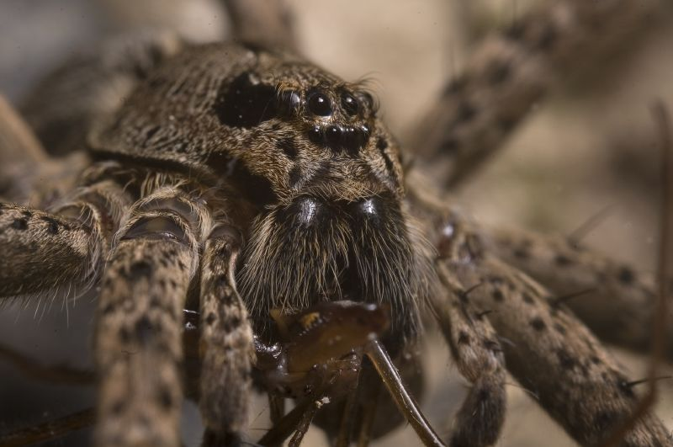
Introduction
What are personalities?
Different individual behaviour
Consistent over time and context
Why is this important?
Infinite plastic behaviour has an selective advantage …?
Behaviour is not as plastic as previously thought → Empiric data ¹
Notes:
Empiric data shows in several animal species that within population personalities can coexist. But what are personalities exactly? Different individual behaviour that is consistent over time and context. Example fishing spiders. Many more examples are given in literature!
Form an adaptive point of view it would be more advantage for an individual to have infinite plastic behaviour, but empirical data suggest otherwise.

Slide 3
Project aim
How does responsiveness influence the evolution of cooperative personalities?
Do different cooperative personalities evolve to coexist in populations of different levels of responsiveness?
Cooperation in a snowdrift game
Individual based simulation (IBS)
Notes:
Why snowdrift and not something like PD?
PD is most used, but not most realistic. The Free Riding problem is central at the PD. In de SD game the co-operator benefits from its cooperation and less important are the costs. This makes it a more realistic approach. This is only one of the games, so we would like to try to get our model working for several different games (staghunt, PD ect) to create a better view of all aspects of cooperation.
Two strategies can evolve to coexist in the SD game, where PD is not likely to get cooperation

Slide 4
Snowdrift game fitness
Benefits = 4
Costs = 2
B > C
 | Cooperate | Defect
Cooperate | B – ½ C | B – C
Defect | B | 0

Slide 5
Model set-up
Population of 1000 individuals
Each individual 10 interactions
Receives fitness based on used strategies
Higher fitness results in higher chance of offspring in next generation
0.01 chance of mutation

Slide 6
Simple model
No responsiveness
Different initial levels of cooperativeness

Slide 7
Introduction of responsiveness
Initially no responsive individuals
Observation of opponent by responsive individuals
Observation has a fitness price (= 0.001)
Notes:
Only due to mutation can responsiveness occur

Slide 9
Responsiveness after 100,000 generations

Slide 10

Price for responsiveness
At what price can responsiveness occur?
Equation for max price ²
$price < δ ∗ {sd}^{2}$
$price <3 ∗ {0.02}^{2}$ = 0.0012
Notes:
At

Slide 11
Zero price for responsiveness … ?

Slide 12
High price for responsiveness

Slide 13
Conclusions

Slide 14
Discussion ?

Slide 15
Any questions?

