Slide 1
Evolution of cooperative personalities
Joris Damhuis and Anna Wolters
Supervised by Franjo Weissing

Slide 2
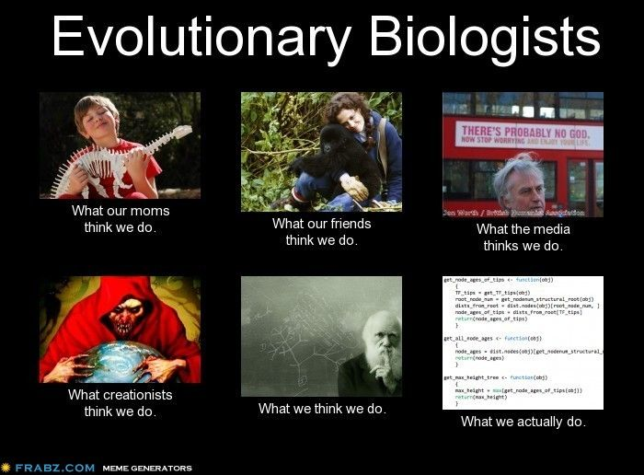
Any questions?

