Slide 1
Evolution of cooperative personalities
Joris Damhuis & Anna Wolters

Slide 2
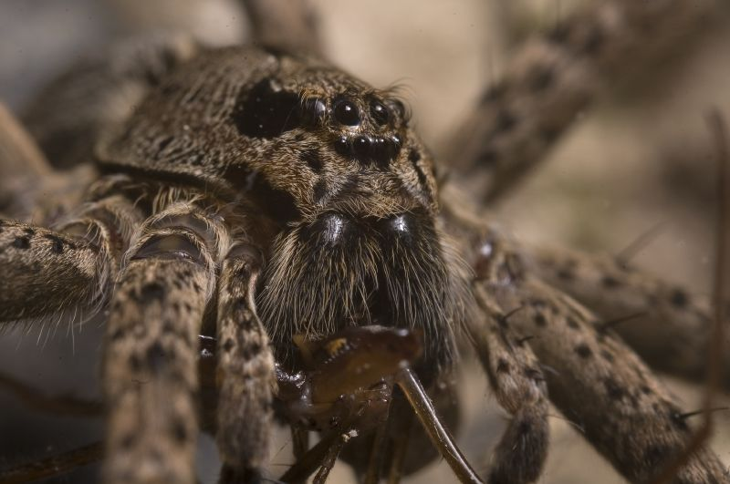
Introduction
What are personalities?
Different individual behaviour
Consistent over time and context
Why is this important?
From an adaptation perspective, infinite plastic behaviour has an selective advantage
Behaviour is not as plastic as previously thought → Empiric data¹
Notes:
Empiric data shows in several animal species that within population personalities can coexist. But what are personalities exactly? Different individual behaviour that is consistent over time and context. Example fishing spiders. Many more examples are given in literature

Slide 3
Project aim
How does the nature of an interaction change when the signalling of the cooperation
Does responsiveness lead to a coexistence of different cooperative personalities in a population?
Cooperation in a snowdrift game
Notes:
Why snowdrift and not something like PD?

Slide 4
Snowdrift game
 | Cooperate | Defect
Cooperate | B – ½ C | B – C
Defect | B | 0
B = benefits
C = costs
B > C

Slide 5
Snowdrift game fitness
Benefits = 4
Costs = 2

Slide 6
Model set-up
Model 0.0
Model 0.1
Model 1.0
Model 1.1

Slide 7
Future model
Model 2.0 → signalling implementation

Slide 8
Analysis plans

Slide 9
Questions ?

