Slide 1
Evolution of cooperative personalities
Joris Damhuis and Anna Wolters

Slide 2
Project framework
Personalities instead plastic behaviour
Responsiveness vs. signalling
Influence on cooperation?
Notes:
Empiric data shows in several animal species that within population personalities can coexist. But what are personalities exactly? Different individual behaviour that is consistent over time and context. Example fishing spiders. Many more examples are given in literature!
Form an adaptive point of view it would be more advantageous for an individual to have infinite plastic behaviour, but empirical data suggest otherwise.
Responsiveness is implemented as being able to see what the other did last time.
Signalling

Slide 3
Snowdrift game fitness
Benefits = 4
Costs = 2
B > C
 | Cooperate | Defect
Cooperate | B – ½ C | B – C
Defect | B | 0

Slide 4
Model set-up
Population of 1000 individuals
Each individual 10 interactions
Receives fitness based on used strategies
Higher fitness results in higher chance of offspring in next generation
0.01 chance of mutation

Slide 5
Simple model
No responsiveness
Different initial levels of cooperativeness

Slide 6
Introduction of responsiveness
Initially no responsive individuals
Observation of opponent by responsive individuals
Observation has a fitness price
Responsiveness as a boolean
Notes:
Only due to mutation can responsiveness occur

Slide 7
Price for responsiveness: 0.0
Responsives
Average
Unresponsives
Fraction responsives

Slide 8

Price for responsiveness
At what price can responsiveness occur?
$price < δ ∗ {sd}^{2}$
$price <3 ∗ {0.02}^{2}$ = 0.0012
Notes:
At

Slide 9
Price for responsiveness: 0.5
Average
Unresponsives
Responsives

Slide 10
Responsiveness continuous
Initially no responsive individuals
Observation of opponent by responsive individuals
Observation has a fitness price
Responsiveness changes slowly

Slide 11
Price for responsiveness: 0.0

Slide 12
Introducing signalling

Slide 13
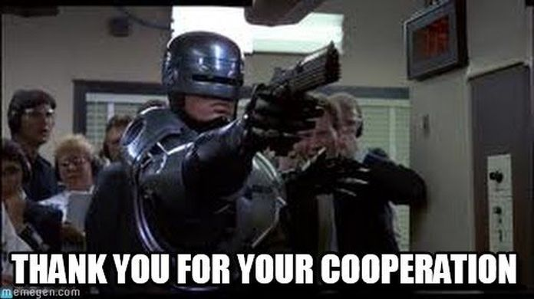
Any questions?

