Slide 1
welcome messages
EE6641 Analysis and Synthesis of [Digital] Audio Signals (ASAS)
Lecturer: Yi-Wen Liu 劉奕汶
Mar. 3, 2020

Slide 2
Who is Yi-Wen Liu?
2010-now:
Probability (4 times)/ Introduction to DSP (3)/ Linear Algebra (4)
PDE and functions of a complex variable (2)
DSP laboratory (3)
Analysis and Synthesis of Digital Audio Signals (7 times)
Neural networks (1)/ Intro to Computer Programming (1)
2006 Ph.D. in EE, Stanford University
Thesis: Parametric representations for digital audio watermarking

Slide 3
Analysis and Synthesis of Digital Audio: the Past
window
w[n]
X(ω,mM)
Y(ω,mM)
FFT
Certain Mani-pulation
Inverse
FFT
Overlap-add
Input
x[n]
output y[n]
length = N_{FFT}
length = N_{FFT}

Slide 4
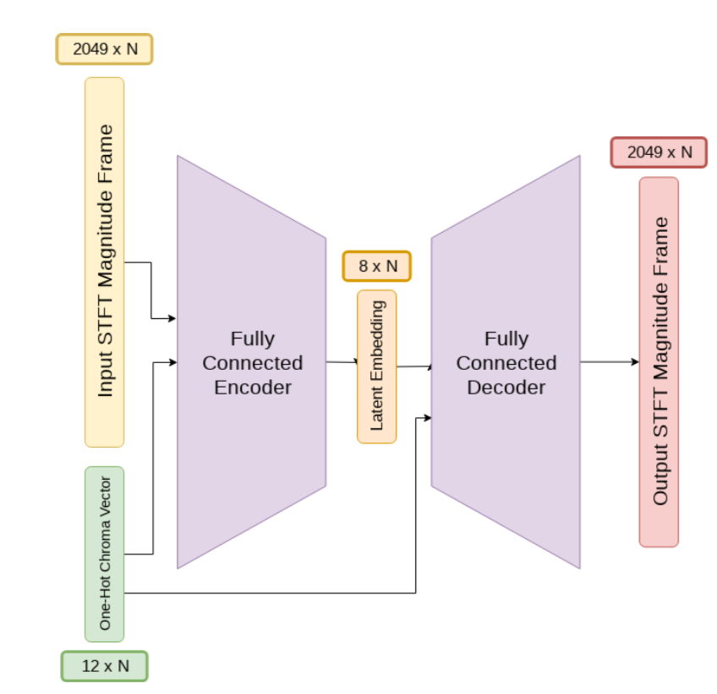
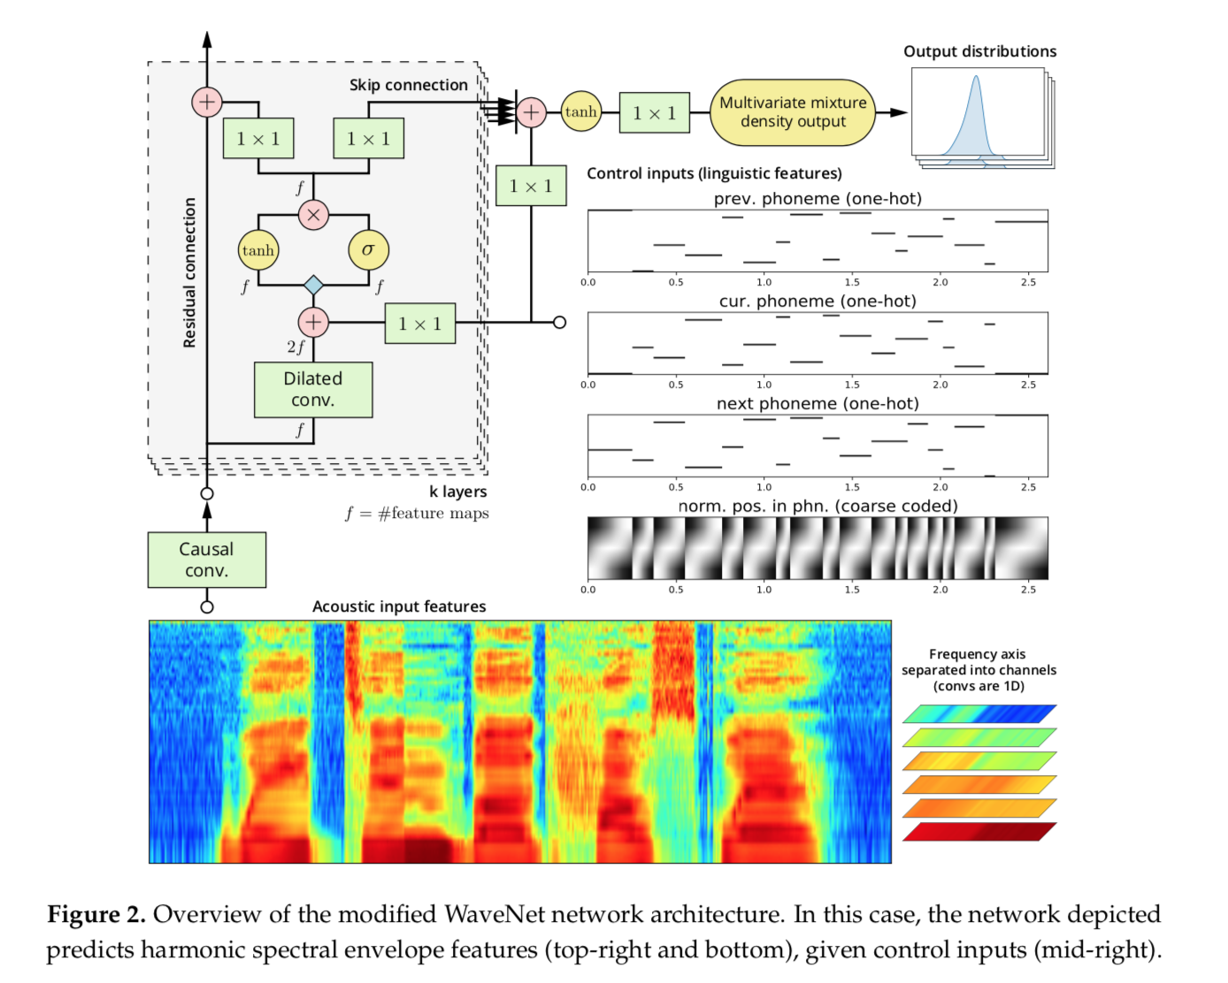
Analysis and Synthesis of Digital Audio: the trendy
Someone’s work (2020) under review.
Topic: musical instrumental sounds synthesis.
Blaauw and Bonada (2017) Applied Sci. 2017, 7, 1313.

Slide 5
What is different this year
Offering in English
Theme = human voice
From flipped classroom to PBL (Problem Based Learning)
The entire semester will pave the way to HW10: Voice conversion.
The idea is to reduce lecturing but facilitate knowledge discovery by yourselves.
Evaluation to match course objectives.

Slide 6
Course objectives/ “outcomes”
To be able to implement signal processing methods upon reading their mathematical descriptions (a set of equations).
To be able to analyse human voice signals, modify parametric representations, and resynthesize to create special effects.
To relate voice processing methods to underlying assumptions about human voice perception and production.
To be able to choose appropriate performance evaluation methods for quality of synthesized voice, including subjective and objective ones.

Slide 7
Background or prerequisite
Matrix and trigonometry
MATLAB or other programming languages
Calculus
(Intro. to) digital signal processing
Acoustics at the level of general physics
Fond of music is a plus
Fond of spoken languages is a plus
Notes:
歡迎聽聽看，一起來玩音訊！

Slide 8
Grading policies: How will you be evaluated?
11 HWs (53%) + 2 quizzes (20%) + Final Project (20%) + Class Participation (7%)
Your final letter grade will not necessarily be the direct number-to-letter conversion.
In principle, a person with a higher raw score will not get a lower letter grade.
The grade boundaries will solely be determined by the teaching team.
I typically give A+ only to about 10% of students (at most 15%).
Notes:
No worse than 的意義：usually I am inclined to reserve A+ for top 10%, and A for top 20-25%. But if everybody performs so well in quizzes and final...

Slide 9
Homework assignment pace
Will issue an assignment every Thursday starting the first week.
I will give a short lecture regarding the HW and brushing upon key points.
Tuesdays on the following week are reserved for HW discussion in class (2 hrs).
HWs are due Wednesdays 1700 (Except HW 7, and 10)
HW solution will be posted at Wednesday evening for later usage.
Thus, overdue HWs are not acceptable.
We will look at it in three days and return to you on Saturdays.

Slide 10
Homework discussion format
You will be divided into 5~7 groups people by the teaching team (we will separate people from the same lab apart) #fairness
Please start working on the HW before coming into the classroom on Tuesday.
All members should take turn to tell what materials they have found, what they have tried, and compare results (if preliminary) with one another.
You are encourage to bring in your laptop and headphone/earphone/bluetooth devices to the Tuesday class.
Each group will have a chair person and a secretary.
The chair person ensures that everyone has a chance to speak up, and controls time.
The secretary’s job is to take notes.
In the 2nd hour, each group will be give some time to share their discovery to the class. This needs to be in English. PPT optional. Its OK to elect a few representatives that are most comfortable in giving the presentation.
Your active participation is crucial for the success of this course.

Slide 11
Attendance
Tuesday classes: You will need to notify the TA and (not or) me if you need to miss a class.
Thursday classes will be recorded and posted, because we will work hard to accommodate enrolled students who cannot return to NTHU due to the coronavirus epidemic.

Slide 12
Report for each HW should contain
self-description of efforts, including honest reflection of difficulties encountered and whether somebody helped? [70%]
Codes and resulting sound files (if applicable) [30%].
Question or thoughts for the teaching team to answer or give comments (Optional).
References (full citation please, as if you are publishing)
Maximum expected work load = 7 hrs
(e.g., 5 hrs work + 2 hrs report writing).

Slide 13
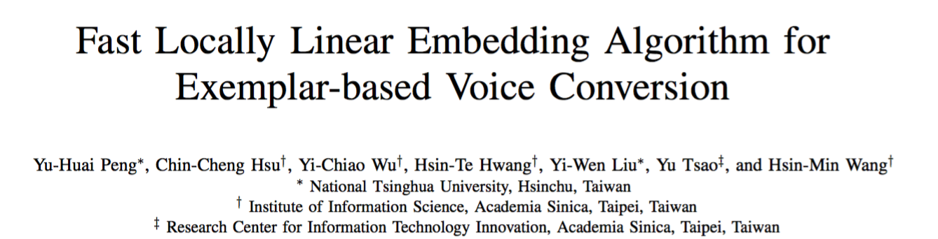
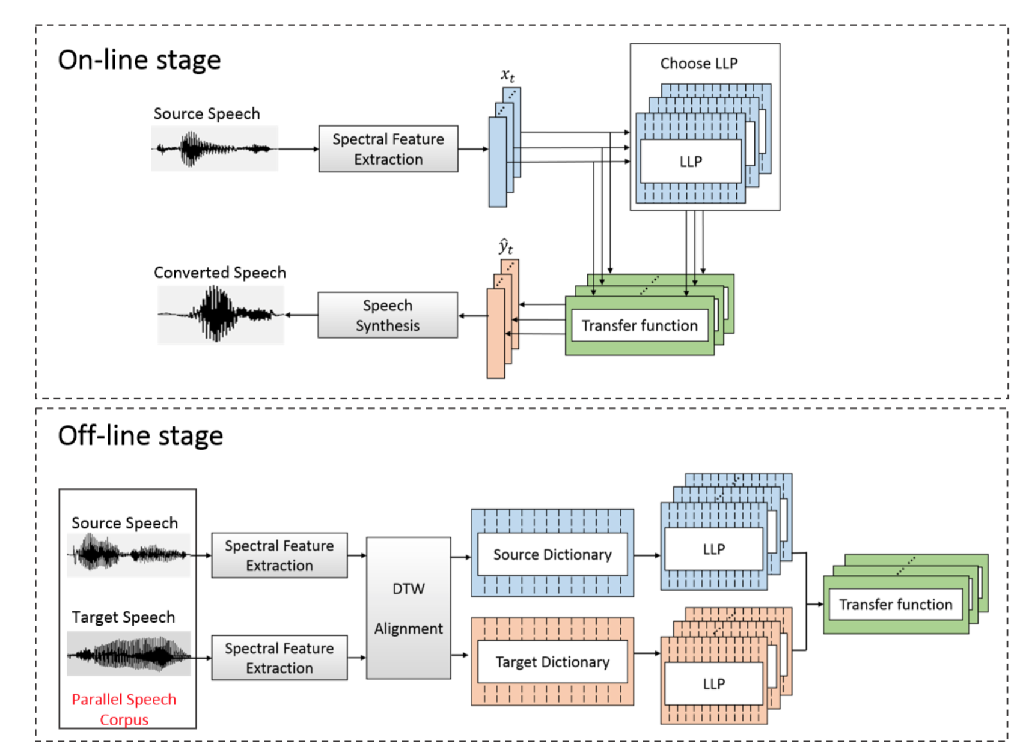

HW10: voice conversion
mixed:
彭玉淮 Best poster award, APSIPA 2017, Kuala Lumpur
Notes:
Talk about implication.

Slide 14
A peek at course schedule
Mar 5: HW1, STFT and windowing
Mar 12: HW2, FIR and IIR audio filters
Mar 19: HW3, Linear prediction (LP)
Mar 26: HW4, Onomatopoeia
Apr 14: Quiz 1 (小考) Fourier basics
Apr 16: HW4.1 TBD
Apr 23: HW5, Sinusoidal modeling
Apr 30: HW6, Pitch change and time stretch
May 7: HW7, Sine + noise decomposition
May 19: Quiz 2: Sinusoidal modeling and LP.
May 21: HW8, STRAIGHT vocoder
May 28: HW9, parallel corpus (group HW)
Jun 4: HW10, Locally linear embedding (voice conversion).
Jun 23: Final Presentation
(To be announced from the NTHU e-learning system)

Slide 15
Course objectives/ “outcomes”
To be able to write an algorithm and implement signal processing methods upon reading their mathematical descriptions (a set of equations).
To be able to analyse human voice signals, modify parametric representations, and resynthesize to create special effects.
To relate voice processing methods to underlying assumptions about human voice perception and production.
To be able to choose appropriate performance evaluation methods for quality of synthesized voice, including subjective and objective ones.
Are you ready?

Slide 16
Our teaching team
TAs:
Mr. Jim Huang 黃志翔 (Head TA)
Ms. Amy “Cosine” Chen 陳玉璇
Mr. Tomic Chu 朱贊全

Slide 17
Summary: this course…
will really interest you if you are interested in audio
might serve you fine if you look for a reasonably loaded graduate-level course to take
You need to write computer programs.
might not be a good fit you if you don’t enjoy oral discussion. Remember class participation = 7%.
should be helpful if your research is about speech, acoustics, or audio.

Slide 18
Any questions?

