Slide 1
ASAS short lecture 1 Basic sinusoidal signals and spectrums
Mar. 5, 2020
Yi-Wen Liu
Dept. Electrical Engineering, National Tsing Hua University

Slide 2
HW1 objectives
In this HW, you will learn to create a digital audio signal, play it back from your soundcard, listen to it, and look at its spectrums.
You will check the definition of short-time Fourier transform and learn to compute and plot the spectrogram of a long signal.

Slide 3
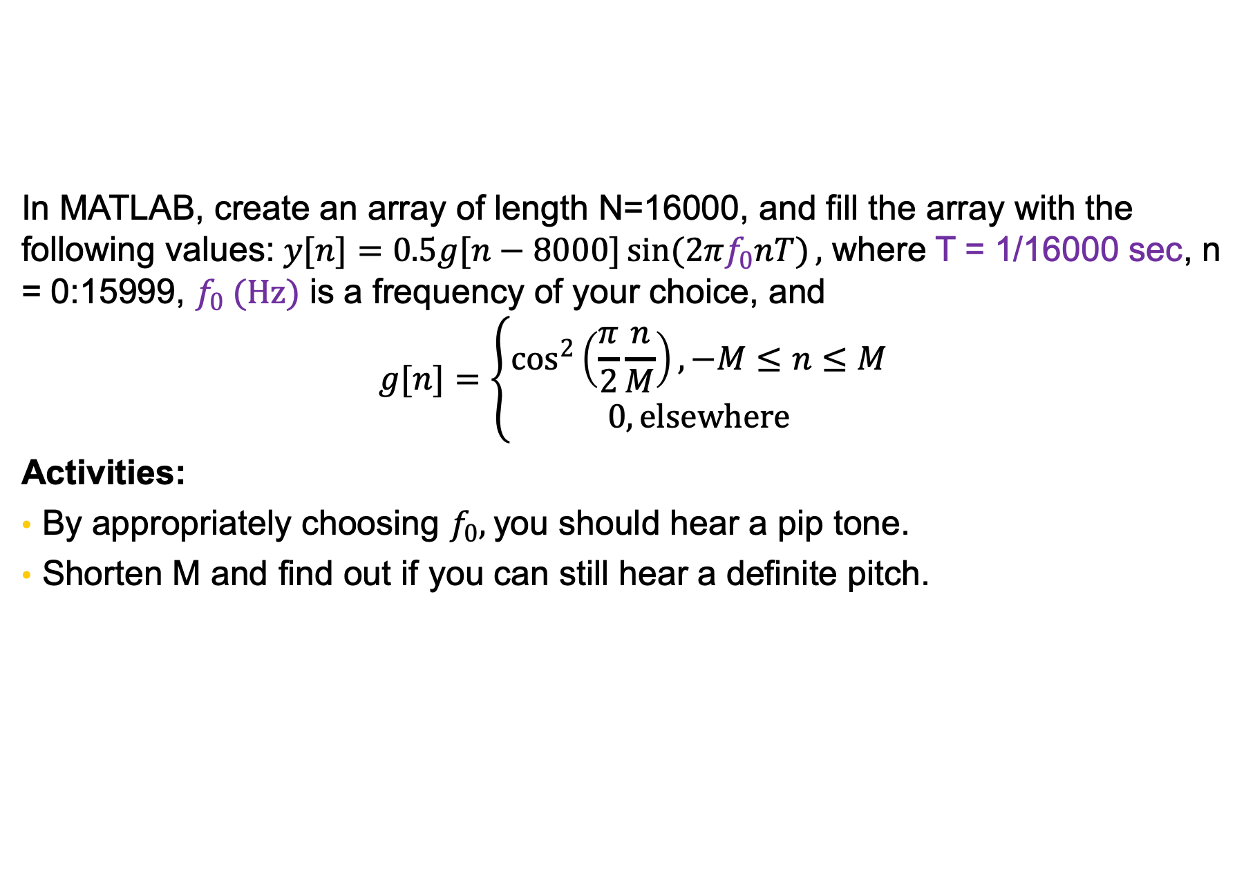
HW1 preview
In MATLAB, create an array of length N=16000, and fill the array with the following values:$y[n]=0.5g[n−8000]\sin{(2πf_{0}nT)},$ where T = 1/16000 sec, n = 0:15999, $f_{0} (Hz)$ is a frequency of your choice, and $$g[n]=\left\{\begin{matrix}\cos^{2}\left(\frac{π}{2}\frac{n}{M}\right), −M≤n≤M \\ 0, elsewhere\end{matrix}\right.$$
Activities:
By appropriately choosing $f_{0},$you should hear a pip tone.
Shorten M and find out if you can still hear a definite pitch.
Note:
Sampling period =
1/ sampling frequency

Slide 4
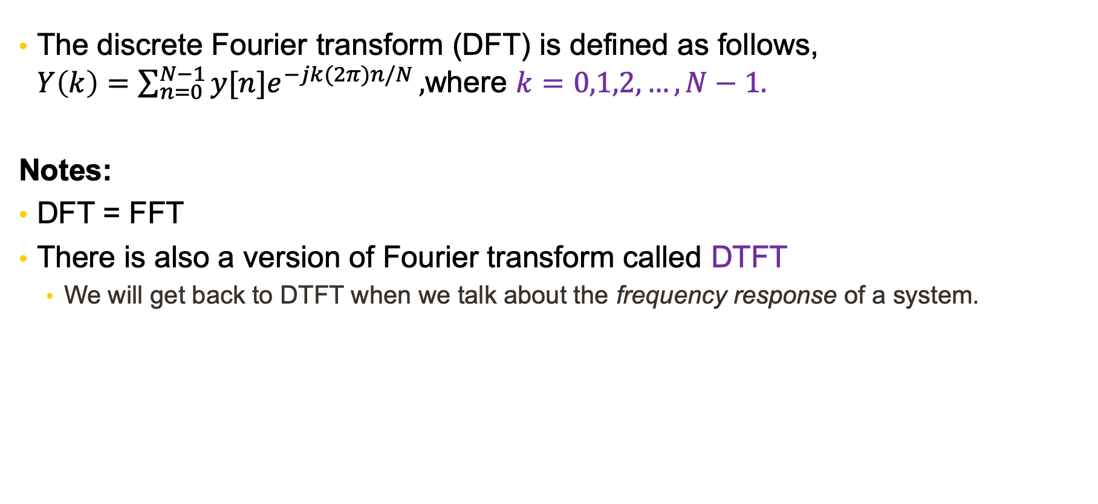
HW1 preview (Cont’d)
The discrete Fourier transform (DFT) is defined as follows, $Y\left(k\right)=\sum_{n=0}^{N−1}{y[n]e^{−jk(2π)n/N}},$where $k=0,1,2,…, N−1.$
Notes:
DFT = FFT
There is also a version of Fourier transform called DTFT
We will get back to DTFT when we talk about the frequency response of a system.

Slide 5
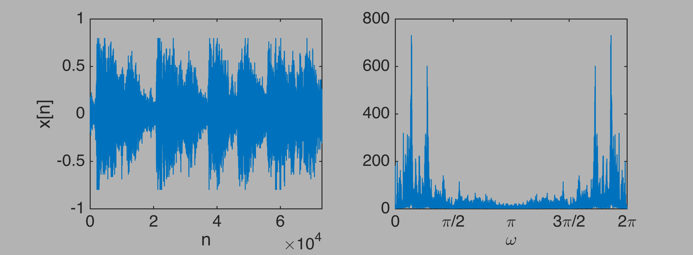

An audio example and its DFT
Note:
is called the magnitude spectrum

Slide 6
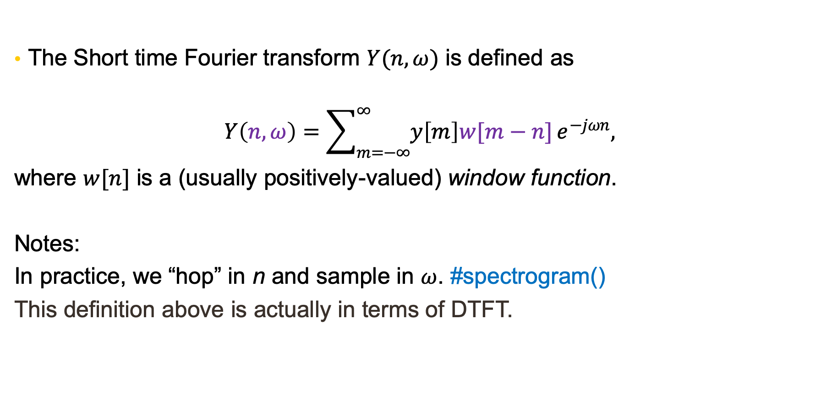
HW1 preview (Cont’d)
The Short time Fourier transform $Y(n,ω)$ is defined as
$$Y\left(n,ω\right)=\sum_{m=−∞}^{∞}{y\left[m\right]w[m−n]}e^{−jωn},$$
where $w[n]$ is a (usually positively-valued) window function.
Notes:
In practice, we “hop” in n and sample in $ω$. #spectrogram()
This definition above is actually in terms of DTFT.

Slide 7
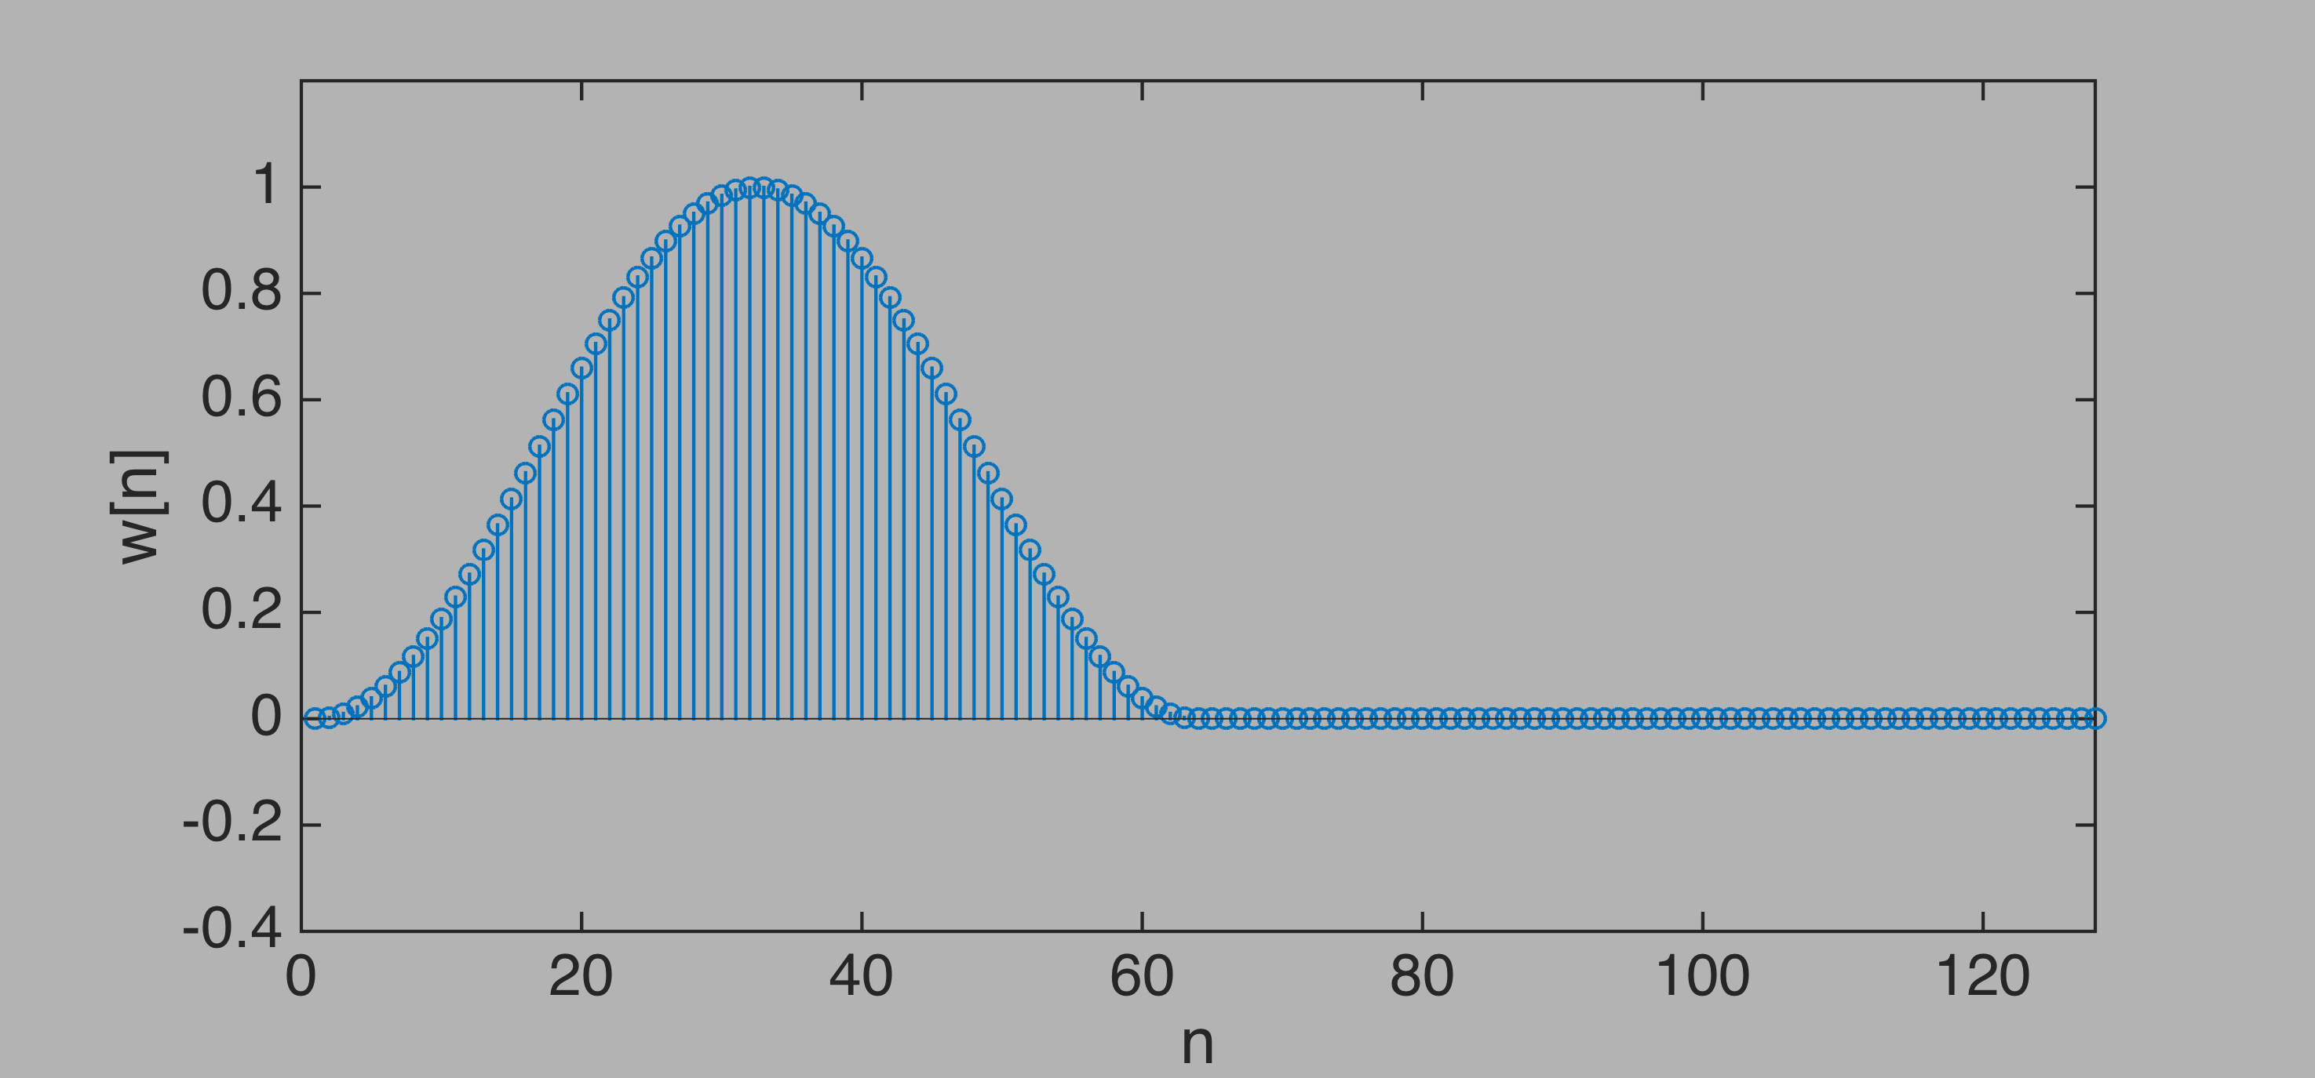
Short-time Fourier transform: converting a sound to an image (Remarks: The following few slides are from a YouTube playlist [in Chinese])
w[n]: a window with finite number of non-zero points.
Also note discrepancy in notation and definition…
Notes:
x[n+m] input
X(n,omega) 2D image
w[n] window function 長度有限，窗函數

Slide 8
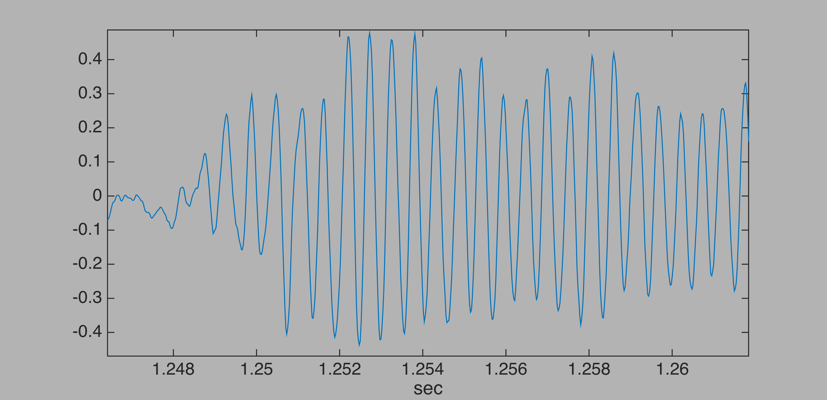
Explaining
Raised cosine window (a.k.a. Hann window)
意義：
x[n+m] is like a train moving to the left
w[n] is literally like a window
Therefore it is called Short-time FT.
Notes:
火車向左開的比喻

Slide 9
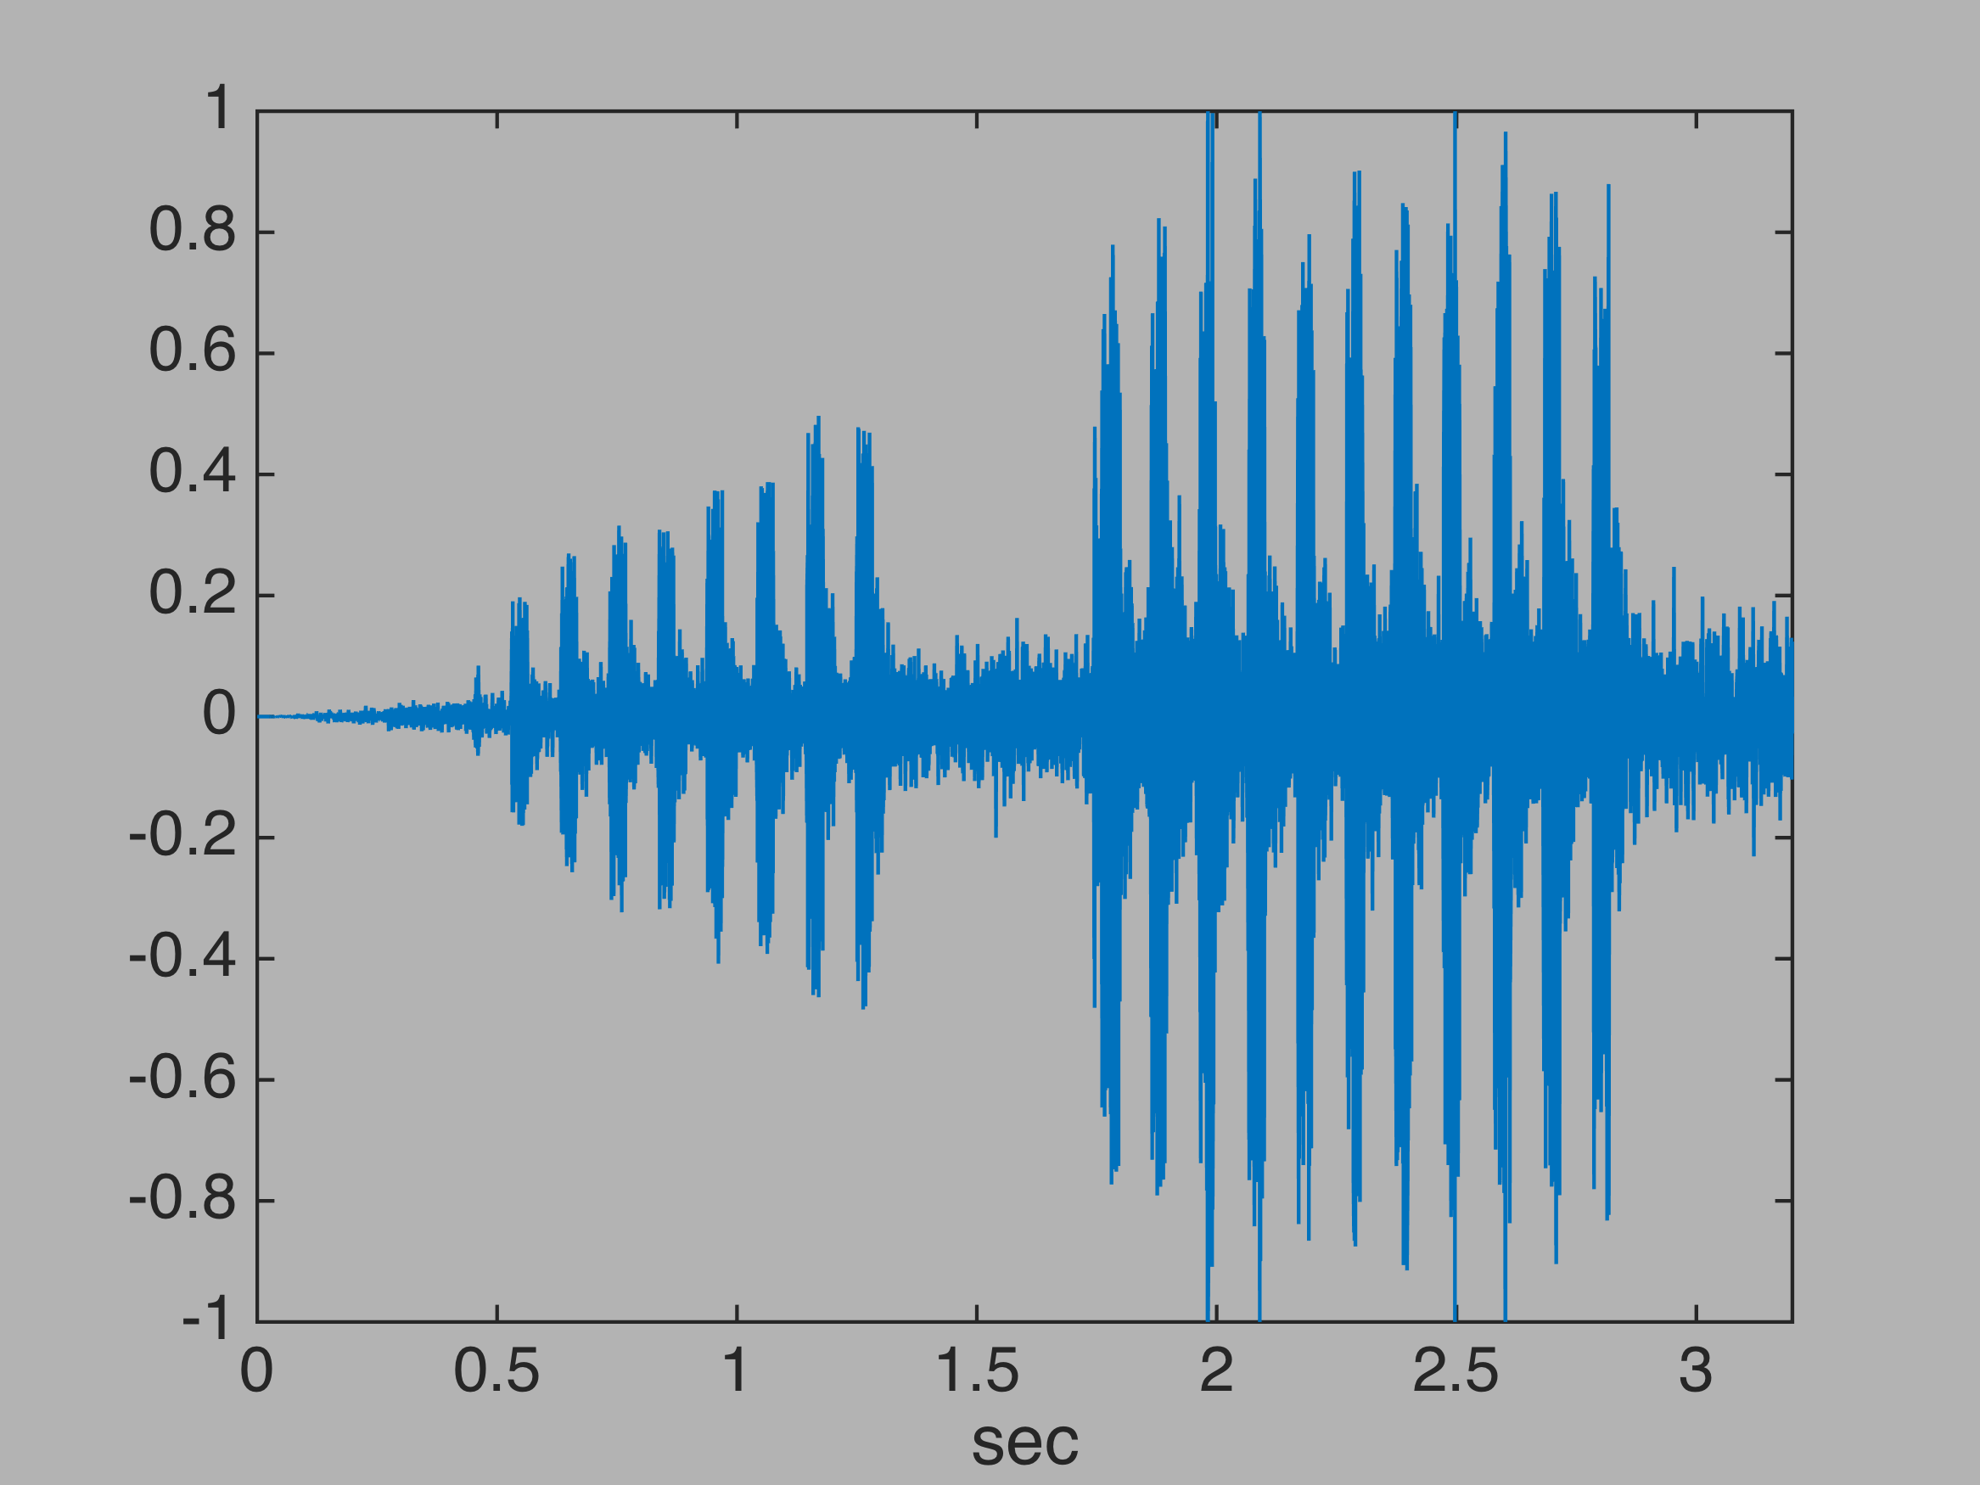
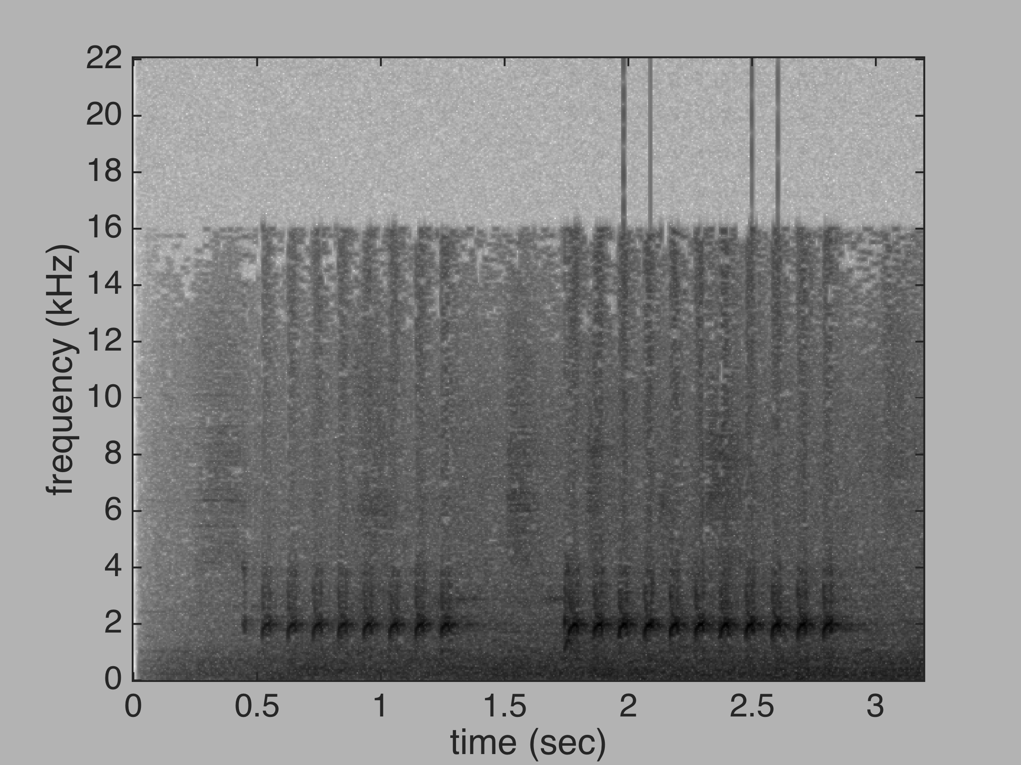
fs = 44100 Hz, window lengh = 1024
Notes:
主要成分 ~ B5，1秒多鐘11連發
background noise
MP3 decoded, > 16 kHz all missing
然後才請觀眾猜猜看

Slide 10
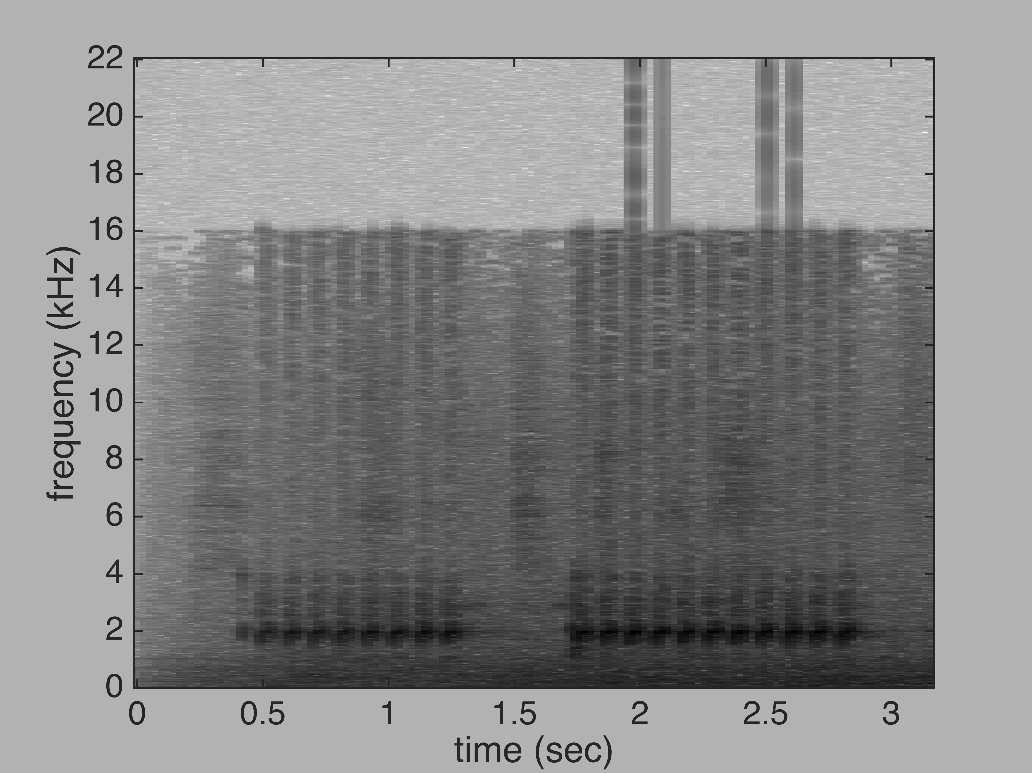
fs = 44100 Hz window length = 1024
window length = 4096
Remarks:
In STFT, usually we discard the phase.
Time and frequency resolution depends on the choice of window.

Slide 11
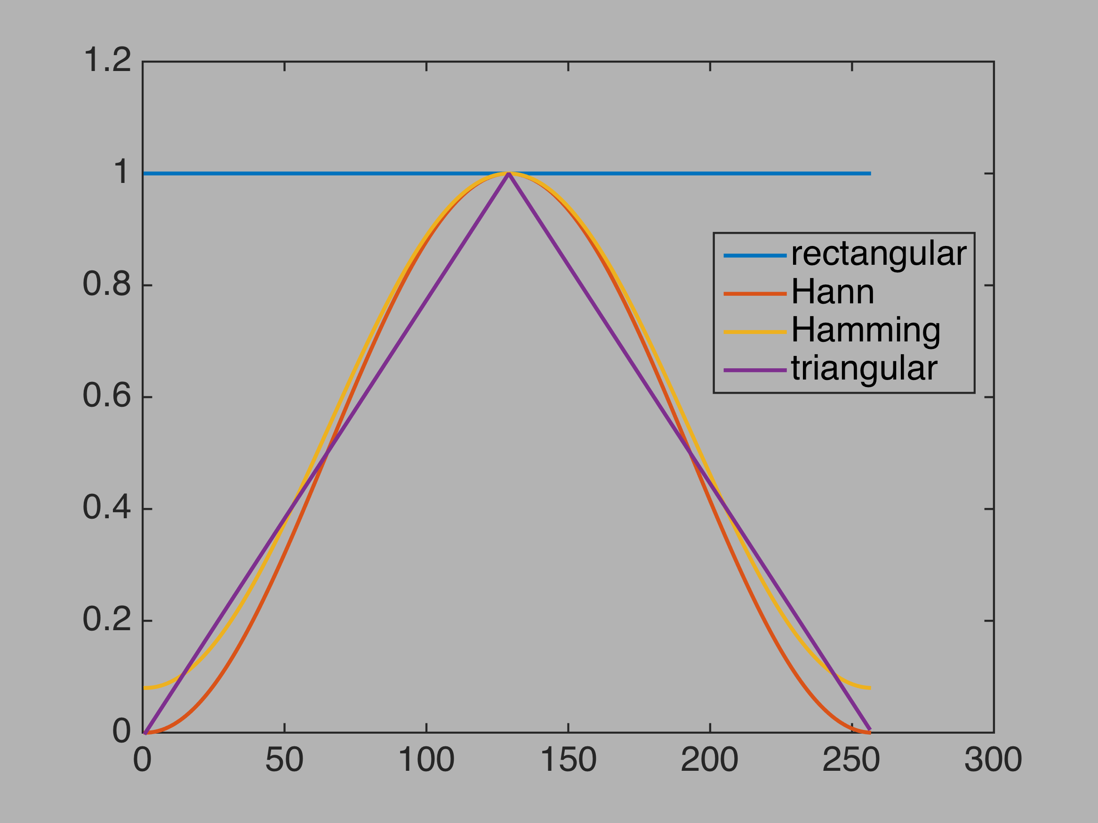
What does the window do?
Recap:
Time and frequency resolution depends on the choice of windows.
Window properties:
Window length
Window shapes
Remarks:
We will come back to this in HW4.1 and 5
Notes:
****** 動畫

Slide 12
Advanced reading list
F. J. Harris. “On the use of windows for harmonic analysis with the discrete Fourier transform,” Proceedings of the IEEE, 66(1):51–83, Jan 1978.
D. Griffin and Jae Lim, "Signal estimation from modified short-time Fourier transform," in IEEE Transactions on Acoustics, Speech, and Signal Processing, vol. 32, no. 2, pp. 236-243, April 1984.

