Slide 1
FINAL-YEAR PROJECT | GUIDE REVIEW
RCAFN
FUNDUS
+
CLINICAL
+
EXPLAINABILITY
Explainable Retinal-Clinical
Adaptive Fusion Network
For CIMT-associated cardiovascular risk assessment
Implementation plan and current progress
1

Slide 2
Project objective
OVERVIEW
What the system will do and what the dataset can support
Input
Model
Output
• Retinal fundus image(s)
• Patient age
• Patient gender
• CNN image encoder
• Clinical MLP
• Adaptive gated fusion
• Normal / thickened CIMT
• Model score
• Visual and feature-level explanations
Primary prediction target
Normal CIMT
Thickened CIMT
CIMT < 0.9 mm
CIMT ≥ 0.9 mm
Scope: dataset labels support CIMT-category prediction, not a validated diagnosis or low/medium/high overall CVD-risk classification.
2

Slide 3
Research foundation
BACKGROUND
China-Fundus-CIMT study as dataset and baseline reference
Reference study
Dataset information
Guo et al. (2025), “High-resolution fundus images for ophthalmomics and early cardiovascular disease prediction.”
Scientific Data.
• 2,903 patients
• Paired left/right fundus images
• Age and gender metadata
• CIMT measurements and labels
Published benchmark reported in the study
Image-only model
Image + clinical model
Test AUC-ROC: 82.58%
Test AUC-ROC: 90.41%
Paper-reported AUC values, not our model results. Our performance must be measured independently.
3

Slide 4
Current project status
PROGRESS
Work completed and work still planned
Dataset preparation
Initial model experiment
• Dataset downloaded and inspected
• JSON fields identified: label, thickness, group, age, gender
• Left/right image filenames identified
• ResNet-50 selected as a basic reference CNN
• Kaggle experiment: 10 epochs
• Approx. 83% accuracy reported
Local Jupyter setup
Remaining work
• Python/PyTorch environment checked
• Image matching and patient-level split prepared
• DataLoader and batch verification steps prepared
• Verify baseline evaluation and test metrics
• Build bilateral CNN and clinical MLP
• Implement adaptive fusion, XAI and application
Note: 83% is an initial reported accuracy. Confirm whether it is training, validation or test accuracy before presenting it as a baseline result.
4

Slide 5
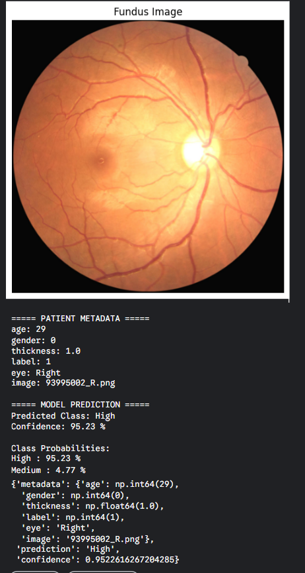
Current prototype output — sample prediction
Illustration from the current fundus-image prediction workflow
What this demonstrates
• Fundus image is loaded into the current prediction pipeline.
• Patient metadata is displayed: age, gender and CIMT thickness.
• The current prototype returns a class and confidence score.
• This is an early demonstration, not the final RCAFN model.
5

Slide 6
Overall system architecture
ARCHITECTURE
Proposed end-to-end workflow
User inputs
Left eye + right eye + age + gender
Retinal image branch
Clinical branch
Shared-weight CNN extracts features from both eyes; combine the representations.
MLP processes normalized age and encoded gender.
Adaptive gated fusion
Learned gate combines image and clinical representations.
Prediction + XAI
CIMT class, score, Grad-CAM and modality explanation.
5

Slide 7
Phase 1 — Data verification and preparation
PHASE 1
• Read JSON fields: patient ID, image names, age, gender, group, label and CIMT thickness.
• Match each patient record to the correct left- and right-eye image.
• Check missing images, duplicates, image readability and label consistency.
• Use predefined groups for training, validation and testing.
• Verify that no patient appears in more than one split.
Why it matters
Incorrect labels or patient overlap can produce misleading performance.
Output
Validated metadata table and split files.
Success check: both eyes of each patient remain in the same split.
6

Slide 8
Phase 2 — Image-only CNN baseline
PHASE 2
Input
Model
Training
Fundus image resized and normalized.
ImageNet-pretrained ResNet-50; final layer changed to 2 classes.
Train on training patients; select checkpoint using validation AUC.
Evaluation
• Accuracy, precision, recall and F1-score
• ROC-AUC and confusion matrix
• Training/validation curves
Why it matters
Establishes the image-only reference for later bilateral and multimodal comparisons.
Output: saved ResNet-50 checkpoint and reproducible baseline metrics.
7

Slide 9
Phase 3 — Bilateral retinal feature extraction
PHASE 3
Fundas Data Set
Left-eye image
Right-eye image
Fundus photograph
Fundus photograph
Shared-weight CNN
Same encoder weights process both eyes.
Feature aggregation
Combine left and right feature vectors.
8

Slide 10
Phase 4 — Clinical feature branch
PHASE 4
Clinical inputs
Clinical MLP
Clinical features
Age (normalized)
Gender (encoded)
Small fully connected network.
Patient-level feature vector.
Implementation steps
• Use JSON age and gender fields.
• Normalize using training data only.
• Train a clinical-only reference model.
Why it matters
Measures the information in clinical variables and prepares the branch for fusion.
9

Slide 11
Phase 5 — Adaptive gated fusion
PHASE 5
Image features (I)
Clinical features (C)
Bilateral CNN representation
MLP representation
Sigmoid gating network
Learns feature weighting from both branches.
Fused representation
F = g ⊙ I + (1 − g) ⊙ C
Two-class classifier
Normal / thickened CIMT
Compare gated fusion with simple concatenation using identical data splits.
10

Slide 12
Phase 6 — Explainable AI
PHASE 6
1. Grad-CAM
2. Vessel segmentation
3. Modality explanation
Generate a heatmap showing image regions that influenced the selected class. Overlay it on the original fundus image.
Use U-Net trained with annotated retinal vessel images. Compare heatmap regions with the vessel mask.
Show learned gate information and test predictions with image or clinical inputs removed.
User-facing explanation panel
Visual explanation
Feature explanation
Original image + Grad-CAM overlay + vessel mask
Image/clinical contribution with appropriate caveats
Caution: heatmaps and gate values explain model behavior; they do not prove causation or clinical validity.
11

Slide 13
Phase 7 — Model evaluation and comparison
PHASE 7
Experiment | Model | Purpose
E1 | Image-only CNN | Image baseline
E2 | Bilateral CNN | Use both eyes
E3 | Clinical MLP | Clinical-only reference
E4 | CNN + clinical concatenation | Standard multimodal baseline
E5 | RCAFN adaptive fusion | Proposed model
Metrics: accuracy, precision, recall/sensitivity, specificity, F1-score, ROC-AUC, confusion matrix and calibration. Use the untouched test set only after model selection.
12

Slide 14
Phase 8 — Web application development
PHASE 8
React frontend
FastAPI backend
PyTorch model
Upload left/right images; enter age and gender; show results and explanations.
Validate inputs; preprocess images; load model; run inference and XAI.
Bilateral CNN + clinical MLP + adaptive fusion + classifier.
User workflow
• Upload required fundus image(s).
• Enter age and gender.
• Backend preprocesses and runs inference.
• Return CIMT category, score and explanation visuals.
Why it matters
Connects the saved model to a user workflow without retraining for every upload.
13

Slide 15
Phase 9 — Integration testing and documentation
PHASE 9
• Test valid, invalid, corrupted and poor-quality fundus images.
• Check missing or invalid age/gender inputs.
• Verify identical preprocessing in training and inference.
• Confirm the saved model produces consistent API outputs.
• Document architecture, experiments, metrics and limitations.
• Prepare the final demo, report and viva presentation.
Final deliverables
Trained model, working application, XAI outputs, evaluation report and documentation.
Success condition
End-to-end upload → prediction → explanation works reliably.
14

Slide 16
Implementation sequence
Build and validate one module before moving to the next
01
Dataset verification
02
ResNet-50 baseline
03
Bilateral CNN
Validate metadata, image matching and patient-level splits.
Complete image-only training and record evaluation metrics.
Process left and right eye images using a shared encoder.
04
Clinical MLP
05
Adaptive gated fusion
06
Explainable AI
Process normalized age and encoded gender.
Combine image and clinical representations using a learned gate.
Generate Grad-CAM, vessel analysis and modality explanations.
07
Final evaluation
08
Web application
09
Testing and documentation
Compare baseline, bilateral, clinical and fusion experiments.
Connect the saved model to React and FastAPI.
Validate the end-to-end workflow and prepare project report.
Implementation will proceed in this order; completion depends on validation at each stage.
15

Slide 17
Expected final result and project scope
OUTCOME
What we aim to demonstrate
Functional system
Research contribution
Explainability
Web prototype accepts retinal images and clinical inputs and returns a CIMT-category prediction.
Adaptive gated fusion evaluated against image-only and standard multimodal baselines.
Grad-CAM, vessel-related analysis and modality contribution information.
Scientific limitations to state clearly
• Dataset labels support normal vs thickened CIMT, not validated low/medium/high overall CVD-risk.
• The model is a research prototype, not a clinical diagnostic tool.
• External validation on other populations and camera sources is needed before clinical use.
16

Slide 18


