Slide 1
Database Systems I
Dr. Rasool Hisham
For 3rd year students, 1st semester
Al-Nahrain University
College of Science
Computer Science Department

Slide 2

Syllabus
Week | Topics
1 | Data and Information, Database, Database Management System, Objectives of DBMS (Data Availability, Data Integrity, Data Security, Data Independence).
2 | File-Based System, Drawbacks of File-Based System( Duplication of Data, Data Dependence, Incompatible File Formats, Separation and Isolation of Data), DBMS Approach, Advantages of DBMS(Centralized Data Management, Data Independence, Data Consistency )
3 | ANSI/Spark Data Model, Need for Abstraction , Data Independence , Physical Level, Logical Level, View Level, Database Instances, Database Schema
4 | Data Models, Components and Interfaces of Database Management System(Hardware, Software, Data, Procedure, People Interacting with Database, Data Dictionary)
5 | Functional Components of Database System Structure, Storage Manager(Authorization and Integrity Manager, Transaction Manager, File Manager, Buffer Manager), Database Architecture( Two-Tier Architecture, Three-tier Architecture), Overview of Database Design
6 | Data Modeling Using the Entity-Relationship Model , The Building Blocks of an Entity–Relationship Diagram( Entity, Relationship, Attributes), ER Diagram, Classification of Entity Sets(Strong Entity, Weak Entity), Attribute Classification(Single value attribute, Multivalue attribute, Derived Attribute, Null Value Attribute, Composite Attribute), Relationship Degree(Unary Relationship , Binary Relationship, Ternary Relationship), Relationship Classification(One-to-One Relationship Type, One-to-Many Relationship Type, Many-to-One Relationship Type, Many-to-Many Relationship Type)

Slide 3
Syllabus (cont.)
Week | Topics
7 | Relational Model, CODD’S Rules, Relational Model Properties, Relation Schema and Relation Instance, Concept of Key, Relational Integrity(Entity Integrity, Null Integrity, Domain Integrity Constraint, Referential Integrity)
8 | Relational Algebra, Role of Relational Algebra in DBMS, Relational Algebra Operations, Selection Operation, Projection Operation, Union Compatibility and Union Operation, Intersection Operation, Difference Operation
9 | Cartesian Product Operation, Join Operations, Types of Join Operation, Natural Join, Equi Join, Theta Join, Outer Join, Examples of Relational Algebra Queries
10 | Structured Query Language, Commands in SQL, Data Definition Language, Creating a Database, Data types in SQL, Creating, Altering, and Deleting Tables Ensuring Data Validity with Constraints(NOT NULL Constraint, UNIQUE Constraint, CHECK Constraint, Primary Key and PRIMARY KEY Constraint, Foreign Key)
11 | Speeding Up Results with Indexes, Data Manipulation Language, Inserting New Data, Updating Data, The WHERE Clause, The Logical Operators AND and OR, Deleting Data
12 | Extracting Information Using the SELECT Statement, Returning Only Distinct Rows, Using Aliases, Filtering Results with the WHERE Clause, Using Logical Operators, NOT Operator, BETWEEN Operator, LIKE Operator, IN Operator, Ordering Results with ORDER BY, Selecting Data from More Than One Table

Slide 4
Reference books
1. S. Sumathi, S. Esakkirajan, "Fundamentals of Relational Database Management Systems", Springer, 2007.
2. Ramez Elmasri, Shamkant B. Navathe, "Fundamentals of Database Systems", 4th Edition, Addison Wesley, 2003.
3. C. J. Date, "An Introduction to Database Systems", 8th Edition, Addison Wesley, 2004.
4. Raghu Ramakrishnan , Johannes Gehrke, "Database Management Systems", 3rd Edition, McGraw Hill, 2003.
5. Paul Wilton, John W. Colby, "Beginning SQL", Wiley Publishing, Inc. 2005

Slide 5
Introduction to Database Systems
Information is a valuable resource to an organization
Computer software provides an efficient means of processing information
Database systems are becoming increasingly common means by which it is possible to store and retrieve information in an effective manner.
Relational databases are the most popular database management systems
Essential component of everyday life in modern society

Slide 6
Examples of traditional database applications
a bank
a hotel or airline reservation,
access a computerized library catalog
buy some item from an Internet vendor through its Web page
Even purchasing items from a supermarket nowadays in many cases involves an automatic update of the database that keeps the inventory of supermarket items.

Slide 7
Other types of databases
Multimedia databases can now store pictures, video clips, and sound messages.
Geographic information systems (GIS) can store and analyze maps, weather data, and satellite images.
Data warehouses and online analytical processing (OLAP) systems are used in many companies to extract and analyze useful information from very large databases for decision making.
Real-time and active database technology is used in controlling industrial and manufacturing processes.
Database search techniques are being applied to the World Wide Web to improve the search for information that is needed by users browsing the Internet.

Slide 8
What is a database system?
A database system is basically just a computerized record-keeping system.
The database itself can be regarded as a kind of electronic filing cabinet; that is, it is a container for a collection of computerized data files.
Users of the system can perform (or request the system, to perform, rather) a variety of operations involving such files-for example:
Adding new files to the database
Inserting data into existing files
Retrieving data from existing files
Deleting data from existing files
Changing data in existing files
Removing existing files from the database

Slide 9
Data and Information
Data are raw facts that constitute building block of information.
Data are the heart of the DBMS.
The data will not convey useful information.
Useful information is obtained from processed data.
In other words, data has to be interpreted in order to obtain information. Good, timely, relevant information is the key to decision making.
Good decision making is the key to organizational survival.
The data in DBMS can be broadly classified into two types, one is the collection of information needed by the organization and the other is “metadata” which is the information about the database.

Slide 10
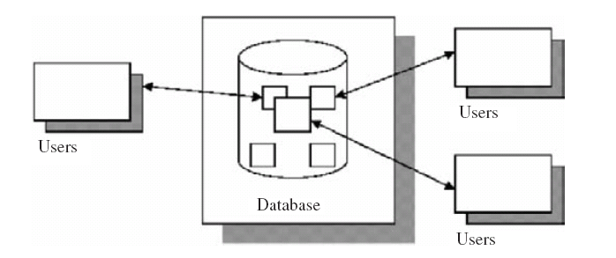
Database
A database is a well-organized collection of data that are related in a meaningful way.
Database systems are systems in which the interpretation and storage of information are of primary importance.
The database should contain all the data needed by the organization as a result, a huge volume of data, the need for long-term storage of the data, and access of the data by a large number of users generally characterize database systems.
The simplified view of database system is shown in Fig. (1). From this figure, it is clear that several users can access the data in an organization still the integrity of the data should be maintained.

Slide 11
Database Management System
The database management system (DBMS) is a software component that manages the database and shields users from low-level details (in particular, details of how the database is physically stored and accessed).
A DBMS consists of collection of interrelated data and a set of programs to access that data.
A DBMS consists of:
A collection of interrelated and persistent data. This part of DBMS is referred to as database (DB).
A set of application programs used to access, update, and manage data. This part constitutes data management system (MS).

Slide 12
Database Management System
A DBMS is general-purpose software i.e., not application specific.
The same DBMS (e.g., Oracle, Microsoft Access, MySQL etc.) can be used in railway reservation system, library management, university, etc.
A DBMS takes care of storing and accessing data, leaving only application specific tasks to application programs.
DBMS is a complex system that allows a user to do many things to data, that DBMS allows user to input data, share the data, edit the data, manipulate the data, and display the data in the database. Because a DBMS allows more than one user to share the data; the complexity extends to its design and implementation.

Slide 13
Objectives of DBMS
Data Availability: Data availability refers to the fact that the data are made available to wide variety of users in a meaningful format at reasonable cost so that the users can easily access the data.
Data Integrity: Data integrity refers to the correctness of the data in the database. In other words, the data available in the database is a reliable data.
Data Security: Data security refers to the fact that only authorized users can access the data. Data security can be enforced by passwords. If two separate users are accessing a particular data at the same time, the DBMS must not allow them to make conflicting changes.
Data Independence: DBMS allows the user to store, update, and retrieve data in an efficient manner. DBMS provides an “abstract view” of how the data is stored in the database. In order to store the information efficiently, complex data structures are used to represent the data. The system hides certain details of how the data are stored and maintained.

Slide 14
File-Based System
Prior to DBMS, file system provided by OS was used to store information.
In a file-based system, we have collection of application programs that perform services for the end users.
Each program defines and manages its own data.
Consider University database, the University database contains details about student, faculty, lists of courses offered, and duration of course, etc.
In File-based processing for each database there is separate application program which is shown in fig 2

Slide 15
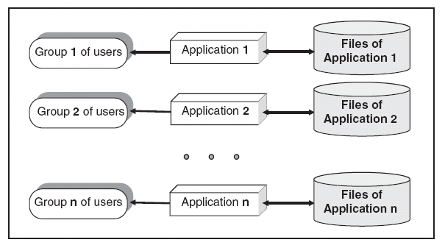
File-Based System (cont.)
One group of users may be interested in knowing the courses offered by the university. One group of users may be interested in knowing the faculty information. The information is stored in separate files and separate applications programs are written.

Slide 16
Drawbacks of File-Based System
The limitations of file-based approach are duplication of data, data dependence, incompatible file formats, separation, and isolation of data.
Duplication of Data: Duplication of data means same data being stored more than once. This can also be termed as data redundancy. Data redundancy is a problem in file based approach due to the decentralized approach. Duplication of data leads to wastage of storage space and can lead to loss of data integrity.
Data Dependence: Data dependence means the application program depends on the data. If some modifications have to be made in the data, then the application program has to be rewritten.
Incompatible File Formats: As file-based system lacks program data independence, the structure of the file depends on the application programming language. For example, the structure of the file generated by FORTRAN program may be different from the structure of a file generated by “C” program.
Separation and Isolation of Data: In file-based approach, data are isolated in separate files. Hence it is difficult to access data.

