Slide 1
Database Systems I
Dr. Rasool Hisham
For 3rd year students, 1st semester
Al-Nahrain University
College of Science
Computer Science Department

Slide 2

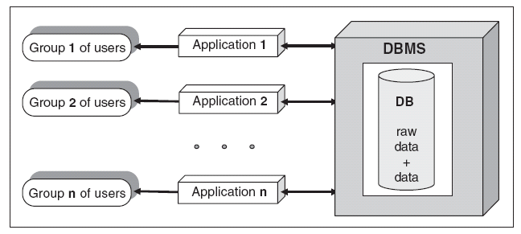
DBMS Approach
DBMS is software that provides a set of primitives for defining, accessing, and manipulating data.
In DBMS approach, the same data are being shared by different application programs; DBMS approach of data access is shown in Fig. (3).

Slide 3
Advantages of DBMS
There are many advantages of database management system. Some of the advantages are listed later:
Centralized data management.
Data Independence.
Data Consistency.

Slide 4
Centralized Data Management
In DBMS all files are integrated into one system thus reducing redundancies and making data management more efficient.

Slide 5
Data Independence
Data independence means that programs are isolated from changes in the way the data are structured and stored.
In a database system, the database management system provides the interface between the application programs and the data.
Data independence is the immunity of application programs to changes in storage structures and access techniques.
Physical data independence is the ability to modify physical schema without causing the conceptual schema or application programs to be rewritten.
Logical data independence is the ability to modify the conceptual schema without having to change the external schemas or application programs.

Slide 6
Data Consistency
Data inconsistency means different copies of the same data will have different values.
For example, consider a person working in a branch of an organization. The details of the person should be stored and maintained both in the branch office as well as in the main office in order to ensure data consistency.

Slide 7
Some of the qualities achieved in DBMS
Data redundancy → Reduced in DBMS
Data independence → Activated in DBMS.
Data inconsistency → Avoided in DBMS.
Centralizing the data → Achieved in DBMS.
Data integrity → Necessary for efficient Transaction.
Support for multiple views → Necessary for security reasons.

Slide 8
Some of the qualities achieved in DBMS (cont.)
Data redundancy means duplication of data. Data redundancy will occupy more space hence it is not desirable.
Data independence means independence between application program and the data. The advantage is that when the data representation changes, it is not necessary to change the application program.
Data inconsistency means different copies of the same data will have different values.
Centralizing the data means data can be easily shared between the users but the main concern is data security.
The main threat to data integrity comes from several different users attempting to update the same data at the same time. For example, The number of booking made is larger than the capacity of the aircraft/train.
Support for multiple views means DBMS allows different users to see different views of the database, according to the perspective each one requires. This concept is used to enhance the security of the database.

Slide 9
ANSI/Spark Data Model
The distinction between the logical and physical representation of data were recognized in 1978 when ANSI/SPARK committee proposed a generalized framework for database systems.
This framework provided a three-level architecture, three levels of abstraction at which the database could be viewed.

Slide 10
Need for Abstraction
The main objective of DBMS is to store and retrieve information efficiently; all the users should be able to access same data.
The designers use complex data structure to represent the data, so that data can be efficiently stored and retrieved, but it is not necessary for the users to know physical database storage details.
The developers hide the complexity from users through several levels of abstraction.
Data independence means the internal structure of database should be unaffected by changes to physical aspects of storage. Because of data independence, the Database administrator can change the database storage structures without affecting the users view.

Slide 11
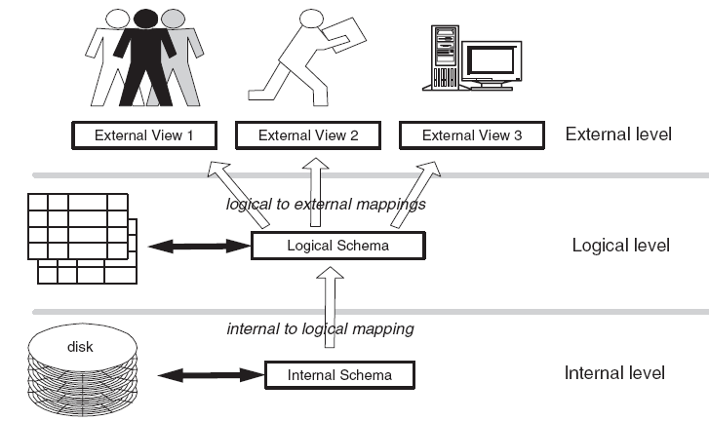
The three levels of data abstraction
1. Physical level or internal level
2. Logical level or conceptual level
3. View level or external level

Slide 12
Physical Level
It is concerned with the physical storage of the information.
It provides the internal view of the actual physical storage of data.
The physical level describes complex low-level data structures in detail.

Slide 13
Logical Level
Logical level describes what data are stored in the database and what relationships exist among those data.
Logical level describes the entire database in terms of a small number of simple structures.
The implementation of simple structure of the logical level may involve complex physical level structures; the user of the logical level does not need to be aware of this complexity.
Database administrator use the logical level of abstraction.

Slide 14
View Level
View level is the highest level of abstraction.
It is the view that the individual user of the database has.
There can be many view level abstractions of the same data.

Slide 15
Database Instances
Database change over time as information is inserted and deleted.
The collection of information stored in the database at a particular moment is called an instance of the database.

Slide 16
Database Schema
The overall design of the database is called the database schema.
A schema is a collection of named objects.
Schemas provide a logical classification of objects in the database.
A schema can contain tables, views, triggers, functions, packages, and other objects.
A schema is also an object in the database. It is explicitly created using the CREATE SCHEMA statement with the current user recorded as the schema owner.

Slide 17
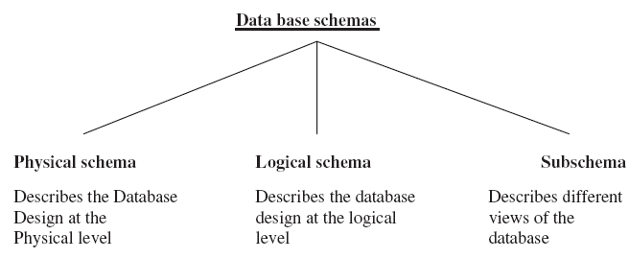
Database Schema (cont.)

Slide 18
Components and Interfaces of Database Management System
A database management system involves five major components: data, hardware, software, procedure, and users.
These components and the interface between the components are shown in the next figure.

Slide 19
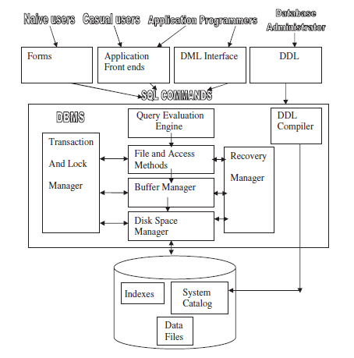
Components and Interfaces of Database Management System (cont.)

Slide 20
Hardware
The hardware can range from a single personal computer, to a single mainframe, to a network of computers.
The particular hardware depends on the requirements of the organization and the DBMS used.
Some DBMSs run only on particular machine, while others run on a wide variety of machines.

Slide 21
Software
The software includes the DBMS software, application programs together with the operating systems including the network software if the DBMS is being used over a network.
The application programs are written in third-generation programming languages like “C,” COBOL, FORTRAN, Ada, Pascal, etc. or using fourth-generation language such as SQL, embedded in a third-generation language.
The target DBMS may have its own fourth-generation tools which allow development of applications through the provision of nonprocedural query languages, report generators, graphics generators, and application generators.

Slide 22
Data
A database is a repository for data which, in general, is both integrated and shared.
Integration means that the database may be thought of as a unification of several otherwise distinct files, with any redundancy among those files partially or wholly eliminated.
The sharing of a database refers to the sharing of data by different users, in the sense that each of those users may have access to the same piece of data and may use it for different purposes.

Slide 23
Procedure
Procedures are the rules that govern the design and the use of database.
The procedure may contain information on how to log on to the DBMS, start and stop the DBMS, procedure on how to identify the failed component, how to recover the database, change the structure of the table, and improve the performance.

