Slide 1
Database Systems I
Dr. Rasool Hisham
For 3rd year students, 1st semester
Al-Nahrain University
College of Science
Computer Science Department

Slide 2

People Interacting with Database
Here people refers to the people who manages the database, database administrator, people who design the application program, database designer and the people who interacts with the database, database users.
A DBMS is typically run as a back-end server in a local or global network, offering services to clients directly or to Application Servers.

Slide 3
Database Administrator
Database Administrator is a person having central control over data and programs accessing that data.
The database administrator is a manager whose responsibilities are focused on management of technical aspects of the database system.

Slide 4
Responsibilities of Database Administrator (DBA)
The responsibility of the database administrator is to maintain the integrity, security, and availability of data.
The responsibilities of the database administrator are summarized as follows:
Authorizing access to the database.
Coordinating and monitoring its use.
Acquiring hardware and software resources as needed.
Database Backup and recovery

Slide 5
Database Designer
Database designer can be either logical database designer or physical database designer.
Logical database designer is concerned with identifying the data, the relationships between the data, and the constraints on the data that is to be stored in the database.
The logical database designer must have thorough understanding of the organizations data and its business rule.
The logical database designer is responsible for mapping the logical data model into a set of tables and integrity constraints, selecting specific storage structure, and designing security measures required on the data.
The physical database designer takes the logical data model and decides the way in which it can be physically implemented.

Slide 6
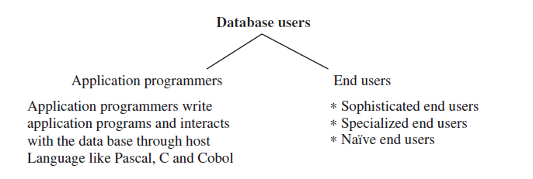
Database Users
Database users are the people who need information from the database to carry out their business responsibility.
The database users can be broadly classified into two categories like application programmers and end users.

Slide 7
Database Users (cont.)
Sophisticated end users interact with the system without writing programs. They form requests by writing queries in a database query language. These are submitted to query processor. Analysts who submit queries to explore data in the database fall in this category.
Specialized end users write specialized database application that does not fit into data-processing frame work. Application involves knowledge base and expert system, environment modeling system, etc.
Naive end user interact with the system by using permanent application program Example: Query made by the student, namely number of books borrowed in library database.

Slide 8
Definitions
System analysts determine the requirements of end user, and develop specification for canned transaction that meets this requirement.
Canned Transaction: Ready made programs through which naive end users interact with the database.
Application programmers implement these specifications as programs; then they test, debug, document, and maintain these canned transactions. Such analysts and programmers (nowadays called software engineers) should be familiar with the full range of capabilities provided by the DBMS to accomplish their tasks.

Slide 9
Data Dictionary
A data dictionary, also known as a “system catalog,” is a centralized store of information about the database.
It contains information about the tables, the fields of tables, data types, primary keys, indexes, the joins which have been established between those tables, referential integrity, cascades update, cascade delete, etc.
The information stored in the data dictionary is called the “Metadata.” Thus a data dictionary can be considered as a file that stores Metadata.
Metadata: The information (data) about the data in a database is called Metadata. The Metadata are available for query and manipulation, just as other data in the database.

Slide 10
Database Manager
Database manager is a program module which provides the interface between the low level data stored in the database and the application programs and queries submitted to the system:
The database manager would translate DML statement into low level file system commands for storing, retrieving, and updating data in the database.
Integrity enforcement. Database manager enforces integrity by checking consistency constraints like the bank balance of customer must be maintained to a minimum of 300, etc.
Security enforcement. Unauthorized users are prohibited to view the information stored in the database.
Backup and recovery. Backup and recovery of database is necessary to ensure that the database must remain consistent despite the fact of failures.

Slide 11
Functional Components of Database System Structure
The functional components of database system structure are:
A) Storage manager.
B) Query processor.

Slide 12
Storage Manager
Storage manager is responsible for storing, retrieving, and updating data in the database. Storage manager components are:
Authorization and integrity manager.
Transaction manager.
File manager.
Buffer manager.

Slide 13
1-Authorization and Integrity Manager
Checks the integrity constraints and authority of users to access data.

Slide 14
2-Transaction Manager
It ensures that the database remains in a consistent state despite system failures. The transaction manager manages the execution of database manipulation requests. The transaction manager function is to ensure that concurrent access to data does not result in conflict.
Transaction Management
A transaction is a collection of operations that performs a single logical function in a database application.
Transaction-management component ensures that the database remains in a consistent state despite system failures and transaction failure.
Concurrency control manager controls the interaction among the concurrent transactions, to ensure the consistency of the database.

Slide 15
3- File Manager
File manager manages the allocation of space on disk storage.
A file management system manages independent files, helping to enter and retrieve information records.
File manager establishes and maintains the list of structure and indexes defined in the internal schema.
The file manager can:
Create a file
Delete a file
Update the record in the file
Retrieve a record from a file

Slide 16
4- Buffer Manager
Buffer: The area into which a block from the file is read is termed a buffer. The management of buffers has the objective of maximizing the performance or the utilization of the secondary storage systems, while at the same time keeping the demand on CPU resources tolerably low. The use of two or more buffers for a file allows the transfer of data to be overlapped with the processing of data.
Buffer manager is responsible for fetching data from disk storage into main memory. Programs call on the buffer manager when they need a block from disk. The requesting program is given the address of the block in main memory, if it is already present in the buffer. If the block is not in the buffer, the buffer manager allocates space in the buffer for the block, replacing some other block, if required, to make space for new block. Once space is allocated in the buffer, the buffer manager reads in the block from the disk to the buffer, and passes the address of the block in main memory to the requester.
Indices: Indices provide fast access to data items that hold particular values. An index is a list of numerical values which gives the order of the records when they are sorted on a particular field or column of the table.

Slide 17
b) Query Processor
The query processor in a database management system receives as input a query request in the form of SQL text, parses it, generates an execution plan, and completes the processing by executing the plan and returning the results to the client.
DDL Interpreter: It interprets the DDL statements and records the definitions in data dictionary.
DML Compiler: It translates the DML statements in a query language into an evaluation plan consisting of low-level instructions that the query evaluation understands. It also performs query optimization which actually picks up the lowest cost evaluation plan from various alternatives.
Query Evaluation Engine: It executes the low-level instruction compiled by the DML compiler.

Slide 18
Database Architecture
Database architecture essentially describes the location of all the pieces of information that make up the database application.
The database architecture can be broadly classified into two-, three-, and multitier architecture.

Slide 19
Two-Tier Architecture
The two-tier architecture is a client–server architecture in which the client contains the presentation code and the SQL statements for data access. The database server processes the SQL statements and sends query results back to the client. The two-tier architecture is shown in next figure.
Two-tier client/server provides a basic separation of tasks. The client, or first tier, is primarily responsible for the presentation of data to the user and the “server,” or second tier, is primarily responsible for supplying data services to the client.

Slide 20
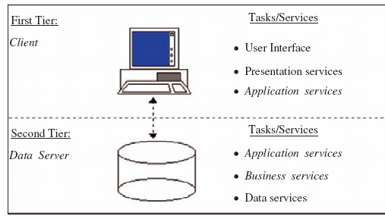
Two-Tier Architecture (cont.)

Slide 21
Two-Tier Architecture (cont.)
Presentation Services refer to the portion of the application which presents data to the user.
Business services encapsulate an organizations business processes and requirements.
Application Services provide other functions necessary for the application.
Data Services provide access to data independent of their location.

Slide 22
Three-tier Architecture
A “Multitier,” often referred to as “three-tier” or “N-tier,” architecture provides greater application scalability lower maintenance, and increased reuse of components.
The three-tier architecture is shown in next figure, offers a technology neutral method of building client/server applications with vendors who employ standard interfaces which provide services for each logical “tier”.

Slide 23
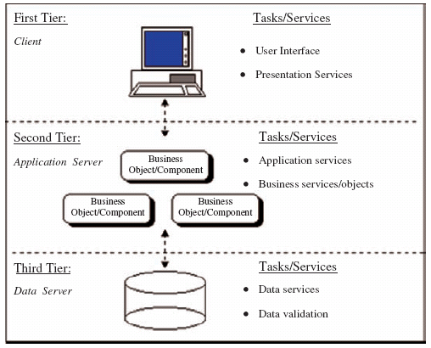
Three-tier Architecture

Slide 24
Definitions
A data definition language (DDL) is a language for defining, or declaring, database objects.
A data manipulation language (DML) is a language for "manipulating" or processing database objects.
A data sublanguage (DSL) is that portion of a given language that's concerned specifically with database objects and operations.
A host language is a language in which a data sublanguage is embedded. The host language is responsible for providing various nondatabase facilities, such as I/O operations, local variables, computational operations, if-then-else logic, and so on.
The server is the term used to refer to the hardware platform the DBMS runs on, especially when that platform is distinct from the one the clients run on.

Slide 25
Definitions
Back end: Same as server.
A client is an application that runs on top of the DBMS. The term is also used to refer to the hardware platform the client application runs on, especially when that platform is distinct from the one the server runs on.
Front end: Same as client.
A distributed database is a database that is logically centralized but physically distributed across many distinct physical sites.
Distributed processing means that distinct machines can be connected together into some kind of communications network, in such a way that a single data processing task can be spread across several machines in the network (and, typically, carried out in parallel).

