Slide 1
Database Systems I
Dr. Rasool Hisham
For 3rd year students, 1st semester
Al-Nahrain University
College of Science
Computer Science Department

Slide 2

OVERVIEW OF DATABASE DESIGN
The database design process can be divided into six steps. The ER model is most relevant to the first three steps:
(1) Requirements Analysis: The very first step in designing a database application is to understand what data is to be stored in the database, we must find out what the users want from the database. Several methodologies have been proposed for organizing and presenting the information gathered in this step, and some automated tools have been developed to support this process.
(2) Conceptual Database Design: This step is often carried out using the ER model. The information gathered in the requirements analysis step is used to develop a high-level description of the data to be stored in the database.

Slide 3
(cont.)
OVERVIEW OF DATABASE DESIGN
(3) Logical Database Design: The task in the logical design step is to convert an ER schema into a relational database schema. We must choose a DBMS to implement our database design.
The remaining four steps of database design are briefly described below:
(4) Schema Refinement: The fourth step in database design is to analyze the collection of relations in our relational database schema to identify potential problems, and to refine it. We discuss the theory of normalizing relations to ensure some desirable properties later.

Slide 4
(cont.)
OVERVIEW OF DATABASE DESIGN
(5) Physical Database Design: In this step we must consider typical expected workloads that our database must support and further refine the database design to ensure that it meets desired performance criteria.
(6) Security Design: In this step, we identify different user groups and different roles played by various users. For each role and user group, we must identify the parts of the database that they must be able to access and the parts of the database that they should not be allowed to access, and take steps to ensure that they can access only the necessary parts.

Slide 5
Data Models
Data model is collection of conceptual tools for describing data, relationship between data, and consistency constraints. Data model describe the structure of the database.
The data model is a language for describing the data and database, it may consist of abstract concepts, which must be translated by the designer into the constructs of the data definition interface, or it may consist of constructs, which are directly supported by the data definition interface. The constructs of the data model may be defined at many levels of abstraction.
Three historically important data models are the hierarchical, network, and relational models. Together they are often referred to as the “basic” data models.

Slide 6
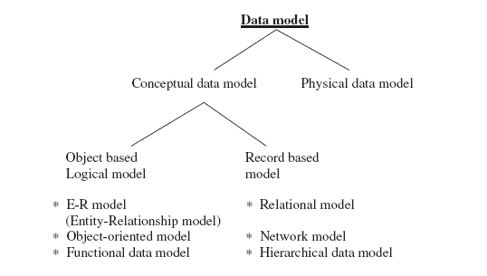
Data Models

Slide 7
Data Modeling Using the Entity-Relationship Model
Conceptual modeling is an important phase in designing a successful database application.
The entity-relationship (ER) data model allows us to describe the data involved in a real-world enterprise in terms of objects and their relationships and is widely used to develop an initial database design.
The ER model is used in a phase called conceptual database design.
The main motivation for defining the ER model is to provide a high-level model for conceptual database design.
The ER model achieves a high degree of data independence which means that the database designer does not have to worry about the physical structure of the database.

Slide 8
The Building Blocks of an Entity–Relationship Diagram
The ER modeling can be carried out with the help of pictorial representation of:
Entity
Relationship
Attributes

Slide 9
Entity
An entity is an object that exists and is distinguishable from other objects.
The examples of entities are: a particular person, a particular department, a particular place.
Entity Type: An entity type or entity set is a collection of similar entities. Some examples of entity types are: students, courses, departments.

Slide 10
Relationship
A relationship is an association of entities where relationship type is a meaningful association between entity types.
The examples of relationship types are:
Teaches is the relationship type between LECTURER and STUDENT.
Buying is the relationship between VENDOR and CUSTOMER.
Treatment is the relationship between DOCTOR and PATIENT.

Slide 11
Attributes
Entities are described in a database by a set of attributes.
The following are example of attributes:
Brand, cost, and weight are the attributes of CELLPHONE.
Roll number, name, and grade are the attributes of STUDENT.
Data bus width, address bus width, and clock speed are the attributes of MICROPROCESSOR.

Slide 12
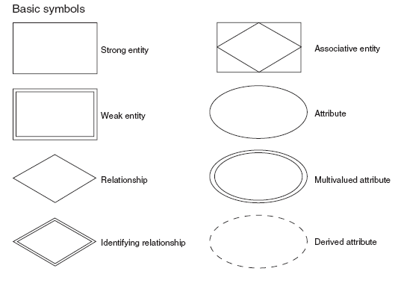
ER Diagram
The ER diagram is used to represent database schema. The elements in ER diagram are Entity, Attribute, and Relationship.
A rectangle represents an entity set.
An ellipse represents an attribute.
A diamond represents a relationship.
Lines represent linking of attributes to entity sets and of entity sets to relationship sets.

Slide 13
Example of ER diagram
Let us consider a simple ER diagram as shown in Fig. (10).
In the ER diagram the two entities are STUDENT and CLASS.
Two simple attributes which are associated with the STUDENT are Roll number and the name.
The attributes associated with the entity CLASS are Subject Name and Hall Number.
The relationship between the two entities STUDENT and CLASS is Attends.

Slide 14
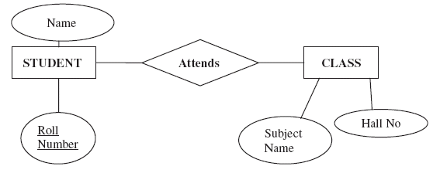
Example of ER diagram

Slide 15
Classification of Entity Sets
Entity sets can be broadly classified into:
1. Strong entity
2. Weak entity
3. Associative entity

Slide 16
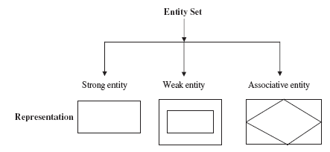
Classification of Entity Sets (cont.)

Slide 17

1-Strong Entity
Strong entity is one whose existence does not depend on other entity.
Example: Consider the example, student takes course. Here student is a strong entity. In this example, course is considered as weak entity because, if there are no students to take a particular course, then that course cannot be offered. The COURSE entity depends on the STUDENT entity.

Slide 18

2-Weak Entity
Weak entity is one whose existence depends on other entity. In many cases, weak entity does not have primary key.
Example: Consider the example, customer borrows loan. Here loan is a weak entity. For every loan, there should be at least one customer. Here the entity loan depends on the entity customer hence loan is a weak entity.

Slide 19
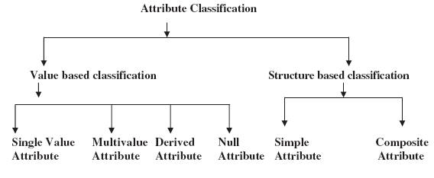
Attribute Classification
Attribute is used to describe the properties of the entity. This attribute can be broadly classified based on value and structure.

Slide 20
Single value attribute
Single value attribute means, there is only one value associated with that attribute.
One example of single value attribute is age of a person.

Slide 21
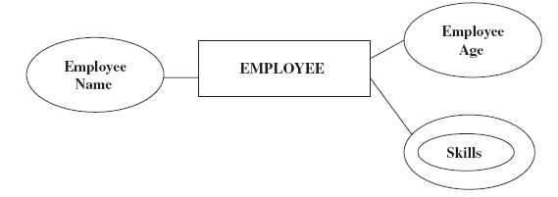
Multivalue attribute
In the case of multivalue attribute, more than one value will be associated with that attribute.
Consider an entity EMPLOYEE. An Employee can have many skills; hence skills associated to an employee are a multivalue attribute.

Slide 22
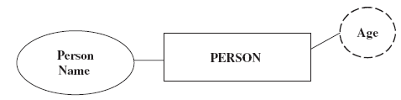
Derived Attribute
The value of the derived attribute can be derived from the values of other related attributes or entities.
Example: Age of a person can be derived from the date of birth of the person. In this example, age is the derived attribute.

Slide 23
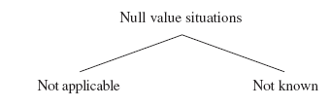
Null Value Attribute
In some cases, a particular entity may not have any applicable value for an attribute. For such situation, a special value called null value is created.
Example: In application forms, there is one column called phone no. if a person do not have phone then a null value is entered in that column.

Slide 24
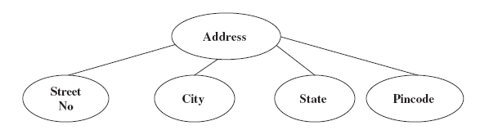
Composite Attribute
Composite attribute is one which can be further subdivided into simple attributes.
Example: Consider the attribute “address” which can be further subdivided into Street name, City, and State.

Slide 25
Relationship Degree
Relationship degree refers to the number of associated entities. The relationship degree can be broadly classified into unary, binary, and ternary relationship

Slide 26
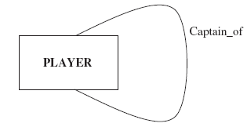
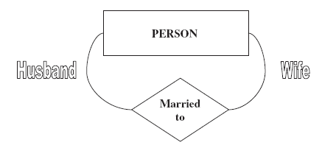
1. Unary Relationship
The unary relationship is otherwise known as recursive relationship.
In the unary relationship the number of associated entity is one.
An entity related to itself is known as recursive relationship.
Example: In this example, Husband and wife are referred as roles.

Slide 27
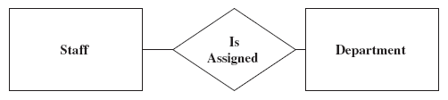
2. Binary Relationship
In a binary relationship, two entities are involved.
Consider the example; each staff will be assigned to a particular department. Here the two entities are STAFF and DEPARTMENT.

Slide 28
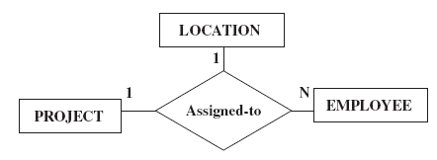
3. Ternary Relationship
In a ternary relationship, three entities are simultaneously involved.
Ternary relationships are required when binary relationships are not sufficient.
Example: Consider the example of employee assigned a project. Here we are considering three entities EMPLOYEE, PROJECT, and LOCATION. The relationship is “assigned-to.” Many employees will be assigned to one project hence it is an example of one-to-many relationship.

Slide 29
Relationship Classification
Relationship is an association among one or more entities.
This relationship can be broadly classified into
one-to-one relation
one-to-many relation
many-to- many relation
recursive relation.

Slide 30
One-to-One Relationship Type
One-to-one relationship is a special case of one-to-many relationship.
True one-to-one relationship is rare.
The relationship between the President and the country is an example of one-to-one relationship.
For a particular country there will be only one President.

Slide 31
One-to-Many Relationship Type
The relationship that associates one entity to more than one entity is called one-to-many relationship.
Example of one-to-many relationship is Country having states. For one country there can be more than one state.

Slide 32
Many-to-One Relationship Type
The relationship between EMPLOYEE and DEPARTMENT is an example of many-to-one relationship. There may be many EMPLOYEES working in one DEPARTMENT.

Slide 33
Many-to-Many Relationship Type
The relationship between EMPLOYEE entity and PROJECT entity is an example of many-to-many relationship.
Many employees will be working in many projects hence the relationship between employee and project is many-to-many relationship.

Slide 34
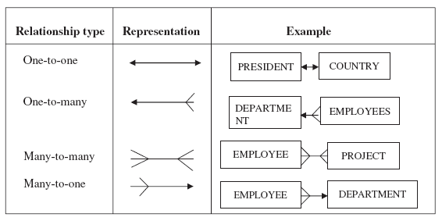
The summary of the four relationship types

