Slide 1
Database Systems I
Dr. Rasool Hisham
For 3rd year students, 1st semester
Al-Nahrain University
College of Science
Computer Science Department

Slide 2

Relational Algebra
The relational algebra is a theoretical language with operations that work on one or more relations.
Both the operands and the results are relations; hence the output from one operation can become the input to another operation.
Relational algebra is an abstract language, which means that the queries formulated in relational algebra are not intended to be executed on a computer.
Relational algebra consists of group of relational operators that can be used to manipulate relations to obtain a desired result.

Slide 3
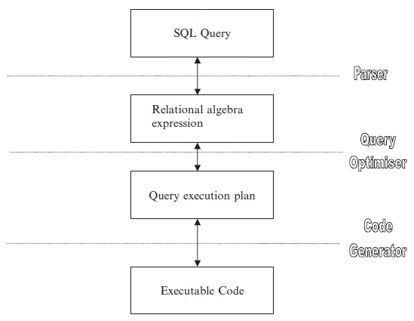
Role of Relational Algebra in DBMS
Knowledge about relational algebra allows us to understand query execution and optimization in relational database management system.
The role of relational algebra in DBMS is shown in the figure.

Slide 4
Role of Relational Algebra in DBMS (cont.)
From the figure it is evident that when a SQL query has to be converted into an executable code, first it has to be parsed to a valid relational algebraic expression, then there should be a proper query execution plan to speed up the data retrieval.
The query execution plan is given by query optimizer.

Slide 5
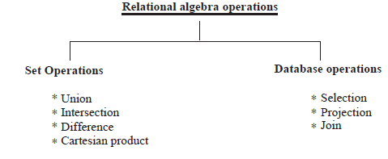
Relational Algebra Operations
Operations in relational algebra can be broadly classified into set operation and database operations.

Slide 6
Unary and Binary Operations
Unary operation involves one operand, whereas binary operation involves two operands.
The selection and projection are unary operations.
Union, difference, Cartesian product, and Join operations are binary operations:
Unary operation operate on one relation
Binary operation operate on more than one relation
Three main database operations are SELECTION, PROJECTION, and JOIN.

Slide 7

Selection Operation
The selection operation works on a single relation R and defines a relation that contains only those tuples of R that satisfy the specified condition (Predicate).
Selection operation can be considered as row wise filtering.
Pictorial representation of SELECTION operation

Slide 8
Syntax of Selection Operation
The syntax of selection operation is: σ _{Predicate} (R).
Here R refers to relation and predicate refers to condition.

Slide 9
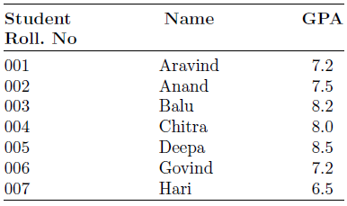
Illustration of Selection Operation
To illustrate the SELECTION operation, consider the STUDENT relation with the attributes Roll number, Name, and GPA (Grade Point Average).
Example: Consider the relation STUDENT :

Slide 10
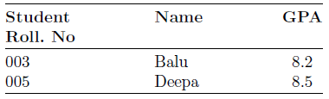
Illustration of Selection Operation
Query 1: List the Roll. No, Name, and GPA of those students who are having GPA of above 8.0
Query expressed in relational algebra as: σ _{GPA > 8} (Student).
The result of the earlier query is:
The result of the earlier query is:

Slide 11
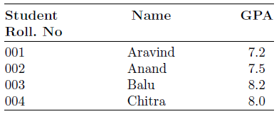
Illustration of Selection Operation
Query 2: Give the details of first four students in the class.
Relational algebra expression is: σ _{Roll. No} ≤ 4 (student).

Slide 12

Projection Operation
The projection operation works on a single relation R and defines a relation that contains a vertical subject of R, extracting the values of specified attributes and elimination duplicates.
The projection operation can be considered as column wise filtering.
The projection operation is pictorially represented in the figure
Pictorial representation of Projection operation

Slide 13
Syntax of Projection Operation
The syntax of projection operation is given by: ∏ _{a1,a2,......an} (R). Where a1, a2, . . . . . . a_{n} are attributes and R stands for relation.

Slide 14
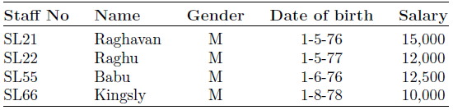
Illustration of Projection Operation
To illustrate projection operation consider the relation STAFF, with the attributes Staff number, Name, Gender, Date of birth, and Salary.

Slide 15
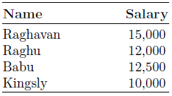
Illustration of Projection Operation
Query 1: Produce the list of salaries for all staff showing only the Name and salary detail.
Relational algebra expression: ∏ _{Name.salary} (staff)

Slide 16
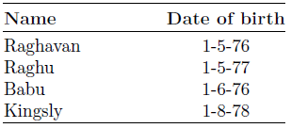
Illustration of Projection Operation
Query 2: Give the name and Date of birth of the all the staff in the STAFF relation.
Relational algebra expression for query 2: ∏ _{Name, date of birth} (staff)

Slide 17
Union Compatibility
In order to perform the Union, Intersection, and the Difference operations on two relations, the two relations should be union compatible.
Two relations are union compatible if they have same number of attributes and belong to the same domain.
Mathematically UNION COMPATIBILITY it is given as:
Let R(A1,A2,........An) and S(B1,B2,.............Bn) be the two relations. The relation R has the attributes A1,A2,........An and the relation S has the attributes B1,B2,.............Bn.
The two relations R and S are union compatible if dom(Ai) = dom(Bi) for i = 1 to n.

Slide 18
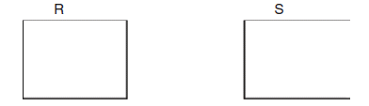
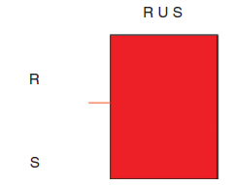
Union Operation
The union of two relations R and S defines a relation that contains all the tuples of R or S or both R and S, duplicate tuples being eliminated.
Relational Algebra Expression
The union of two relations R and S are denoted by R ∪ S.
It is pictorially represented in the figure.

Slide 19
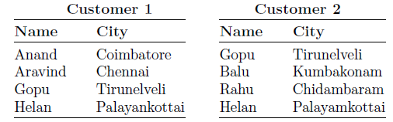
Illustration of UNION Operation
To illustrate the UNION operation consider the two relations Customer 1 and Customer 2 with the attributes Name and city.

Slide 20
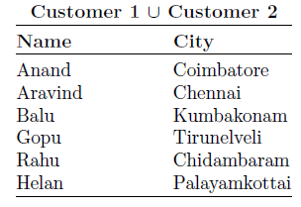
Illustration of UNION Operation
Query: Determine Customer 1 ∪ Customer 2

Slide 21

Intersection Operation
The intersection operation defines a relation consisting of the set of all tuples that are in both R and S.
Relational Algebra Expression: The intersection of two relations R and S is denoted by R ∩ S.
The intersection between the two relations R and S is pictorially shown in the figure.
Intersection of two relations R and S

Slide 22
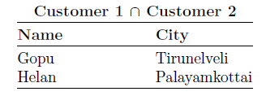
Illustration of Intersection Operation
Example: Find the intersection of Customer 1 with Customer 2 in the following table.

Slide 23

Difference Operation
The set difference operation defines a relation consisting of the tuples that are in relation R but not in S.
Relational Algebra Expression
The difference between two relations R and S is denoted by R–S.

Slide 24
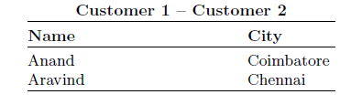
Illustration of Difference Operation
Example: Compute R–S for the relation shown in the following table.

