Slide 1
Database Systems I
Dr. Rasool Hisham
For 3rd year students, 1st semester
Al-Nahrain University
College of Science
Computer Science Department

Slide 2

Cartesian Product Operation
The Cartesian product operation defines a relation that is the concatenation of every tuples of relation R with every tuples of relation S.
The result of Cartesian product contains all attributes from both relations R and S.

Slide 3
Relational Algebra Symbol for Cartesian Product
The Cartesian product between the two relations R and S is denoted by R × S.
Note: If there are n1 tuples in relation R and n2 tuples in S, then the number of tuples in R × S is n1* n2.
Example: If there are 5 tuples in relation “R” and 2 tuples in relation “S” then the number of tuples in R × S is 5 * 2 = 10.

Slide 4
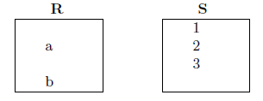
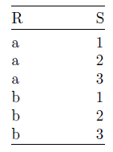
Illustration of Cartesian Product
To illustrate Cartesian product operation, consider two relations R and S as given later:
Determine R × S:
Note:
No. of tuples in R ×S = 2* 3 = 6
No. of attributes in R ×S = 2

Slide 5
Join Operations
Join operation combines two relations to form a new relation. The tables should be joined based on a common column.
The common column should be compatible in terms of domain.

Slide 6
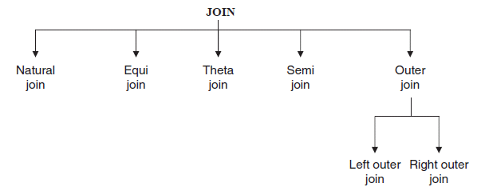
Types of Join Operation

Slide 7
Natural Join
The natural join performs an equi join of the two relations R and S over all common attributes.
One occurrence of each common attribute is eliminated from the result.
In other words a natural join will remove duplicate attribute.
In most systems a natural join will require that the attributes have the same name to identity the attributes to be used in the join.
This may require a renaming mechanism.
Even if the attributes do not have same name, we can perform the natural join provided that the attributes should be of same domain.

Slide 8
Natural Join (cont.)
For example a JOIN operation can be specified as a CARTESIAN PRODUCT followed by a SELECT operation:
σ _{<condition>} (R x S)
If the _{<condition>} is the condition of equi join for R and S over all common attributes, it will equivalent to:
R S

Slide 9
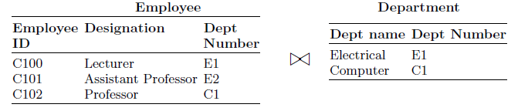
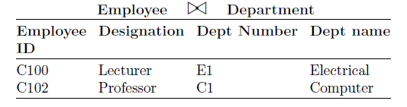
Example of Natural Join Operation
Consider two relations EMPLOYEE and DEPARTMENT.
Let the common attribute to the two relations be DEPTNUMBER. The two relations are shown later:
It is worth to note that Natural join operation is associative. i.e., If R, S, and T are three relations then:

Slide 10
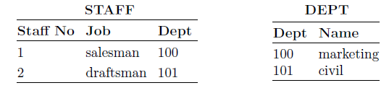
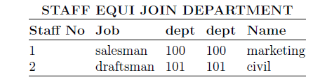
Equi Join
A special case of condition joins where the condition C contains only equality.
Example of Equi Join: Given the two relations STAFF and DEPT, produce a list of staff and the departments they work in.
Answer for the earlier query is equi-join of STAFF and DEPT:

Slide 11
Theta Join
A conditional join in which we impose condition other than equality condition.
If equality condition is imposed then theta join become equi join. The symbol θ stands for the comparison operator which could be >, <, >=, <=.
Expression of Theta Join:
σ θ(R × S)

Slide 12
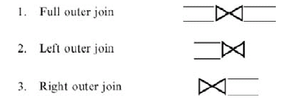
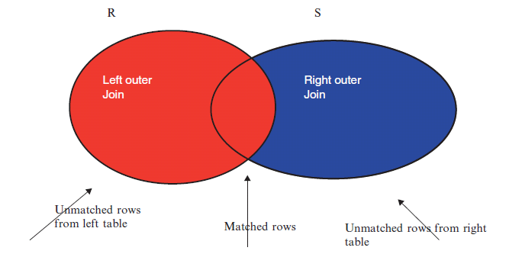
Outer Join
In outer join, matched pairs that retained unmatched values in other tables are left null.
The pictorial representation of the left and the right outer join of two relations R and S are shown in the figure

Slide 13
Types of Outer Join
Left Outer Join. Left outer joins is a join in which tuples from R that do not have matching values in the common column of S are also included in the result relation.
Right Outer Join. Right outer join is a join in which tuples from S that do not have matching values in the common column of R are also included in the result relation.
Full Outer Join. Full outer join is a join in which tuples from R that do not have matching values in the common columns of S still appear and tuples in S that do not have matching values in the common columns of R still appear in the resulting relation.

Slide 14
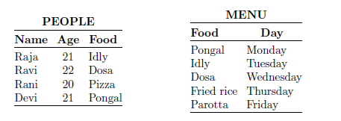
Example of outer join

Slide 15
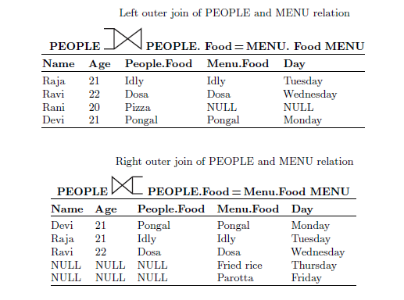
Example of outer join (cont.)

Slide 16
Examples of Relational Algebra Queries
We will consider a number of example queries using the following schema:
Sailors(sid: integer, sname: string, rating: integer, age: real)
Boats(bid: integer, bname: string, color: string)
Reserves(sid: integer, bid: integer, day: dates)

Slide 17
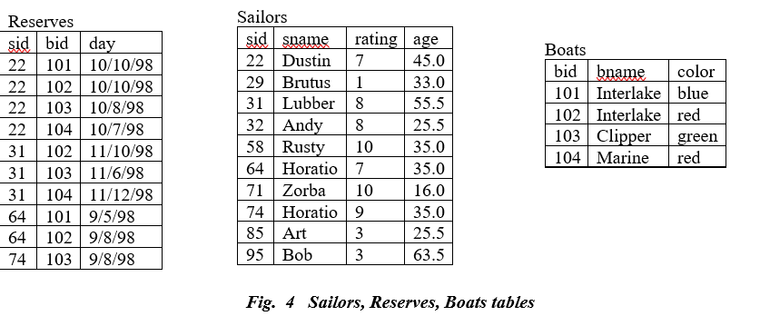
Examples of Relational Algebra Queries
We illustrate queries using the instances of tables: Sailors, Reserves, and Boats as shown below:

Slide 18


Example
(Q1) Find the names of sailors who have reserved boat 103.
This query can be written as follows:
However, there are indeed several distinct ways to write a query in relational algebra. Here is another way to write this query:
In this version we first compute the natural join of Reserves and Sailors and then apply the selection and the projection.

Slide 19
Example
(Q2) Find the names of sailors who have reserved a red boat.
An equivalent expression is:
(Q3) Find the colors of boats reserved by Lubber.
This query is very similar to the query we used to compute sailors who reserved red boats.

Slide 20

Example
(Q4) Find the names of sailors who have reserved at least one boat.
The join of Sailors and Reserves creates an intermediate relation in which tuples consist of a Sailors tuple `attached to' a Reserves tuple.
A Sailors tuple appears in (some tuple of) this intermediate relation only if at least one Reserves tuple has the same sid value, that is, the sailor has made some reservation.

